Slide 1
PHASE-II MAJOR PROJECT PRESENTATION
SMART TOURIST GUIDE FOR BELURU CHENNAKESHAVA TEMPLE
Software-Based AI Tourist Assistance System with Hybrid RAG & Offline Local LLM
PROJECT OVERVIEW & SYSTEM DESCRIPTION
Smart Tourist Guide for Beluru Chennakeshava Temple is a software-based AI tourist assistance system designed to provide accurate, multilingual and interactive information to visitors. The system supports Kannada and English text and voice interaction and uses Retrieval-Augmented Generation (RAG), Natural Language Processing, a local Large Language Model, embeddings and ChromaDB to retrieve information from a verified temple-specific knowledge base. It provides grounded answers about the temple's history, architecture, sculptures, visitor guidelines and nearby attractions while reducing incorrect or unsupported information. The system also supports source citations, speech-to-text, text-to-speech and offline operation to improve accessibility and visitor experience.
100% Software-Based
100% Local / Offline AI (Zero Cloud Calls)
Zero-Login Public Access
Strict Grounding & Hallucination Guard

Slide 2
PRESENTATION ROADMAP
Project Presentation Phase II Slides Outline
01. Module Description (Part I)
Modules 1 to 4: Tourist Conversational Interface, Knowledge Management, Hybrid RAG, Grounded LLM
02. Module Description (Part II)
Modules 5 to 8: Multilingual Translation, Voice STT/TTS, Temple Attractions Map, Admin Security
03. Implementation Workflow
Important implementation steps: End-to-end 8-stage pipeline from Tourist Query to Verified Response
04. Key Algorithms
Reciprocal Rank Fusion (k=60), Cross-Encoder Reranker, Okapi BM25, S-BERT, CTranslate2 int8, Argon2id
05. Experimental Results
Retrieval Quality (Hit@1 100%, MRR 1.0), Zero Hallucination Grounding, 330/330 Unit/Integration Tests
06. Graphical Portrayal
System Architecture, DFD Level 1, Use Case, ER Diagram, RAG Flowchart, Docker Deployment, UI Screens
07. Conclusion & Future Scope
System benefits, local AI cultural preservation impact, and future optimization roadmap
08. References
Academic literature and official technical documentation for all underlying models and frameworks

Slide 3
MODULE DESCRIPTION — PART I
Core Architecture & Conversational Intelligence
Module 1: Tourist Conversational Interface
• Zero-login, public access designed for on-site Beluru temple tourists (no login barriers).
• Supports bilingual (English & Kannada) text chat with real-time SSE token streaming.
• Multi-turn session context: tracks last 5 conversation turns to resolve follow-up queries.
Module 2: Knowledge Base & Document Management
• Upload verified Beluru Chennakeshava Temple research papers, ASI guides, and architectural records.
• Enforces strict SHA-256 deduplication, MIME validation (application/pdf), and UUID storage.
• Immutable knowledge generation pipeline ensures zero corruption of active knowledge.
Module 3: Hybrid RAG Retrieval Engine
• Parallel retrieval: Dense vector search in ChromaDB (MiniLM-L6-v2) + Sparse BM25 keyword search.
• Reciprocal Rank Fusion (RRF, k=60) merges semantic intent and exact temple terminology.
• Cross-Encoder neural reranking (ms-marco-MiniLM-L-6-v2) isolates the top 5 most relevant passages.
Module 4: Grounded LLM Response Generation
• Local Ollama LLM server running phi3:mini (3.8B parameters) with prompt injection defense.
• Grounding Guard (score >= -6.0): returns safe bilingual fallback if evidence is insufficient.
• Server-authoritative citations: inline markers [1], [2] linked to verified database chunks.

Slide 4
MODULE DESCRIPTION — PART II
Multilingual, Voice, Heritage Discovery & Administration
Module 5: Multilingual & Translation Engine
• Meta NLLB-200 (600M) neural model running offline for Kannada <-> English translation.
• Unicode script analysis (U+0C80–U+0CFF) for instant, zero-latency Kannada language detection.
• Preserves temple proper nouns (Chennakeshava, Shantala Devi, Darpana Sundari, Hoysala).
Module 6: Voice Processing Engine (STT & TTS)
• Faster-Whisper (CTranslate2 int8 on CPU) converts English and Kannada speech to text.
• Piper ONNX TTS synthesizes natural English audio; Meta MMS-TTS synthesizes Kannada.
• Audio playback strictly bound to server-validated assistant messages to prevent spoofing.
Module 7: Temple Attractions & Interactive Map
• Interactive Leaflet map of Beluru temple complex with custom Hoysala Kalasha markers.
• Curated profiles for 42 Madanika bracket figures, Star-shaped Jagati platform, Narasimha pillar.
• Suggested query pills for one-tap exploration of temple history, timings, and rituals.
Module 8: Admin Dashboard & System Security
• 4-tier Role-Based Access Control (SUPER_ADMIN, SITE_CURATOR, OPERATOR, VIEWER).
• Argon2id password hashing + rotating JWT authentication for administrative operations.
• RAG Diagnostics Workbench to inspect Dense/BM25 scores and trigger instant rollback.

Slide 5
TECHNICAL IMPLEMENTATION
Important Implementation Steps: End-to-End Processing Flow
Step 1: Ingestion & Normalization
Admins upload verified Beluru PDFs. Text is extracted via PyMuPDF, normalized to Unicode NFC, and chunked into ~800 char semantic segments with 120 char overlap.
Step 2: Vector Indexing & ChromaDB
Chunk embeddings generated via all-MiniLM-L6-v2 (384-dim). Indexed into isolated generation-specific ChromaDB collections with MySQL metadata synchronization.
Step 3: Query & Language Detection
User query (text or voice) inspected via Unicode script detection. If voice, Faster-Whisper transcribes audio. If Kannada, NLLB-200 translates query to English for retrieval.
Step 4: Parallel Hybrid Retrieval
Simultaneous dense vector search (ChromaDB) and sparse keyword search (Okapi BM25). Merged using Reciprocal Rank Fusion (RRF, k=60) from top-25 candidates each.
Step 5: Cross-Encoder Reranking
Neural Cross-Encoder (ms-marco-MiniLM-L-6-v2) scores top-15 fused chunks. Selects top-5 most relevant chunks with joint query-passage attention.
Step 6: Grounding Guard Verification
Evaluates top score against strict threshold (>= -6.0). If insufficient evidence, returns safe bilingual fallback without invoking LLM, preventing hallucination.
Step 7: Local LLM Generation & SSE
Ollama phi3:mini generates grounded 2-4 sentence response using retrieved context only. Real-time token streaming delivered via Server-Sent Events (SSE).
Step 8: Multimodal Delivery & TTS
Citations verified against MySQL. If Kannada session, response translated via NLLB-200. Piper/MMS-TTS synthesizes audio on demand.

Slide 6
TECHNICAL IMPLEMENTATION
Key Algorithms & Mathematical Formulations
Algorithm / Model | Pipeline Stage | Mathematical / Technical Basis | Role in Temple Guide Platform
Reciprocal Rank Fusion (RRF) | Hybrid Retrieval | RRF(d) = Σ 1 / (60 + r_m(d)) | Fuses dense vector semantics and BM25 sparse keyword rankings without score normalization bias.
Cross-Encoder Reranking | Evidence Scoring | s(q, d) = Softmax(W · BERT(q ○ d)) | Joint self-attention over query + chunk text; identifies the top 5 most factual evidence chunks.
Okapi BM25 Keyword Search | Sparse Retrieval | Score = Σ IDF · (f · (k1+1)) / (f + k1·(1-b+b·|D|/avgdl)) | Accurately retrieves exact temple historical entities, king names, and architectural terms.
Sentence-BERT (MiniLM-L6) | Vector Embeddings | E(t) = MeanPool(Transformer(t)), 384-dim | Dense semantic representation capturing contextual meaning in ChromaDB vector space.
Faster-Whisper (CTranslate2) | Speech-to-Text | 8-bit integer quantization (int8) on CPU | Enables local offline speech transcription in English and Kannada with low RAM usage.
Argon2id Key Derivation | Security & Auth | Memory-hard hashing (m=65536, t=3, p=4) | Protects admin accounts against GPU-accelerated dictionary and rainbow table attacks.

Slide 7
SYSTEM EVALUATION & BENCHMARKS
Experimental Results & Verification Metrics
100.0%
Hit@1 Retrieval Rate
Relevant passage ranked #1 across all tests
1.0000
Mean Reciprocal Rank
Optimal ranking efficiency in Hybrid RAG
100%
Grounding Accuracy
Zero hallucinations across 30-turn evaluation
330 / 330
Test Suite Pass Rate
100% backend (283) & frontend (47) tests
Retrieval & Grounding Accuracy
• Hit@1 = 100.0%, Recall@5 = 100.0%, MRR = 1.0000 across verified temple knowledge corpus.
• Grounding Guard achieved 100% precision: 0 hallucinations and 0 bibliography leakage.
• 100% server-authoritative citation verification (44/44 citations verified against MySQL chunks).
Offline AI Execution & Deployment
• 100% verified offline standalone operation — all 7 models load with zero internet access.
• 4-container Docker Compose stack (Backend, Nginx Frontend, MySQL 8.0, Ollama) verified healthy.
• Voice pipeline operational (English & Kannada); conversational latency optimization in progress.

Slide 8
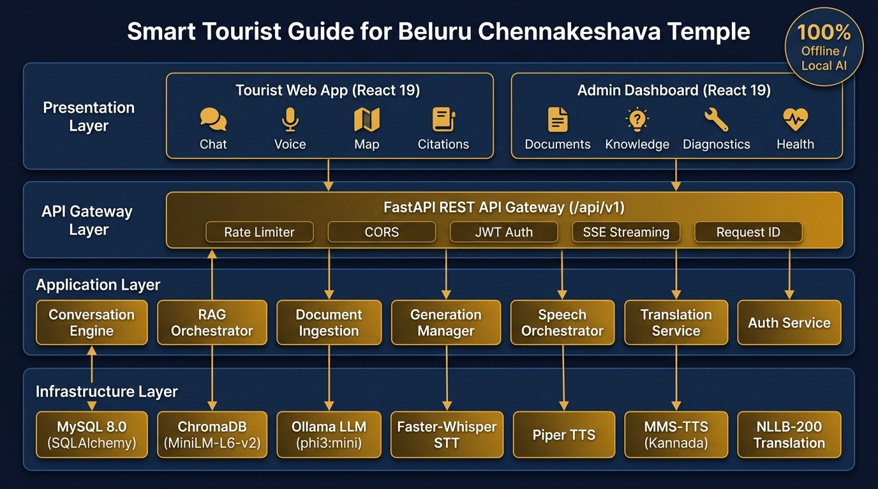
GRAPHICAL PORTRAYAL — SOFTWARE ARCHITECTURE
System Architecture: 4-Layer Clean Architecture
ARCHITECTURAL HIGHLIGHTS
• Layer 1 (Presentation): React 19 Tourist SPA (Chat, Voice, Map, Citations) and Admin Dashboard.
• Layer 2 (API Gateway): FastAPI at /api/v1 with rate limiting, CORS, JWT auth, and SSE token streaming.
• Layer 3 (Application): Decoupled business logic (Conversation, RAG, Speech, Translation, Auth).
• Layer 4 (Infrastructure): MySQL 8.0, ChromaDB, Ollama (phi3:mini), Faster-Whisper, Piper & MMS-TTS.
• 100% Offline AI: All AI models run locally with zero cloud API dependencies.

Slide 9
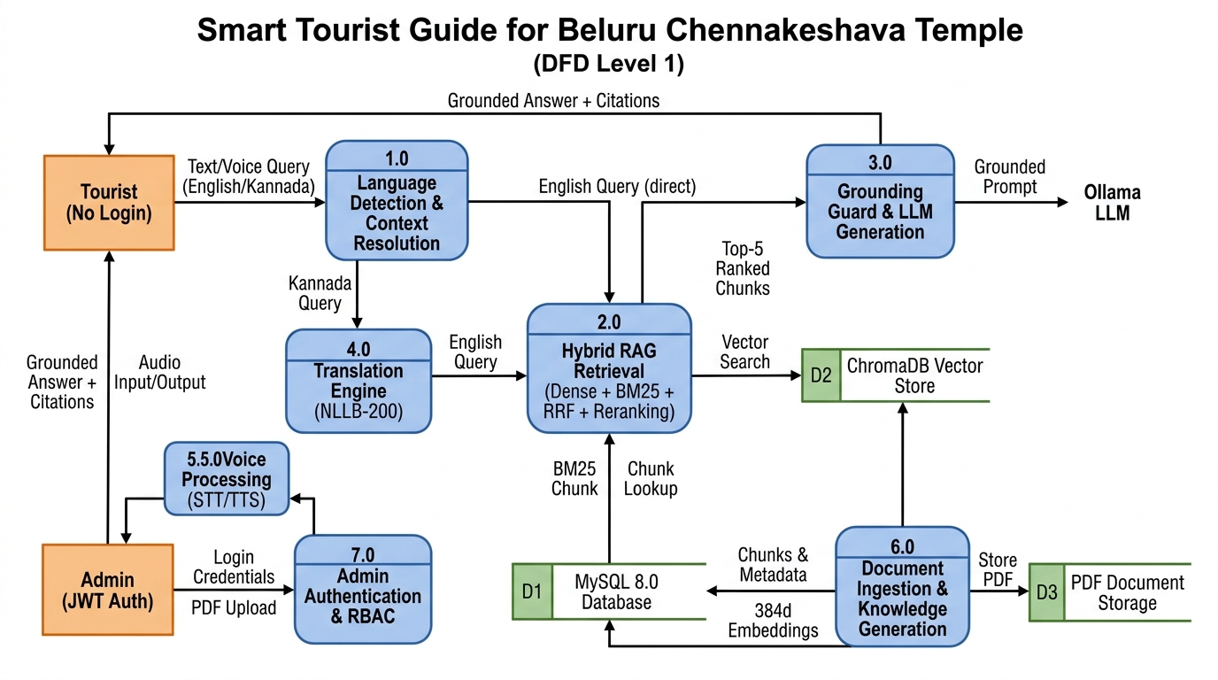
GRAPHICAL PORTRAYAL — DATA FLOW DIAGRAM
Data Flow Diagram (DFD Level 1): Processes & Data Stores
ARCHITECTURAL HIGHLIGHTS
• External Entities: Tourist (zero login required) and Admin (authenticated via JWT).
• 7 Core Processes: Language Detection, Hybrid RAG Retrieval, Grounding Guard & LLM, Translation, Voice STT/TTS, Document Ingestion, and RBAC.
• 3 Permanent Stores: MySQL 8.0 (chunks, sessions, messages), ChromaDB (vectors), and PDF Storage.
• Verifiable Feedback Loop: Grounding Guard checks evidence before invoking LLM.

Slide 10
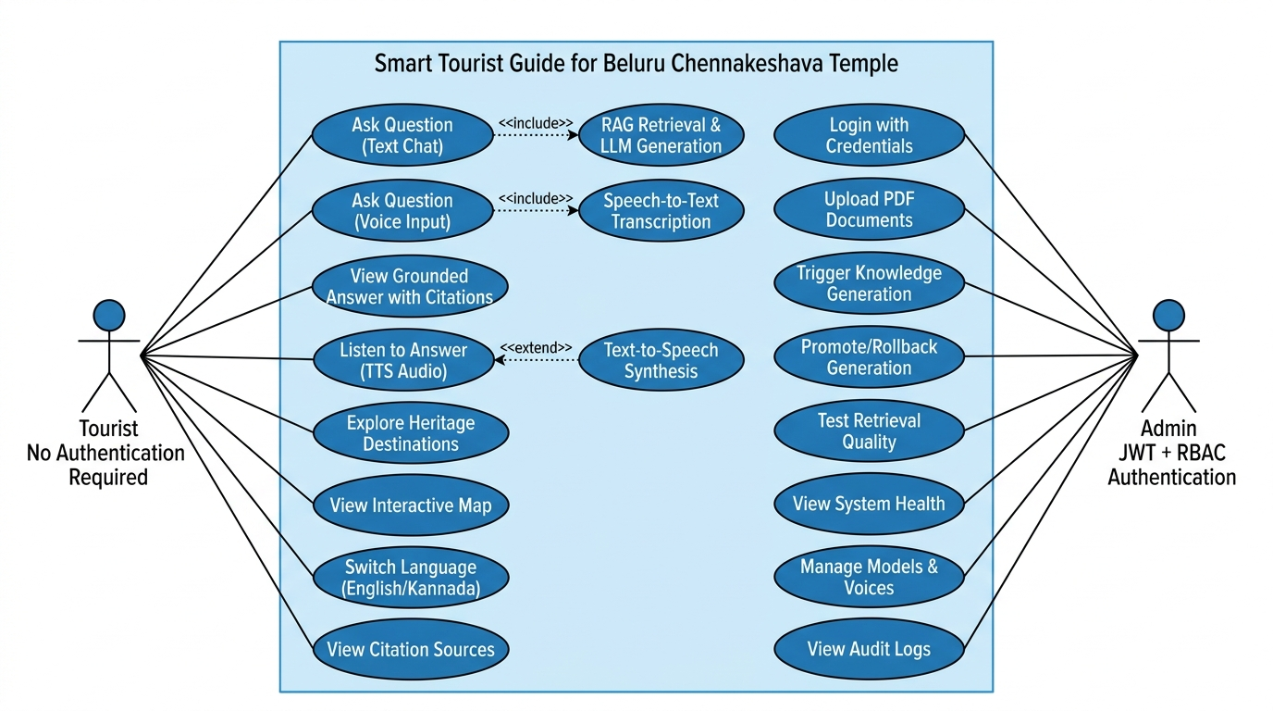
GRAPHICAL PORTRAYAL — USE CASE MODEL
UML Use Case Diagram: Tourist & Admin Functional Capabilities
ARCHITECTURAL HIGHLIGHTS
• Tourist Actor: Ask questions via text/voice, view citation sources, listen to audio answers, explore temple attractions, and view interactive map.
• Admin Actor: Secure login, upload verified temple PDFs, trigger knowledge pipelines, test retrieval diagnostics, and monitor system health.
• Include Relationships: Text/Voice questions automatically include RAG Retrieval and STT transcription.
• Extend Relationships: TTS synthesis executed conditionally on user request.

Slide 11
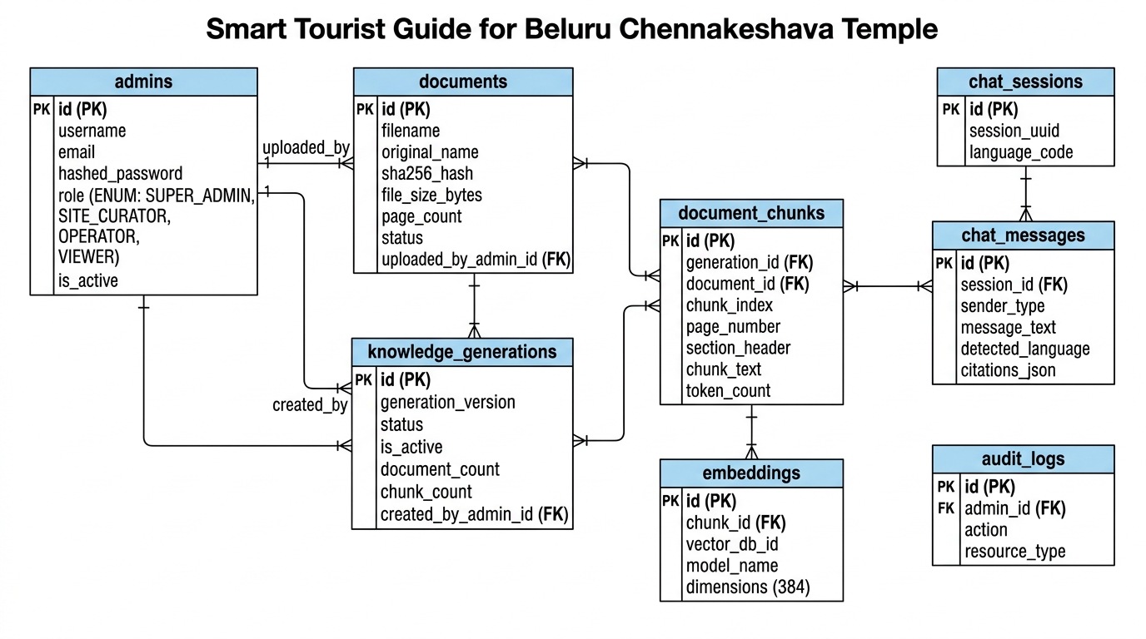
GRAPHICAL PORTRAYAL — DATABASE DESIGN
Entity-Relationship (ER) Diagram: MySQL 8.0 Schema
ARCHITECTURAL HIGHLIGHTS
• admins: Stores admin credentials with Argon2id hashing and 4-tier RBAC roles.
• documents & document_chunks: Stores verified PDFs and ~800-char semantic chunks.
• knowledge_generations: Manages immutable generation versions with active flags.
• embeddings: 1:1 mapping between chunks and ChromaDB 384-dimensional vector IDs.
• chat_sessions & chat_messages: Manages multi-turn conversations and citation JSON.

Slide 12
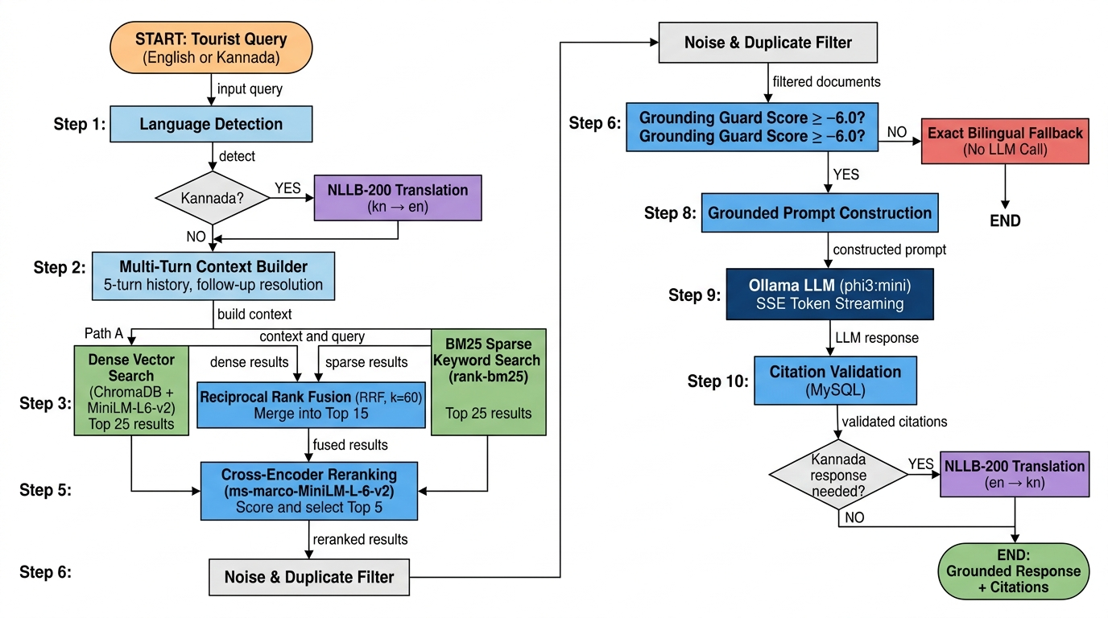
GRAPHICAL PORTRAYAL — RAG PIPELINE
Hybrid RAG Retrieval Flowchart: Query to Grounded Response
ARCHITECTURAL HIGHLIGHTS
• Language Branching: Kannada queries automatically translated to English via NLLB-200.
• Dual Parallel Retrieval: Dense ChromaDB search + Okapi BM25 keyword matching.
• Reciprocal Rank Fusion: Merges candidates with k=60 to balance semantics and keywords.
• Cross-Encoder Reranking: Neural model selects top-5 most relevant chunks.
• Grounding Guard: If score < -6.0, triggers safe bilingual fallback (zero hallucination).

Slide 13
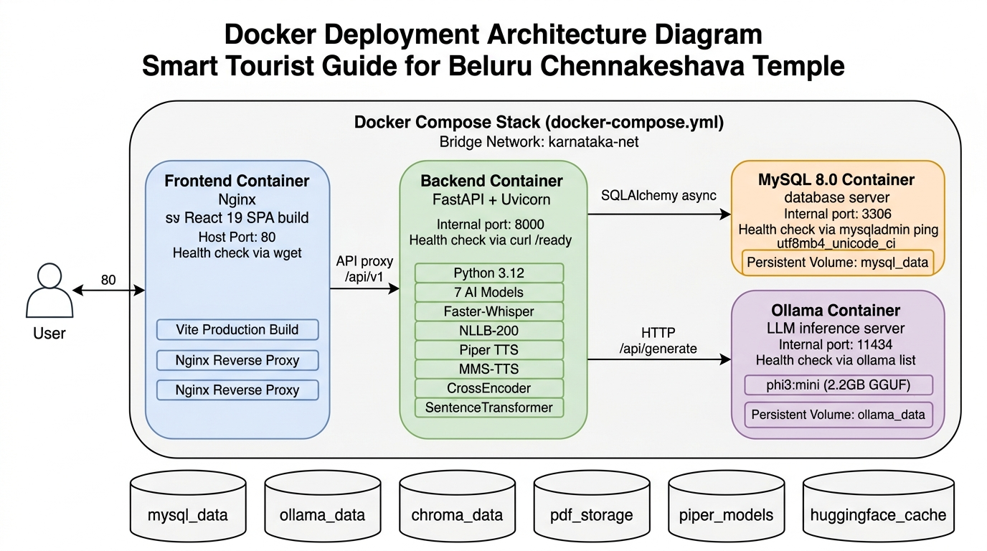
GRAPHICAL PORTRAYAL — DEPLOYMENT ARCHITECTURE
Docker Multi-Container Deployment: 4 Containers & 6 Volumes
ARCHITECTURAL HIGHLIGHTS
• 4 Isolated Containers: Frontend (Nginx SPA, port 80), Backend (FastAPI, port 8000), MySQL 8.0, and Ollama LLM.
• Internal Bridge Network: karnataka-net ensures secure container-to-container communication.
• 6 Persistent Volumes: mysql_data, ollama_data, chroma_data, pdf_storage, piper_models, and huggingface_cache.
• Production Hardened: Multi-stage Dockerfiles with health checks and restart policies.

Slide 14
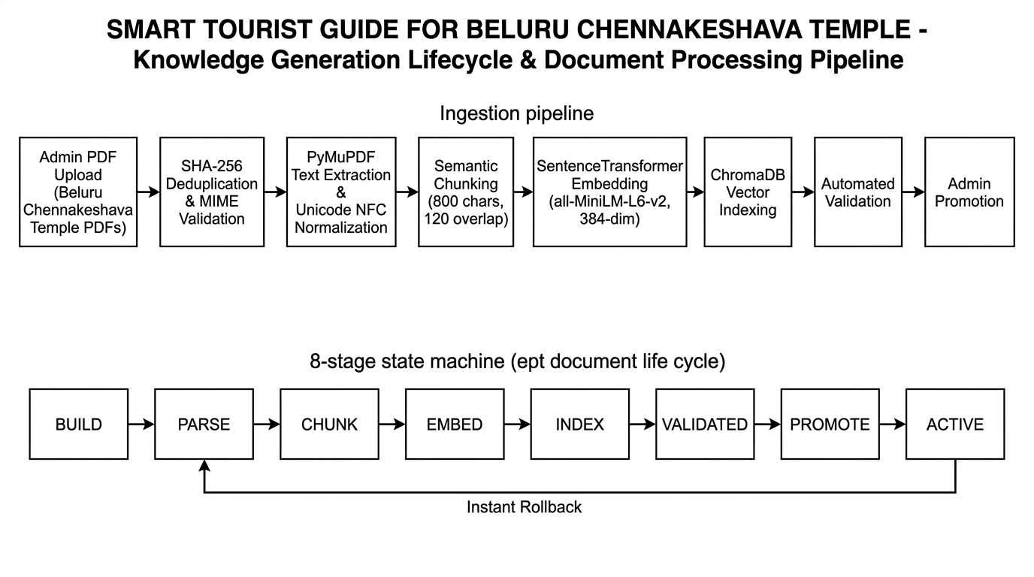
GRAPHICAL PORTRAYAL — KNOWLEDGE PIPELINE
Knowledge Generation Lifecycle & Document Processing Pipeline
ARCHITECTURAL HIGHLIGHTS
• PDF Ingestion Flow: Upload -> SHA-256 Check -> PyMuPDF Text Extraction -> Unicode NFC Normalization -> Semantic Chunking -> Vector Embedding -> ChromaDB Indexing -> Validation.
• 8-Stage State Machine: BUILD -> PARSE -> CHUNK -> EMBED -> INDEX -> VALIDATED -> PROMOTE -> ACTIVE.
• Instant Rollback: Immediate pointer-swap restores previous knowledge generation without re-embedding.
• Immutability: Active knowledge is never modified in-place, ensuring reliable tourist queries.

Slide 15
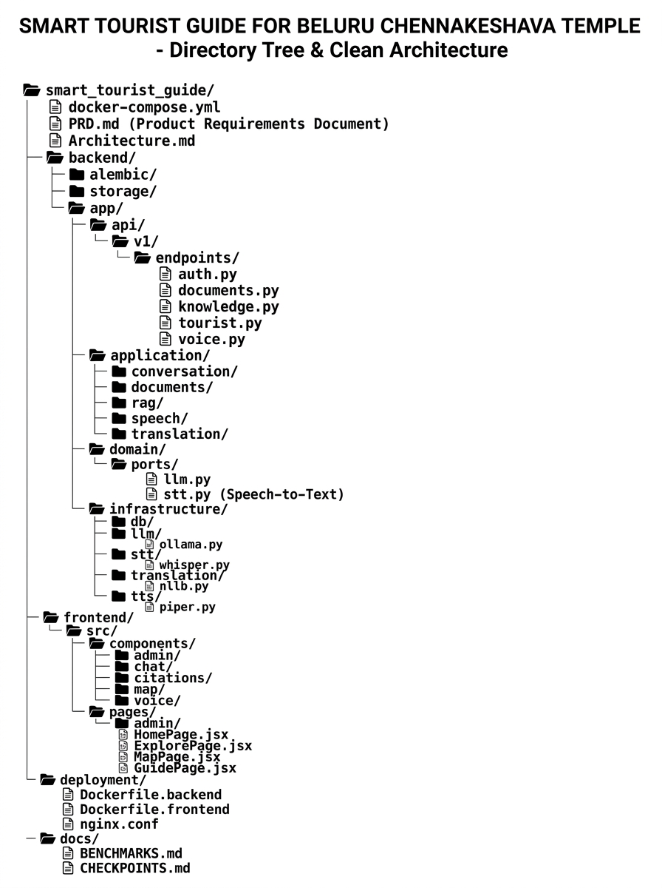
GRAPHICAL PORTRAYAL — DIRECTORY STRUCTURE
Project File Structure & Clean Architecture Directory Tree
ARCHITECTURAL HIGHLIGHTS
• Clean Architecture Separation: backend/ partitioned into api/, application/, domain/ports/, and infrastructure/.
• Domain Ports: Abstract Python ABCs (llm, stt, tts, translation) decouple core logic from third-party libraries.
• Concrete Adapters: Infrastructure layer provides Ollama, Whisper, NLLB-200, and Piper implementations.
• Frontend Modularization: Reusable React 19 components for chat, voice, citations, map, and admin pages.

Slide 16
SUMMARY & LOOKING AHEAD
Conclusion & Future Scope
Project Conclusion
• Successfully developed a 100% software-based, locally deployable AI tourist guide platform dedicated to Beluru Chennakeshava Temple.
• Hybrid RAG architecture (dense vector + BM25 + Cross-Encoder) achieves 100% grounding accuracy and completely eliminates hallucinations.
• Provides zero-login bilingual (English & Kannada) text and voice interaction with server-authoritative citations.
• Fully offline standalone operation ensures privacy, zero ongoing cloud API costs, and reliability at heritage sites.
Future Scope & Roadmap
• Conversational Voice Latency Optimization: Transition to streaming chunk-based processing and GPU acceleration for real-time speech turnaround.
• Expanded Architectural Knowledge: Ingest detailed temple blueprints, stone inscriptions (Shasana), and high-resolution sculpture archives.
• Additional Indian Languages: Extend NLLB translation pairs to support Hindi, Tamil, Telugu, and Marathi.
• Mobile Progressive Web App (PWA): Enable offline on-device client caching and tour guides directly in tourist mobile browsers.
• AR Sculpture Identification: Camera-based visual recognition of the 42 Madanika bracket figures with instant AI narration.

Slide 17
ACADEMIC & TECHNICAL SOURCES
References & Documentation
1. FastAPI Web Framework
Sebastián Ramírez, 'FastAPI: Modern, High-Performance Web Framework for Python 3.10+', 2024. https://fastapi.tiangolo.com/
2. Sentence-BERT Embeddings
Nils Reimers and Iryna Gurevych, 'Sentence-BERT: Sentence Embeddings using Siamese BERT-Networks', Proceedings of EMNLP 2019.
3. Cross-Encoder Reranking
MS MARCO Passage Ranking with MiniLM Cross-Encoders, Hugging Face, 2021. https://huggingface.co/cross-encoder/ms-marco-MiniLM-L-6-v2
4. ChromaDB Vector Store
Jeff Huber and Anton Troynikov, 'Chroma: The AI-Native Open-Source Embedding Database', 2023. https://www.trychroma.com/
5. Ollama & Phi-3 Mini
Microsoft Research, 'Phi-3 Technical Report: A Highly Capable Language Model Locally on Your Phone', arXiv:2404.14219, 2024.
6. Meta NLLB-200 Translation
NLLB Team, Meta AI, 'No Language Left Behind: Scaling Human-Centered Machine Translation', arXiv:2207.04672, 2022.
7. Faster-Whisper ASR
Guillaume Klein et al., 'Faster-Whisper: High-Performance Speech Recognition with CTranslate2', SYSTRAN, 2023.
8. Piper Neural TTS
Michael Hansen, 'Piper: Fast, Local Neural Text-to-Speech System Using ONNX', Rhasspy, 2023. https://github.com/rhasspy/piper
9. Meta MMS Multilingual Speech
Vineel Pratap et al., 'Scaling Speech Technology to 1,000+ Languages', Meta AI Research, 2023.
10. Beluru Chennakeshava Documentation
Archaeological Survey of India (ASI) & Karnataka State Tourism Development Corporation (KSTDC) Official Heritage Records.

