Slide 1
Argo cd

Slide 2
Introduction
A GitOps Continuous Deployment tool
It monitors the cluster and declarative yamls stored in Git repository and resolves differences
ArgoCD automatically deploys new configuration and new version of code to target environment
This tool is great for complex application rollout

Slide 3
Installation and tools
Follow following URL for installation –
https://argo-cd.readthedocs.io/en/stable/getting_started/
kubectl create namespace argocd
kubectl apply -n argocd -f https://raw.githubusercontent.com/argoproj/argo-cd/v2.6.15/manifests/install.yaml
kubectl get pods -n argocd –w (wait for pods to be in running state)
For local env, to access Argo CD API server, do port forwarding
The code setup required few plugins. Run these commands to setup those –
At argo-all repo , get files inside folder - /plugins/argocd-vault-plugin-helm-custom
kubectl -n argocd patch cm/argocd-cm -p "$(cat cm.yaml)"
kubectl -n argocd patch deploy/argocd-repo-server -p "$(cat deploy.yaml)"
Ensure all pods are running
kubectl get pods –n argocd
To get admin password for UI, command is –
curl -sSL -o argocd-linux-amd64 https://github.com/argoproj/argo-cd/releases/latest/download/argocd-linux-amd64
sudo install -m 555 argocd-linux-amd64 /usr/local/bin/argocd
rm argocd-linux-amd64
argocd admin initial-password -n argocd
Port forwarding –
kubectl port-forward svc/argocd-server -n argocd 8080:443
Notes:
curl -sSL -o argocd-linux-amd64 https://github.com/argoproj/argo-cd/releases/latest/download/argocd-linux-amd64
sudo install -m 555 argocd-linux-amd64 /usr/local/bin/argocd
rm argocd-linux-amd64

Slide 4
Few Terminologies
ArgoCD ‘Application’ is a yaml manifest which tells ArgoCD, how the application should be deployed
ArgoCD ‘ApplicationSet’, is controller, which helps ArgoCD to generate/deploy applications
Generator in ApplicationSet is responsible for generating parameters, which can be latter used in templates section of ApplicationSet
Project is located at –
https://github.com/cbagade/argocd-configurations
https://github.com/cbagade/argocd-code
Git can be checked out to specific commit
git log -> gives commits in reverse way
git reset --hard [commit_id] -> reset local branch to a commit
git push -f origin <main> -> reset remote to local commit

Slide 5
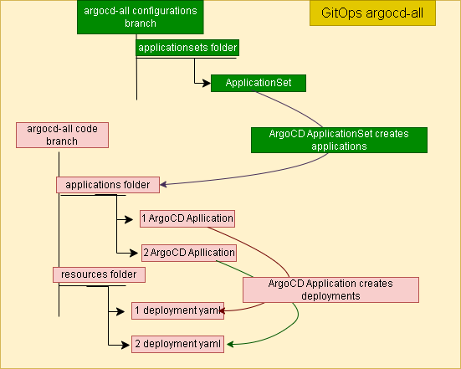
Application Structure

Slide 6
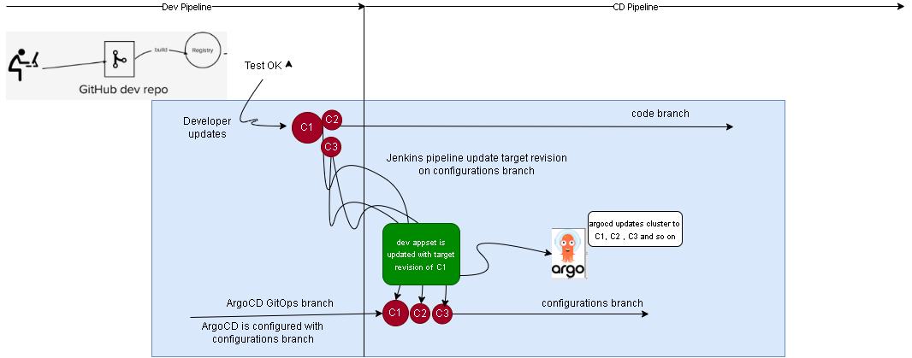
CD pipeline

Slide 7
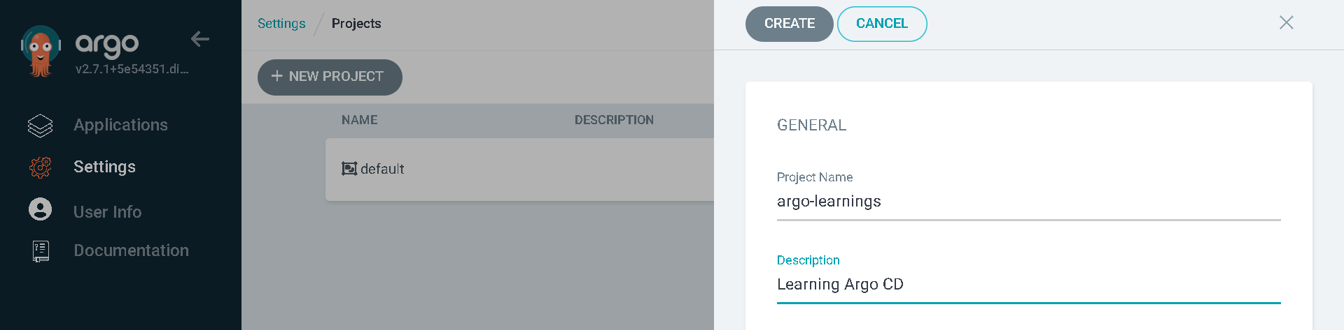
Over THE Argo cd UI – Add Project
Login to UI and on Settings, Project, create new Project
Setting, Project, click on project and add Source repository, Destinations, Cluster Resource Allow List, Namespace Resource Allow List as *
Don’t put any entry for Cluster Resource Deny List, Namespace Resource Deny List

Slide 8
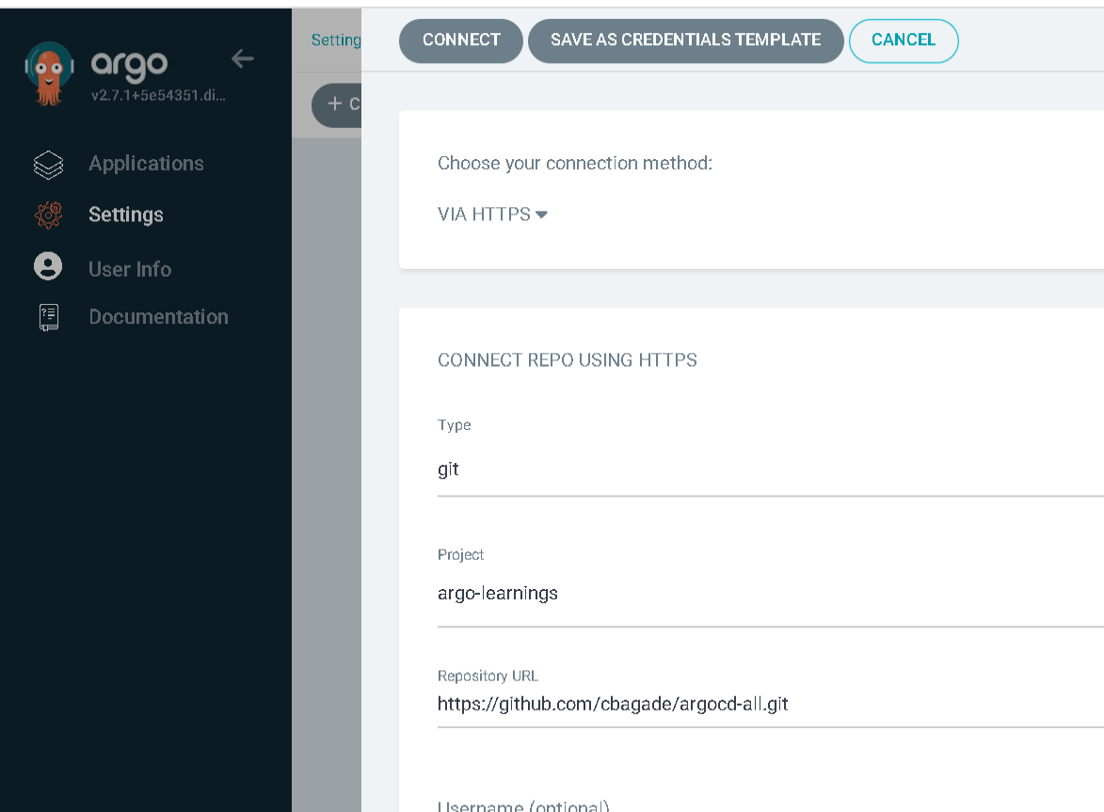
Over THE Argo cd UI – Add Git REPO
On Settings, Connect Repo , add the git repository containing code (configurations branch)
Put appropriate username and token as password

Slide 9
Over THE Argo cd UI – create application
On Application -> New App and Input following
Once application is created, do hard refresh and sync
Ensure docker login on host
Also ensure to turn off ZScaler
Field | Value
Application Name | learning-app
Project Name | argo-learnings
SYNC Policy | Automatic
Repository URL | https://github.com/cbagade/argocd-all.git
Revision (branch name) | configurations
Path | applicationsets/development
Cluster URL | https://kubernetes.default.svc
Namespace (in which argocd is deployed) | argocd

Slide 10
Continuous deployment
Continuous integration was discussed during Jenkins demo
The CI will create a docker image and place it in docker hub
Now application should be auto deployed with new docker image.
Run Jenkins with ngrok
Update webhook URL on argocd-all GitHub settings
Create a pipeline (argocd_all_pipeline), for code branch and Jenkinsfile, therein
While creating pipeline no need to give “Additional Behaviours”
Script Path should be mentioned as Jenkinsfile – no slashes anywhere
After Webhook creation don’t forget to enable, GitHub hook trigger for GITScm polling,
Now update the new image version at -
resources/nodeapp/templates/01-deployments/nodeapp_deployment.yaml
The application will be auto deployed in sometime

Slide 11
Further learning
ArgoCD is well integrated with Helm. The values can be externalized to manage in better way.
Implement ArgoCD with helm templating
Explore more on ArgoCD plugins

Slide 12
SUMMARY
We learnt a complete CICD process with Jenkins and ArgoCD.
ArgoCD is widely used in industry for complex application deployment.

