Slide 1

Basic Details of the Team and Problem Statement
Ministry/Organization Name/Student Innovation: Ministry of Education
PS Code: SIH1434
Problem Statement Title: Making career choices and AI-based counseling accessible to every child at the secondary level along with aptitude tests and detailed career paths.
Team Name: SourceForces
Team Leader Name: Shruti Shrivastava
Institute Code (AISHE): C-53649
Institute Name: Gyan Ganga Institute of Technology and Sciences
Theme Name: Smart Education

Slide 2
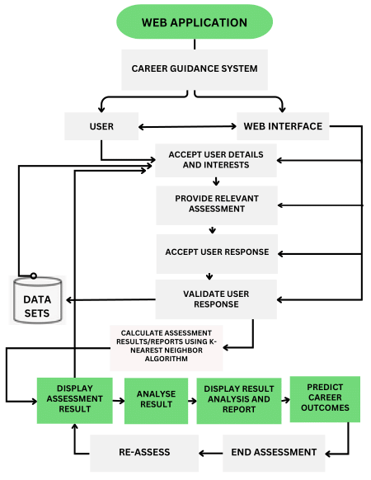














Idea/Approach Details
We are looking for a solution by creating an AI-based career counseling web-application using machine learning to offer personalized guidance, recommend career paths, and provide real-time job market insights, empowering users to make informed career decisions and achieve their professional goals,
Identifying the user current level of knowledge by taking aptitude test, and assessment, and their area of Interest.
Surprise and Delight: This element of surprise and delight can be very engaging, as players are amazed by the AI’s career-guidance ability.
Generation of equivalent career-choices according to the test score through Machine Learning(ML) and Artificial Intelligence (AI).
Web application to continuously analyze the job market, providing users with up-to-the-minute data and trends (Real-Time Job Market Insights).
The most closely matched field will be recommended to the user, keeping in mind their area of interest.
Web application uses LSTM and RNN models, they are invaluable in sequential data analysis, best in time series forecasting, as they adeptly capture long-term dependencies and context, ultimately leading to heightened prediction accuracy and contextual awareness.
Web application effectively incorporates gamification elements such as interactivity, skill-building challenges, and personalized career plans to create an engaging and productive user experience. These elements encourage users to actively participate and return to the platform, illustrating how gamification can enhance user engagement in educational and career development contexts.
Technology bucket:
LSTM & RNN model

Slide 3
Workflow:-

Slide 4
Idea/Approach Details
Describe your Use Cases here
Describe your Dependencies / Show stopper here

Slide 5
Team Member Details
Team Leader Name: Shruti Shrivastava
Branch: Btech Stream :CSE Year: 3
Team Member 1 Name: Riddhi Shukla
Branch: Btech Stream :CSE Year: 3
Team Member 2 Name: Shreya Singh
Branch: Btech Stream :CSE Year: 3
Team Member 3 Name: Tanish Paigwar
Branch: Btech Stream :CSE Year: 3
Team Member 4 Name: Shashank Shekhar Pandey
Branch: Btech Stream :CSE Year: 3
Team Member 5 Name: Shivam Shukla
Branch: Btech Stream :CSE Year: 3
Team Mentor 1 Name: Dr. Ruchi Patel Sahu
Category: Academic Expertise: AI/ML Domain Experience (in years): 11

