Slide 1
DATA SCIENCE
Predicting High-Traffic
Recipes for the Homepage
Presented to: Product Manager — Recipe Discovery
DataCamp Data Scientist Professional Practical Exam
947
574
60.6%
0.864
Total Recipes
Labelled Recipes
High-Traffic Rate
Best Model AUC

Slide 2
Business Context & Goal
The Business Ask
Why It Matters
Predict which recipes will lead to high website traffic
Correctly predict high-traffic recipes ≥ 80% of the time
A popular homepage recipe drives up to 40% more site traffic → more subscriptions
40%
More site traffic from a popular recipe
↑
More subscriptions from higher traffic
⚡ Key Clarification on '80% of the time'
(A) Recall: We correctly identify 80% of all high-traffic recipes
(B) Precision: 80% of our homepage picks actually drive high traffic
In an ideal scenario I'd clarify with the client. Given the goal is to minimise bad homepage picks, we optimised for Precision.
80%
Business precision target to hit

Slide 3
Data Validation
947 recipes · 8 columns · all cleaning decisions documented
Column | Issue Found | Decision | ✓
calories / carbohydrate sugar / protein | 52 rows (5.5%) missing across all 4 simultaneously | Imputed with column median (robust to right skew) | Clean
category | 'Chicken Breast' not in spec (11 vs 10 expected categories) | Merged into 'Chicken' | Clean
servings | Mixed format: '4 as a snack' vs plain numeric '4' | Extracted numeric value, converted to integer | Clean
high_traffic (target) | 373 rows (39.4%) unlabelled — never featured on homepage | Modelled on 574 labelled rows 'High' → 1, else → 0 | Clean
Nutrition accuracy | 324 recipes: reported calories don't match macro totals | Left as-is (same data users saw); added inaccuracy flag feature | Noted

Slide 4
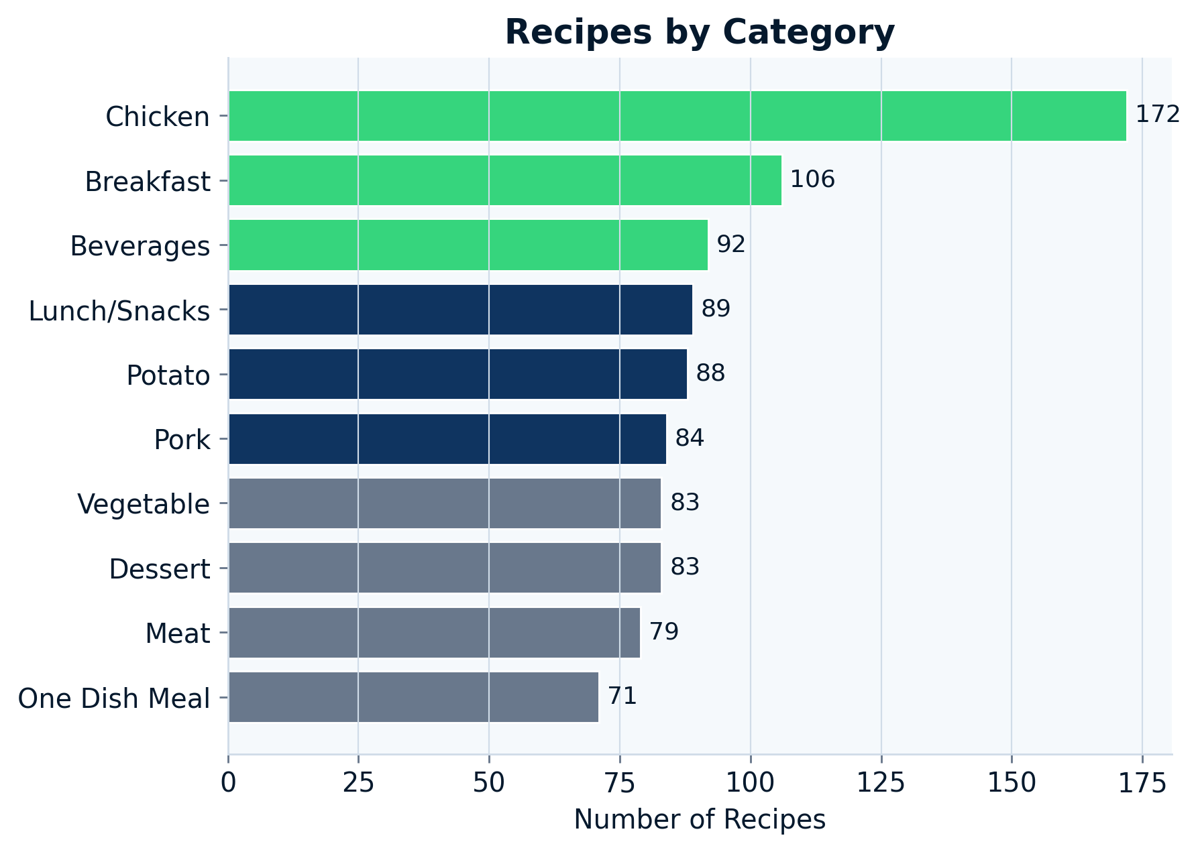
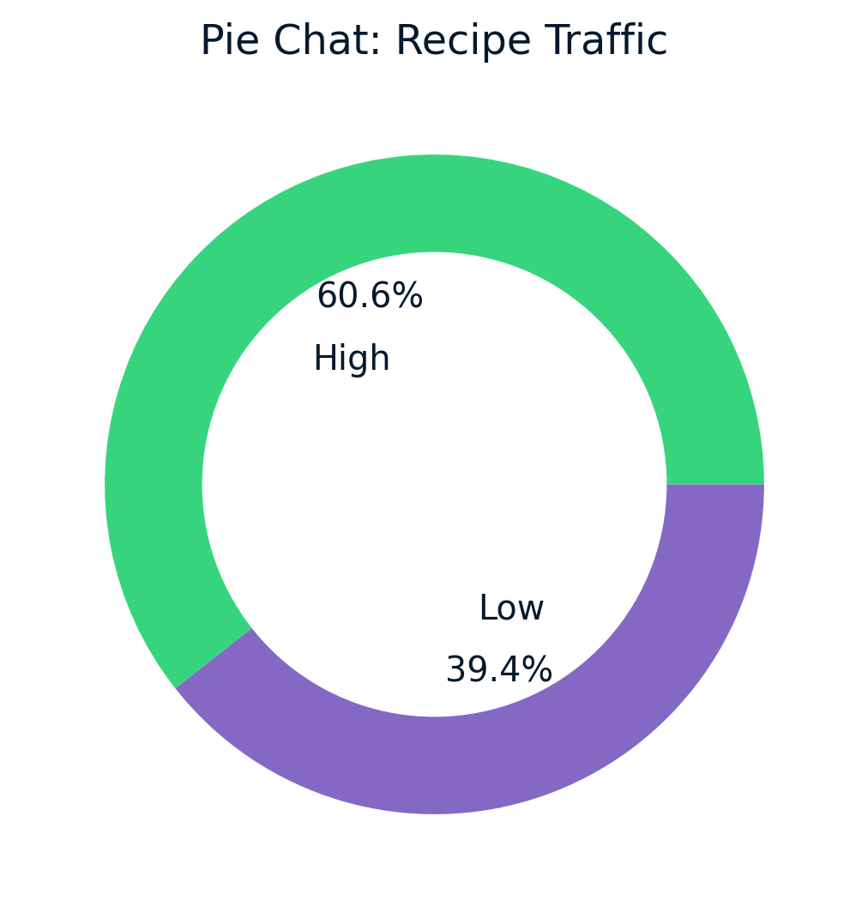
Exploratory Analysis — Single Variable Plots
Target is moderately imbalanced (60/40) · Chicken has the most recipes but Vegetable/Potato convert to high traffic most frequently

Slide 5
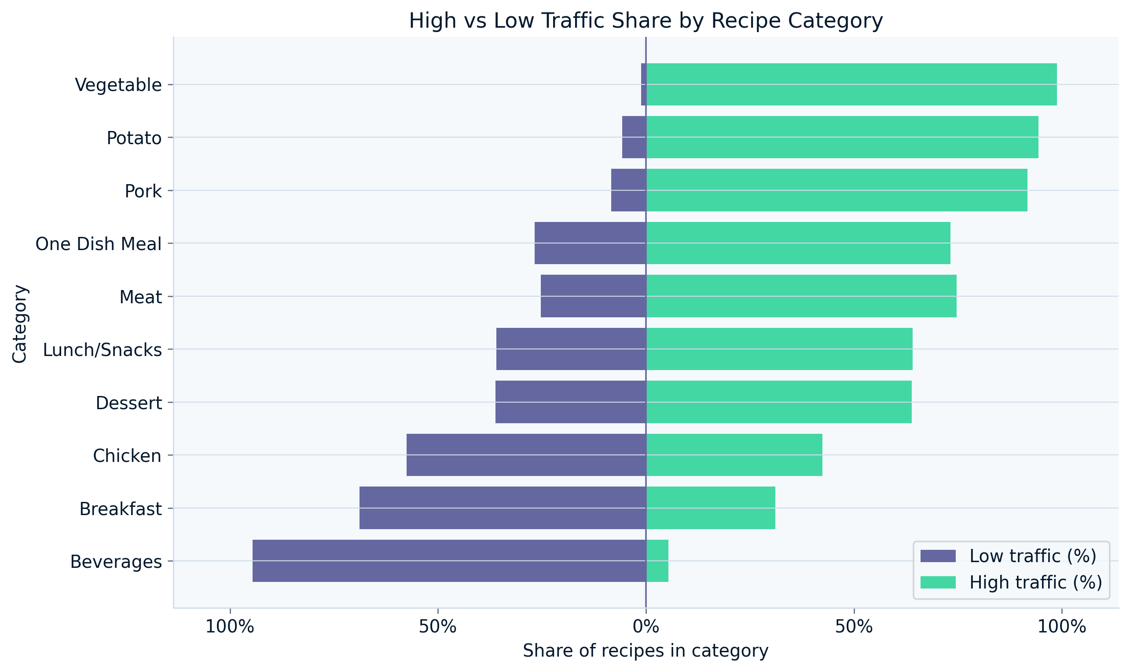
Exploratory Analysis — Multi-Variable: Category vs Traffic
Vegetable, Potato & Pork
Near 100% high-traffic share — the strongest category predictors in the dataset.
Beverages & Breakfast
Mostly low-traffic categories — avoid featuring unless no alternatives.
Nutritional features
Boxplots (not shown) confirm heavy overlap between High/Low — weak standalone predictors.

Slide 6
Model Development
Binary classification — High Traffic (1) vs Not High (0)
Problem: Binary Classification · Split: 80/20 stratified · CV: 5-fold StratifiedKFold · Tuning: GridSearchCV on train set only
BASELINE — Logistic Regression
COMPARISON — Decision Tree
Why chosen
Fast, interpretable, well-suited to linearly separable classification. Coefficients directly show which categories drive high traffic.
Why chosen
Non-parametric, captures non-linear interactions, produces interpretable rules for non-technical stakeholders.
Features
One-hot encoded category dummies + log-transformed nutritional features
Features
Same feature set as Logistic Regression (one-hot + log-transformed)
Tuning
GridSearchCV: C ∈ {0.01, 0.1, 1, 10, 100}, L2 penalty, lbfgs solver
Tuning
GridSearchCV: max_depth, min_samples_split, min_samples_leaf, ccp_alpha
Best params
C=10 · Best CV AUC: 0.820
Best params
max_depth=9, ccp_alpha=0.005 · Best CV AUC: 0.786
Test AUC: 0.864 | Precision: 0.85 | Recall: 0.77
Test AUC: 0.839 | Precision: 0.83 | Recall: 0.76

Slide 7
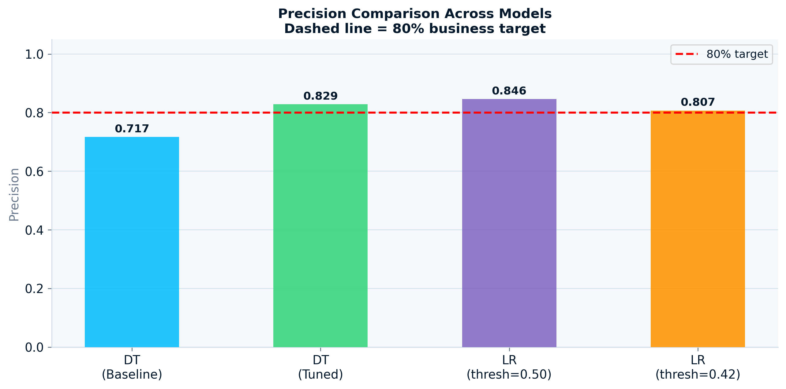
Model Evaluation
AUC used internally to compare · Precision/Recall reported to business
Model | Precision | Recall | F1 | AUC | CV AUC
Logistic Regression (Baseline) | 0.70 | 0.76 | 0.72 | 0.774 | 0.703 ± 0.080
Logistic Regression (Tuned) ★ | 0.85 | 0.77 | 0.80 | 0.864 | 0.820
Decision Tree (Baseline) | 0.72 | 0.66 | 0.69 | 0.631 | 0.609 ± 0.045
Decision Tree (Tuned) | 0.83 | 0.76 | 0.79 | 0.839 | 0.786
✅ Winner
Tuned Logistic Regression
Precision 0.85 → exceeds 80% target
AUC 0.864 → best overall
F1 0.80 → balanced
Interpretable via coefficients

Slide 8
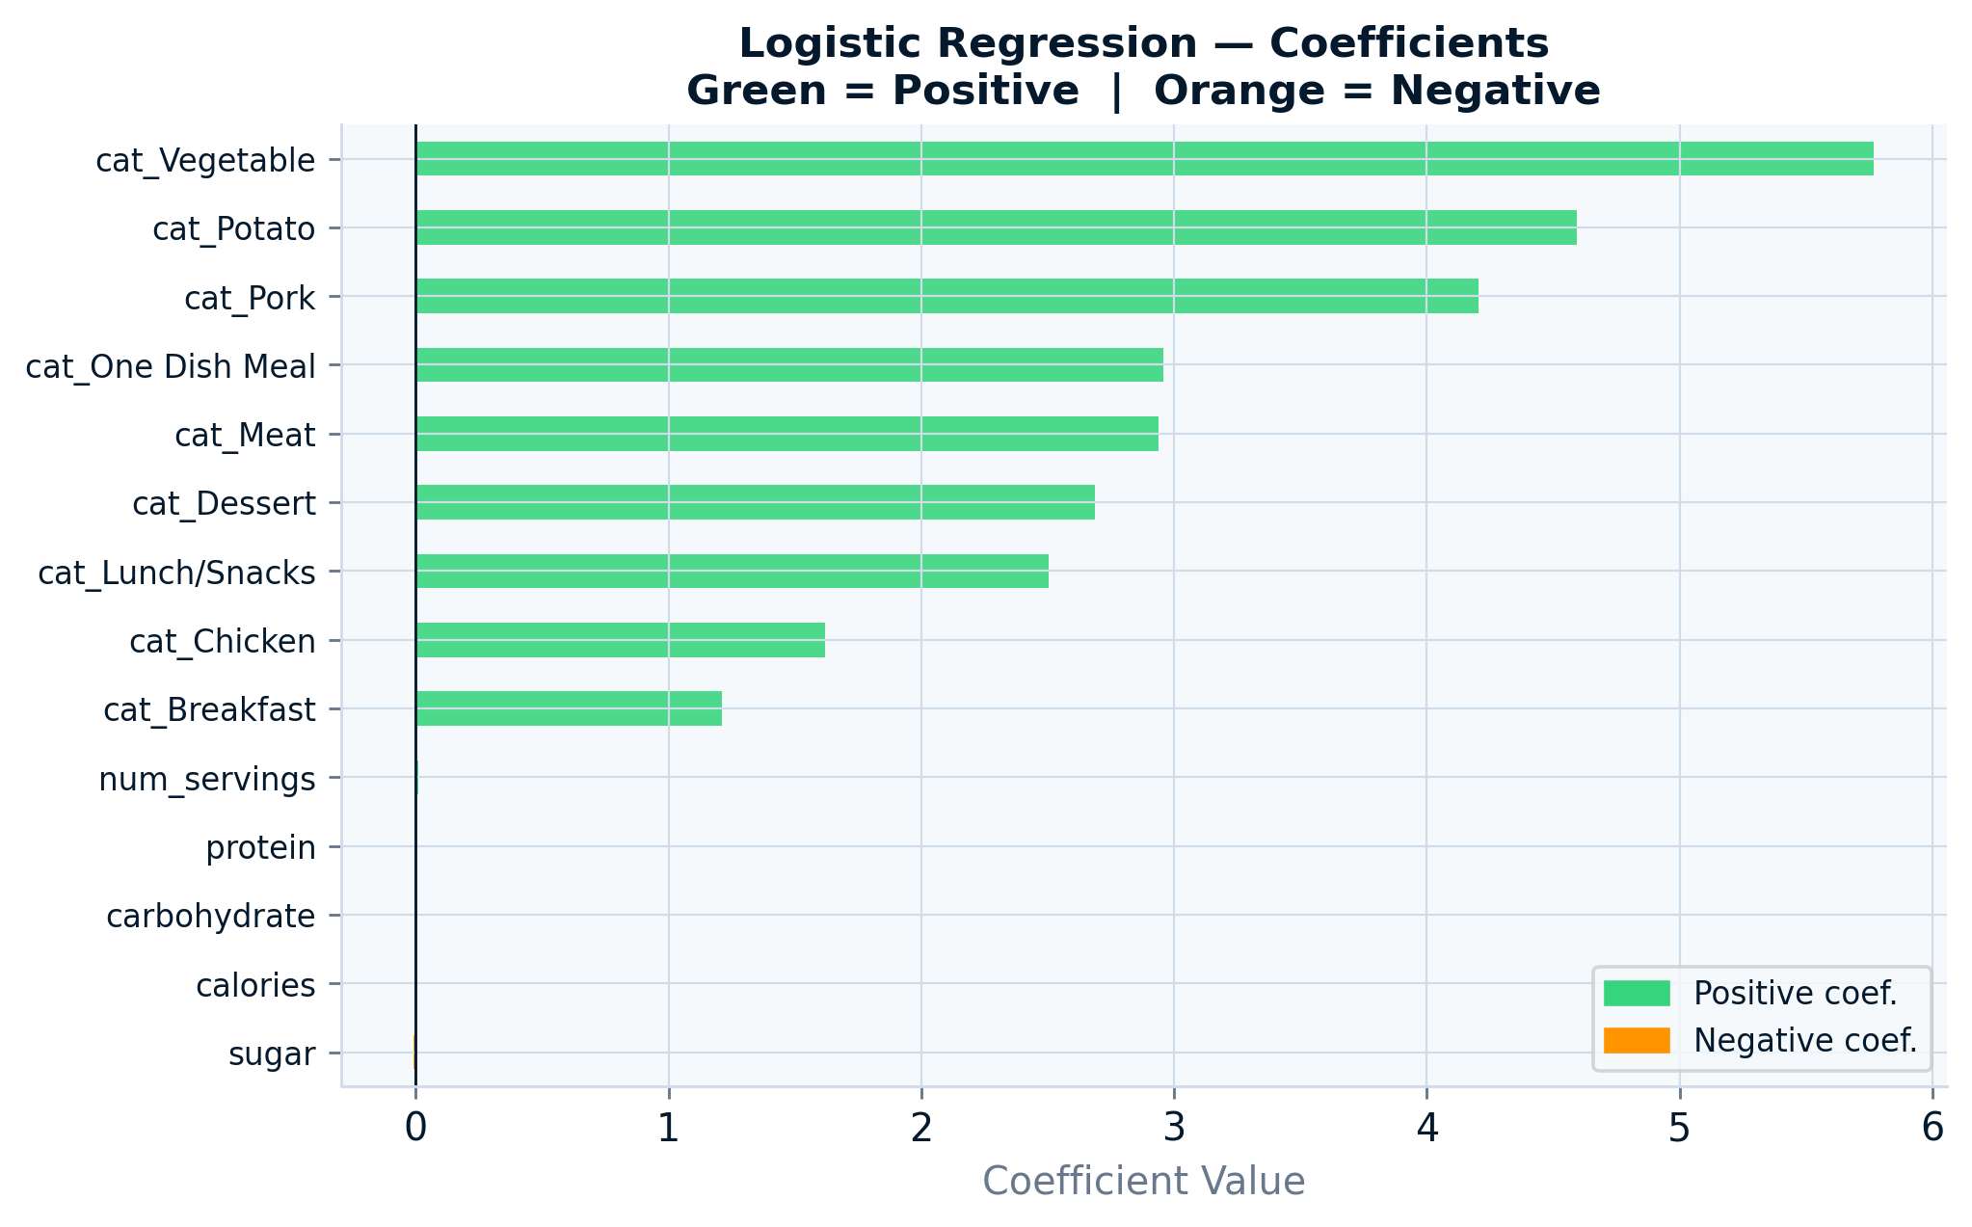
Feature Importance
Category dominates — nutritional features are secondary
Top 3 categories
Vegetable, Potato & Pork have the largest positive coefficients. These are your best bets for the homepage.
Nutritional features
Protein, sugar, calories show near-zero coefficients. They contribute marginally once category is accounted for.
Business implication
The model is essentially a sophisticated category-based recommender. Category scheduling is the most impactful lever.

Slide 9
Business Metric to Monitor
Homepage High-Traffic Precision Rate
Precision Rate = Recipes that drove High Traffic ÷ Total Recipes Featured on Homepage
0.85
0.80
40%
Current Model
Precision
Business
Target
Traffic Uplift
on a Win
85 of 100 picks drive high traffic
Minimum acceptable rate
Extra traffic from popular recipe
How to Monitor in Production
Track rolling 30-day Precision Rate · Alert at 0.80 · If it drops → model review & retrain with recent data
Current estimate: 85 in every 100 model-selected homepage recipes are predicted to drive high traffic.

Slide 10
Recommendations
Deploy the Tuned Logistic Regression
Run an A/B Test Before Full Rollout
01
04
Precision 0.85 — exceeds the 80% business target. Interpretable, fast, and easy to maintain in production.
Compare model selections vs current manual picks for 4–6 weeks to quantify real-world traffic uplift.
Prioritise Vegetable, Potato & Pork
Expand Labelled Data Over Time
02
05
Largest positive model coefficients. Homepage scheduling should favour these when multiple candidates are available.
39% of recipes have no traffic label yet. As more are featured, the training set grows for future retraining.
Monitor Precision Rate Monthly
03
Set a 0.80 alert threshold. If precision drops, investigate category mix shifts and retrain with recent data.
Thank you · Questions welcome

