Slide 1
Lending Club Case Study
Shashank Khandelwal
Rudrangshu Das

Slide 2
Objective
The Objective of this case study is to implement EDA technique on a real world problem and understand the insights and present in a business first manner via presentation.
Benefits of the case study:
Gives a idea about how EDA is used in real life business problems.
It also develops a basic understanding of risk analytics in banking and financial services.
How the data is used to minimize loss of money while lending it to clients.
It improves our understating of visualization and what charts to use for real life data.

Slide 3
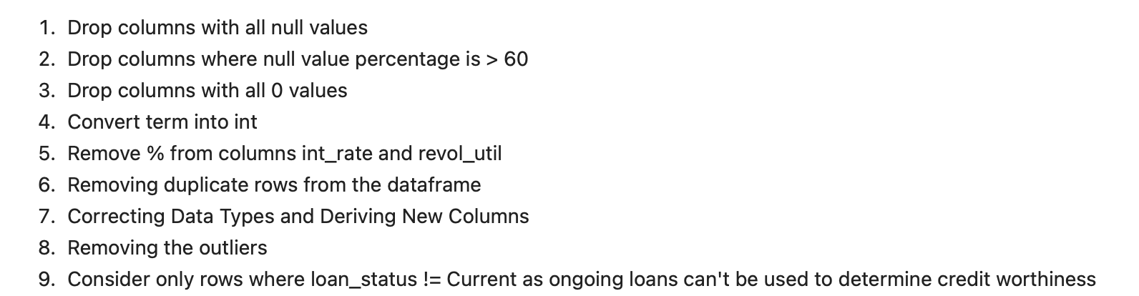
Business Understanding
The business objective is to take a decision whenever they receive a loan application whether to reject or approve based on certain variables.
Dataset Details:
The data given below contains information about past loan applicants and whether they ‘defaulted’ or not. Data has details regarding approved loan not the rejected ones. It has 3 status of loan which is Fully Paid, Current and Charged-Off.
Data Clean-up and preparation process:

Slide 4
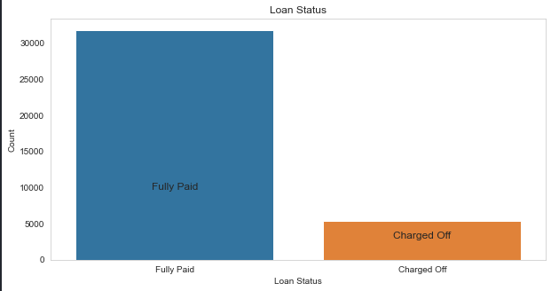
Loan Status and Amount
Loan Status: The number of charged off loan is much smaller(14.5%) compared to total count.
.

Slide 5
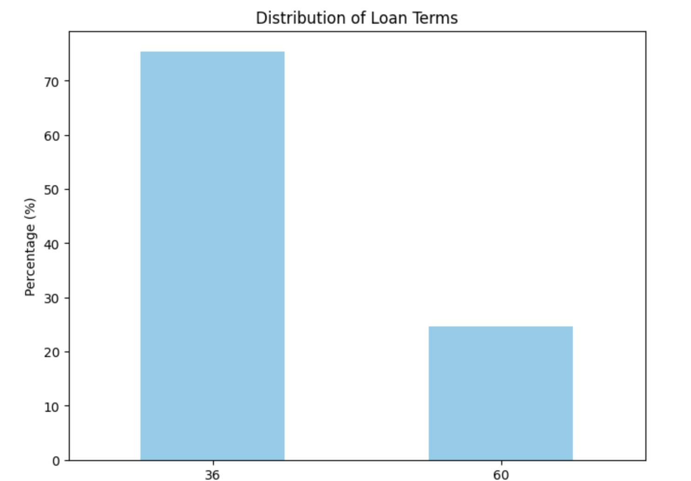
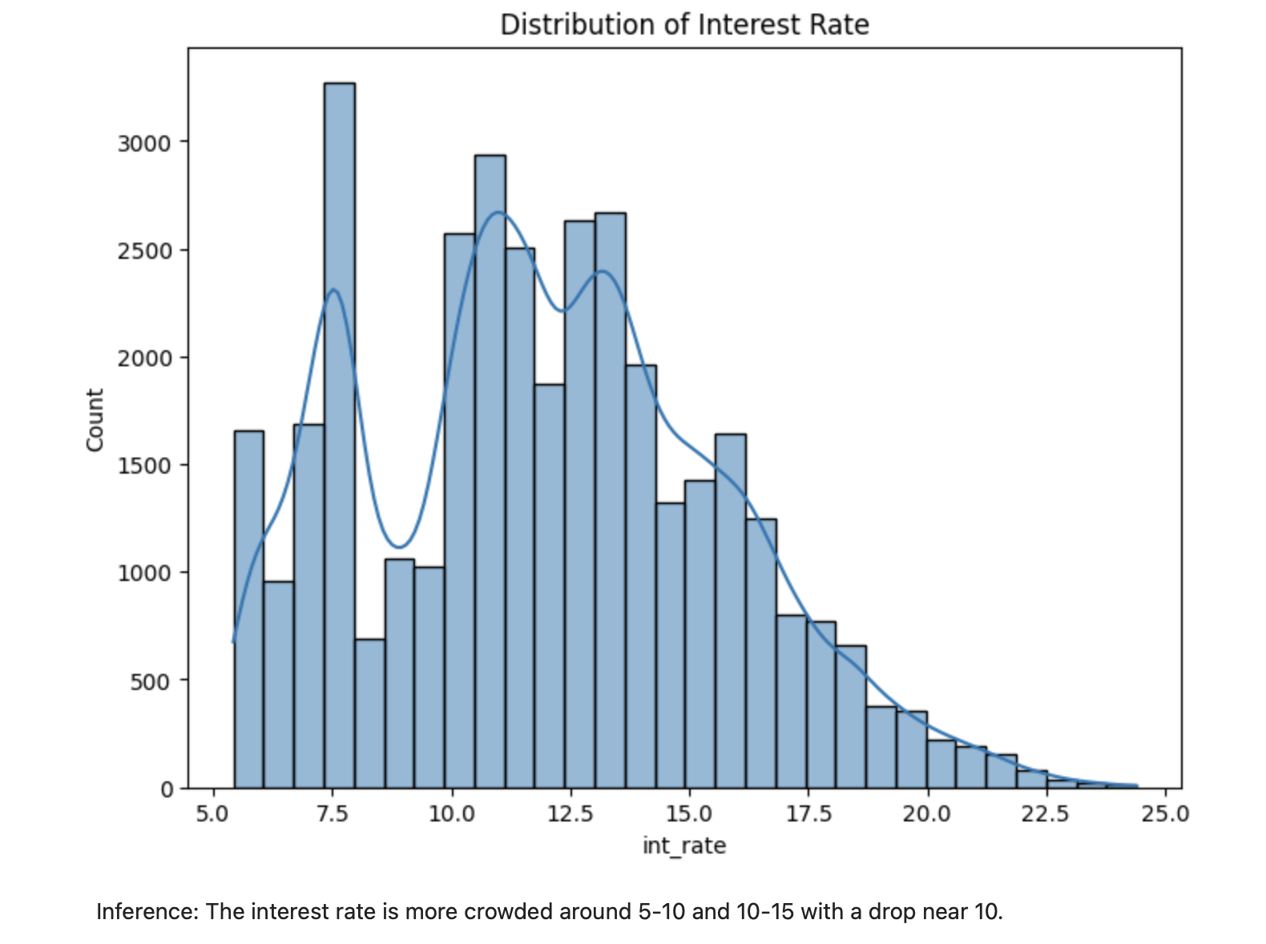
Term and Interest Rate
Loan Term: The Loans taken for 36 month term are much more than 60 months and have lower chance of defaulting.
Interest Rate: The count of loan taken varies with interest rate showing peak around in 10 and 10 to 15 bracket and decreasing slowly where as the chance of defaulting increases with interest rate.

Slide 6
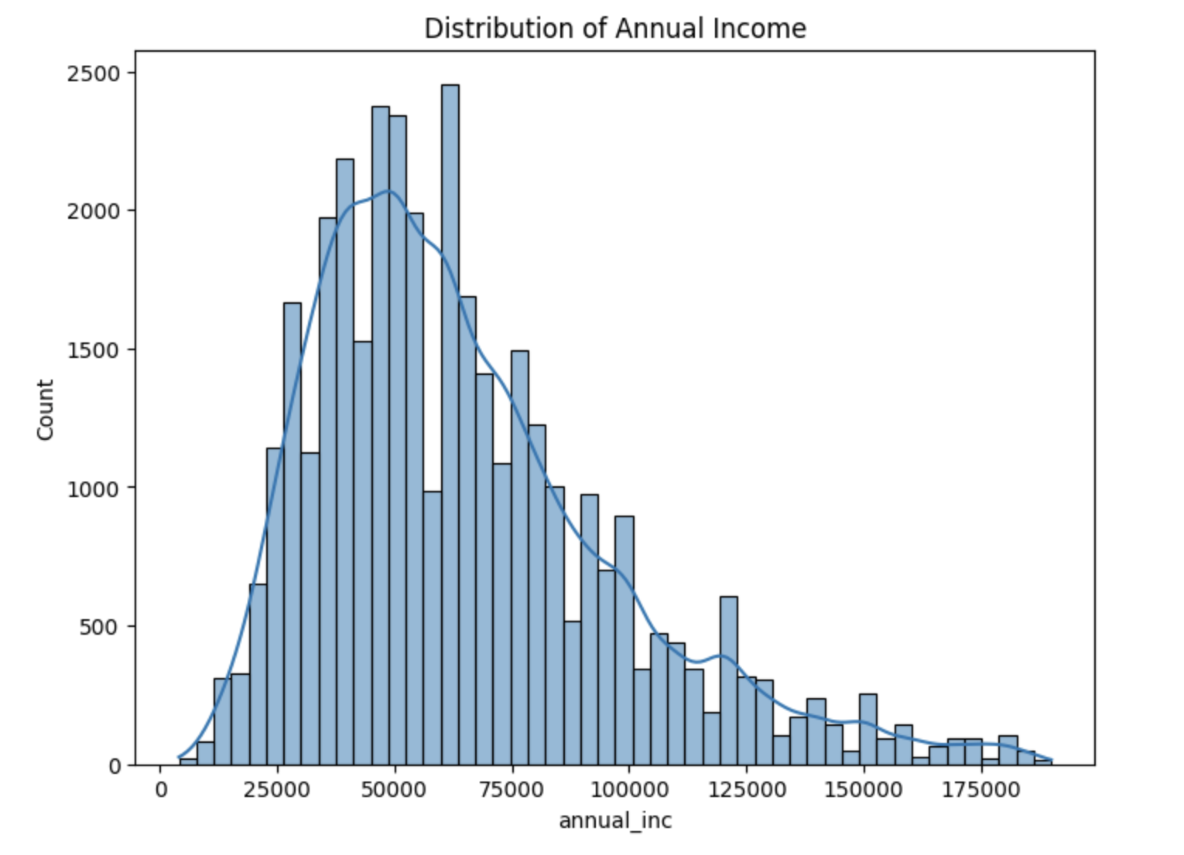
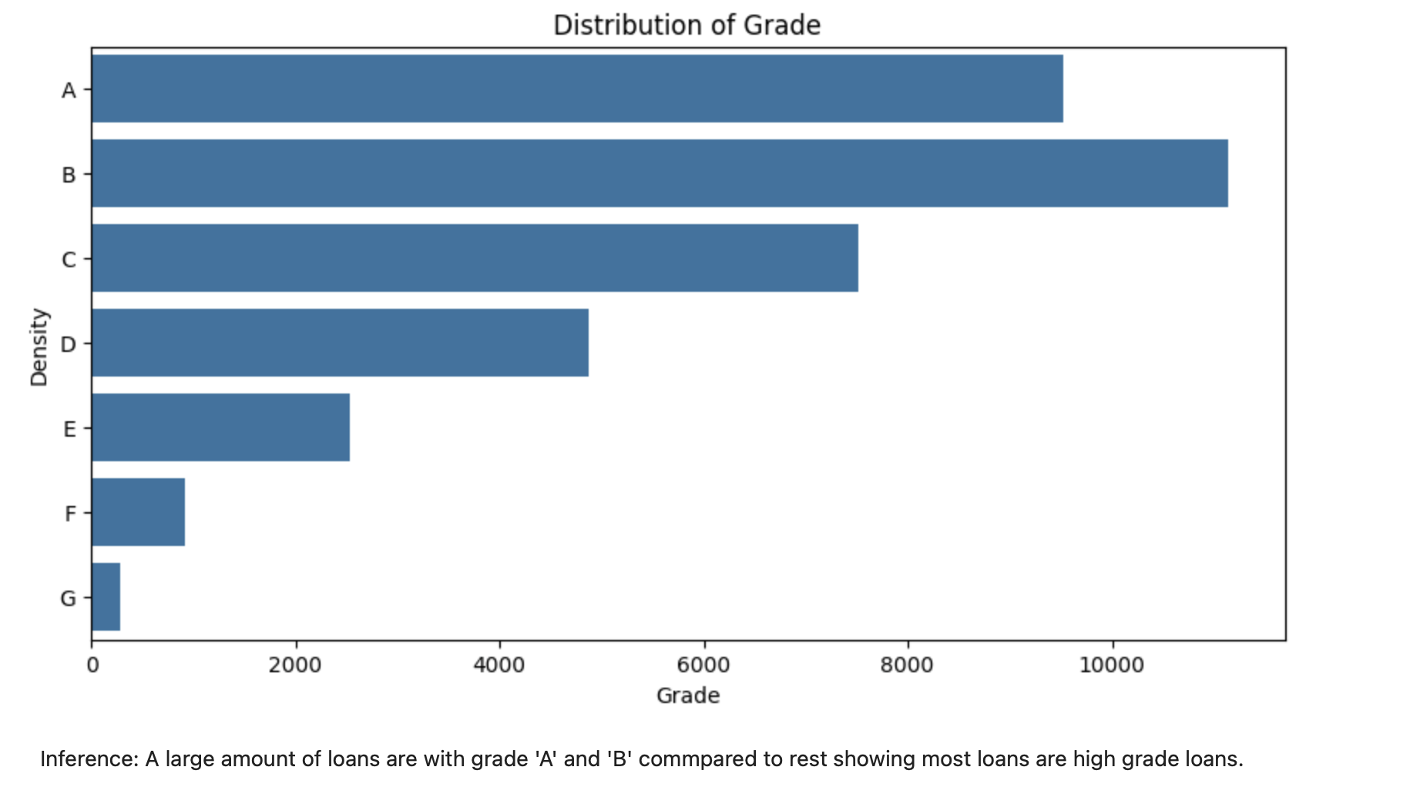
Grade and Annual Income
Grade: The loan approved are majorly of higher grade as they are of low risk thus low chance of defaulting. 60 month term loans have larger number of lower grade loans with high risk.
Annual Income: Most of the people have annual income in range of 25K to 100K.

Slide 7
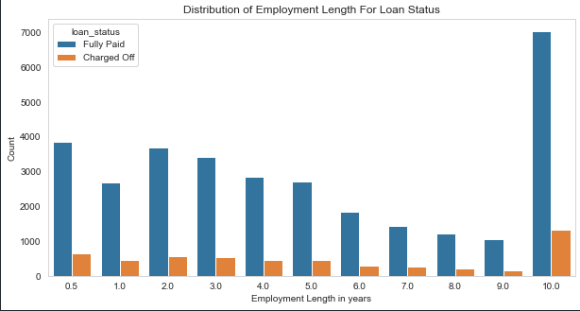
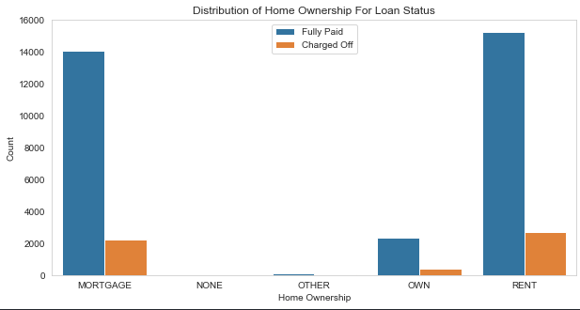
Employment Length & Homeownership
Employment Length: Majority of clients have 10+ years of experience and has highest number of defaulted loan.
Home Ownership: Majority of clients are lacking ownership of any property and are on rent or mortgage and have a higher chance of defaulting.

Slide 8
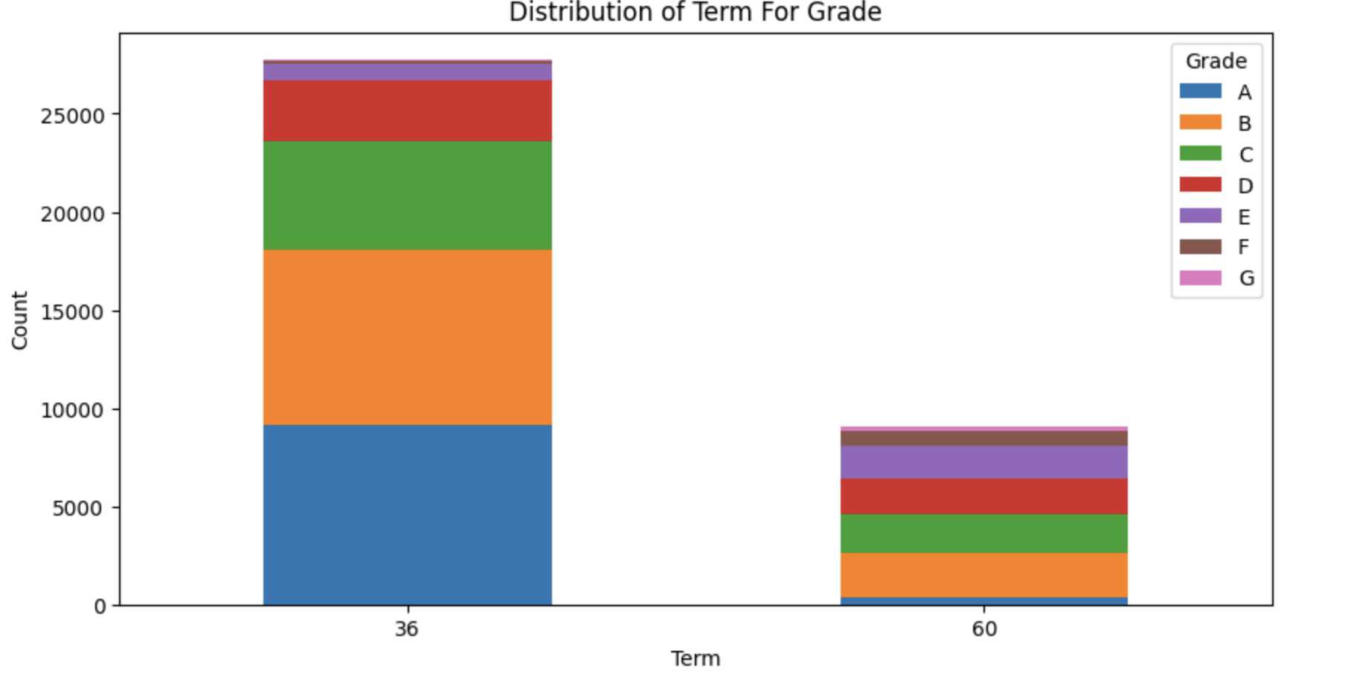
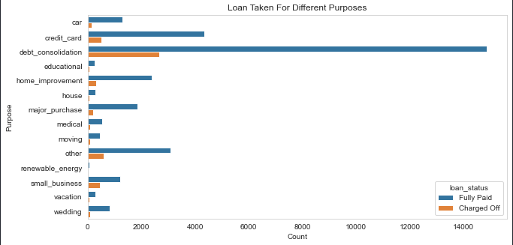
Grade distribution& Purpose
The loans in 36 month term majorily consist of grade A and B loans whereas the loans in 60 month term mostly consist of grade B, C and D loans..
Purpose: Loans are taken mostly for debt consolidation followed by credit card payment. Whereas the debt consolidation has highest fully paid loan but also has highest defaulted loans as well.

Slide 9
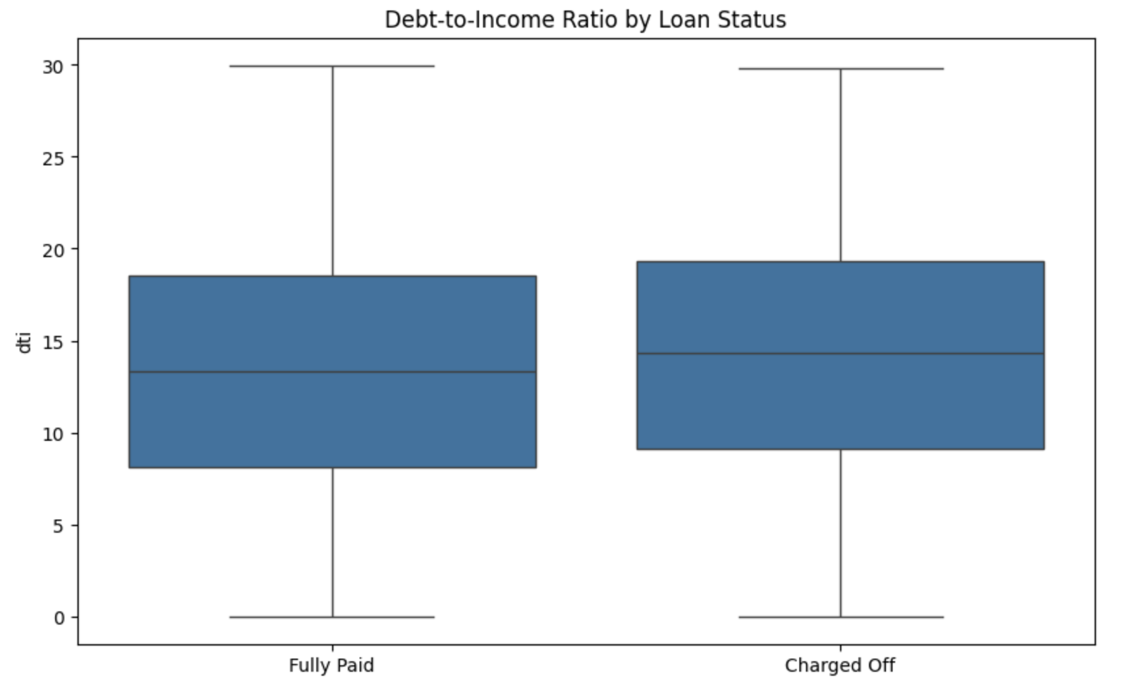
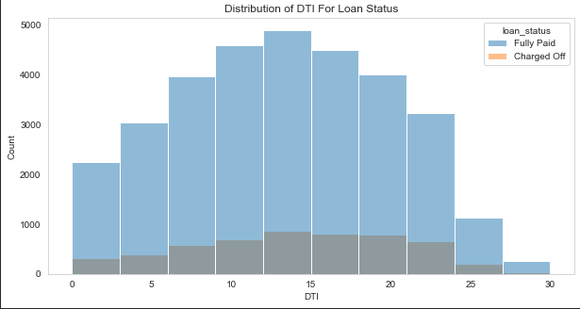
DTI ratio Distribution
DTI: The large percentage of Clients have a large Debt to Income ratio which shows that lending to such clients can be very risky.

Slide 10
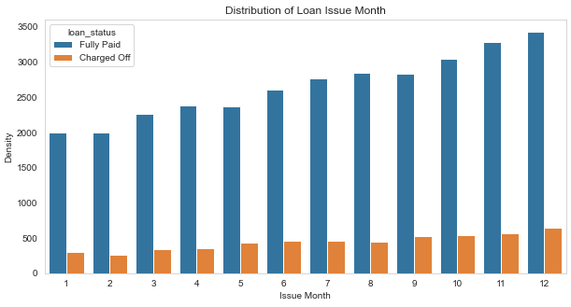
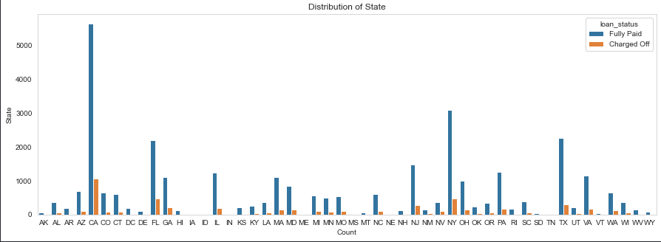
Loan Trend over years
We see a gradual increase in loan taken through the year, with lesser defaulting rate in April ,August, December quarter wise and better more late in year.
For large metropolitan cities we see large number of loans, with higher number of defaulted loans like California, New York, Texas, Florida but have a lower chance of defaulting.

Slide 11
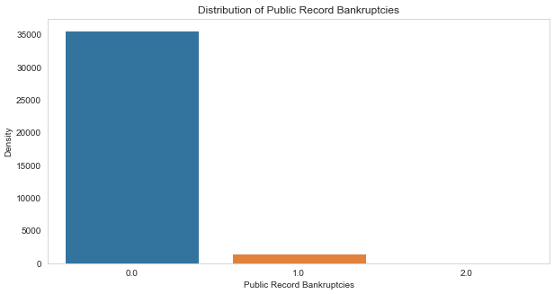
Public Recorded Bankruptcy
Public Recorded Bankruptcy: Majority of clients have no record of declaring bankruptcy.

Slide 12
Recommendations
Recommendations
Major Driving factor which can be used to predict the chance of defaulting and avoiding Credit Loss:
1. DTI
2. Grades
3. Verification Status
4. Annual income
5. Pub_rec_bankruptcies
Other considerations for 'defaults' :
1. Burrowers not from large urban cities like California, new york, texas, florida etc.
2. Burrowers having annual income in the range 50000-100000.
3. Burrowers having Public Recorded Bankruptcy.
4. Burrowers with least grades like E,F,G which indicates high risk.
5. Burrowers with very high Debt to Income value.
6. Burrowers with working experience 10+ years.

Slide 13
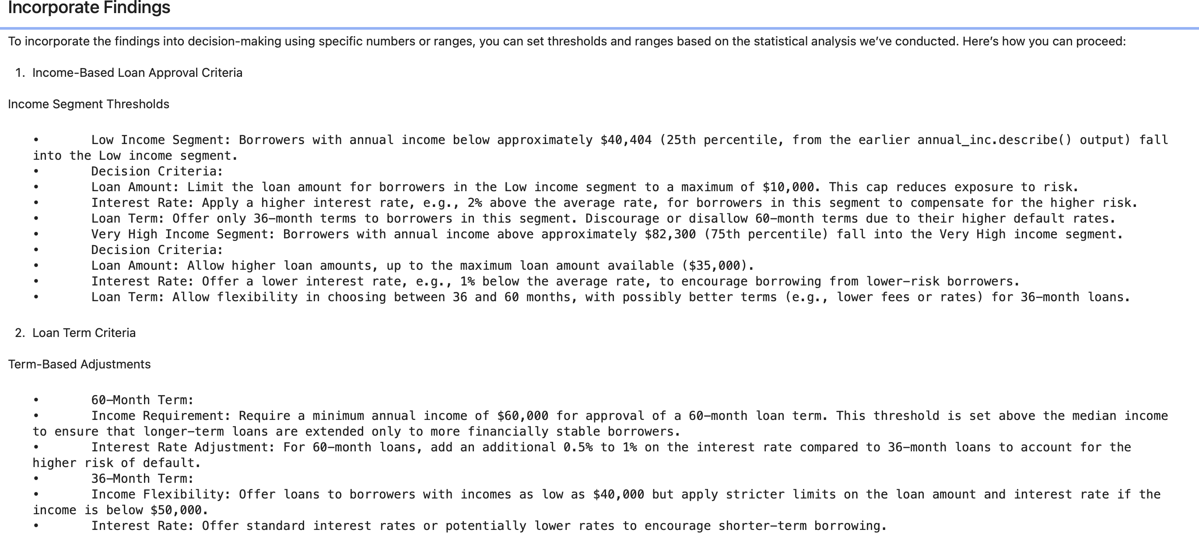

Slide 14
