Slide 1
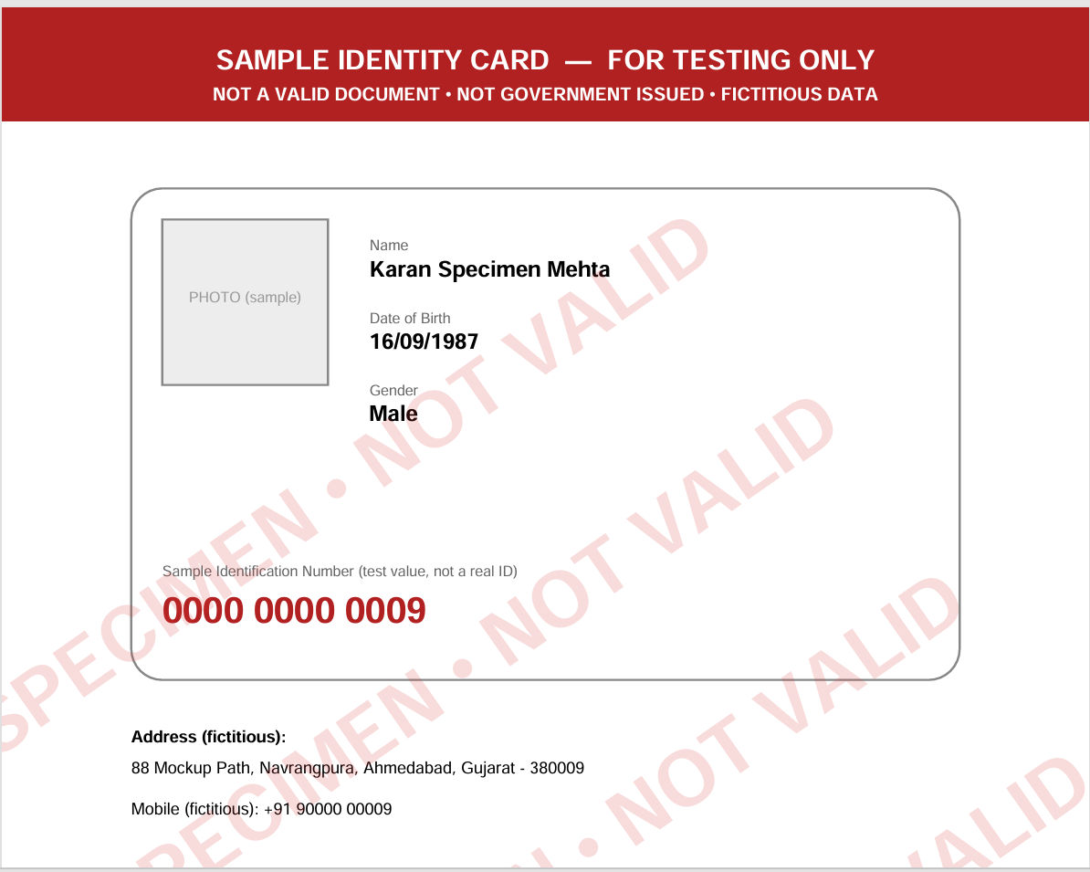
Contact details are on the right side..

