Slide 1
Shashank Hegde ENG21CT0036
Presentation Demo for Webknot Technology
Event Management Dashboard

Slide 2
Table of contents
01
02
03
04
MongoDB
Express JS
Used for Storage
For all the APIs
React JS
Node Js
For frontend
For API calls

Slide 3

Pages
1.Login 2.Home 3.Events 4.Tasks 5.Attendees

Slide 4
Works
All the 3 pages support CRUD Operations. And I have added login page, Calendar view and Progress bar to show completion of tasks

Slide 5
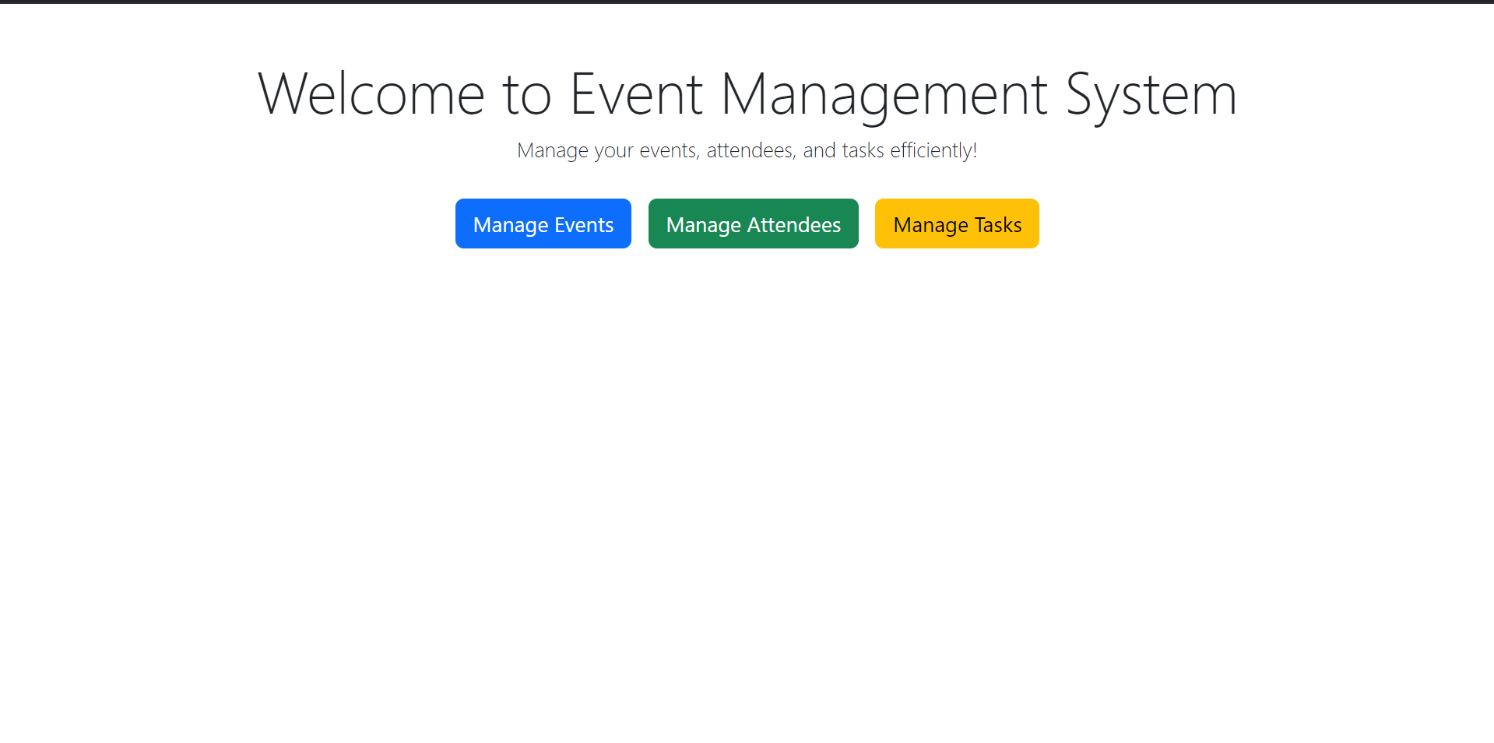
Images

Slide 6
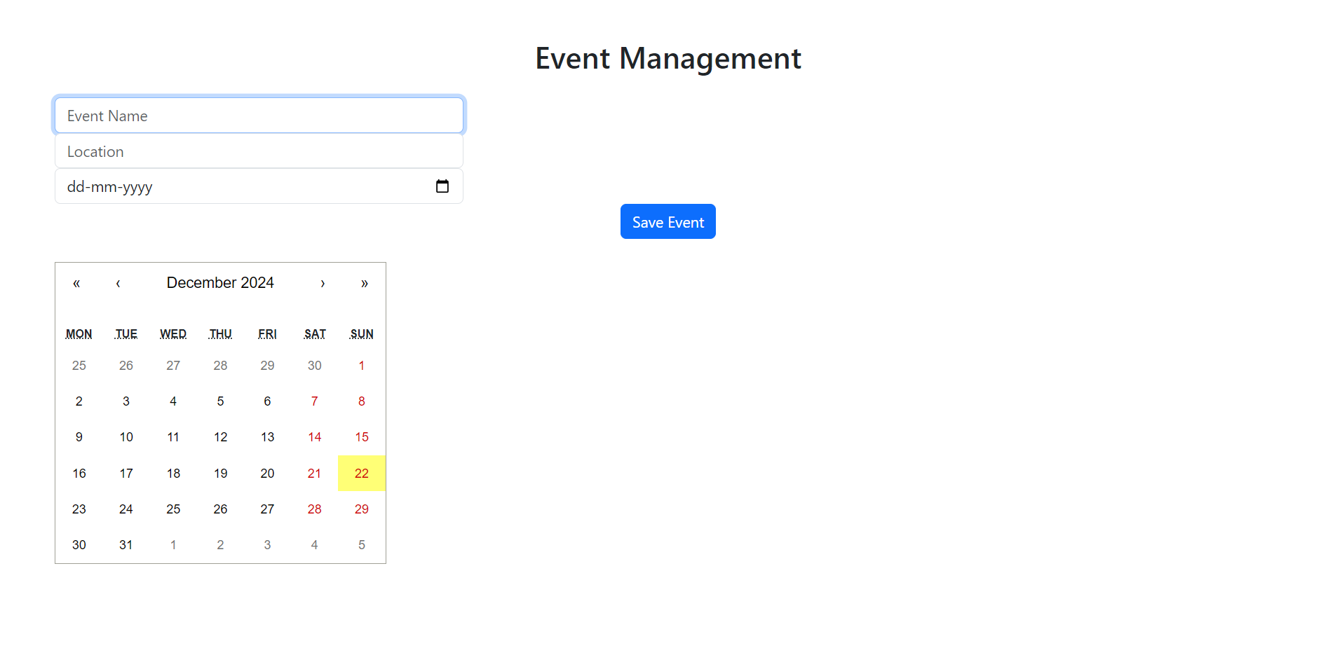

Slide 7
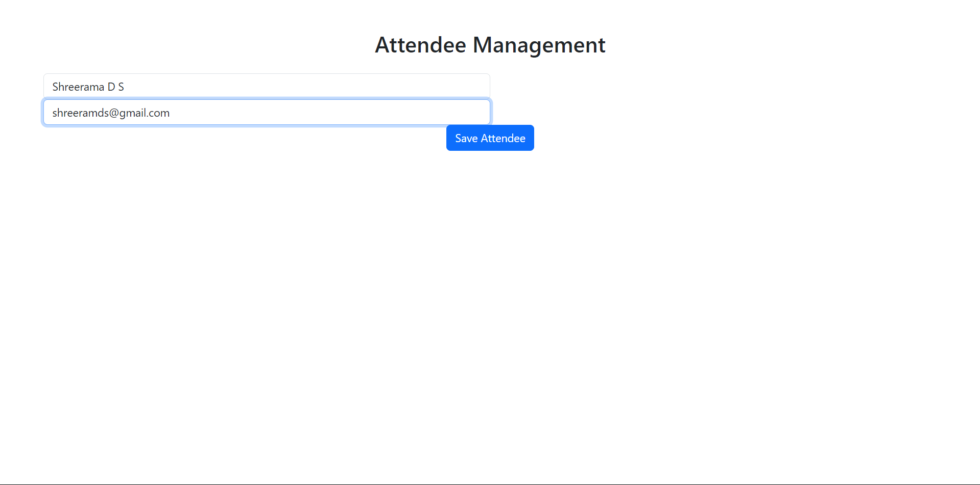

Slide 8
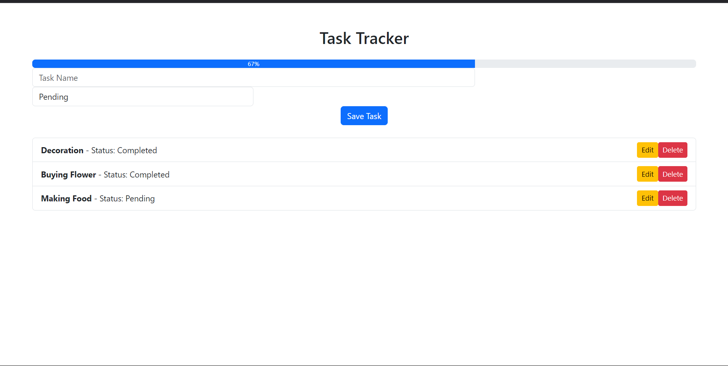

Slide 9
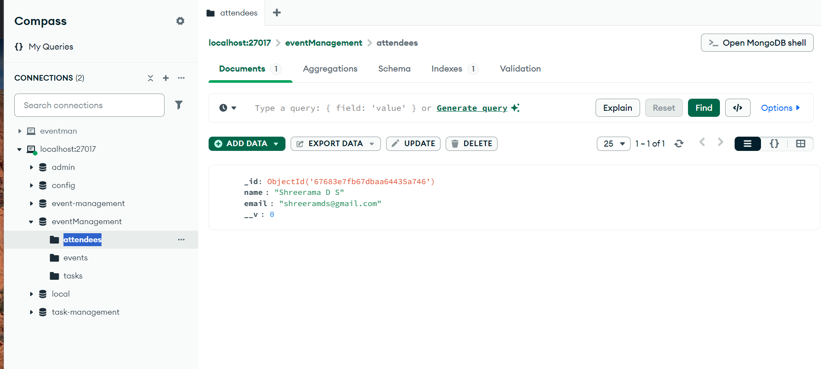

Slide 10
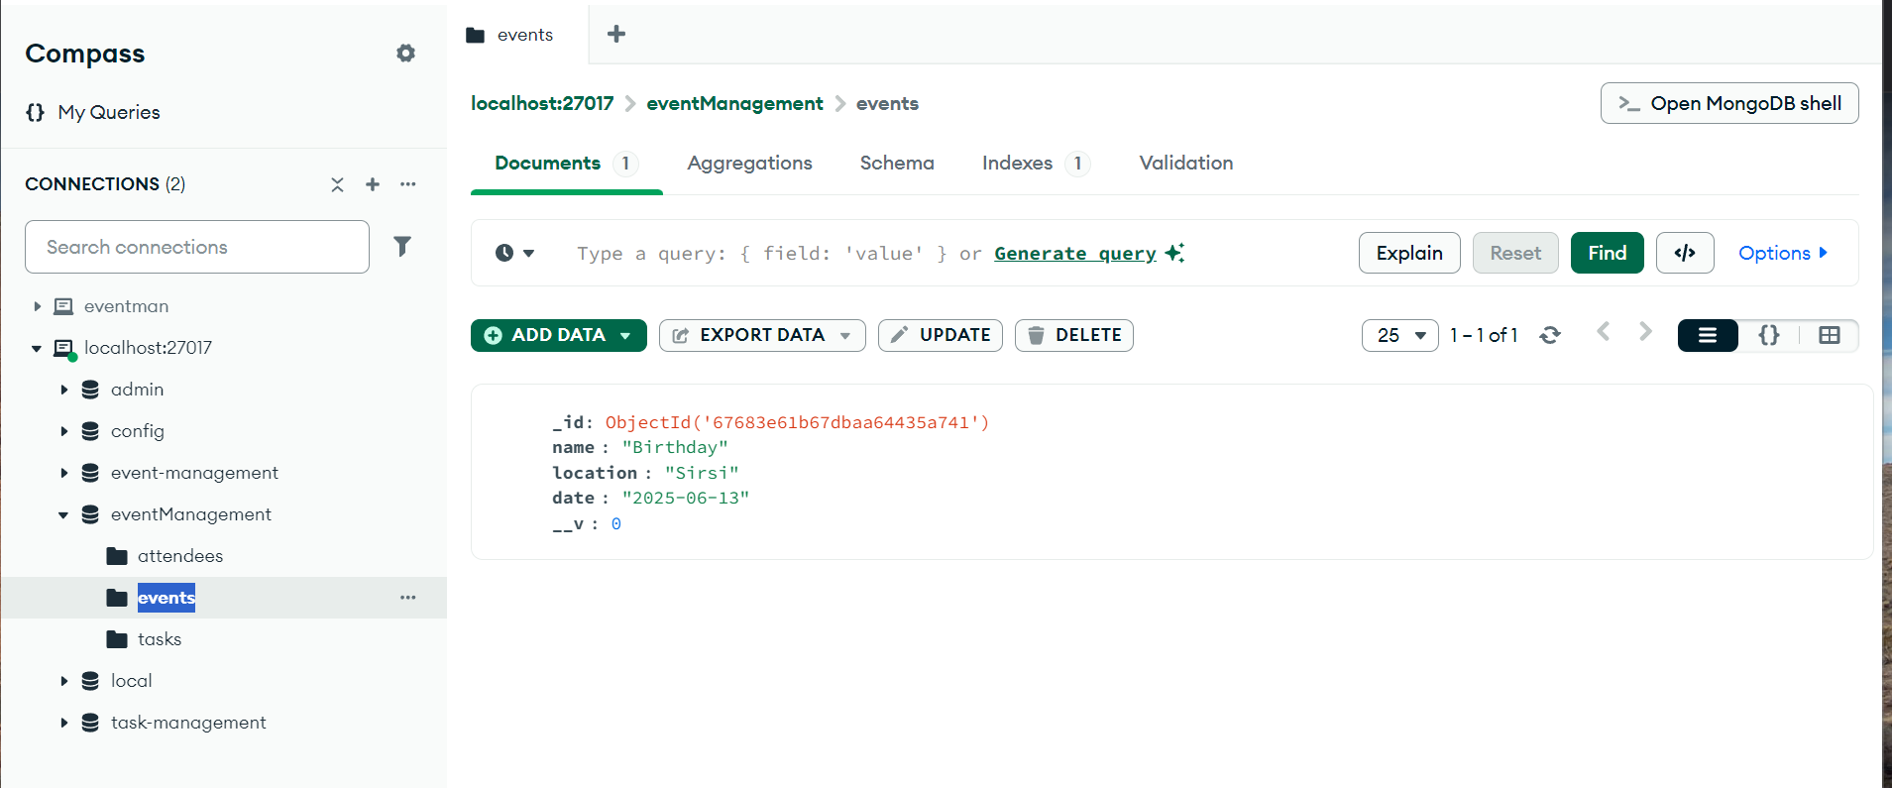

Slide 11
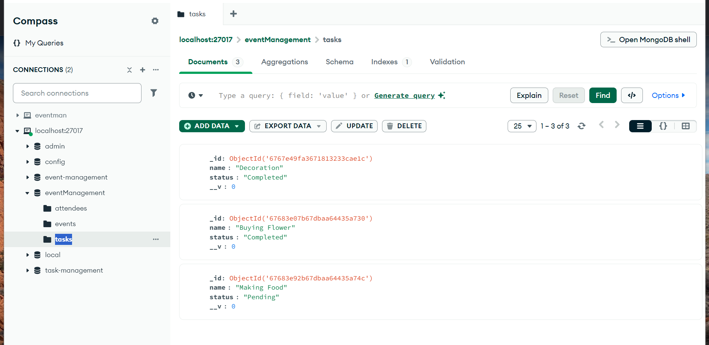

Slide 12
Video Explanation of how it works
Drive link: https://drive.google.com/file/d/1qVFqTMeT7tPaEs3A2zLoC3MrjcMvQW8T/view?usp=sharing

Slide 13
THANKYOU

