Slide 1
Route Management Using Satellite Images
Allan Dsouza
Hemal S
Jaice S Joseph
Shashank Hegde
Swaroop KR

Slide 2
Abstract
Urbanization and infrastructure development often lead to unplanned modifications in man-made structures such as buildings, roads, and vehicles, which can have detrimental effects on natural ecosystems. Current methods for monitoring these changes and planning sustainable development routes are often resource-intensive and lack precision. This project addresses the need for an efficient system to identify and classify modifications in urban and rural landscapes using advanced satellite datasets like Sentinel-2 and LISS-4. By leveraging AI and ML techniques, particularly an ensemble of U-Net and SegNet models, the goal is to provide accurate classification of affected areas and suggest optimal routes between locations that minimize ecological damage, thereby promoting sustainable development and environmental conservation.

Slide 3
Introduction
Urbanization and human activities, such as road construction and infrastructure development, are rapidly transforming our environment, often at the cost of ecosystems. These activities lead to deforestation, habitat destruction, and other ecological impacts, underscoring the need for effective land monitoring and management strategies. Satellite imagery offers a powerful tool for observing Earth's surface, capturing high-resolution data over time. However, traditional methods of manually analyzing these images are inefficient, time-consuming, and error-prone, making them inadequate for addressing urgent environmental and urban challenges.This project harnesses the power of artificial intelligence (AI) and machine learning (ML) to address these challenges. By employing an ensemble model combining U-Net and SegNet architectures, the system accurately identifies and classifies modifications in man-made structures and natural ecosystems. Additionally, it suggests optimal routes between locations that minimize ecological damage, such as avoiding deforestation and preserving water bodies.By providing precise, actionable insights, this system not only facilitates efficient route planning but also emphasizes sustainable development and environmental conservation. The integration of advanced AI techniques with satellite datasets such as Sentinel-2 and LISS-4 positions this project as a significant step toward harmonizing urbanization with ecological preservation.

Slide 4
Literature Survey
1. Land Cover Classification Using Machine Learning Models - "Fully Convolutional Networks for Semantic Segmentation" (Long et al., 2015): Introduced FCNs for classifying land like forests and water bodies. Drawback: High computational cost. 2. Cost Mapping and Environmental Assessment - "GIS-Based Ecological Impact Assessment of Infrastructure Projects" (Geneletti, 2003): Used GIS to map ecological and economic costs. Drawback: Limited real-time adaptability. 3. Geospatial Data Integration for Road Planning - "Remote Sensing and Infrastructure Planning" (Zhang et al., 2016): Combined remote sensing and ML for terrain analysis. Drawback: Limited scalability for diverse regions. 4. Sustainability in Infrastructure Development - "Road Ecology: Science and Solutions" (Forman et al., 2003): Highlighted ecological impact and advocated eco-friendly approaches. Drawback: Lacks computational framework for real-time analysis.
5. Applications of Similar Approaches - "Optimization Models for Urban Utility Networks" (Xu et al., 2020): Used segmentation and optimization for urban utility planning. Drawback: Focused on urban areas, less applicable to rural regions.

Slide 5
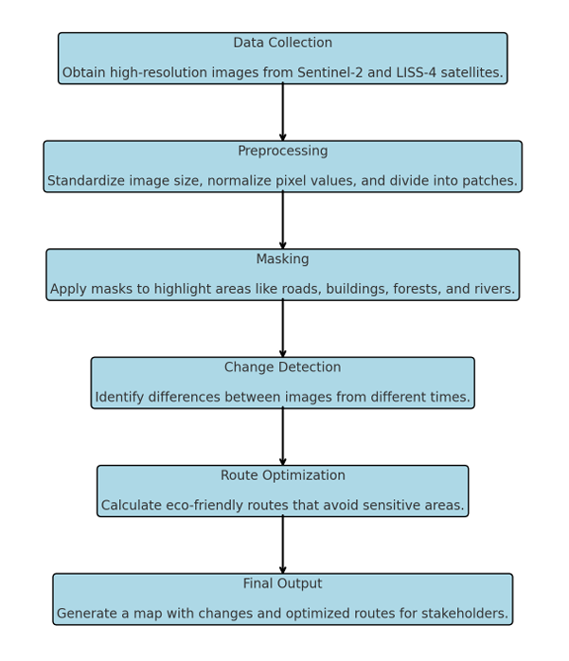
MODEL DEVELOPMENT

Slide 6
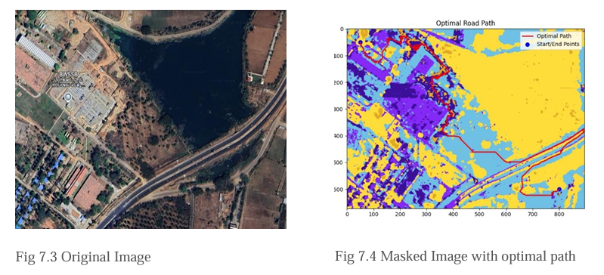
RESULTS
The trained model successfully detects changes in human-related activities from satellite imagery. Comparisons of original images, ground truth masks, and predictions demonstrate its ability to identify man-made objects accurately and able to find the most optimal path for the construction of road from Source to Destination.

Slide 7
CHALLENGES:
1. Variations in lighting and seasons affect segmentation accuracy.
2. High-resolution satellite data requires significant processing power.
3. Temporal data shifts due to satellite motion make alignment difficult.
4. Minor changes are hard to detect due to resolution limitations.

Slide 8
USE CASES:
Route Optimization
Military
Agriculture
Disaster Management

Slide 9
CONCLUSION
•This project highlights the potential of AI/ML techniques in automating change detection tasks from satellite imagery. By focusing on human-
related changes, it opens avenues for diverse applications like route optimization, urban development, monitoring, and emergency management.
ALLAN D’SOUZA - ENG21CT0002 HEMAL S - ENG21CT0009 JAICE S JOSEPH - ENG21CT0011
SHASHANK SWAROOP
- ENG21CT0036
- ENG21CT0041

