Slide 1
PROBLEM STATEMENT & MARKET GAP
Security failures happen
when code breaks business rules
INVARIA'S UNIT OF WORK
The security case
01
Policy
Modern applications often authenticate users correctly yet fail to keep authorization, ownership, and workflow constraints consistent across routes, services, and data stores.
What must always be true
02
Path
How a request reaches sensitive data or action
03
Proof
THE REVIEW GAP
Which source evidence supports the hypothesis
A line-level alert or a general coding-model answer rarely preserves the application policy, the inspected evidence, and the remaining uncertainty in one place.
04
Decision
What remains for a reviewer to validate
Invaria treats a security finding as a structured case: expected invariant, source-backed path, evidence gate, and a human review decision.
Not a claim of a breach. A traceable basis for review.
INVARIA | REVIEW PRESENTATION
Sources: Invaria blueprint and INVARIANT engine design
01
Notes:
Source: Invaria Engineering & Product Blueprint; docs/INVARIANT_ENGINE.md.
Talking points: The core problem is not only finding suspicious code. A reviewer needs to see what business rule might be broken, how the source path supports the concern, and what remains unknown. Invaria is built around that security case.

Slide 2
MARKET OPPORTUNITY
Application security is a growing
category with a clear entry point
WHERE INVARIA FITS
Initial wedge
Invaria begins with API-driven products where a broken ownership or business-flow rule can directly affect money, tenant data, or regulated records.
JavaScript and TypeScript teams building multi-tenant SaaS and API products, especially when a dedicated application-security team is unavailable.
Global application security market, USD billions
Why now
AI-assisted delivery speeds up code creation. Security review still needs evidence that a system preserves its access and workflow rules.
Market context
$10.6B in 2025 · $42.1B projected for 2033 · 18.8% CAGR
Category sizing is market context, not a revenue forecast for Invaria.
INVARIA | REVIEW PRESENTATION
Source: Grand View Research, Application Security Market, 2026–2033
02
Notes:
Source: Grand View Research, ‘Application Security Market (2026–2033)’, accessed 24 September 2026: https://www.grandviewresearch.com/industry-analysis/application-security-market.
Data: Global application security market $10.6B in 2025, $12.6B estimate in 2026, $42.1B projected in 2033, CAGR 18.8% (2026–2033).
Talking points: The market number gives category context. Our initial addressable use case is narrower: API-driven, multi-tenant applications with sensitive data or sensitive business actions.

Slide 3
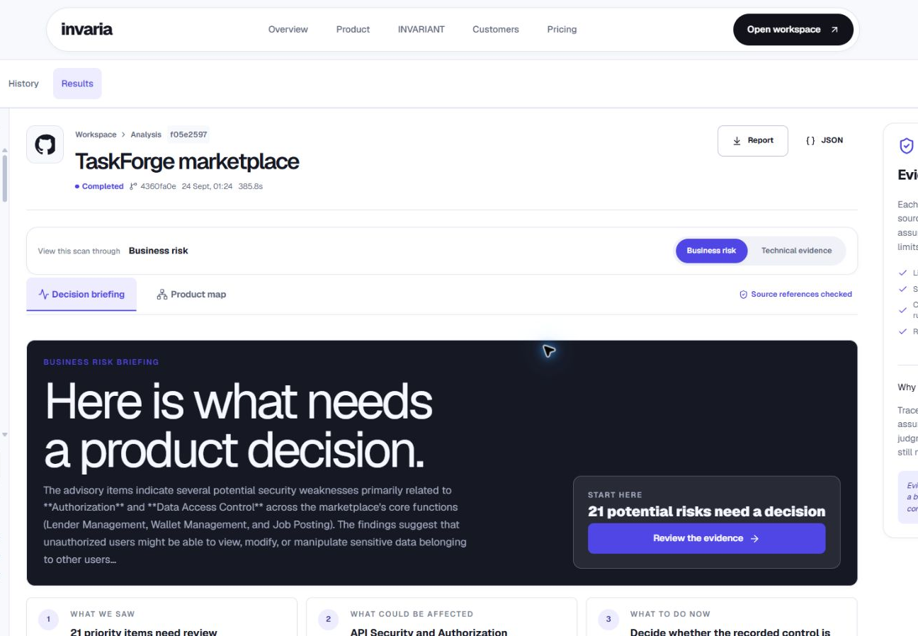
THE PLATFORM
Invaria turns a repository into
an inspectable security case
The product connects a repository snapshot to application structure, evidence-backed security hypotheses, and a review workflow that speaks in technical and business terms.
1
2
3
4
Snapshot
Model
Investigate
Review
Immutable code input
Routes, handlers, data paths
Rule-specific hypotheses
Evidence, uncertainty, action
LIVE PRODUCT VIEW
A reviewer can start from business impact, then open the decision ledger and exact source evidence.
Where it differs from a standalone coding assistant
Invaria makes the policy, evidence gate, coverage boundary, and human decision persistent product objects. The model remains a replaceable, advisory component.
INVARIA | REVIEW PRESENTATION
Screenshot: live local Invaria workspace, captured 24 Sep 2026
03
Notes:
Screenshot: live local Invaria workspace captured 24 September 2026.
Sources for competitive boundary: OpenAI, ‘Codex Security: now in research preview’, https://openai.com/index/codex-security-now-in-research-preview/; Anthropic, ‘Making frontier cybersecurity capabilities available to defenders’, https://www.anthropic.com/news/claude-code-security.
Talking points: Codex Security and Claude Code Security now offer serious security analysis. Invaria should not claim an unproven performance advantage. Its product differentiation is the versioned, inspectable policy and decision ledger that do not depend on one model provider.

Slide 4
CORE ALGORITHM
INVARIANT: a security-decision engine
Invariant-based Networked Verification and Attack-path Reasoning defines the conditions under which a code pattern becomes a reported finding.
01
02
03
04
05
Model
Hypothesis
Evidence
Gate
Ledger
Parse routes, functions, queries, identities, and trust boundaries
Ask a rule-specific question, such as BOLA001
Trace request flow and collect source snippets and controls
Require the minimum evidence needed for that rule
Persist proof, conditions, coverage, and confidence basis
MODEL BOUNDARY
RAG and the LLM can review a bounded evidence bundle. They cannot satisfy an evidence gate or replace missing source evidence.
INVARIA | REVIEW PRESENTATION
Source: docs/INVARIANT_ENGINE.md and current implementation
04
Notes:
Source: docs/INVARIANT_ENGINE.md; backend/invaria/algorithm.py; backend/invaria/pipeline.py.
Talking points: An invariant describes what must stay true in the application. The algorithm creates a question from a rule and the application structure, collects source evidence, then applies a gate. The gate makes it impossible for model prose or RAG content to fill an evidence gap. The decision ledger retains why we reported or discarded the candidate.

Slide 5
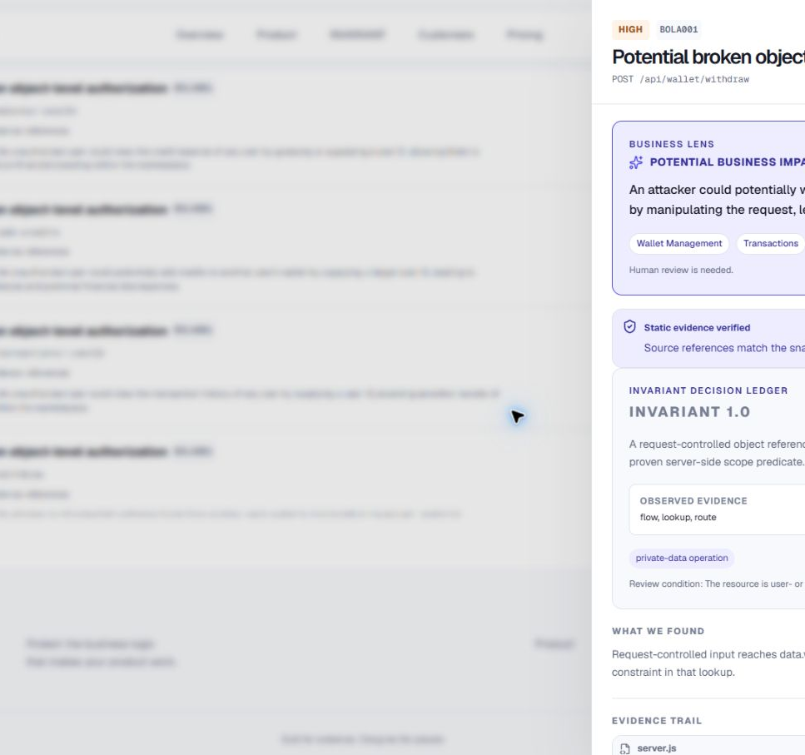
CORE ALGORITHM
A BOLA finding must pass
an evidence test
BOLA001 asks whether a request-controlled object reference reaches private data without a proven server-side ownership or tenant predicate.
EXAMPLE PATH
POST /api/wallet/withdraw
const wallet = getWallet(userId);
let wallet = data.wallets.find(
w => w.userId === userId
);
The engine follows request-derived data into the resolved local helper and inspects the lookup for a server-derived scope constraint.
The decision ledger states what was observed, which controls were proven, and what requires human validation.
BOLA001: route + lookup | BFL001: route + mutation | INJ001: route + sink | SEC001: credential literal
INVARIA | REVIEW PRESENTATION
Screenshot: live INVARIANT decision ledger, captured 24 Sep 2026
05
Notes:
Screenshot: live Invaria decision ledger captured 24 September 2026. Source: docs/INVARIANT_ENGINE.md; backend/invaria/algorithm.py.
Talking points: BOLA is broken object-level authorization. In this candidate the record selection depends on request-controlled input. The tool identifies the route, the helper flow, and the lookup. It checks for a recognized server-side owner or tenant constraint. The evidence gate passes only when route and lookup evidence are both present. Passing the gate produces a source-backed candidate, not confirmation of exploitation.

Slide 6
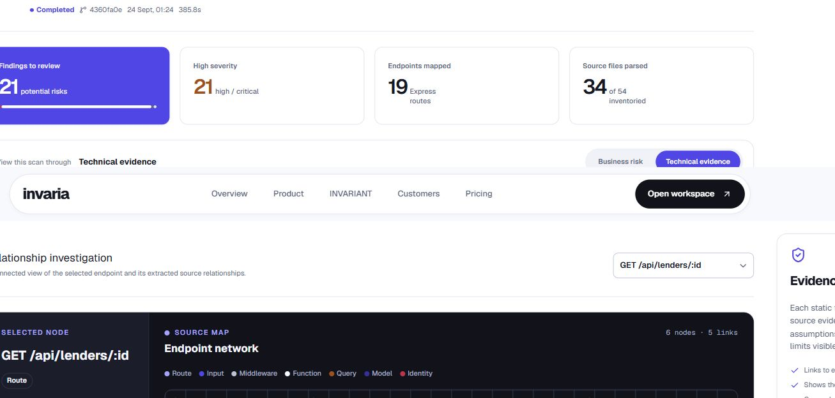
REAL-LIFE EXAMPLE
A marketplace authorization path
In a multi-tenant marketplace, a participant should only access lender records they own or are permitted to view.
Expected invariant
The actor's identity or tenant scope must constrain access to the lender record.
Observed source path
Route receives id → inline handler → data.lenders.find → data.lenders
Review decision
The reviewer checks whether a server-derived ownership or tenant predicate scopes the lookup. If the source does not prove it, Invaria reports the condition and uncertainty.
Live relationship graph: GET /api/lenders/:id
The same method applies to wallet, refund, patient-record, and admin-action workflows.
INVARIA | REVIEW PRESENTATION
Screenshot: live public TaskForge scan; source-backed candidate, not a confirmed breach
06
Notes:
Screenshot: live scan of the public TaskForge repository captured 24 September 2026.
Talking points: This is an example of a real repository scan, but it is not an allegation of a confirmed vulnerability or breach. The graph shows the route, request input, handler, query, and data model. Invaria turns the graph into an explicit authorization question that a human can validate against intended policy and controls.

Slide 7
TARGET CUSTOMERS
Who needs evidence-backed
security review first
FIRST SALES WEDGE
API-driven
multitenant products
The first customers share a common risk: their applications make sensitive access or business decisions faster than a small team can manually review them.
Start with JavaScript or TypeScript teams that need to demonstrate control over access paths and business logic before they can hire a mature AppSec function.
AI-built SaaS
CTO or engineering lead
Tenant isolation, sensitive APIs, rapid release cycles
Fintech & payments
Security or platform lead
Refunds, balances, transfers, and state-changing actions
Primary buyer
Health software
Product security lead
CTO / VP Engineering / Product Security Lead
Patient ownership, role-based access, data exposure
Value delivered
Internal platforms
Platform or IT lead
A path from suspicious code to an accountable security decision.
Privileged workflows, employee data, uneven security coverage
INVARIA | REVIEW PRESENTATION
Source: Invaria blueprint; target segments are prospective
07
Notes:
Source: Invaria Engineering & Product Blueprint.
Talking points: These are target segments, not named customers or current contracts. We start where the consequences of a policy failure are tangible and teams have limited application-security bandwidth. The wedge is API-driven, multi-tenant SaaS because ownership and authorization flows are common and inspectable.

Slide 8
DEVELOPMENT STAGES & FUTURE SCOPE
The path from a working engine
to trusted security coverage
The roadmap prioritizes measurable accuracy and clear coverage boundaries before product breadth.
NOW
NEXT
THEN
Vertical slice
Stronger policy verification
Workflow and validation
JS/TS Express parsing; BOLA, sensitive business-flow, injection and credential hypotheses; decision ledger; review workflow
Typed actor and tenant policies; framework and ORM adapters; call/return propagation; dominance-aware authorization
Multi-step state transitions; held-out evaluation; approved sandbox validation; remediation proposals and incremental scans
Review focus: the next proof point is a frozen evaluation set showing where the engine reports correctly, where it does not, and what remains unsupported.
INVARIA
Evidence first. Human judgment retained.
INVARIA | REVIEW PRESENTATION
Source: docs/ROADMAP.md and docs/INVARIANT_ENGINE.md
08
Notes:
Source: docs/ROADMAP.md; docs/INVARIANT_ENGINE.md.
Talking points: The implementation today is intentionally bounded. Future work should expand only behind measured regression gates. The priority is not a larger model or more agents; it is better policy verification, stronger data-flow evidence, evaluations on held-out cases, and safe validation in approved environments.

