Slide 1
PROBLEM STATEMENT
AI-built apps can still
have security gaps
WHAT INVARIA DOES
It checks whether
the app follows its
important rules
A feature can work correctly and still let the wrong person see data, change a transaction, or access a sensitive action.
1
Understand the app
Simple example
2
Find a risky path
A user changes an ID in a URL. The app shows another customer's record because it never checks who owns that record.
3
Show the proof
4
Help a human decide
The security issue sits in the full path from user request to database, not in only one line of code.
INVARIA | REVIEW PRESENTATION
Source: Invaria Engineering & Product Blueprint
01
Notes:
Source: Invaria Engineering & Product Blueprint, sections 2 and 3.
Talk track: Invaria focuses on security problems that appear when separate pieces of a product work together. One API might look safe by itself, but a request path can still expose another user's data or enable an unsafe action.

Slide 2
MARKET GAP
Coding tools help write code.
Security review needs to understand the app.
The gap is not a lack of code generation. The gap is knowing what users are allowed to do and checking that the code follows those rules.
CODING ASSISTANTS
INVARIA
Codex and Claude Code
A focused security review
They help developers write, explain, and review code.
It maps the app, asks security questions, and shows the code path behind each possible issue.
The model helps reason about evidence. Invaria owns the security process around it.
INVARIA | REVIEW PRESENTATION
Source: Invaria Engineering & Product Blueprint
02
Notes:
Source: Invaria Engineering & Product Blueprint, section 2.
Talk track: We do not position Invaria as a replacement for coding assistants. The blueprint says the key idea clearly: Invaria owns the security reasoning process and uses an LLM as one component inside that process.

Slide 3
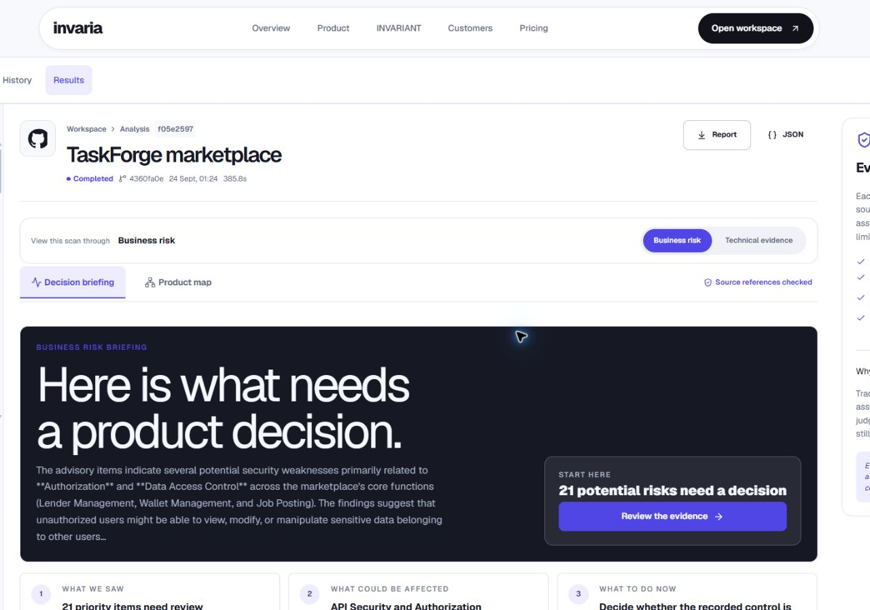
OUR PLATFORM
What is Invaria?
Invaria reads a software repository and gives the team a clear security review.
1
Repository
Connect a GitHub or GitLab project
2
Analysis
Read code, APIs, data, and access rules
3
Report
Show possible risks, proof, and suggested fixes
The dashboard can show both the technical evidence and the business impact.
INVARIA | REVIEW PRESENTATION
Screenshot: live local Invaria workspace, captured 24 Sep 2026
03
Notes:
Source: Invaria Engineering & Product Blueprint, section 2. Screenshot: live local Invaria workspace.
Talk track: This is the product in one sentence. A team connects a repository, Invaria understands the code and important data paths, then it produces a review that a developer or product owner can use.

Slide 4
HOW IT WORKS
From repository to security report
The blueprint describes one simple flow.
1
2
3
4
5
Repository
Scan
App map
Questions
Report
A company connects its code
Invaria reads the code and APIs
It maps users, data, and routes
It asks what could go wrong
It shows evidence and a fix
The LLM helps with reasoning, but the final report must have code and data-flow evidence.
INVARIA | REVIEW PRESENTATION
Source: Invaria Engineering & Product Blueprint
04
Notes:
Source: Invaria Engineering & Product Blueprint, section 2.
Talk track: This slide follows the blueprint exactly. We start with the repository, scan it, build a map of how the application works, ask security questions, verify the evidence, and create a report.

Slide 5
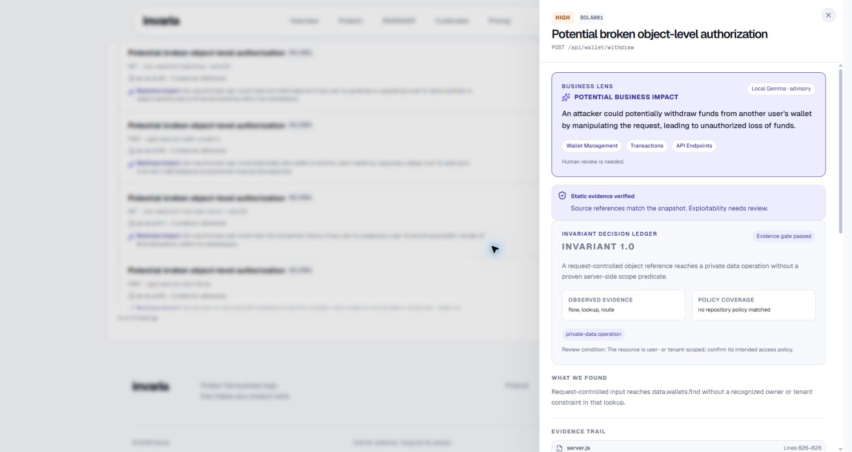
THE INVARIANT ALGORITHM
It checks the rules
that must always be true
An invariant is a simple security rule for the application.
1
User data
A user should only see their own data
2
Money actions
A refund or withdrawal should follow the right checks
3
Secrets
Passwords and keys should not sit in source code
For every possible issue, the tool records the evidence and what a human still needs to check.
INVARIANT follows the code path and checks whether the rule is being followed.
INVARIA | REVIEW PRESENTATION
Screenshot: live INVARIANT decision ledger, captured 24 Sep 2026
05
Notes:
Source: Invaria Engineering & Product Blueprint, sections 2 and 3; docs/INVARIANT_ENGINE.md. Screenshot: live Invaria decision ledger.
Talk track: INVARIANT is the product's decision engine. It starts with a rule, follows the relevant code path, and checks whether the code can prove that the rule is protected. If it cannot, it gives the reviewer the evidence instead of pretending that the issue is already confirmed.

Slide 6
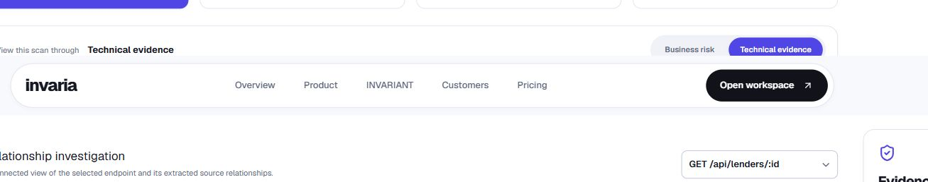
REAL-LIFE EXAMPLES
The same idea works in many applications
Fintech
Healthcare
SaaS
Can a user change a refund or withdraw money that is not theirs?
Can one patient open another patient's medical record?
Can changing an ID reveal another company's files or invoices?
Invaria maps the path from a user request to the sensitive data or action.
Then it asks whether the app has the right security check in that path.
INVARIA | REVIEW PRESENTATION
Source: Invaria Engineering & Product Blueprint, section 3
06
Notes:
Source: Invaria Engineering & Product Blueprint, section 3. Screenshot: live Invaria graph.
Talk track: The blueprint gives these examples because the security idea stays the same across industries. Invaria asks who is making the request, what they are trying to access or change, and whether the code protects that action.

Slide 7
TARGET CUSTOMERS
Who will use Invaria?
THE MAIN USER
Teams that build products with user data, money movement, or important business actions.
Developers and
engineering leads
1
AI-built startups
Fast-moving teams without a dedicated security team
They need a clear answer to one question:
2
SaaS companies
Does this product protect its users and important data?
Teams responsible for keeping customer data separate
3
Fintech products
Teams handling payments, wallets, refunds, or balances
Invaria gives them a focused review before a release or major change.
4
Healthcare products
Teams protecting patient data and access rights
INVARIA | REVIEW PRESENTATION
Source: Invaria Engineering & Product Blueprint
07
Notes:
Source: Invaria Engineering & Product Blueprint, section 3.
Talk track: We start with teams that have real application risk but limited security capacity. The main user is the developer or engineering lead who needs a clear review before releasing a product or an important change.

Slide 8
FUTURE SCOPE
What is built now and what comes next
BUILT NOW
NEXT
Repository scan
Broader coverage
Code and API mapping
Security questions
Evidence-backed reports
More frameworks and languages
Deeper business-flow checks
Suggested fixes and future pull requests
Goal: give every product team a clear, evidence-based security review before they ship.
INVARIA | REVIEW PRESENTATION
Source: Invaria Engineering & Product Blueprint, sections 2 and 4
08
Notes:
Source: Invaria Engineering & Product Blueprint, sections 2 and 4.
Talk track: The blueprint gives us a clear direction. Today the product can scan a repository, map its structure, find supported security issues, and report them. Next we will support more technologies, check deeper workflows, and help teams fix issues through future pull requests.

