Slide 1

MALLA REDDY COLLEGE OF ENGINEERING & TECHNOLOGY
(Autonomous Institution – UGC, Govt. of India)
DEPARTMENT OF COMPUTER SCIENCE AND ENGINEERING
Handwritten Text Recognition
Batch No : 21
M Hrusheekendar Reddy 22N31A05D6
R Manoj kumar 22N31A05K5
K Shashank 23N35A0516
Under the Guidance of
Ms. D. Sai Eswari
Asst. Professor

Slide 2
AGENDA
Abstract
Introduction
Existing system
Proposed system
Software & Hardware Requirements
Literature survey
System architecture
UML Diagrams
Algorithms and technologies
Output screens/ Results
Conclusion
Future scope

Slide 3
Abstract
Handwritten Text Recognition (HTR) converts handwritten text into machine-readable form using machine learning techniques. This project focuses on building an accurate and efficient HTR system to address challenges like varying handwriting styles.
With applications in education, data digitization, and automation, our system aims to improve recognition accuracy using OCR and supervised learning. This presentation outlines the objectives, existing methods, proposed solutions, and technical requirements for developing the HTR system.

Slide 4
Introduction
Handwritten Text Recognition (HTR) bridges the gap between handwritten documents and digital text. It involves identifying and converting handwritten text into a machine-readable format using advanced machine learning algorithms.
The need for HTR has grown with the increasing demand for digitizing handwritten records in fields such as education, healthcare, historical document preservation, and data entry automation.
This project focuses on addressing challenges like varying handwriting styles, noise, and overlapping characters to create a robust and reliable HTR system.

Slide 5
Existing System
The current handwritten text recognition systems predominantly rely on traditional Optical Character Recognition (OCR) techniques. While OCR works well for printed text, it struggles with handwritten inputs due to :
High variability in handwriting styles and sizes
Irregular spacing, overlaps, and connected characters
Inability to process noisy or distorted inputs
Limited contextual understanding, leading to poor recognition accuracy
Dependence on language-specific templates, reducing adaptability

Slide 6
Proposed System
The proposed system introduces an intelligent, machine learning-based approach to handwritten text recognition, overcoming the challenges of traditional OCR systems. Key highlights include:
Deep learning models (e.g., CNNs) for precise feature extraction and sequence prediction.
Attention mechanisms to focus on key parts of the input image for better recognition.
Advanced preprocessing techniques to handle noise, skewness, and uneven character spacing.
Data augmentation strategies to enhance model generalization across diverse handwriting styles.
Real-time processing for fast and efficient recognition in practical applications.
Scalable and robust design ensures high accuracy across diverse handwriting styles.
Performs well even in challenging scenarios like low-quality scans.

Slide 7


Software & Hardware Requirements
Software Requirements :
Programming Language: Python 3.x
Frameworks/Libraries:
TensorFlow or PyTorch (for deep learning)
NumPy, Pandas (for data handling)
OpenCV (for image preprocessing)
Development Environment: Jupyter Notebook or Google Collab
Operating System: Windows 10/11, macOS, or Linux

Slide 8
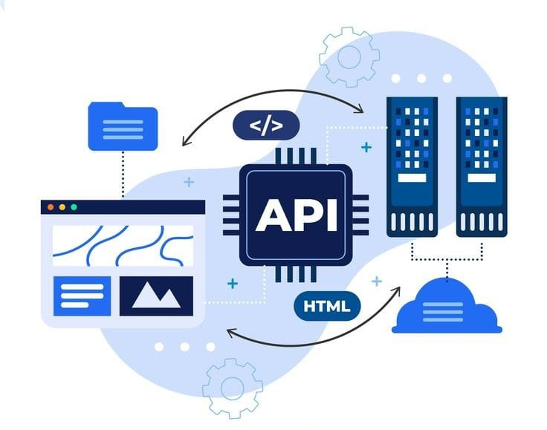
Software & Hardware Requirements
Hardware Requirements :
Processor: Intel i5 or above (or equivalent)
RAM: 8 GB (minimum), 16 GB (recommended)
Storage: 10 GB free space for datasets and models
GPU: NVIDIA GTX 1050 or higher (for training DL models)

Slide 9
Literature Survey
S.No | Author(s) & Journal Details | Title of the paper | Outcome
1 | Singh et al., International Journal of Machine Learning, 2022 | "Handwritten Text Recognition Using CNNs" | Proposed a CNN-based model for HTR; demonstrated improved accuracy over traditional OCR methods.
2 | Lee & Kumar, Journal of Artificial Intelligence, 2021 | "Enhancing Handwritten Text Recognition with RNNs" | Explored the use of RNNs for sequence-based HTR; achieved better recognition of cursive and variable handwriting styles.
3 | Zhang et al., Pattern Recognition Letters, 2020 | "A Survey of Handwritten Text Recognition Techniques" | Reviewed state-of-the-art HTR methods; highlighted the challenges in diverse handwriting recognition and suggested future research directions.

Slide 10
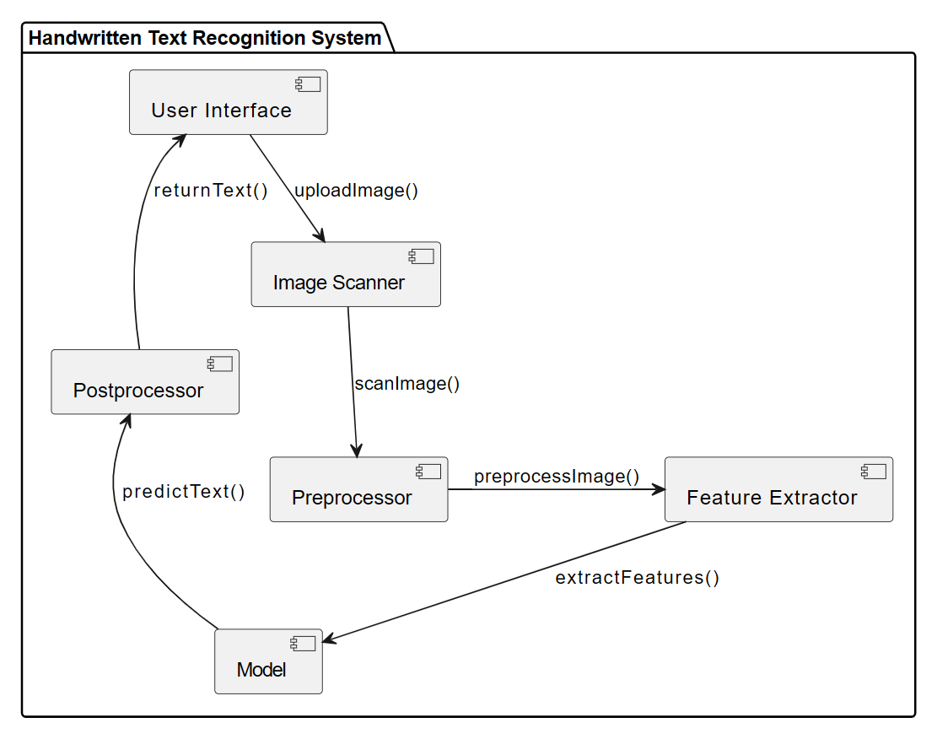
System Architecture

Slide 11
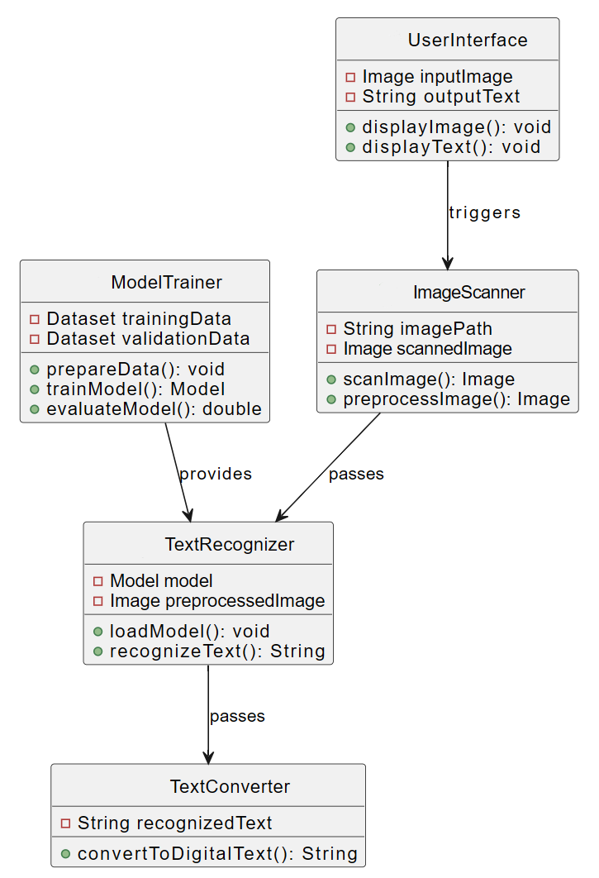
UML Diagrams
Class Diagram :

Slide 12
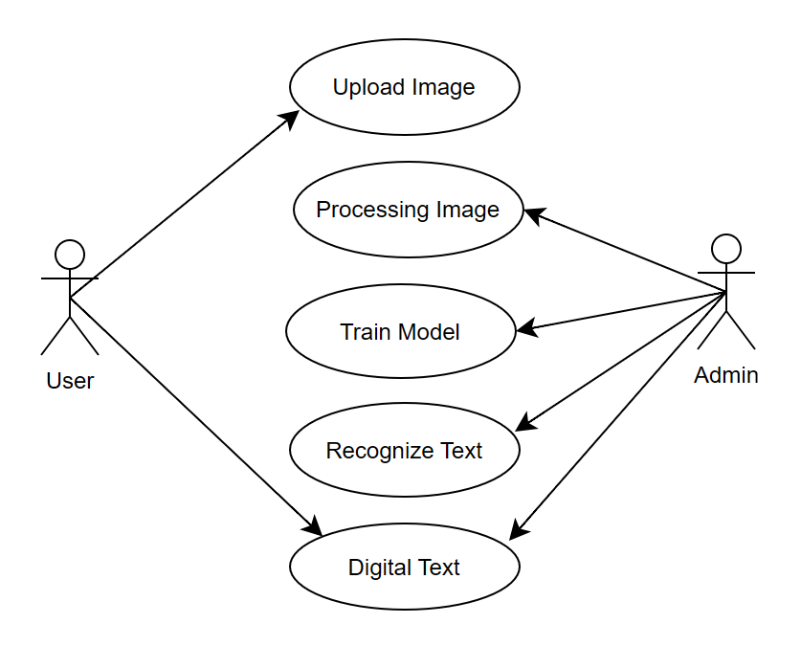
UML Diagrams
Use Case Diagram :

Slide 13
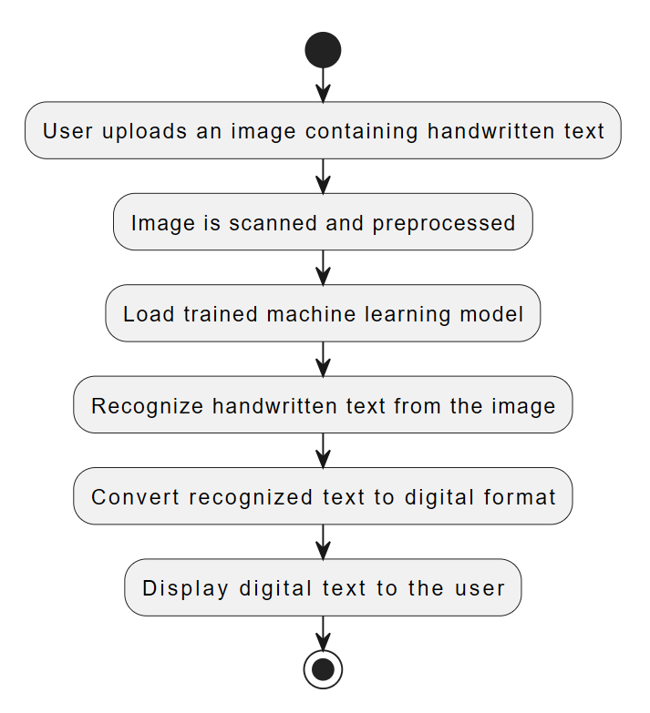
UML Diagrams
Activity Diagram :

Slide 14
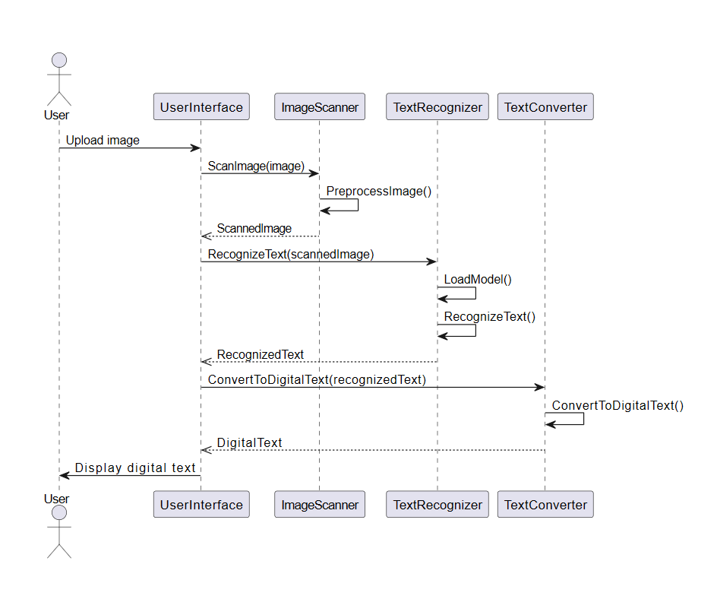
UML Diagrams
Sequence Diagram :

Slide 15


Technologies
Python :
Python is widely used in Machine Learning (ML) and Image Processing due to its simplicity, versatility, and extensive libraries like TensorFlow, OpenCV, and PIL. It offers a rich ecosystem for handling data, training models, and integrating OCR tools efficiently.
Tensorflow / Py Torch:
TensorFlow/PyTorch are powerful frameworks used to build and train deep learning models for accurate handwritten text recognition.

Slide 16
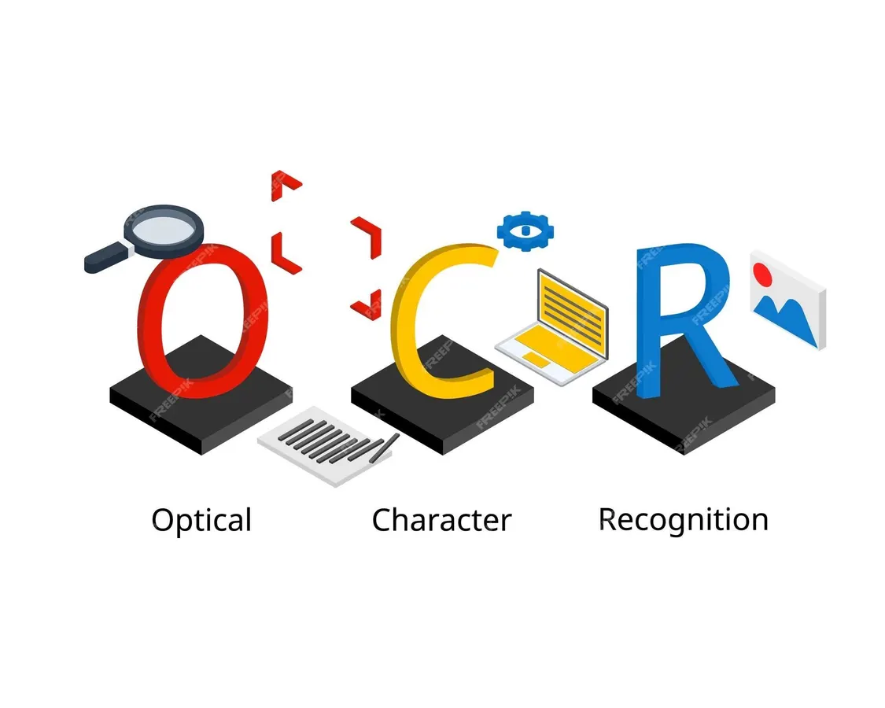

Technologies
OCR Tools :
Tesseract OCR - An open-source OCR engine capable of recognizing various scripts.
EasyOCR - A deep learning-based OCR tool that supports multiple languages, including English.
Image Processing Libraries :
OpenCV - Used for preprocessing images (grayscale conversion, thresholding, noise removal).
PIL (Pillow) - Handles image resizing, format conversions, and enhancements.

Slide 17
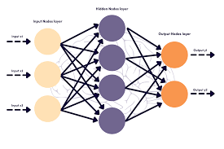

Technologies
Deep Learning Models :
CNN (Convolutional Neural Networks) - Extracts features from handwritten text images.
RNN / LSTM (Recurrent Neural Networks) - Recognizes sequential patterns in text.
Development Environment & Additional Tools :
Jupyter Notebook/Google Collab - Used for writing, debugging, and executing code.
NumPy & Pandas - For numerical computations and dataset handling.
Matplotlib & Seaborn - To visualize model performance and data distribution

Slide 18
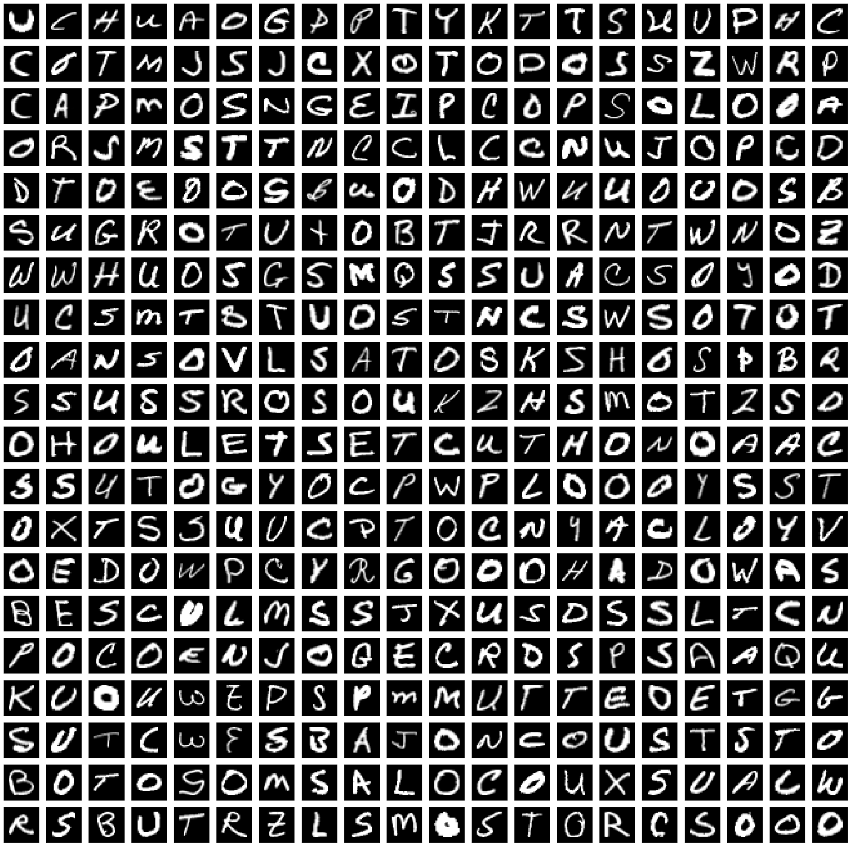
Model Analysis

Slide 19
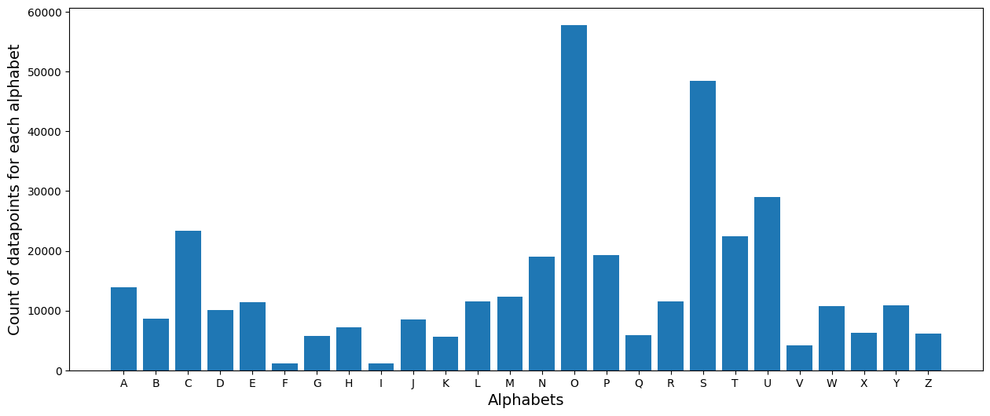
Model Analysis

Slide 20
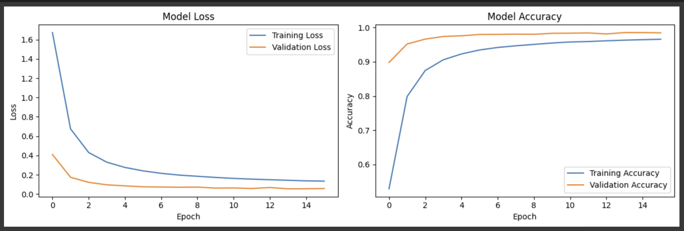
Model Analysis

Slide 21
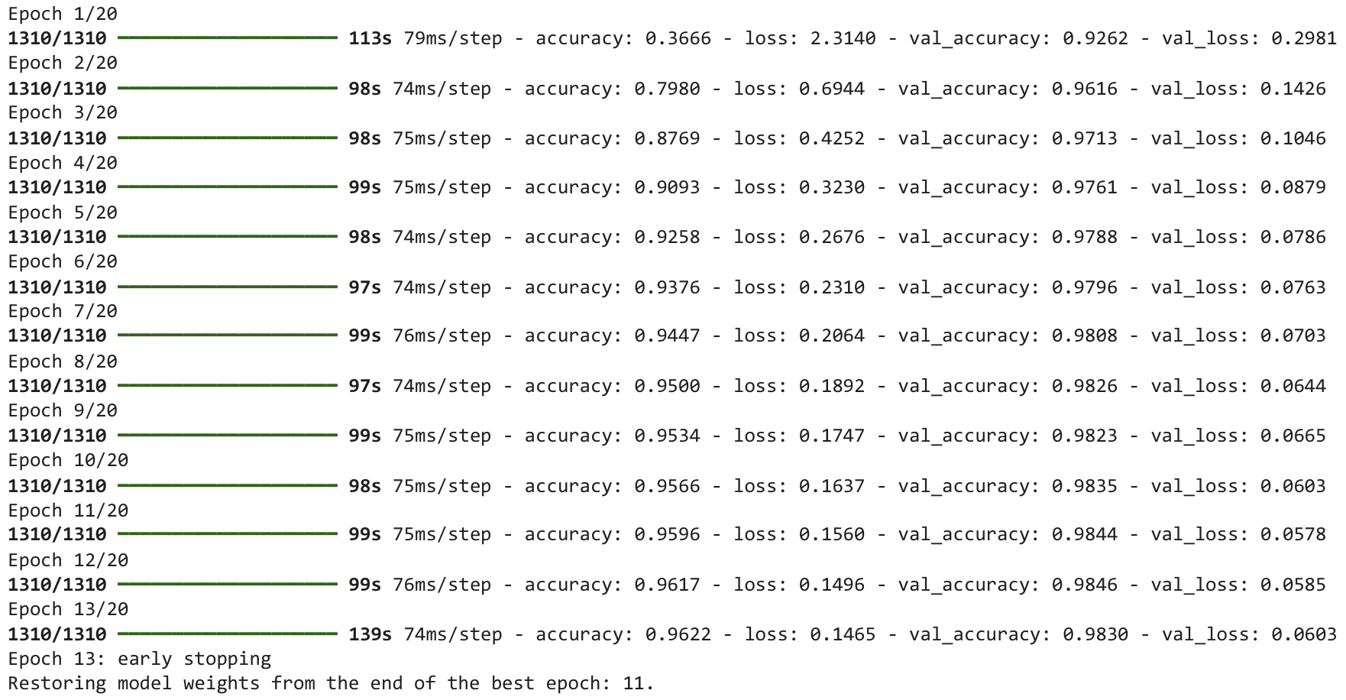
Model Analysis

Slide 22
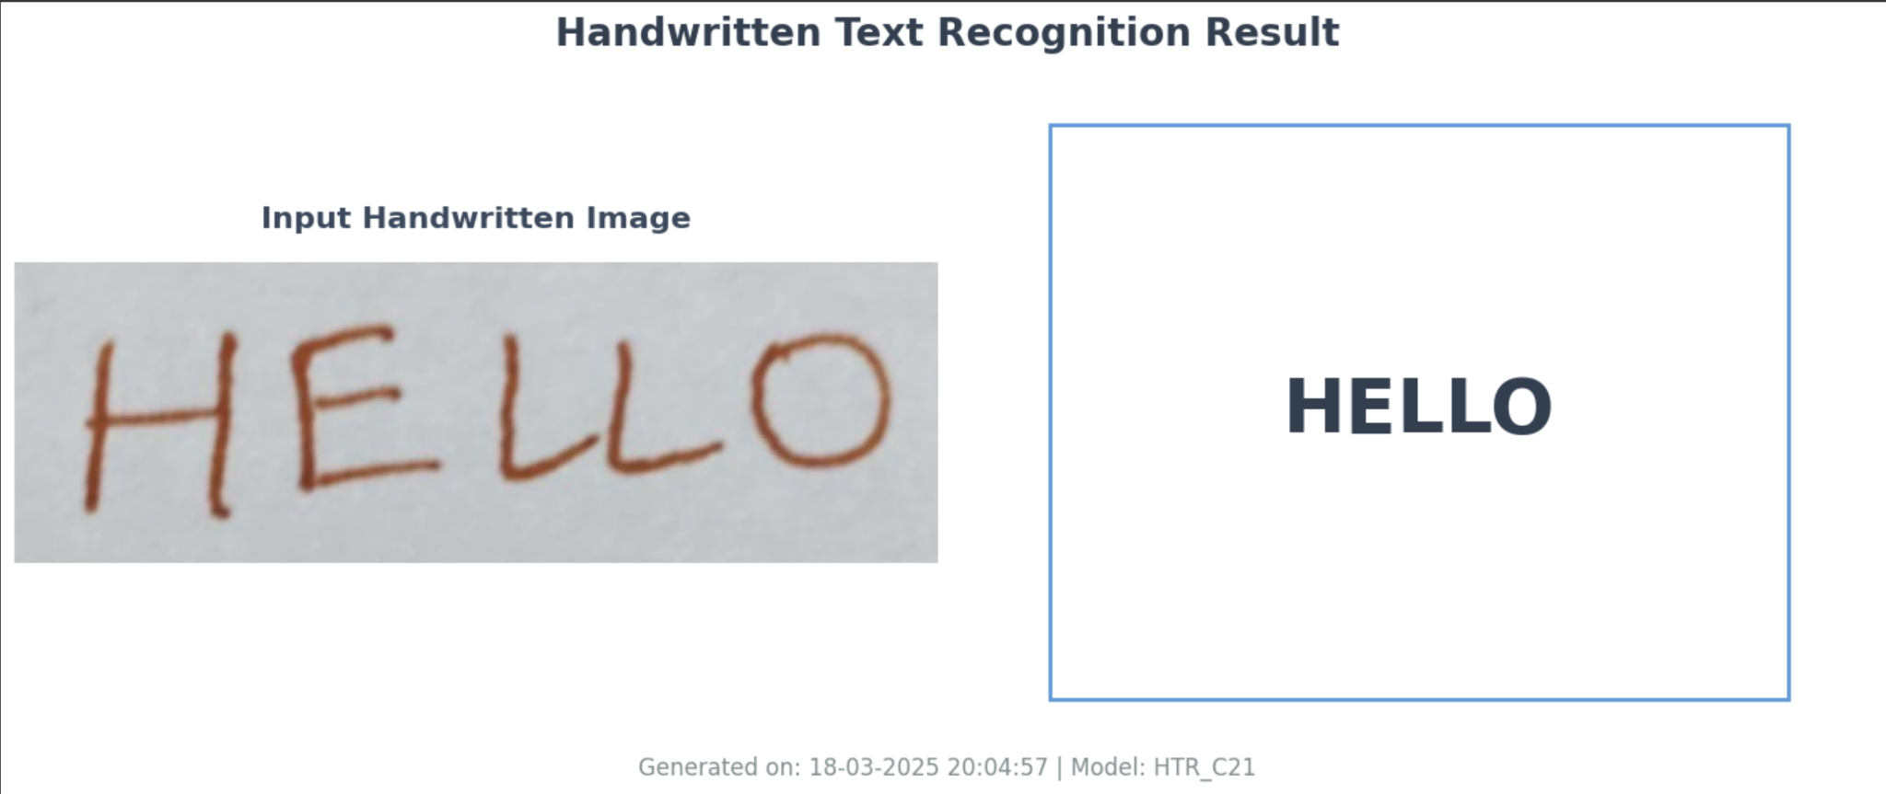
Output Screens

Slide 23
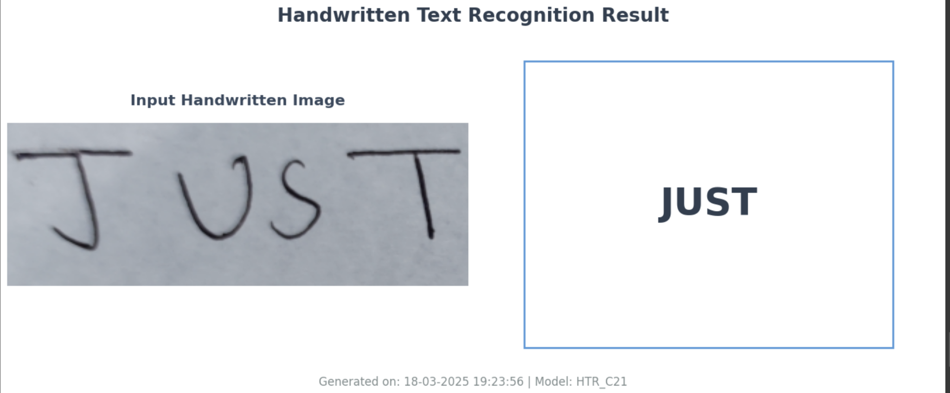
Output Screens

Slide 24
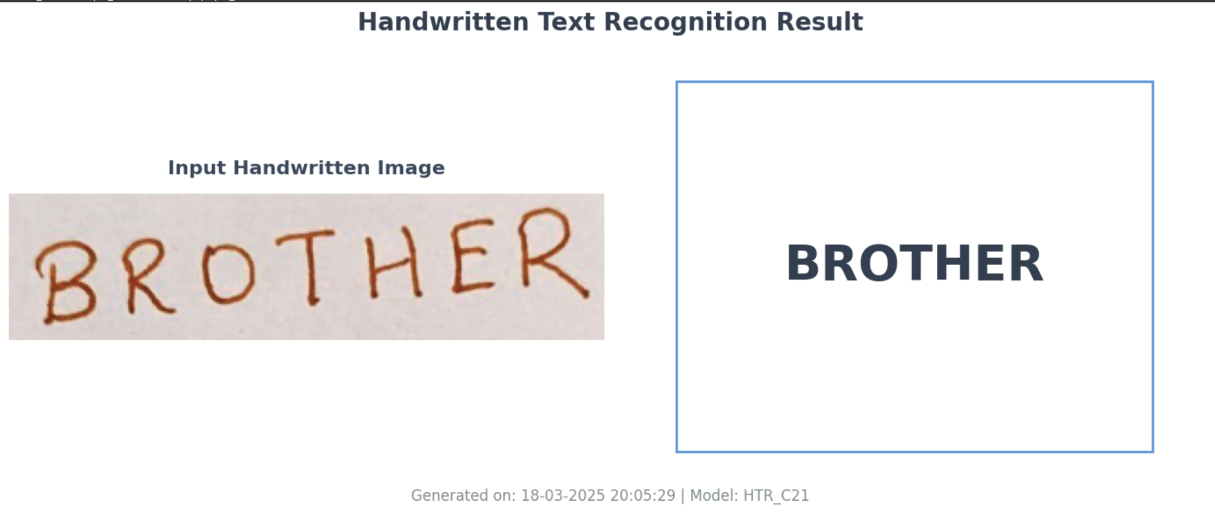
Output Screens

Slide 25
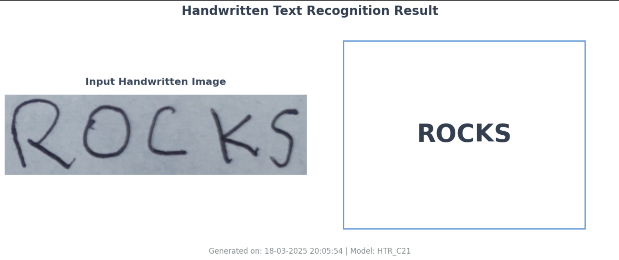
Output Screens

Slide 26
Conclusion
Handwritten Text Recognition (HTR) simplifies text digitization by converting handwritten content into editable digital text.
Our project demonstrates the effectiveness of machine learning models in recognizing and processing handwritten text accurately.
The implementation reduces manual effort, enhances accessibility, and can be extended to various real-world applications.
Future enhancements include improving accuracy with advanced deep learning techniques and expanding support for multiple languages.
Overall, this project contributes to bridging the gap between traditional and digital text processing.

Slide 27
Future Scope
Enhanced Accuracy: Improve recognition accuracy using advanced deep learning models like Transformer-based architectures.
Multi-Language Support: Extend the system to recognize handwritten text in multiple languages.
Real-Time Processing: Optimize the model for faster and real-time text recognition.
Mobile & Web Integration: Develop a mobile or web-based application for easy accessibility.
Dataset Expansion: Train on larger and diverse datasets to handle different handwriting styles.
Error Correction & Context Awareness: Implement NLP-based post-processing to improve text accuracy.

Slide 28
Thank you

