Slide 1



Presented By | Shashank Kumar
Registration ID | RPACULT153
Team Name | -
Team Members | -

Slide 2
“The” RPACULT 2020 – Process Summary Report
Project Title
IntelliGate
Automation Tool Used
BluePrism
Process Brief Description
This project deals with counting the number of people entering/exiting in enclosed spaces. The aim of this project is to automate the task of staff in managing the crowd to maintain social distancing protocols. A live feed from Wyze IP Cam is sent to BluePrism Digital Worker for counting people entering/exiting the space. The bot calculates the number of people inside at real-time using computer vision and transmits the data to ThingSpeak IOT channel. The ThinkSpeak IOT triggers a tweet whenever the people count exceeds maximum limit which the staffs can monitor on their mobile devices. An Arduino microcontroller connected with ESP8266 and LCD screen is used to retrieve feed from the ThingSpeak IOT channel to provide visual indication at the entry gate whenever the building has reached its maximum capacity.
Robot To-Be Design Insight
Applications Used
Name | Type
Wyze IP Cam | Camera
ThingSpeak IOT, Twitter | Cloud IOT Service, Messaging
TinkerCAD, RGB_LCD.js | Circuit Simulator/LCD Emulator
Data Gathering
Wyze IP Cam through RTSP protocol
Data Processing
BluePrism, OpenCV, ThingSpeak IOT
Estimated Benefits (Optional)
Quantitative
① Manual Processing time per case (min) | xx
② Number of cases per month | xx
③ FTE capacity creation (①*②/9,600) | xx
Qualitative
Comments: Automated AI powered crowd management Helps in social distancing to stop COVID spread Frees up staff to perform store related activities (such as in malls, etc.)
Application Interaction
Video Frames
Robot Outcome
LCD Display Output / Tweet to manage crowd in enclosed spaces

Slide 3



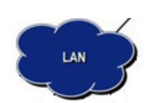


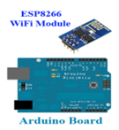



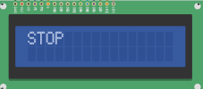
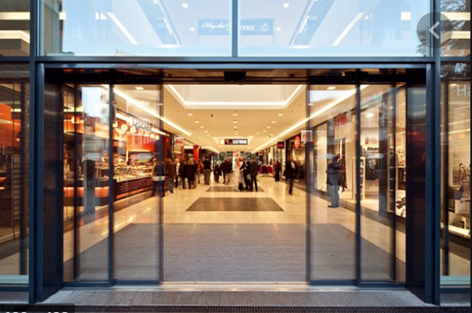
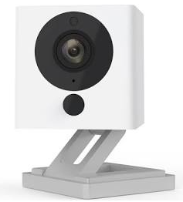
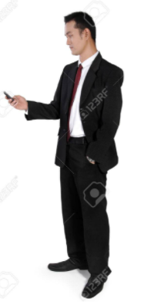
System Architecture

Slide 4
Future Work
Connect multiple Wyze IP camera for multi-entrance enclosed spaces
Control door open/close through IOT

