Slide 1

IE 643
End-term Review
Transfer Learning from Speaker Veriﬁcation
to Multispeaker Text-To-Speech Synthesis
170050005 - Yateesh Agarwal
170050031 - Shashank Kumar
170050050 - Mahesh Lomrar

Slide 2

Outline
Problem
Work done before mid-term review
Mid-term review comments
Working on comments
Work done after mid-term review
Results
Future directions
Conclusions
References

Slide 3
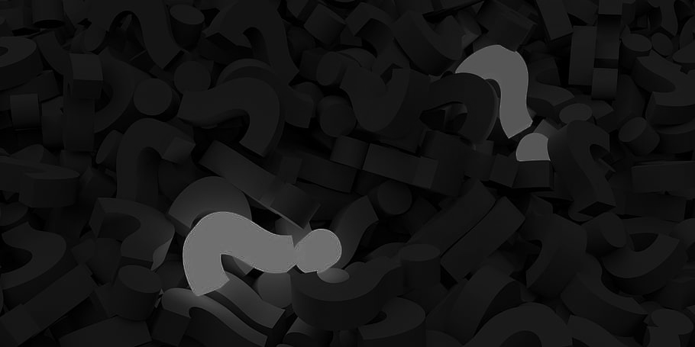
Work done before Mid-term Review
History
Related papers and architectures
Understanding architecture proposed
Working with code and datasets available
Experiments conducted in the paper
Proposed modifications

Slide 4
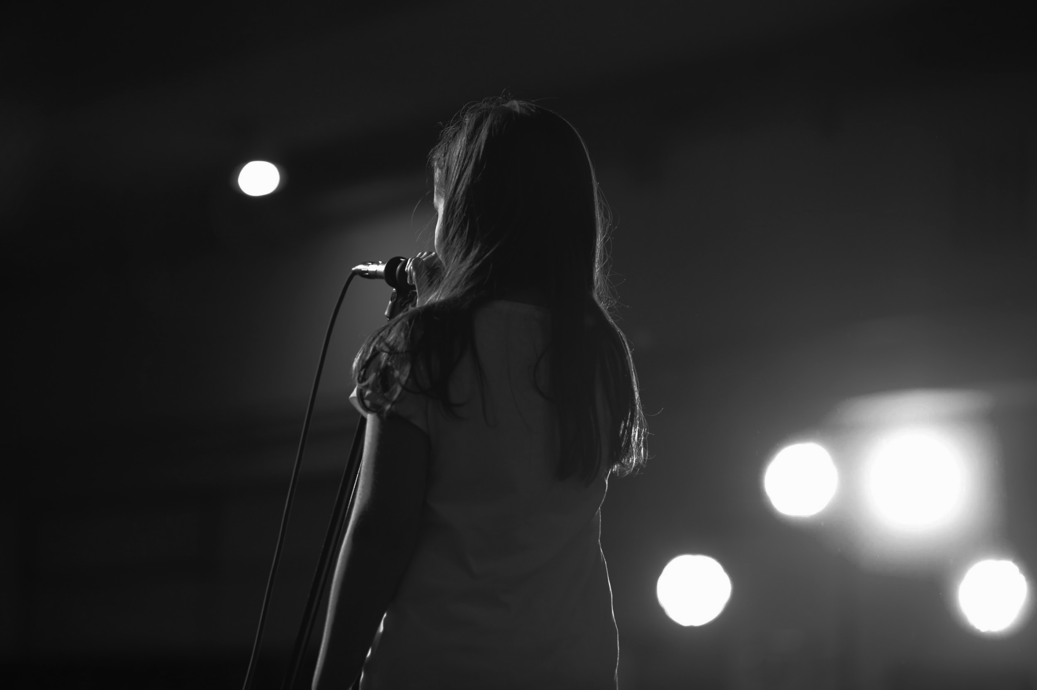
Mid-term review comment
Missing discussion of previous architectures
Initial experiments and proposed modifications are satisfactory

Slide 5

Working on comment
Looked into previous works and architectures
Worked on existing modifications
Ideated new changes to the project

Slide 6
Work done after Mid-term Review (Experiment 1)
Setting up the GPU provided to train a new synthesizer
Modification was to take average of speaker embeddings from all audios available of that speaker
This stopped leak of prosodical information from encoder to synthesizer

Slide 7
Work done after Mid-term Review (Experiment 1)
Used the pre-trained models to train further instead of starting from scratch
Experimented with using a combination of embeddings from the same speaker
Trained the pre-trained model for 60k steps on one percent of data

Slide 8
Work done after Mid-term Review (Experiment 2)
LibriSpeech data sounds monotonous and less natural
Introduced emotions into the speech to add naturalness
Augmented base emotion embeddings into the generated speaker embeddings to add to the richness of sound quality

Slide 9
Work done after Mid-term Review (Experiment 2)
We see that frequently pair audios of same emotion with different speaker are more similar than pair of audios of same speaker with different emotions. (122 out of 126)
This shows that audios with same emotions have tendency to cluster together. We can exploit this to get an 'emotion vector'
We get more natural audios when we add happiness to speech

Slide 10
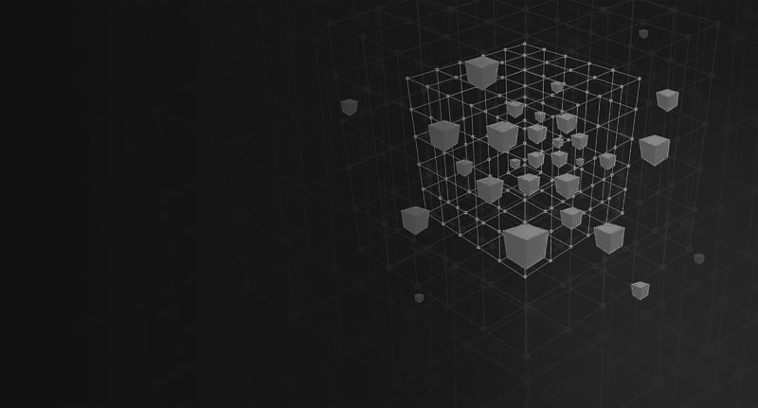
Datasets
LibriSpeech dataset was used after downsampling and trimming to remove silence
Additional datasets used to improve performance were LibriTTS, VoxCeleb and VoxCeleb2
SAVEE dataset was used for further training to incorporate emotions attribute
The dataset consists of voice samples from four people with different emotions
Used it to obtain the base emotion vectors

Slide 11

Replicating Results
For experiment 1, we found almost similar sound being developed from initial and final model,
The reason could be that we only trained for 60k steps on one percent of data, so results are inconclusive
For experiment 2, we randomly sampled actual data points and synthesized speech with augmenting emotion vectors
Survey results show that one has almost comparable result while everyone agreed that in the other two cases, modified ones are more natural

Slide 12
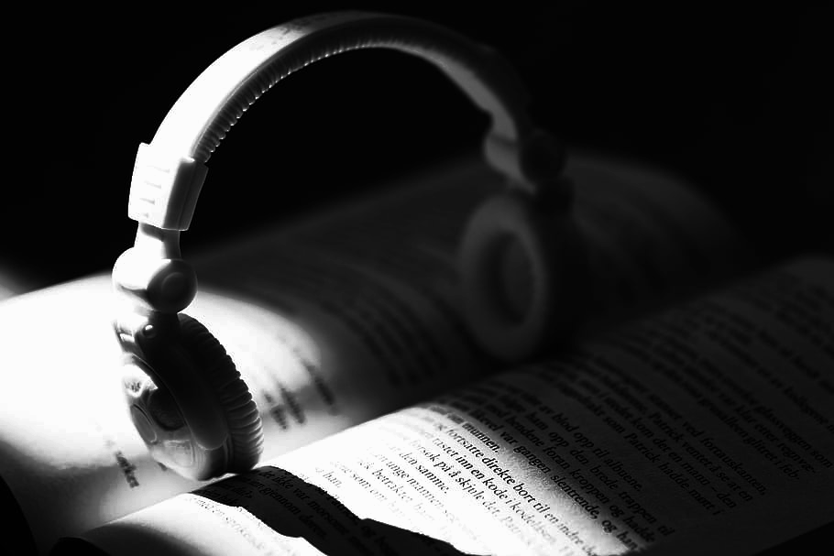
Future Directions
Working towards naturalness of speech by adding pauses and silences
Incorporating emotions into synthesized speech
Working on augmenting multiple emotions to the same speech

Slide 13
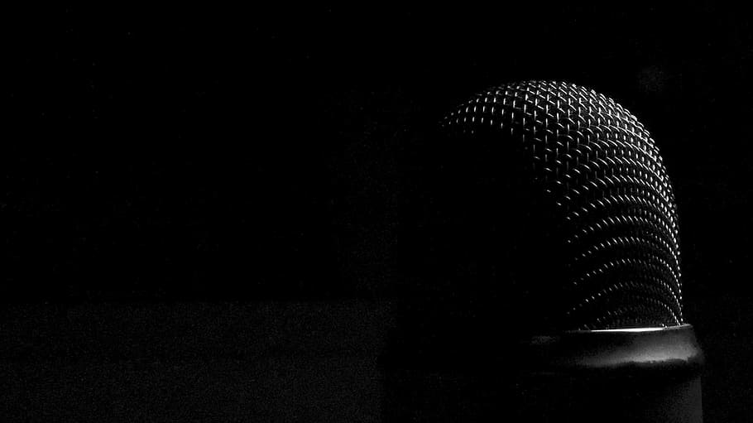
Conclusions
Implemented TTS model for multiple speaker based on the research paper.
The paper aims at zero shot learning that is generating speech for voice unseen during training.
The results obtained are quite substantial in the field of speech synthesis in a plethora of applications.
The synthesized speech looks more realistic which is obtained by adding emotions to the speech in the existing framework.

Slide 14
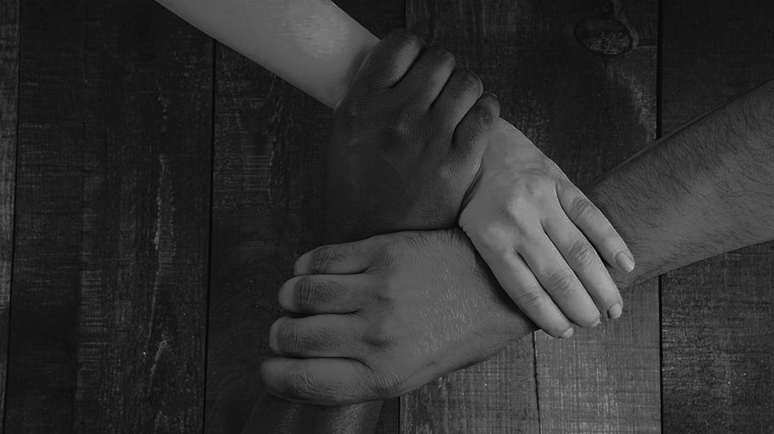
Team Contribution
Every member of the team had equal contribution in the project
Shashank worked on the code setup and training procedure
Yateesh ideated with the modifications by incorporating the emotions
Mahesh worked as a helping hand for the successful completion of the project

Slide 15

References
Transfer Learning from speaker verifications to multispeaker TTS
Github Repository
Generalized end-to-end loss for Speaker Verification
Tacotron2
DeepVoice3
WaveNet

Slide 16
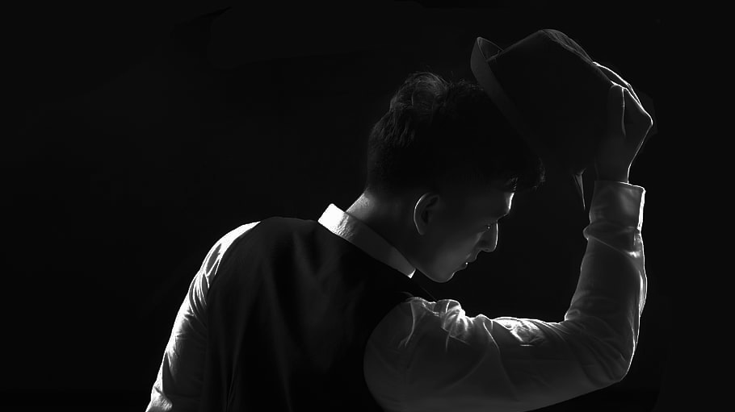
Thank You!

