Slide 2
Benchmarking HelidonMicroProfile
Project Presentation
Shashank Kumar
Summer Intern at Oracle
Enterprise Cloud Native Java
May - June, 2020

Slide 3


Shashank Kumar
B.Tech. (Computer Science)
Indian Institute Of Technology, Bombay

Slide 4
Outline
1
Journey so far
2
Setting the stage
3
Summarizing the results
4
Goals to achieve

Slide 5
Journey so far
Week 1
An insight into the organization
From databases to cloud
Setting up the workspace
Week 2
Transition from campus to corporate
Introduction to Java EE and realted technologies
JDBC
JAX-RS
Servlets
Hikari
Helidon
Week 3
Getting hands dirty
Implemented the tests to benchmark Helidon against TechEmpower Framework Benchmarks

Slide 6
Setting the stage
What is Helidon?
Helidon is a collection of Java libraries for writing microservices
that run on a fast web core powered by Netty.
What is TechEmpower Framework Benchmark (TFB)?
A platform that compares the performance of many web application
frameworks executing fundamental tasks.

Slide 7
How is the framework tested?
TFB tests the framework against the following -
Object instantiation
JSON serialization
Handling simultaneous requests
Random number generation
Database queries and updates
Server side templates
This is just the tip of the iceberg.

Slide 8
Accomplishments made
1
Comparision among different Helidon SE implementations against TFB
2
Implementation of TFB tests for Helidon MP
3
Contrasting the results among Helidon SE and Helidon MP implementations

Slide 9
“A picture is worth a thousand words.”
- Fred R. Barnard

Slide 10
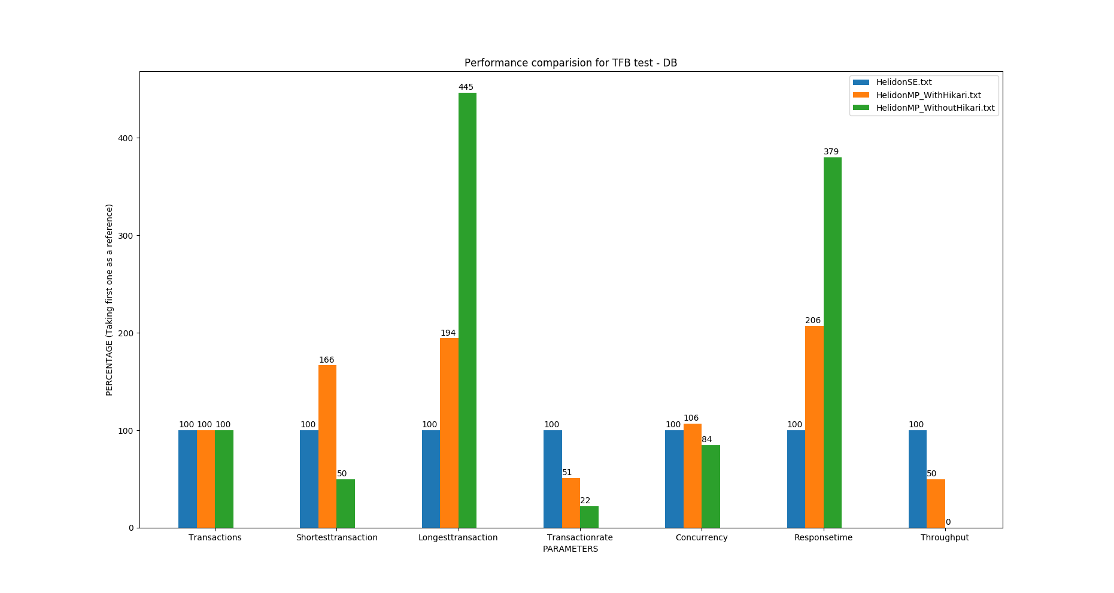
Test Results (Single Query)

Slide 11
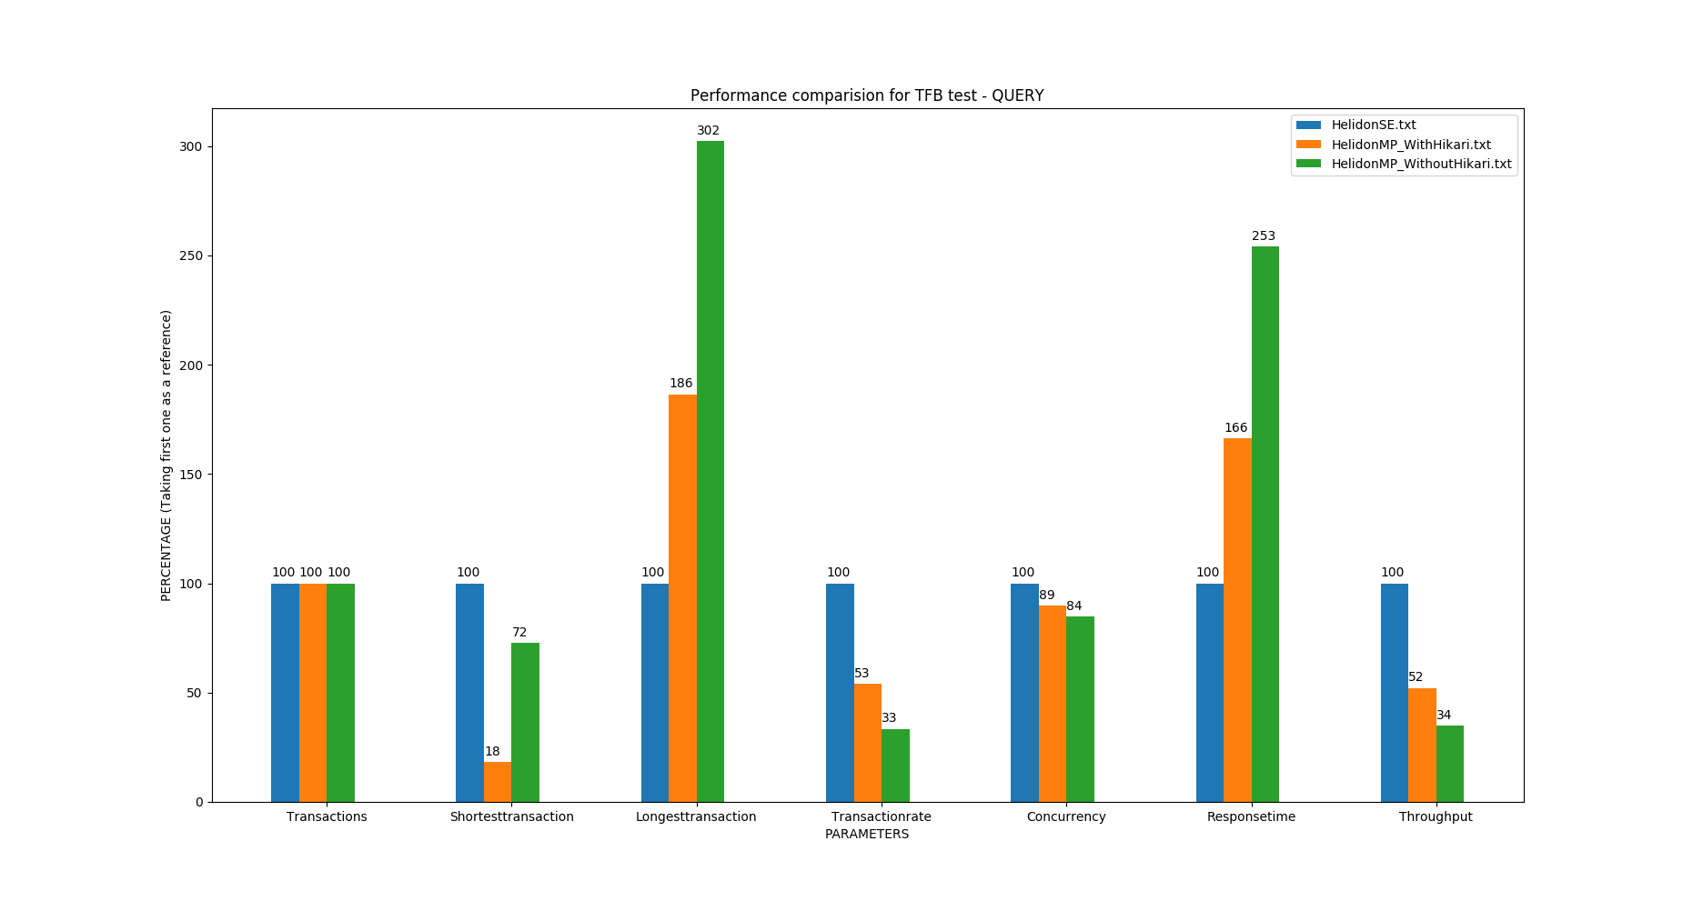
Test Results (Multiple Queries)

Slide 12
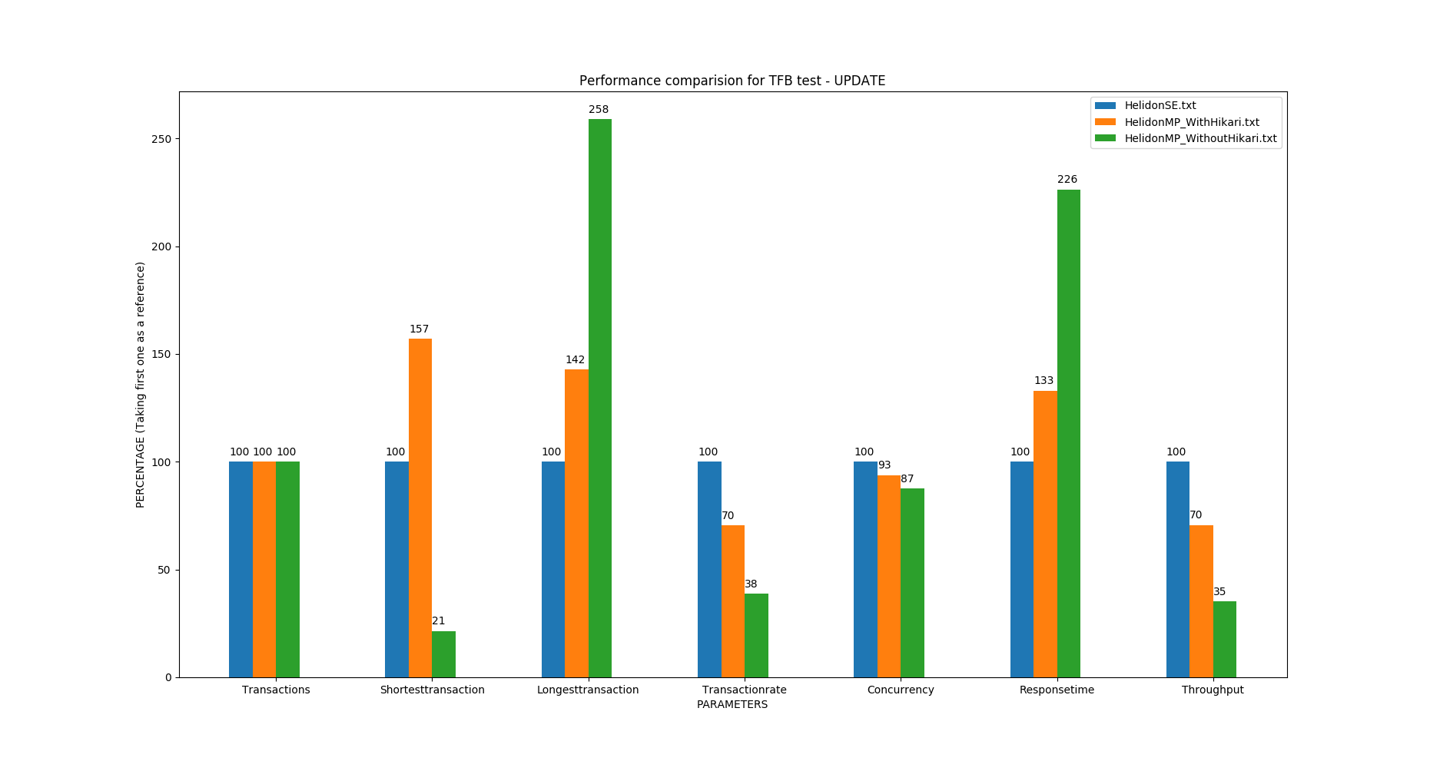
Test Results (Database Updates)

Slide 13
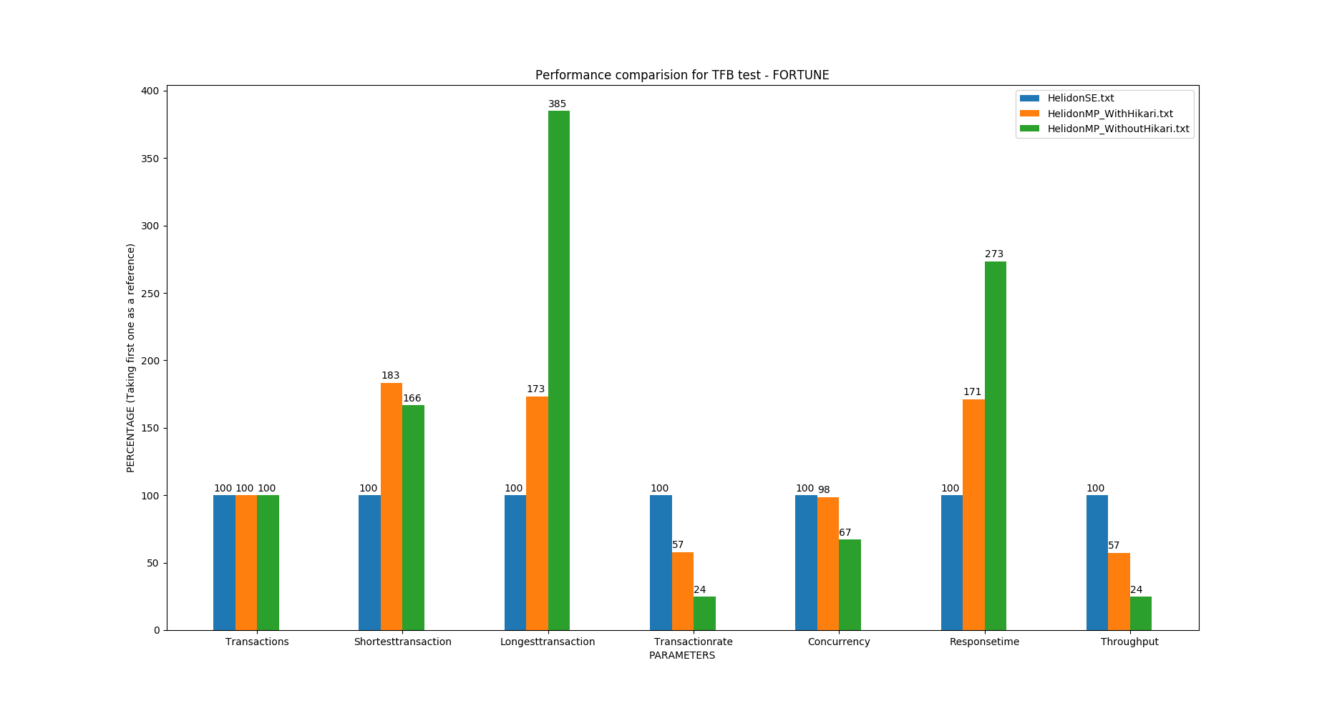
Test Results (Rendering Content To Template)

Slide 14
Goals to achieve
1
Improvising performance of Helidon MP implementation
2
Comparing how different versions of Helidon MP perform
3
Summarizing the results and observations

Slide 15
Q/A Section Ready to take up questions.

Slide 16
Thank You

