Slide 1
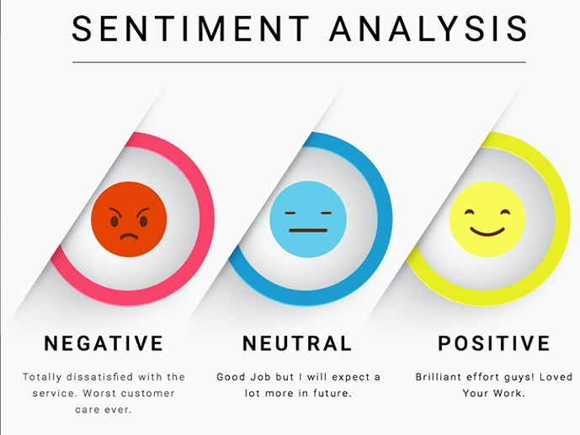
Predict the sentiment
By:
Shashank Mishra
Mandar Phondke
Pratik Patil
Samir Solanki

Slide 2
Objective
Identifying the sentiments about the product/brand can help the business take better actions.
Tweet expressed positive, negative, or no emotion towards a product/brand and labelled accordingly

Slide 3
Data Challenges
Unclean Data:
1) Special Characters
2) Unnecessary links
3) Punctuations
4) Unnecessary Users(eg. @mention)

Slide 4
Approach
EDA
Word Cloud
Removal Stop Words
Performed Count Vectorizer
Model Building

Slide 5
EDA
We removed a special character, links and punctuations using regular expression.
@[A-Za-z]* : to remove @mention
[^a-zA-Z#] : to remove special characters

Slide 6
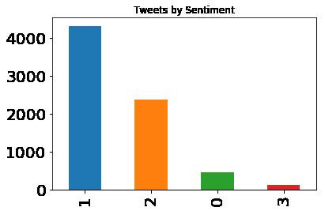
Value Count of Target Training

Slide 7
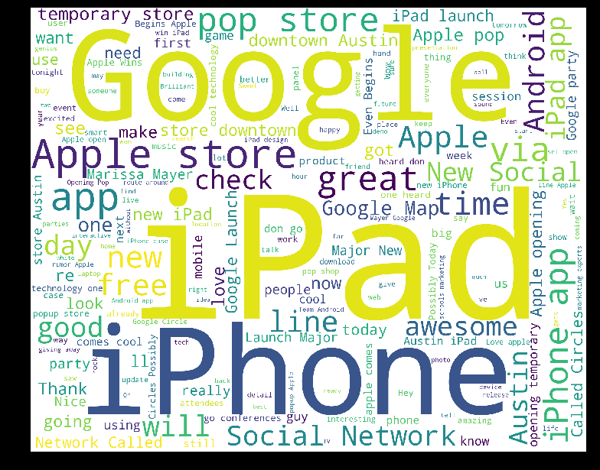
Word Cloud

Slide 8
Model Building
Used One Vs All Classifier(Random Forest)
Metrics for Training : Testing F1 Score : 0.74
Accuracy : 0.9160
Precision : 0.9188
Recall : 0.96
F1 Score : 0.95

Slide 9
Thank You

