Slide 1

UNIT-10 SOFTWARE MANAGEMENT
Er. Deeyoranjan Dongol

Slide 2
Software Project Management
Involves planning, monitoring and control of the person, process and events that occur as software evolves from a primary concept to an operational implementation
Goals of Project Management
Deliver the software to the customer at the agreed time
Keep overall costs within budget
Deliver software that meets the customers expectations
Maintain a happy and well-functioning development team

Slide 3
Difficulties in Project Management
The product is intangible
Large software projects are often “one –off” projects
Software process are variable and organizational specific
Project Management Activities
Project planning
Risk management
People management
Reporting
Proposal writing

Slide 4
Risk Management
Involves anticipating risks that might affect the project schedule, quality of software being developed and then taking action to avoid these risks
Categories of Risk
Project Risks
Affects the project schedule
Product Risks
Affects the quality or performance of software being developed
Business Risks
Affects the organization developing the software

Slide 5
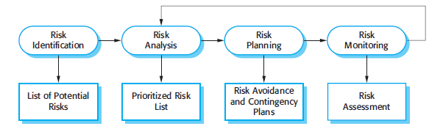

Risk Management Process

Slide 6
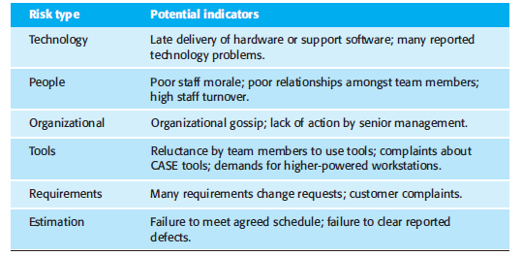
Risk Management Process
Risk Identification

Slide 7
Risk Management Process
Risk Analysis
Assign risk to one of number of bands
The probability of risk might be assessed as very low(<10%), low (10-25%), moderate (25-50%), high (50-75%) or very high (>75%)
The effects of the risk might be assessed as catastrophic, serious, tolerable or insignificant

Slide 8
Risk Management Process
Risk Planning
Three Strategies
Avoidance Strategies
Minimization Strategies
Contingency Plans
Risk Monitoring
Process of checking that the assumptions about the product, process and business risks have not changed

Slide 9
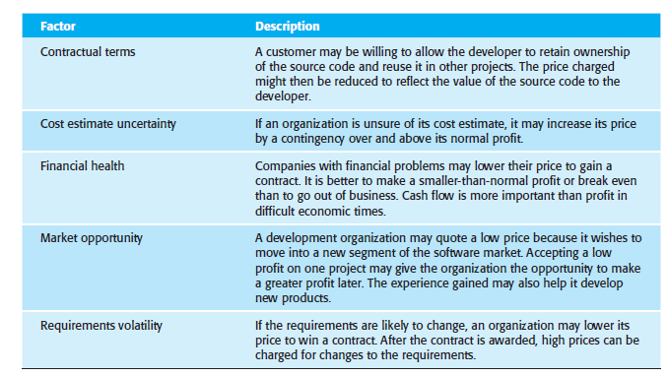

Software Pricing

Slide 10
Plan Driven Development
A project plan is created that records the work to be done, who will do it, the development schedule, and the work products
Project Plan
Project plan sets out the resources available to the project, the work breakdown, and a schedule for carrying out the work

Slide 11
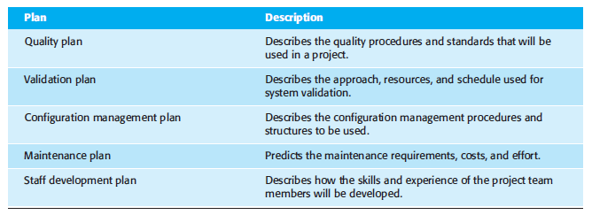
Types of Project Plan

Slide 12
Project Plan Structure
Introduction
Project organization
Risk analysis
Hardware and software resources requirements
Work breakdown
Project schedule
Monitoring and reporting mechanisms

Slide 13
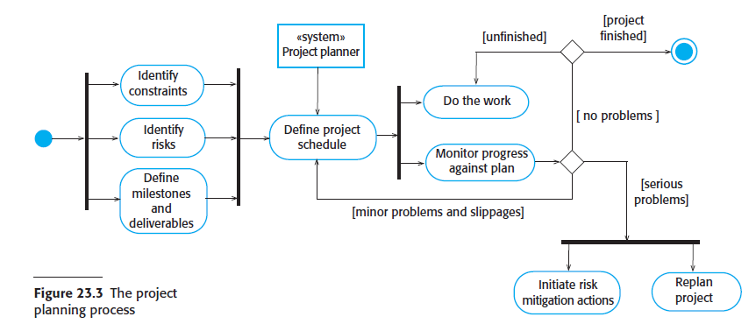
Project Planning Process

Slide 14
Project Scheduling
Split project into tasks and estimate time and resources required to complete each task
Organize tasks concurrently to make optimal use of workforce
Minimize task dependencies to avoid delays
Milestones
End-point of a process activity
Deliverables
Project results delivered to customers

Slide 15
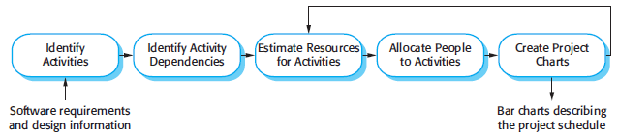

Project Scheduling

Slide 16
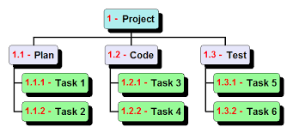
Schedule Representation
Work Breakdown Structure
In "two weeks" rule, nothing is broken down smaller than two weeks worth of work
8/80 rule implies that no task should be smaller than 8 hours of work and should not be larger than 80 hours of work

Slide 17
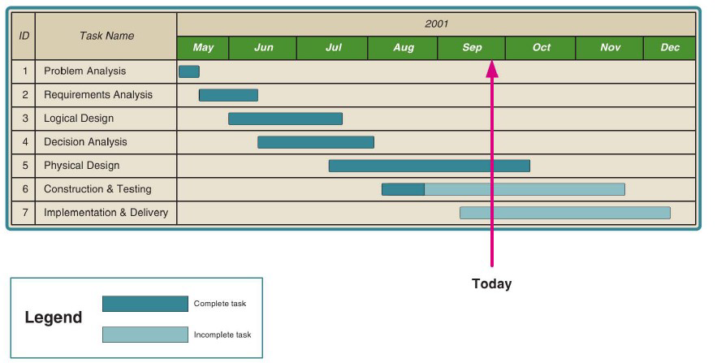
Schedule Representation
GANTT Chart
Developed by Henry L. Gantt
Horizontal bar chart that represents a series of tasks

Slide 18
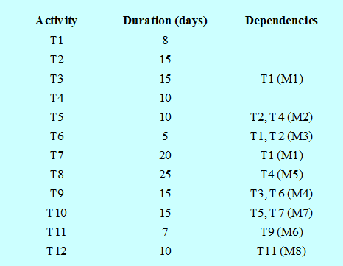
Schedule Representation
Critical Path Method (CPM)
Shows task dependencies and the critical path

Slide 19
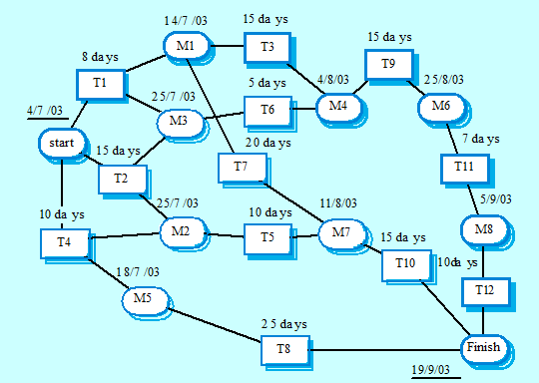
Schedule Representation
Critical Path Method (CPM)

Slide 20
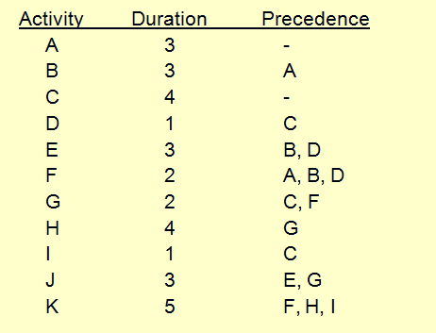
Schedule Representation
Critical Path Method (CPM)

Slide 21
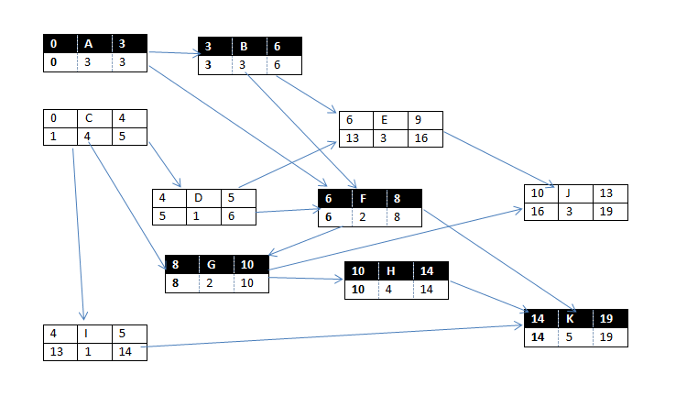

Slide 22
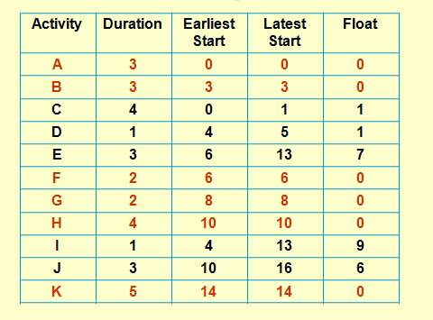
CRITICAL PATH METHOD
Schedule Representation
Critical Path Method (CPM)

Slide 23
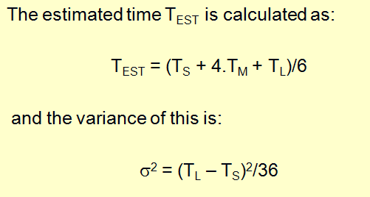
PERT CHART
Schedule Representation
PERT Chart (Project Evaluation Review Technique)
Graphical model that depicts a project’s tasks and relationships between those tasks
Three time estimates optimistic, most likely, pessimistic

Slide 24
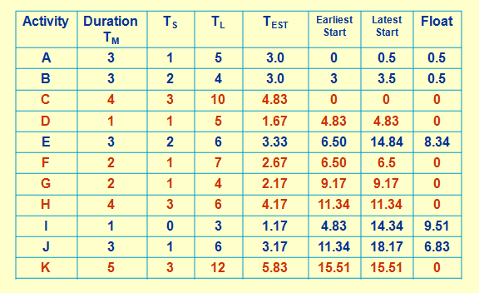
PERT CHART
Schedule Representation
PERT Chart (Project Evaluation Review Technique)

Slide 25
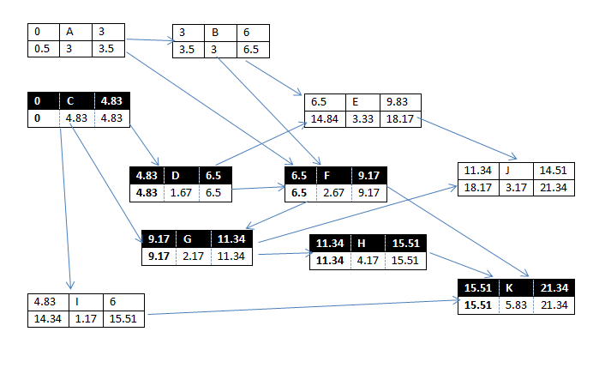

Slide 26
Estimation Techniques
Types of techniques
Experience Based Technique
The estimate of future effort requirements is based on the manager’s experience of past projects and the application domain
The manager makes an informed judgment of what the effort requirements are likely to be
Algorithmic Cost Modeling
In this approach, a formulaic approach is used to compute the project effort based on estimates of product attributes, such as size, process characteristics, and experience of staff involved

Slide 27
Algorithmic Cost Modeling
Uses a mathematical formula to predict project costs based on estimates of the project size, the type of software being developed, and other team, process, and product factors
Developed by analyzing the costs and attributes of completed projects, then finding the closest-fit formula to the actual costs incurred

Slide 28
Algorithmic Cost Modeling
Most algorithmic models for estimating effort in a software project are based on a simple formula:
Effort = A x Size^{B} x M
A: a constant factor, which depends on local organizational practices and the type of software that is developed
Size: an assessment of the code size of the software or a functionality estimate expressed in function or application points
B: represents the complexity of the software and usually lies between 1 and 1.5.
M: is a factor that takes into account process, product and development attributes, such as the dependability requirements for the software and the experience of the development team. These attributes may increase or decrease the overall difficulty of developing the system

Slide 29
COCOMO II
To reflect radical changes in software development approaches such as use of prototyping techniques, incremental approach in software development the original COCOMO model was updated using COCOMO II
Supports spiral model and contains several sub models that produce increasingly detailed estimate
The sub-models of COCOMO II
An Application Composite Model
The Early Design Stage
The Reuse Model
The Post-Architectural Model

Slide 30
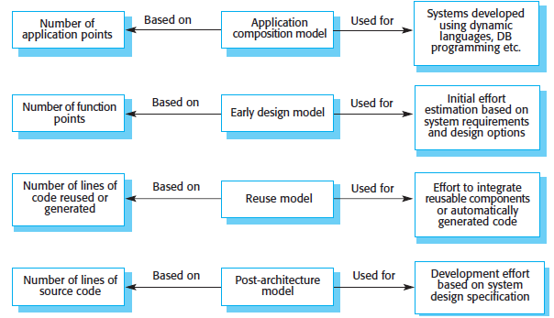
COCOMO II

Slide 31
Sub- Models of COCOMO II
An Application Composite Model
Estimates the efforts required to develop a prototyping project
Supports cost estimation of the projects that are developed using existing component, database programming
Efforts can be estimated using following expression
PM= (NAP*(1-%reuse/100))/PROD
Where, PM is effort in person-month NAP is no of object points % reuse is expected percentage of reuse PROD is productivity

Slide 32
Sub- Models of COCOMO II
The Early Design Stage
Process is moved little forward and developer may try an alternate architecture and not enough information to arrive at accurate estimate
The effort is estimated as, Effort = A*[KLOC]^{B}*M
Where A is constant having value 2.94 and B is constant whose value varies from 1.1 to 2.4 respective
KLOC (size) is kilo lines of code,
M is multiplier given as
M = PERS * RCPX * RUSE * PDIF * PREX * FCIL * SCED
Where, PERS= personnel capability, RCPX = reliability and complexity, Ruse= reuse required, POIF= platform difficulty, PREX= personnel experience, FCIL = support facilities, SCED= schedule
These values are estimated using a six-point scale where 1 corresponds to ‘very low’ and 6 corresponds to ‘very high’

Slide 33
Sub- Models of COCOMO II
The Reuse Model
Estimate effort required to integrate reusable code or automatically generated code
Reuse code are of two types
Black box code: code that can be reused without understanding and modifying it and hence development cost is zero
White box code: Understood and integrated with new code, thus cost is involved
The effort is estimated as,
PM = (ASLOC*AT/100)/ATPROD
Where, ASLOC = no of automatically generated code and reused code
AT = percentage of reused code that is automatically generated
ATPROD = 2400 = productivity of engineers in integrating such code

Slide 34
Sub- Models of COCOMO II
The Post-Architectural Model
System architecture has been designed, size of system can be estimated more accurately
The estimate process uses more extensive set of multipliers
The effort is estimated as,
Effort = a*(KLOC)^{b}*M
The value of the exponent b is therefore based on five factors (precedentedness, Development flexibility, Risk resolution, Team cohesion, Process maturity)
These factors are rated on a six-point scale from 0 to 5, where 0 means ‘extra high’ and 5 means ‘very low’
To calculate b, you add the ratings, divide them by 100, and add the result to 1.01 to get the exponent that should be used

Slide 35
Introduction to Quality Management
Software quality management is concerned with ensuring that developed software systems are “fit for purpose”
Systems should meet the needs of their users, should perform efficiently and reliably, and should be delivered on time and within budget
Software Quality
Reflects how well it complies with or conforms to a given design, based on functional requirements or specifications
Refers to how it meets non-functional requirements that support the delivery of the functional requirements such as robustness or maintainability, the degree to which the software was produced correctly

Slide 36
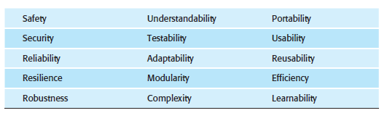
Software Quality Attributes
Software Quality Assurance (SQA)
Process of evaluating the quality of a product and enforcing adherence to software product standards and procedures
Consists of a means of monitoring the software engineering processes and methods used to ensure quality
Organized into goals, commitments, abilities, activities, measurements and verifications

Slide 37
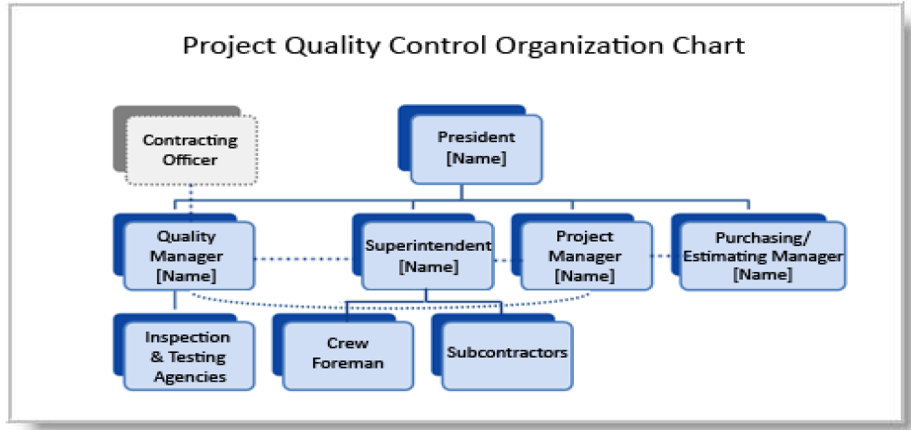
SQA Organizational Structure

Slide 38
Software Quality Assurance (SQA) Activities
Formulating a quality management plan
Applying software engineering techniques
Conducting formal technical reviews
Applying a multi-tiered testing strategy
Enforcing process adherence
Controlling change
Measuring impact of change
Performing SQA audits
Keeping records and reporting

Slide 39
SQA Plan
Management section
Describes the place of SQA in the structure of the organization
Documentation section
Describes each work product produced as part of the software process
Standards, practices and conventions
Lists all applicable standards/practices applied during the software process and any metrics to be collected as part of the software engineering work
Reviews and audits section
Provides an overview of the approach used in the reviews and audits to be conducted during the project

Slide 40
SQA Plan
Problem reporting and corrective action section
Defines procedures for reporting, tracking and resolving errors or defects, identifies organizational responsibilities for these activities
Other
Tools, SQA methods, change control, record keeping, training and risk management
Test section
References test plan and procedure document and defines test record keeping requirements

