Slide 1

UNIT-1 Introduction
Er. Deeyoranjan Dongol

Slide 2
Software
Computer programs and associated documentation [configuration files, System and user documentation]
Software Types
Generic products
Customized (Bespoke) products

Slide 3
Software Types
Generic products
Stand-alone systems that are marketed and sold to any customer who wishes to buy them
The specification of what the software should do is owned by the software developer and decisions on software change are made by the developer
Customized (Bespoke) products
Developed for a single customer according to their specification
The specification of what the software should do is owned by the customer for the software and they make decisions on software changes that are required

Slide 4
Characteristics of a Software
Maintainability
Dependability and Security
Efficiency
Acceptability

Slide 5
Software Engineering
An engineering discipline that is concerned with all aspects of software production from the early stages of system specification through to maintaining the system after it has gone into use
Engineering Discipline
Using appropriate theories and methods to solve problems bearing in mind organizational and financial constraints
All Aspects of Software Production
Not just technical process of development but also project management and the development of tools, methods etc. to support software production

Slide 6
Importance of Software Engineering
More and more, individuals and society rely on advanced software systems. We need to be able to produce reliable and trustworthy systems economically and quickly
It is usually cheaper, in the long run, to use software engineering methods and techniques for software systems rather than just write the programs as if it was a personal programming project. For most types of system, the majority of costs are the costs of changing the software after it has gone into use

Slide 7
Advantages of using Software Engineering
Improved Quality
Improved Requirement Specification
Improved Cost and Schedule Estimation
Improved Reliability
Improved Productivity
Better use of Automated Tools and Techniques
Software Engineering Activities
Software Specification
Software Development
Software Validation
Software Evolution

Slide 8
System
Purposeful collection of interrelated components of different kinds which work together to achieve some objective
System that include software fall into two categories:
Technical Computer-Based System
Socio-technical System
Properties of System
Emergent Properties
Functional Emergent properties
Emerge when the system components are integrated
Non –Functional Emergent properties
Relates to behavior of the system in its operational environment

Slide 9
System and their Environment
Systems are used within organizations and are therefore profoundly affected by the organizational environment in which they are used
Failure to take this environment into account when designing the system is likely to lead to user dissatisfaction and system rejection
Organizational Elements

Slide 10
Organizational Affects
Process changes
Systems may require changes to business processes so training may be required
Job changes
Systems may de-skill users or cause changes to the way they work
Organizational policies
The proposed system may not be consistent with current organizational policies
Organizational politics
Systems may change the political power structure in an organization

Slide 11
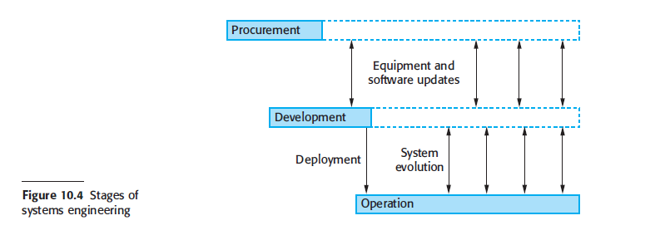
System Engineering
Process that is concerned with specifying a system, integrating its components and testing that the system meets its requirements
Concerned with the whole socio-technical system (software, hardware, and operational processes)not just the system software

Slide 12
System Procurement
Acquiring a system to meet some identified organizational need
Before procurement, decisions are made on
Scope of the system
System budgets and timescales
High level system requirements

Slide 13
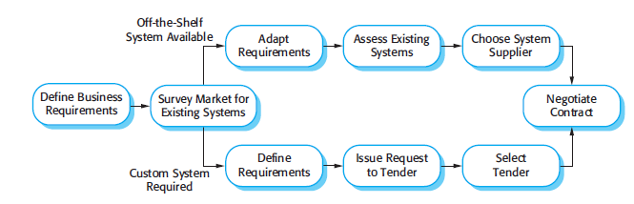

System Procurement

Slide 14
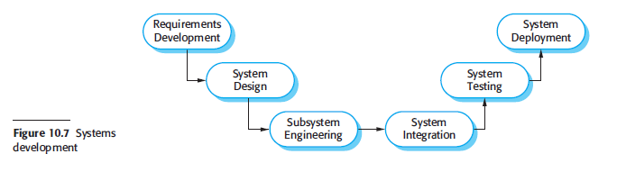
i
System Development
Develop all of the components of a system and then these components are integrated to create a final system
Requirements act as bridge between procurement and development process

Slide 15
System Operation
Operational processes that are involved in using the system for its defined purpose
Operational processes are defined and documented
Operators are trained and other processes are adapted to make effective use of the new system

Slide 16
Software Engineering vs Computer Science
Computer science focuses on theory and fundamentals
Software engineering is concerned with the practicalities of developing and delivering useful software
Software Engineering vs System Engineering
System engineering is concerned with all aspects of computer based systems development including hardware, software and process engineering
Software engineering is part of this more general process

Slide 17
Challenges of Software Engineering
Coping with increasing diversity
Demands for reduced delivery times
Developing trustworthy software
Cost of Software Engineering
Roughly 60% of software costs are development costs, 40% are testing costs
For custom software, evolution costs often exceed development costs

Slide 18
Professional Software Development
People in business write spreadsheet programs to simplify their jobs; scientists and engineers write programs to process their experimental data; hobbyists write programs for their own interest and enjoyment
However, most software development is a professional activity in which software is developed for business purposes, for inclusion in other devices, or as software products such as information systems and computer-aided design systems
The key distinctions are that professional software is intended for use by someone apart from its developer and that teams rather than individuals usually develop the software. It is maintained and changed throughout its life.

Slide 19
Professional Software Development
However, when we are talking about software engineering, software is not just the programs themselves but also all associated documentation, libraries, support websites, and configuration data that are needed to make these programs useful
A professionally developed software system is often more than a single program. A system may consist of several separate programs and configuration files that are used to setup these programs. It may include system documentation, which describes the structure of the system, user documentation, which explains how to use the system, and websites for users to download recent product information

Slide 20
Software Engineering Diversity
Different applications
Stand-alone applications
Interactive transaction based applications
Batch processing systems
Entertainment systems
Systems for modeling and simulation
Data collection and analysis systems

Slide 21
Software Engineering Diversity
The specific methods, tools, and techniques used depend on the organization developing the software, the type of software, and the people involved in the development process
There are no universal software engineering methods that are suitable for all systems and all companies. Rather, a diverse set of software engineering methods and tools has evolved over the past 50 years

Slide 22
Internet Software Engineering
Initially, the web was primarily a universally accessible information store, and it had little effect on software systems. These systems ran on local computers and were only accessible from within an organization
Around 2000, the web started to evolve, and more and more functionality was added to browsers. This meant that web-based systems could be developed where, instead of a special-purpose user interface, these systems could be accessed using a web browser
This led to the development of a vast range of new system products that delivered innovative services, accessed over the web
These are often funded by adverts that are displayed on the user’s screen and do not involve direct payment from users.

Slide 23
Internet Software Engineering
The advent of the web has led to a dramatic change in the way that business software is organized. Before the web, business applications were mostly monolithic, single programs running on single computers or computer clusters
Communications were local, within an organization. Now, software is highly distributed, sometimes across the world. Business applications are not programmed from scratch but involve extensive reuse of components and programs.

Slide 24
Software Engineering Ethics
Confidentiality
Respect the confidentiality of your employers or clients regardless of whether or not a formal confidentiality agreement has been signed
Competence
Never misrepresent your level of competence and accept work that is outside your competence
Intellectual Property Rights
Be aware of local laws governing the use of intellectual property such as patents and copyright
Computer Misuse
Not use technical skills to misuse other people’s computers

