Slide 1
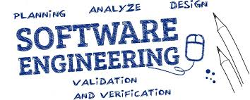
UNIT-2 SOFTWARE PROCESSES
Er. Deeyoranjan Dongol

Slide 2
Software Process
Set of related activities that leads to the production of a software product
These activities may include development of software from scratch
Business software are developed by extending and modifying existing system or configuring and integrating off-the-shelf software or system components
Different Software Process Include below Activities
Software Specification
Software Design and Implementation
Software Validation
Software Evolution

Slide 3
Software Process Models
Simplified representation of a software process
Each process model represents a process from a particular perspective and provides partial information about that process
Different Software Process Models
The Waterfall Model
Incremental Development
Integration and Configuration

Slide 4
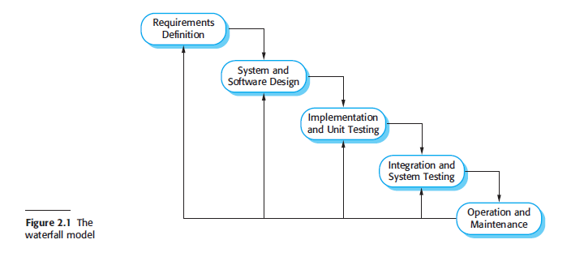
The Waterfall Model

Slide 5
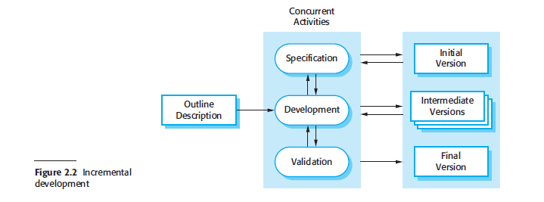
Incremental Development

Slide 6
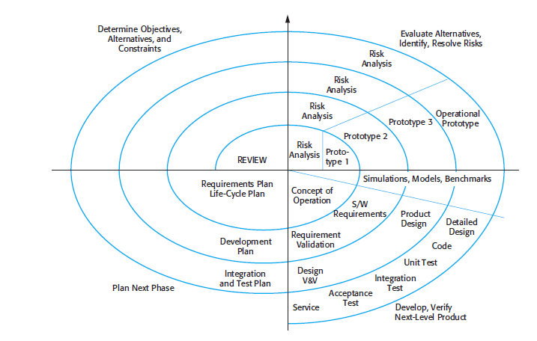
Boehm’s Spiral Model
Each loop in the spiral model is split into four sections
Objective Setting
Risk Assessment & Reduction
Development & Validation
Planning

Slide 7
Benefits of Incremental Development Over Waterfall Model
Cost of accommodating changing customers requirements is reduced
Amount of analysis and documentation that has to be redone is much less
Easier to get customer feedback on the development work that has been done
Rapid delivery and deployment of useful software to the customer even if all of the functionality has not been included
Customers are able to use and gain value from software early

Slide 8
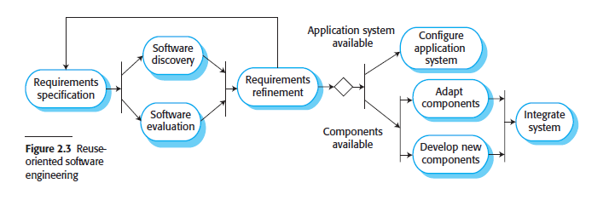
Integration and Configuration
This often happens informally when people working on the project know of or search for code that is similar to what is required. They modify them as needed, and integrate them with the new code that they have developed

Slide 9
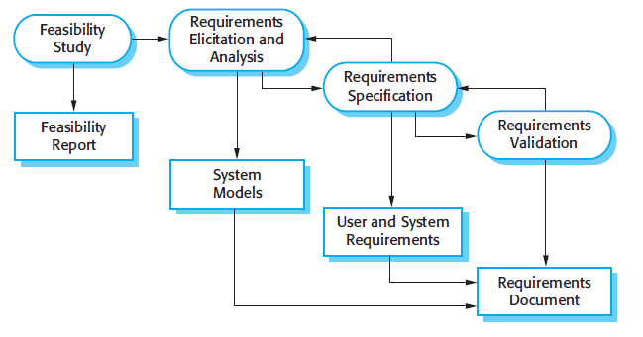

Software Process Activities
Software Specification/Requirements Engineering
The process of understanding and defining what services are required from the system and identifying the constraints on the system’s operation and development

Slide 10
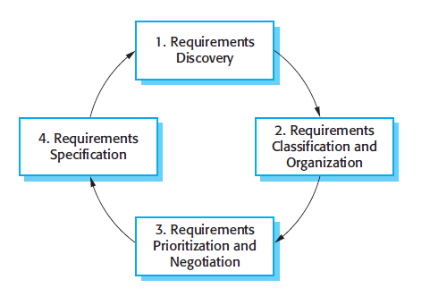

Slide 11
Software Process Activities
Software Design and Implementation
Software design is description of the structure of the software to be implemented, the data models used by the system, the interfaces between software component and algorithm used
The implementation stage of software development is the process of converting a system specification into an executable system

Slide 12
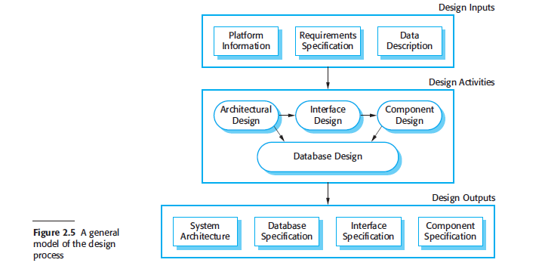
Software Process Activities
Software Design and Implementation

Slide 13
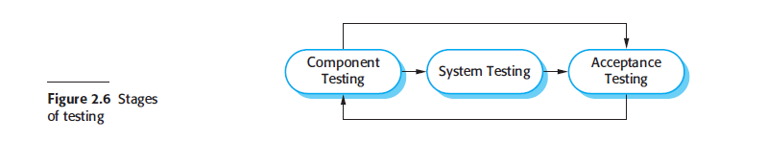
Software Process Activities
Software Validation
Verification & Validation
Intended to show that a system conforms to its specification and meets the requirements of the system customer

Slide 14
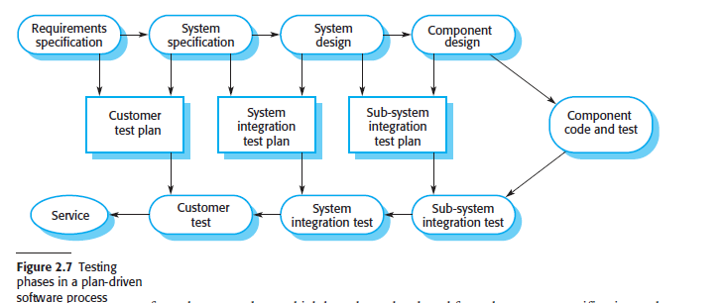
Software Process Activities
Software Validation

Slide 15
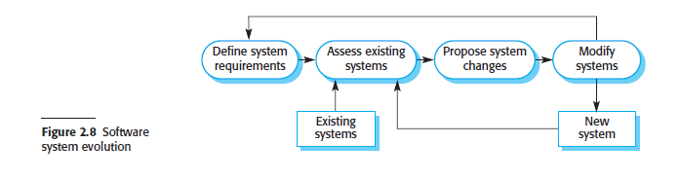
Software Process Activities
Software Evolution

Slide 16
Coping with Change
Two Approaches
System Prototyping
A version of the system or part of the system is developed quickly to check the customer’s requirements and the feasibility of design decisions
Incremental Delivery
System increments are delivered to the customer for comment and experimentation
Supports both change avoidance and change tolerance

Slide 17
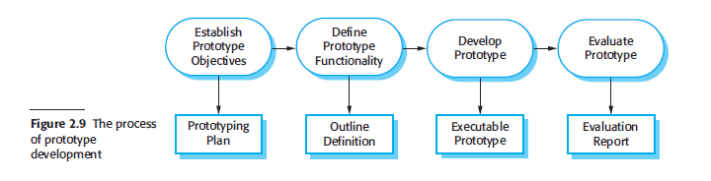
Coping with Change
Prototyping
An initial version of a software system that is used to demonstrate the concepts, try out design options and find out more about the problem and its possible solutions

Slide 18
Prototyping Benefits
Improved system usability
Closer match to the system need
Improved design quality
Improved maintainability
Reduced overall development effort

Slide 19
Evolutionary Prototyping
An approach to system development where an initial prototype is produced and refined through a number of stages to the final system

Slide 20
Throw-Away Prototyping
Usually a practical implementation of the system to help discover requirements problems and then discarded

Slide 21
Rapid Prototyping Techniques
Dynamic High-level Language Development
Database Programming
Component And Application Assembly

Slide 22
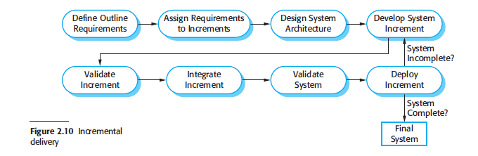
Coping with Change
Incremental Delivery
An approach to software development where some of the developed increments are delivered to the customer and deployed for use in an operational environment

Slide 23
Process Improvement
Approaches to process improvement and change
The Process Maturity Approach
Focused on improving process and project management and introducing good software engineering practice into an organization
The level of process maturity reflects the extent to which good technical and management practice has been adopted in organizational software development processes

Slide 24
Process Improvement
Approaches to process improvement and change
The Agile Approach
Focused on iterative development and the reduction of overheads in the software process
The primary characteristics of agile methods are rapid delivery of functionality and responsiveness to changing customer requirements

Slide 25
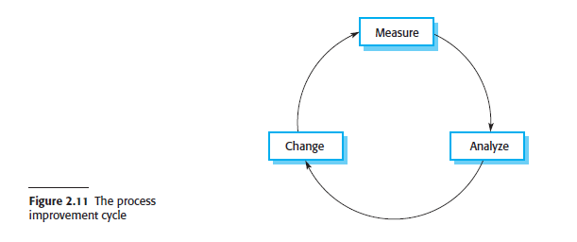
Process Improvement

Slide 26
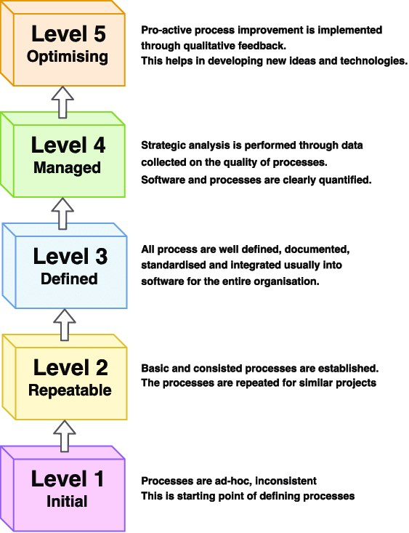
Process Capability Maturity Model

