Slide 1

UNIT-3 agile SOFTWARE development
Er. Deeyoranjan Dongol

Slide 2
Agile
The ability to create and respond to change
A way of dealing with, and ultimately succeeding in, an uncertain and turbulent environment
Agile Software Development
Refers to a group of software development methodologies based on iterative development, where requirements and solutions evolve through collaboration between self-organizing cross-functional teams

Slide 3
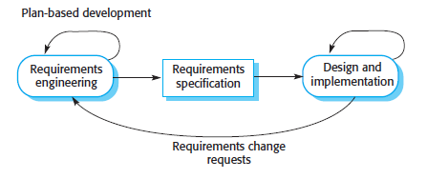
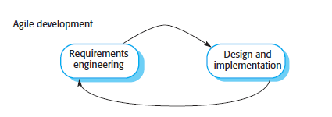
Plan-Driven Development vs Agile Development

Slide 4
Plan-Driven Development vs Agile Development
In a plan-driven software development process
Iteration occurs within activities, with formal documents used to communicate between stages of the process
For example, the requirements will evolve, and, ultimately, a requirements specification will be produced which is then an input to the design and implementation process
In an agile approach
Iteration occurs across activities
The requirements and the design are developed together rather than separately

Slide 5
Agile Methods
Promote a disciplined project management process that encourages frequent inspection and adaptation, a leadership philosophy that encourages teamwork, self-organization and accountability, a set of engineering best practices intended to allow for rapid delivery of high-quality software, and a business approach that aligns development with customer needs and company goals

Slide 6
Principles of Agile Methods
Customer Involvement
Embrace Change
Incremental Delivery
Maintain Simplicity
People, Not Process

Slide 7
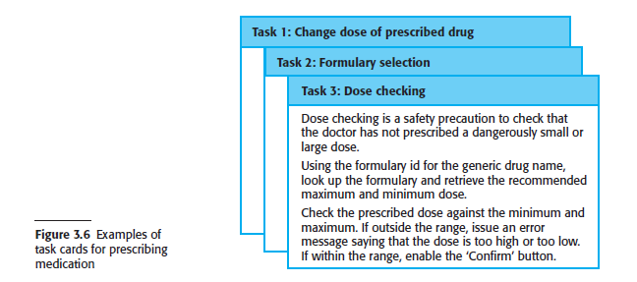
Agile Development Techniques
User Stories
A scenario of use that might be experienced by a system user

Slide 8
Agile Development Techniques
Refactoring
Process of changing a software system in such a way that it does not alter the external behavior of the code yet improves its internal structure
Examples of refactoring
The reorganization of a class hierarchy to remove duplicate code
The tidying up and renaming of attributes and method
The replacement of similar code sections, with calls to methods defined in a program library

Slide 9
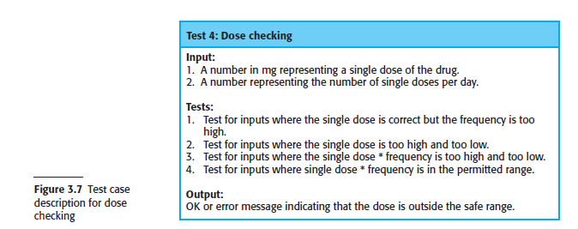
Agile Development Techniques
Test-First Development
You write the unit tests before you write the code to test
Run the test as the code is being written and discover problems during development

Slide 10
Agile Development Techniques
Pair Programming
Two developers work using only one machine
One programmer acts as the driver who codes while the other will serve as the observer who will check the code being written, proofread and spell check it, while also figuring out where to go next
These roles can be switched at any time: the driver will then become the observer and vice versa
Pair Programming Advantages
Two heads are better than one
More efficient and fewer coding mistakes
Efficient way to share knowledge
Develop staff interpersonal skills

Slide 11
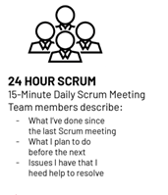
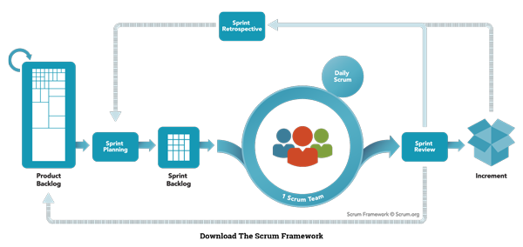
Introduction to Agile Project Management
SCRUM
3-5-3 Concept

