Slide 1
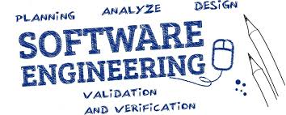
UNIT-5 SYSTEM MODELING
Er. Deeyoranjan Dongol

Slide 2
System Modeling
The process of developing abstract models of a system, with each model presenting a different view or perspective of that system
System modeling now usually means representing a system using some kind of graphical notation based on diagram types in the Unified Modeling Language (UML)
Models are used
During the requirements engineering process to help derive the detailed requirements for a system
During the design process to describe the system to engineers implementing the system
After implementation to document the system’s structure and operation

Slide 3
Context Models
During specification of system decide system boundaries i.e. what is and what is not part of system being developed
This involves working with system stakeholders to decide what functionality should be included in the system and what processing and operations should be carried out in the system’s operational environment
Context models normally show that the environment includes several other automated systems. However, they do not show the types of relationships between the systems in the environment and the system that is being specified
External systems might produce data for or consume data from the system. They might share data with the system, or they might be connected directly, through a network or not connected at all

Slide 4
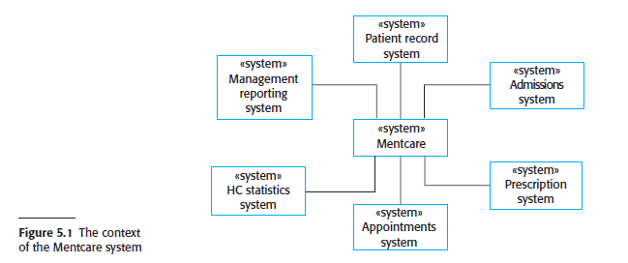
Context Models

Slide 5
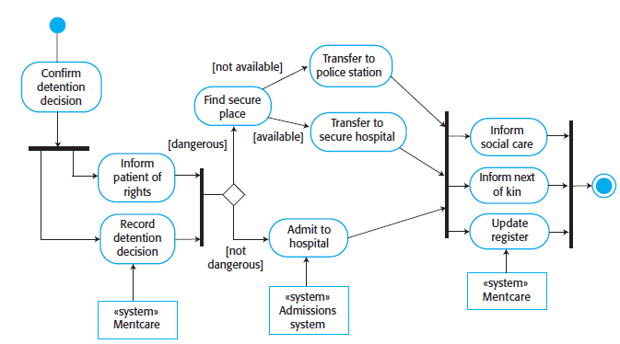

Context Models

Slide 6
Interaction Models
All systems involve interaction of some kind which can be
User interaction which involves user inputs and outputs
Helps to identify user requirements
Interaction between the software being developed and other systems in its environment
Highlights the communication problems that may arise
Interaction between the components of a software system
Helps us understand if a proposed system structure is likely to deliver the required system performance and dependability

Slide 7
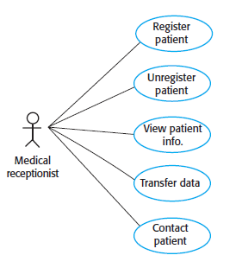

Interaction Models
Use Case Modeling
Used to model interactions between a system and external agents (human users or other systems)

Slide 8
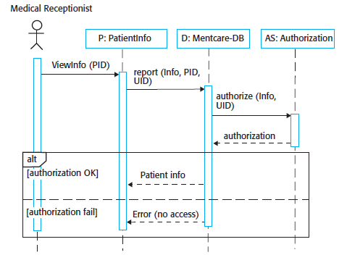

Interaction Models
Sequence Diagram
Notes:
You can read Figure 5.6 as follows:
1. The medical receptionist triggers the ViewInfo method in an instance P of the
PatientInfo object class, supplying the patient’s identifier, PID to identify the
required information. P is a user interface object, which is displayed as a form
showing patient information.
2. The instance P calls the database to return the information required, supplying
the receptionist’s identifier to allow security checking. (At this stage, it is not
important where the receptionist’s UID comes from.)
3. The database checks with an authorization system that the receptionist is authorized
for this action.
4. If authorized, the patient information is returned and is displayed on a form on
the user’s screen. If authorization fails, then an error message is returned. The
box denoted by “alt” in the top-left corner is a choice box indicating that one of
the contained interactions will be executed. The condition that selects the choice
is shown in square brackets.

Slide 9
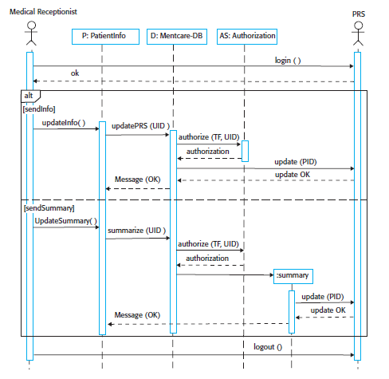

Interaction Models
Sequence Diagram
Notes:
You can read this diagram 5.7
as follows:
1. The receptionist logs on to the PRS.
2. Two options are available (as shown in the “alt” box). These allow the direct
transfer of updated patient information from the Mentcare database to the
PRS and the transfer of summary health data from the Mentcare database to
the PRS.
3. In each case, the receptionist’s permissions are checked using the authorization
system.
4. Personal information may be transferred directly from the user interface object
to the PRS. Alternatively, a summary record may be created from the database,
and that record is then transferred.
5. On completion of the transfer, the PRS issues a status message and the user logs off.

Slide 10
Structural Models
Display the organization of a system in terms of the components that make up that system and their relationships
Structural models may be
Static models
Shows the organization of the system design
Dynamic models
Shows the organization of the system when it is executing

Slide 11
Structural Models
Class Diagrams
Used when developing an object-oriented system model to show the classes in a system and the associations between these classes
Loosely, an object class can be thought of as a general definition of one kind of system object
An association is a link between classes indicating that some relationship exists between these classes

Slide 12
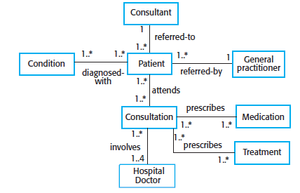
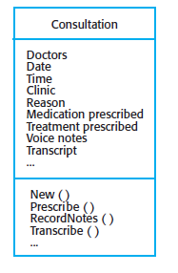


Structural Models
Class Diagrams

Slide 13
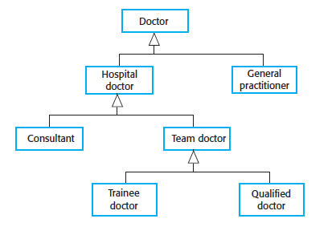

Structural Models
Class Diagrams
Generalization

Slide 14
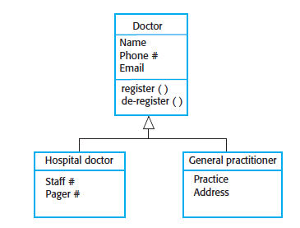

Structural Models
Class Diagrams
Generalization

Slide 15
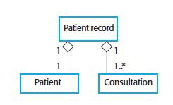

Structural Models
Class Diagrams
Aggregation

Slide 16
Behavioral Models
Models of the dynamic behavior of a system as it is executing
Show what happens or what is supposed to happen when a system responds to a stimulus from its environment
These stimuli may be either data or events:
Data becomes available that has to be processed by the system and its triggers the processing
An event happens that triggers system processing

Slide 17
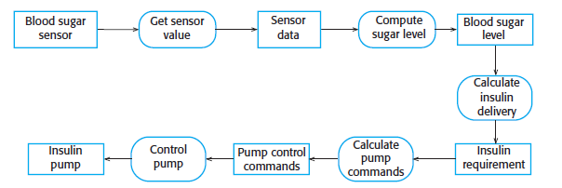

Behavioral Models
Data-Driven Modeling
Show the sequence of actions involved in processing input data and generating an associated output
Used during the analysis of requirements as they show end-to-end processing in a system
Data Flow Diagram

Slide 18
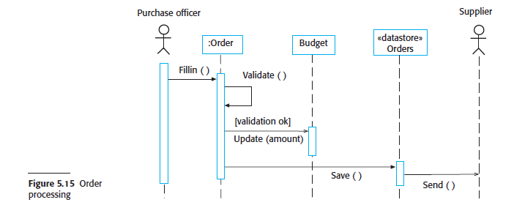
Behavioral Models
Data-Driven Modeling

Slide 19
Behavioral Models
Event-Driven Modeling
Shows how a system responds to external and internal events
Based on the assumption that a system has a finite number of states and that events (stimuli) may cause a transition from one state to another

Slide 20
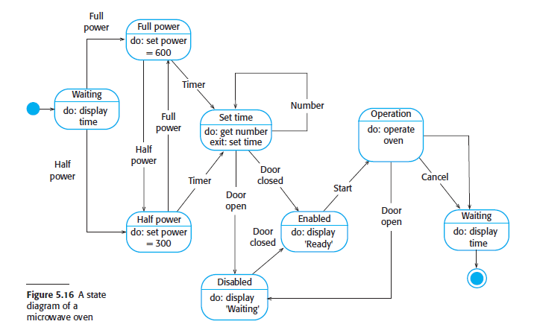
Behavioral Models
Event-Driven Modeling
Notes:
From Figure 5.16, you can see that the system starts in a waiting state and
responds initially to either the full-power or the half-power button. Users can change
their minds after selecting one of these and may press the other button. The time is
set and, if the door is closed, the Start button is enabled. Pushing this button starts the
oven operation, and cooking takes place for the specified time. This is the end of the
cooking cycle, and the system returns to the waiting state.

Slide 21
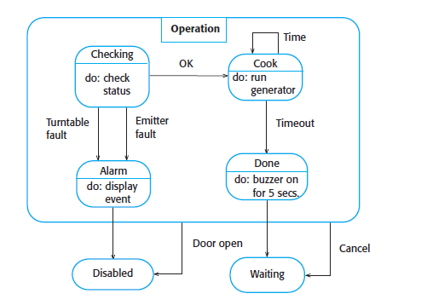

Behavioral Models
Event-Driven Modeling
“Superstate”
Notes:
From Figure 5.16, you can see that the system starts in a waiting state and
responds initially to either the full-power or the half-power button. Users can change
their minds after selecting one of these and may press the other button. The time is
set and, if the door is closed, the Start button is enabled. Pushing this button starts the
oven operation, and cooking takes place for the specified time. This is the end of the
cooking cycle, and the system returns to the waiting state.

Slide 22
Model Driven Architecture
Model-focused approach to software design and implementation that uses a subset of UML models to describe a system
The MDA method recommends that three types of abstract system model should be produced
Computation Independent Model (CIM)
Platform-Independent Model (PIM)
Platform-Specific Model (PSM)

Slide 23
Model Driven Architecture
Computation Independent Model (CIM)
Model the important domain abstractions used in a system and so are sometimes called domain models
Platform-Independent Model (PIM)
Usually described using UML models that show the static system structure and how it responds to external and internal events
Platform-Specific Model (PSM)
Transformations of the platform-independent model with a separate PSM for each application platform

Slide 24
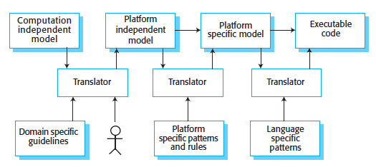
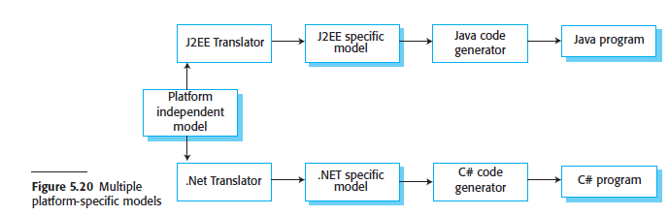
Model Driven Architecture

