Slide 1

UNIT-7 DESIGN & IMPLEMENTATION
Er. Deeyoranjan Dongol

Slide 2
Design and Implementation
The stage in the software engineering process at which an executable software system is developed
Software design and implementation activities are invariably interleaved
Software design is a creative activity in which you identify software components and their relationships, based on a customer’s requirements
Implementation is the process of realizing the design as a program

Slide 3
Buy or Build
In wide range of domains, it is possible to buy off-the-shelf systems that can be adapted and tailored to the users requirements
For example, for implementing a medical records system, one can buy a package that is already used in hospitals which can be cheaper and faster to use rather than developing a system in a conventional programming language
Developing an application in this way, the design process becomes concerned with how to use the configuration features of that system to deliver the system requirements

Slide 4
Object Oriented Design Using UML
There are a variety of different object-oriented design processes that depend on the organization using the process
Common activities in these processes include:
Understand and define the context and the external interactions with the system
Design the system architecture
Identify the principal system objects
Develop design models
Specify interfaces

Slide 5
System Context and Interactions
Understanding the relationships between the software that is being designed and its external environment is essential for deciding how to provide the required system functionality and how to structure the system to communicate with its environment
Understanding of the context also lets to establish the boundaries of the system
Setting the system boundaries helps to decide what features are implemented in the system being designed and what features are in other associated systems

Slide 6
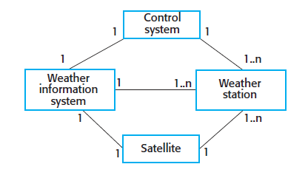

System Context and Interactions
A system context model is a structural model that demonstrates the other systems in the environment of the system being developed
An interaction model is a dynamic model that shows how the system interacts with its environment as it is used

Slide 7
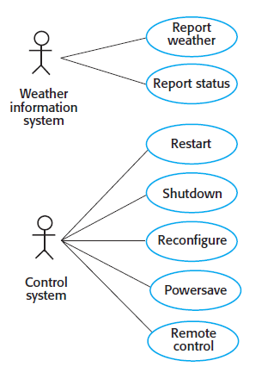

System Context and Interactions

Slide 8
Architectural Design
Once interactions between the system and its environment have been understood, you use that information for designing the system architecture
You identify the major components that make up the system and their interactions, and then may organize the components using an architectural pattern such as a layered or client-server model
The weather station is composed of independent subsystems that communicate by broadcasting messages on a common infrastructure

Slide 9
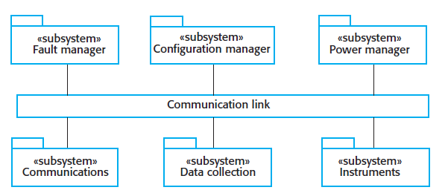

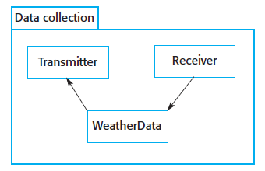

Architectural Design

Slide 10
Object Class Identification
There is no 'magic formula' for object identification
It relies on the skill, experience and domain knowledge of system designers
Approaches to object identification
Use a grammatical approach based on a natural language description of the system
Base the identification on tangible things in the application domain
Use a behavioral approach and identify objects based on what participates in what behavior
Use a scenario-based analysis. The objects, attributes and methods in each scenario are identified

Slide 11
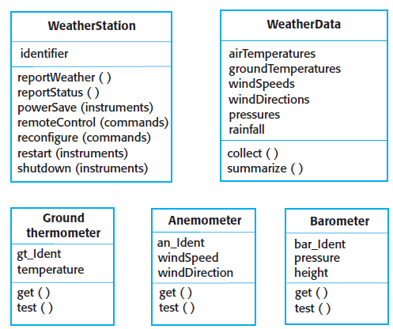

Object Class Identification

Slide 12
Design Models
Design models show the objects and object classes and relationships between these entities
There are two kinds of design model
Structural models describe the static structure of the system in terms of object classes and relationships
Dynamic models describe the dynamic interactions between objects

Slide 13
Examples of Design Models
Subsystem models that show logical groupings of objects into coherent subsystems
Sequence models that show the sequence of object interactions
State machine models that show how individual objects change their state in response to events
Other models include use-case models, aggregation models, generalization models, etc.

Slide 14
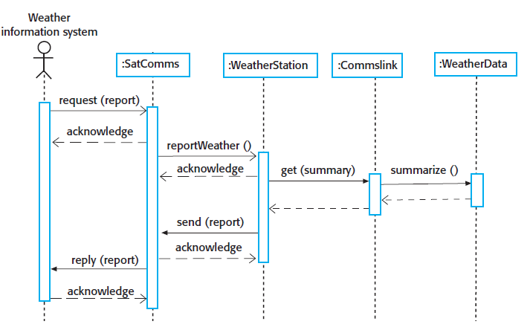


Slide 15
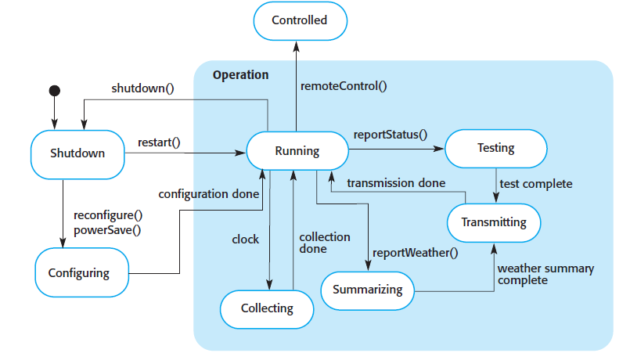


Slide 16
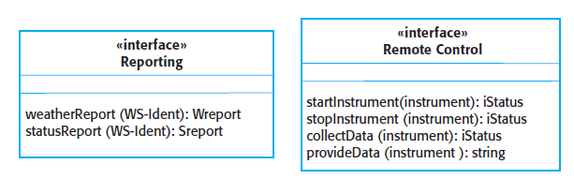

Interface Specification
Interface design is concerned with specifying the detail of the interface to an object or to a group of objects
This means defining the signatures and semantics of the services that are provided by the object or by a group of objects
Interfaces can be specified in the UML using the same notation as a class diagram

Slide 17
Design Patterns
A design pattern is a way of reusing abstract knowledge about a problem and its solution
A pattern is a description of the problem and the essence of its solution
It should be sufficiently abstract to be reused in different settings
Pattern descriptions usually make use of object-oriented characteristics such as inheritance and polymorphism

Slide 18
Elements of Design Patterns
A name that is a meaningful reference to the pattern
A description of the problem area that explains when the pattern may be applied
A solution description of the parts of the design solution, their relationships and their responsibilities
Not a concrete design description but a template for a design solution that can be instantiated in different ways
A statement of the consequences
The results and trade-offs of applying the pattern

Slide 19
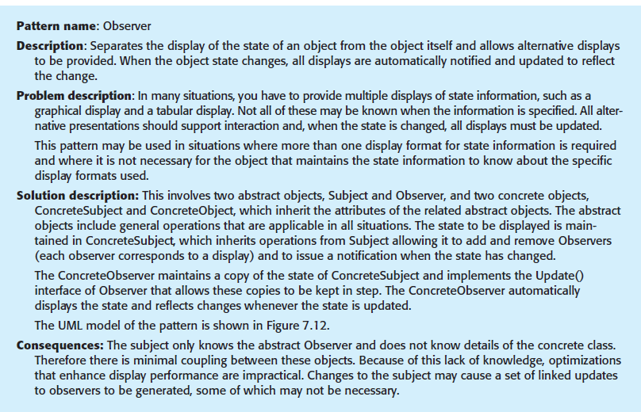
Observer Design Pattern

Slide 20
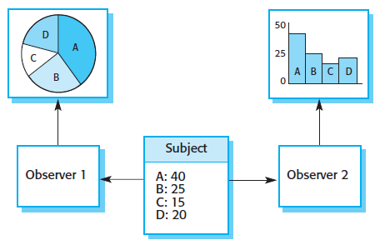

Observer Design Pattern

Slide 21
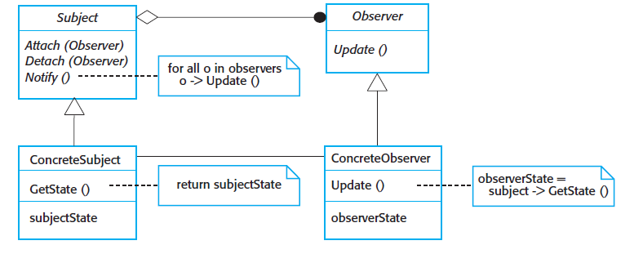
UML Model of Observer Design Pattern

Slide 22
Implementation Issues
Reuse: Most modern software is constructed by reusing existing components or systems. When you are developing software, you should make as much use as possible of existing code
Configuration management: During the development process, you have to keep track of the many different versions of each software component in a configuration management system
Host-target development: Production software does not usually execute on the same computer as the software development environment. Rather, you develop it on one computer (the host system) and execute it on a separate computer (the target system)

Slide 23
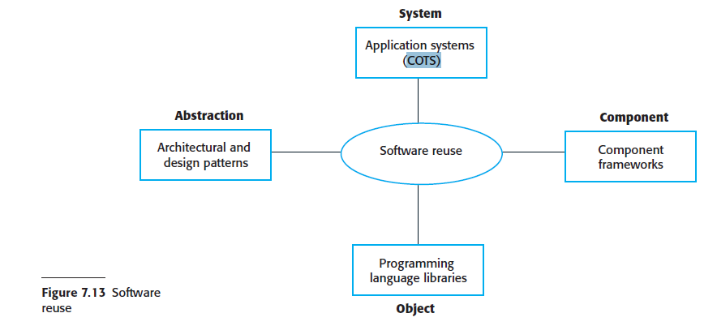
Reuse Levels

Slide 24
Reuse Levels
The Abstraction Level
At this level, you don’t reuse software directly but use knowledge of successful abstractions in the design of your software
The Object Level
At this level, you directly reuse objects from a library rather than writing the code yourself
The Component Level
Components are collections of objects and object classes that you reuse in application systems
The System Level
At this level, you reuse entire application system

Slide 25
Reuse Costs
The costs of the time spent in looking for software to reuse and assessing whether or not it meets your needs
Where applicable, the costs of buying the reusable software. For large off-the-shelf systems, these costs can be very high.
The costs of adapting and configuring the reusable software components or systems to reflect the requirements of the system that you are developing
The costs of integrating reusable software elements with each other (if you are using software from different sources) and with the new code that you have developed

Slide 26
Configuration Management
Configuration management is the name given to the general process of managing a changing software system
The aim of configuration management is to support the system integration process so that all developers can access the project code and documents in a controlled way, find out what changes have been made, and compile and link components to create a system

Slide 27
Configuration Management Activities
Version Management
Support is provided to keep track of the different versions of software components
Version management systems include facilities to coordinate development by several programmers
System Integration
Support is provided to help developers define what versions of components are used to create each version of a system
This description is then used to build a system automatically by compiling and linking the required components

Slide 28
Configuration Management Activities
Problem Tracking
Support is provided to allow users to report bugs and other problems, and to allow all developers to see who is working on these problems and when they are fixed
Release Management
New versions of a software system are released to customers
Concerned with planning the functionality of new releases and organizing the software for distribution

Slide 29
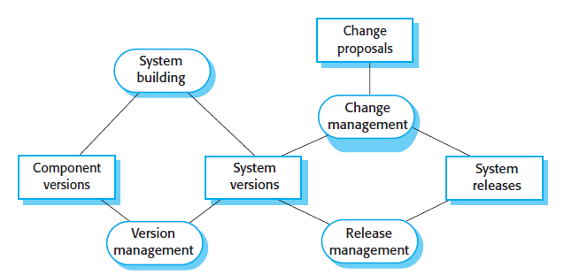

Configuration Management

Slide 30
Host Target Development
Most software is developed on one computer (the host), but runs on a separate machine (the target)
More generally, we can talk about a development platform and an execution platform
A platform is more than just hardware
It includes the installed operating system plus other supporting software such as a database management system or, for development platforms, an interactive development environment
Development platform usually has different installed software than execution platform; these platforms may have different architectures

Slide 31
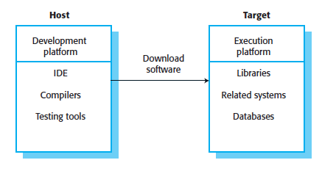
Host Target Development

Slide 32
Development Platform Tools
An integrated compiler and syntax-directed editing system that allows you to create, edit and compile code
A language debugging system
Graphical editing tools, such as tools to edit UML models
Testing tools, such as JUnit that can automatically run a set of tests on a new version of a program
Tools to support refactoring and program visualization
Configuration management tools to manage source code versions and to integrate and build systems

Slide 33
Integrated Development Environment(IDEs)
Software development tools are often grouped to create an integrated development environment (IDE)
An IDE is a set of software tools that supports different aspects of software development, within some common framework and user interface
IDEs are created to support development in a specific programming language such as Java
The language IDE may be developed specially, or may be an instantiation of a general-purpose IDE, with specific language-support tools

Slide 34
Open Source Development
Open source development is an approach to software development in which the source code of a software system is published and volunteers are invited to participate in the development process
Its roots are in the Free Software Foundation (www.fsf.org), which advocates that source code should not be proprietary but rather should always be available for users to examine and modify as they wish
Open source software extended this idea by using the Internet to recruit a much larger population of volunteer developers. Many of them are also users of the code.

Slide 35
Open Source Licensing
A fundamental principle of open-source development is that source code should be freely available, this does not mean that anyone can do as they wish with that code
Legally, the developer of the code (either a company or an individual) still owns the code. They can place restrictions on how it is used by including legally binding conditions in an open source software license
Some open source developers believe that if an open source component is used to develop a new system, then that system should also be open source
Others are willing to allow their code to be used without this restriction. The developed systems may be proprietary and sold as closed source systems

Slide 36
Open Source License Models
The GNU General Public License (GPL). This is a so-called ‘reciprocal’ license that means that if you use open source software that is licensed under the GPL license, then you must make that software open source.
The GNU Lesser General Public License (LGPL) is a variant of the GPL license where you can write components that link to open source code without having to publish the source of these components.
The Berkley Standard Distribution (BSD) License. This is a non-reciprocal license, which means you are not obliged to re-publish any changes or modifications made to open source code. You can include the code in proprietary systems that are sold

Slide 37
License Management
Establish a system for maintaining information about open-source components that are downloaded and used
Be aware of the different types of licenses and understand how a component is licensed before it is used
Be aware of evolution pathways for components
Educate people about open source
Have auditing systems in place
Participate in the open source community

