Slide 1

UNIT-8 SOFTWARE TESTING
Er. Deeyoranjan Dongol

Slide 2
Verification
Are we building the product right?
Software should conform to its specification
Validation
Are we building the right product?
The software should do what the user really requires
Depends on system’s purpose, user expectations and marketing environment
Software Purpose
The level of confidence depends on how critical the software is to an organization
User Expectations
Users may have low expectations of certain kinds of software
Marketing Environment
Getting a product to market early may be more important than finding defects in the program

Slide 3
Verification & Validation Planning Process
Software Inspection
Analyses and checks system representation such as the Requirement document, design program diagrams, and the program source code
Inspection can be used at all the system software development process
Software Testing
Involves running and implementation of the software with test data
Examine the output of the software, its operational behavior to check out that it’s performing as the user requirement

Slide 4
Inspection and Testing Model

Slide 5
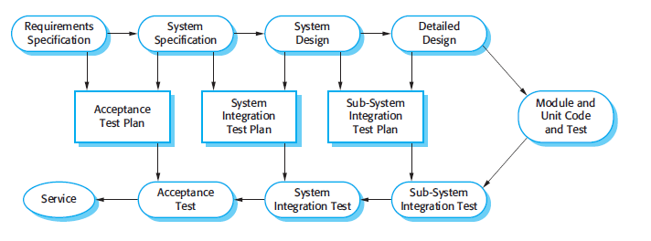
Verification & Validation Planning
Fig: Test plan as a link between development and testing

Slide 6
Software Test Plan Components
The Testing Process
A description of major phases of testing process
Requirement Traceability
Testing should be planned such that all requirements are individually tested
Tested Items
Product of software processes that are to be tested should be specified
Testing Schedule
An overall testing schedule and resource allocation is linked to the general project development schedule

Slide 7
Software Test Plan Components
Test Recording Procedure
Result of the test should be systematically recorded and must be able to audit testing process to ensure its correctness
Hardware & Software Requirement
Set out the h/w and s/w tools required or estimated for testing process
Constraint
Constraint affecting the testing process such as staff shortage should be anticipated

Slide 8
Software Inspection
Static verification and validation process
Software system is reviewed to find errors, omissions and anomalies
May be applied to any representation of the system such as requirements, design, configuration data, test data etc.

Slide 9
Advantages of Software Inspection Over Testing
During testing, errors can mask (hide) other errors; Because inspection is a static process, you don’t have to be concerned with interactions between errors
Incomplete versions of a system can be inspected without additional costs
As well as searching for program defects, an inspection can also consider broader quality attributes of a program, such as compliance with standards, portability and maintainability

Slide 10
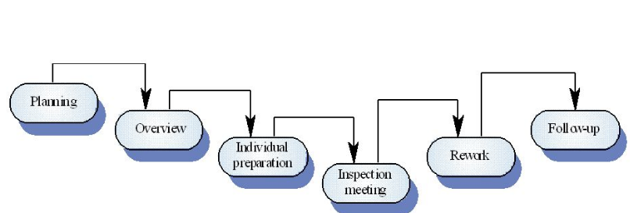
Program Inspection Process
A formal process carried out by a team who systematically analyze the code and point out the possible defect
Inspection team consists of four member
Author
Inspector
Reader
Moderator
Fig: Software Inspection Process

Slide 11
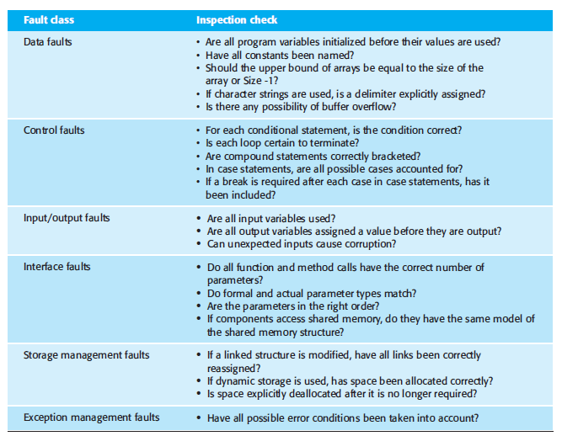
Fig: Inspection Check List

Slide 12
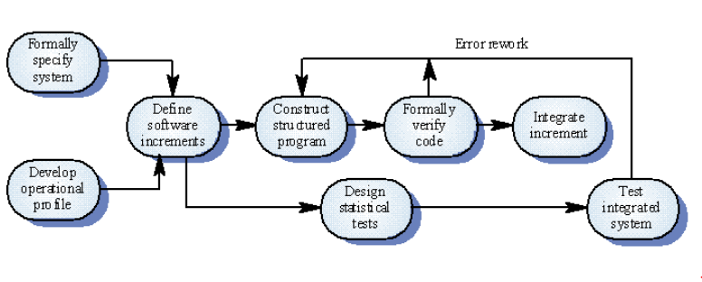
Cleanroom Development Process
Software development philosophy that uses formal method to support software inspection
The philosophy is defect avoidance rather than defect removal

Slide 13
Cleanroom Development Process Key Strategies
Formal Specification
A state transition model used to express the specification
Incremental Development
Developed and validated separately
Structured Programming
Only limited number of control and data abstraction constraints are used
Static Verification
Developed software is statically verified using software inspection techniques
Statistical Testing of the System
Determine program reliability

Slide 14
Cleanroom Process Team
Specification Team
Responsible for developing and maintaining the system specification
Development Team
Responsible for developing and verifying the software
Certification Team
Responsible for developing a set of statistical tests to exercise the software after development
Reliability growth models used to determine when reliability is acceptable

Slide 15
Software Testing
Process intended to show that a program does what it is intended to do and to discover program defects before it is put into use
Test the software by executing a program using artificial data and check the results of the test run for errors, anomalies, or information about the program’s non functional attributes
Two Distinct Goals of Software Testing
To demonstrate the developer and the customer that the software meets its requirements
To discover situations in which the behavior of the software is incorrect, undesirable or does not conform to its specification

Slide 16
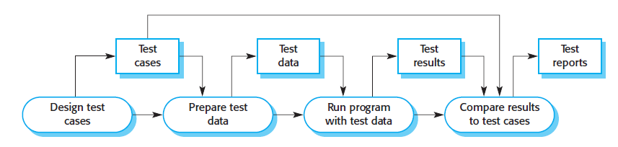
Software Testing Process

Slide 17
Types of Software Testing
Development Testing
System is tested during development to discover bugs and defects
Release Testing
Separate testing team tests a complete version of the system before it is released to users
Aims to check that the system meets the requirements of the system stakeholders
User Testing
Users of a system test the system in their own environment

Slide 18
Development Testing
Includes all testing activities that are carried out by the team developing the system
Three stages of development testing
Unit Testing
Component Testing
System Testing

Slide 19
Development Testing
Unit Testing
Individual program units or object classes are tested
Focus on testing functionality of objects or methods
Examples of state sequences that should be tested in the weather station include
Shutdown → Running → Shutdown
Configuring → Running → Testing → Transmitting → Running
Running → Collecting → Running → Summarizing → Transmitting → Running

Slide 20
Development Testing
Unit Testing
An automated unit testing has three parts
A setup part where the system is initialized with the test case, namely, the inputs and expected outputs
A call part where the object or method to be tested is called
An assertion part where the result of the call is compared with the expected result If the assertion
If the assertion evaluates to true, the test has been successful; if false, then it has failed

Slide 21
Development Testing
Choosing unit testing test cases
Two strategies
Partition testing
Groups of inputs that have common characteristics are identified and processed in the same way
Choose tests from within each of these groups
Guideline-based testing
Use testing guidelines to choose test cases
These guidelines reflect previous experience of the kinds of errors that programmers often make when developing components

Slide 22
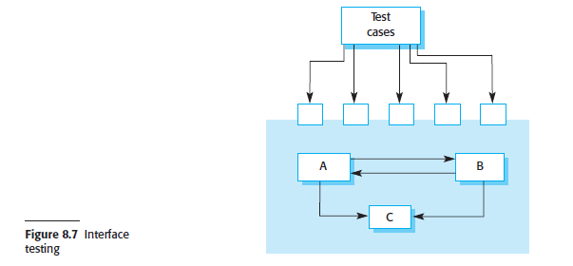
Development Testing
Component Testing
Several individual units are integrated to create composite components
Focus on testing component interfaces

Slide 23
Component Testing
Types of interface between program components
Parameter interfaces
Data or sometimes function references are passed from one component to another
Shared memory interfaces
Block of memory is shared between components
Data is placed in the memory by one subsystem and retrieved from there by other subsystems

Slide 24
Component Testing
Types of interface between program components
Procedural interfaces
One component encapsulates a set of procedures that can be called by other components
Objects and reusable components have this form of interface
Message passing interfaces
One component requests a service from another component by passing a message to it
A return message includes the results of executing the service

Slide 25
Component Testing
Interface error falls into three classes
Interface misuse
A calling component calls some other component and makes an error in the use of its interface
Interface misunderstanding
A calling component misunderstands the specification of the interface of the called component and makes assumptions about its behavior
Timing errors
These occur in real-time systems that use a shared memory or a message-passing interface
The producer of data and the consumer of data may operate at different speeds

Slide 26
Development Testing
System Testing
Some or all of the components in a system are integrated and the system is tested as a whole
Focus on testing component interactions
During system testing, reusable components that have been separately developed and off-the-shelf systems may be integrated with newly developed components. The complete system is then tested
Components developed by different team members or sub teams may be integrated at this stage. System testing is a collective rather than an individual process. In some companies, system testing may involve a separate testing team with no involvement from designers and programmers

Slide 27
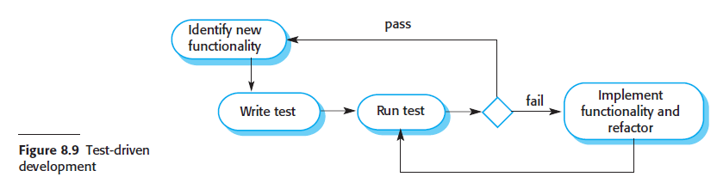
Test-Driven Development (TDD)
An approach to program development in which testing and code development are interleaved

Slide 28
Test-Driven Development (TDD)
Steps in TDD process
Identify the increment of functionality that is required which should normally be small and implementable in a few lines of code
Write a test for this functionality and implement it as an automated test. This means that the test can be executed and will report whether or not it has passed or failed.
Then run the test, along with all other tests that have been implemented
Implement the functionality and re-run the test which may involve refactoring existing code to improve it and add new code to what’s already there
Once all tests run successfully, move on to implementing the next chunk of functionality

Slide 29
Release Testing
The process of testing a particular release of a system that is intended for use outside of the development team
Requirements Based Testing (Validation)
Systematic approach to test case design considering each requirement and deriving a set of tests for it
Scenario Testing
Typical scenarios are devised and used to develop test cases
Several requirements are tested within same scenario
Performance Testing
Testing done to ensure that the system can process its intended load

Slide 30
User Testing
Stage in the testing process in which users or customers provide input and advice on system testing
Alpha Testing
Users of the software work with the development team to test the software at the developer’s site
Beta Testing
Release of the software is made available to users to allow them to experiment and to raise problems that they discover with the system developers

Slide 31
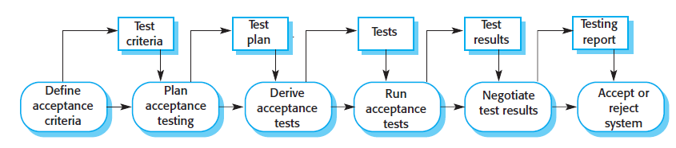

User Testing
Acceptance Testing
Customer test the system whether or not it is ready to be accepted and deployed in the customer environment

