Slide 1
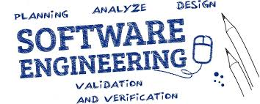
UNIT-9 SOFTWARE EVOLUTION
Er. Deeyoranjan Dongol

Slide 2
Software Change
Software change is inevitable
New requirements emerge when the software is used
The business environment changes
Errors must be repaired
New computers and equipment is added to the system
The performance or reliability of the system may have to be improved
A key problem for all organizations is implementing and managing change to their existing software systems

Slide 3
Importance of Evolution
Organizations have huge investments in their software systems - they are critical business assets
To maintain the value of these assets to the business, they must be changed and updated
The majority of the software budget in large companies is devoted to changing and evolving existing software rather than developing new software

Slide 4
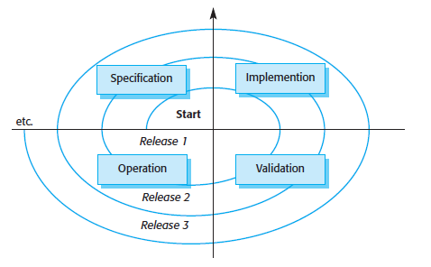
Spiral Model of Development and Evolution

Slide 5
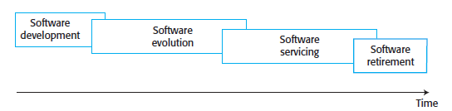
Evolution & Servicing

Slide 6
Evolution & Servicing
Evolution
The stage in a software system’s life cycle where it is in operational use and is evolving as new requirements are proposed and implemented in the system
Servicing
At this stage, the software remains useful but the only changes made are those required to keep it operational i.e. bug fixes and changes to reflect changes in the software’s environment
No new functionality is added
Phase-out
The software may still be used but no further changes are made to it

Slide 7
Evolution Processes
Software evolution processes depend on
The type of software being maintained
The development processes used
The skills and experience of the people involved
Proposals for change are the driver for system evolution
Should be linked with components that are affected by the change, thus allowing the cost and impact of the change to be estimated
Change identification and evolution continues throughout the system lifetime

Slide 8
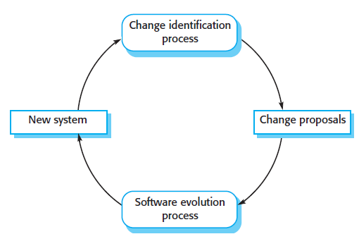


Slide 9
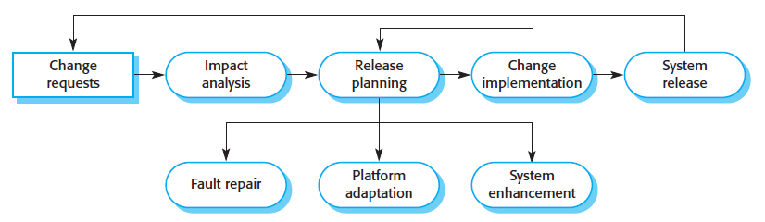

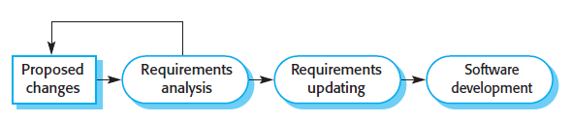


Slide 10
Change Implementation
Iteration of the development process where the revisions to the system are designed, implemented and tested
A critical difference is that the first stage of change implementation may involve program understanding, especially if the original system developers are not responsible for the change implementation
During the program understanding phase, you have to understand how the program is structured, how it delivers functionality and how the proposed change might affect the program

Slide 11


Urgent Change Requests
Urgent changes may have to be implemented without going through all stages of the software engineering process
If a serious system fault has to be repaired to allow normal operation to continue
If changes to the system’s environment (e.g. an OS upgrade) have unexpected effects
If there are business changes that require a very rapid response (e.g. the release of a competing product)

Slide 12
Agile Methods & Evolution
Agile methods are based on incremental development so the transition from development to evolution is a seamless one
Evolution is simply a continuation of the development process based on frequent system releases
Automated regression testing is particularly valuable when changes are made to a system
Changes may be expressed as additional user stories

Slide 13
Handover Problems
Where the development team have used an agile approach but the evolution team is unfamiliar with agile methods and prefer a plan-based approach
The evolution team may expect detailed documentation to support evolution and this is not produced in agile processes
Where a plan-based approach has been used for development but the evolution team prefer to use agile methods
The evolution team may have to start from scratch developing automated tests and the code in the system may not have been refactored and simplified as is expected in agile development

Slide 14
Legacy Systems
Older systems that rely on languages and technology that are no longer used for new systems development
May be dependent on older hardware, such as mainframe computers and may have associated legacy processes and procedures
Not just software systems but are broader socio-technical systems that include hardware, software, libraries and other supporting software and business processes

Slide 15
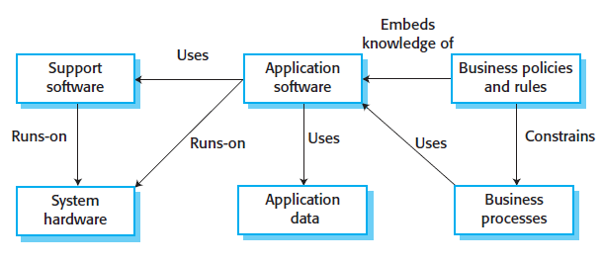

Legacy Systems

Slide 16
Legacy System Components
System Hardware
Legacy systems may have been written for hardware that is no longer available
Support Software
The legacy system may rely on a range of support software, which may be obsolete or unsupported
Application Software
The application system that provides the business services is usually made up of a number of application programs

Slide 17
Legacy System Components
Application Data
These are data that are processed by the application system
They may be inconsistent, duplicated or held in different databases
Business Processes
These are processes that are used in the business to achieve some business objective
May be designed around a legacy system and constrained by the functionality that it provides
Business Policies and Rules
These are definitions of how the business should be carried out and constraints on the business
Use of the legacy application system may be embedded in these policies and rules

Slide 18
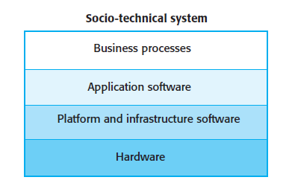
Legacy System Layers

Slide 19
Legacy System Replacement
Legacy system replacement is risky and expensive so businesses continue to use these systems
System replacement is risky for a number of reasons
Lack of complete system specification
Tight integration of system and business processes
Undocumented business rules embedded in the legacy system
New software development may be late and/or over budget

Slide 20
Legacy System Change
Legacy systems are expensive to change for a number of reasons
No consistent programming style
Use of obsolete programming languages with few people available with these language skills
Inadequate system documentation
System structure degradation
Program optimizations may make them hard to understand
Data errors, duplication and inconsistency

Slide 21
Legacy System Management
Organizations that rely on legacy systems must choose a strategy for evolving these systems
Scrap the system completely and modify business processes so that it is no longer required
Continue maintaining the system
Transform the system by re-engineering to improve its maintainability
Replace the system with a new system
The strategy chosen should depend on the system quality and its business value

Slide 22
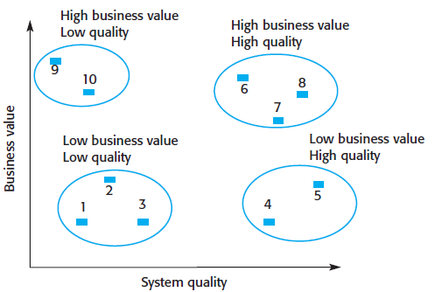
Legacy System Assessment

Slide 23
Legacy System Categories
Low Quality, Low Business Value
These systems should be scrapped
Low Quality, High Business Value
These make an important business contribution but are expensive to maintain
Should be re-engineered or replaced if a suitable system is available
High Quality, Low Business Value
Replace with COTS, scrap completely or maintain
High Quality, High Business Value
Continue in operation using normal system maintenance

Slide 24
Business Value Assessment
Assessment should take different viewpoints into account
System end-users
Business customers
Line managers
IT managers
Senior managers
Interview different stakeholders and collate results

Slide 25
Issues in Business Value Assessment
The use of the system
If systems are only used occasionally or by a small number of people, they may have a low business value
The business processes that are supported
A system may have a low business value if it forces the use of inefficient business processes
System dependability
If a system is not dependable and the problems directly affect business customers, the system has a low business value
The system outputs
If the business depends on system outputs, then the system has a high business value

Slide 26
System Quality Assessment
Business Process Assessment
How well does the business process support the current goals of the business?
Environment Assessment
How effective is the system’s environment and how expensive is it to maintain?
Application Assessment
What is the quality of the application software system?

Slide 27
Business Process Assessment
Use a viewpoint-oriented approach and seek answers from system stakeholders
Is there a defined process model and is it followed?
Do different parts of the organization use different processes for the same function?
How has the process been adapted?
What are the relationships with other business processes and are these necessary?
Is the process effectively supported by the legacy application software?
Example - a travel ordering system may have a low business value because of the widespread use of web- based ordering

Slide 28
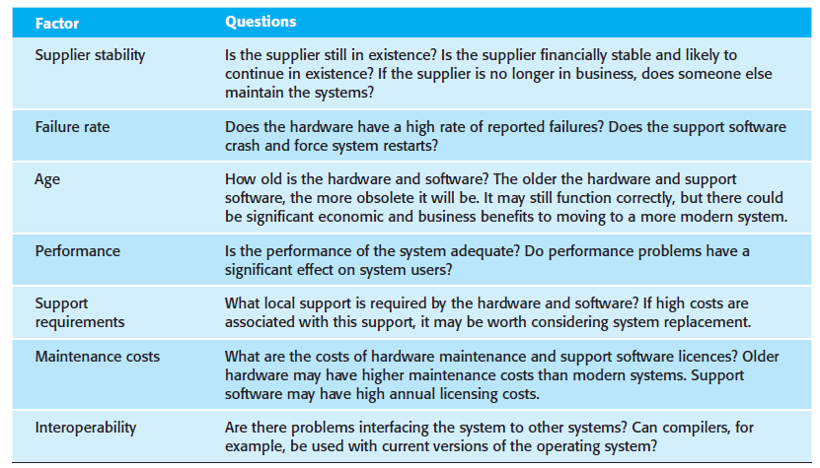

Environment Assessment

Slide 29
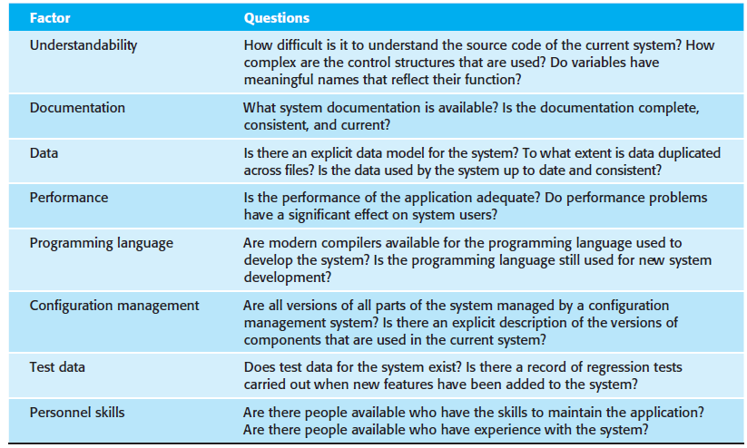

Application Assessment

Slide 30
System Measurement
You may collect quantitative data to make an assessment of the quality of the application system
The number of system change requests; The higher this accumulated value, the lower the quality of the system
The number of different user interfaces used by the system; The more interfaces, the more likely it is that there will be inconsistencies and redundancies in these interfaces
The volume of data used by the system. As the volume of data (number of files, size of database, etc.) processed by the system increases, so too do the inconsistencies and errors in that data
Cleaning up old data is a very expensive and time-consuming process

Slide 31
Software Maintenance
Modifying a program after it has been put into use
The term is mostly used for changing custom software; Generic software products are said to evolve to create new versions
Maintenance does not normally involve major changes to the system’s architecture
Changes are implemented by modifying existing components and adding new components to the system

Slide 32
Types of Software Maintenance
Fault Repairs
Changing a system to fix bugs/vulnerabilities and correct deficiencies in the way meets its requirements.
Environmental Adaptation
Maintenance to adapt software to a different operating environment
Changing a system so that it operates in a different environment (computer, OS, etc.) from its initial implementation
Functionality Addition & Modification
Modifying the system to satisfy new requirements

Slide 33
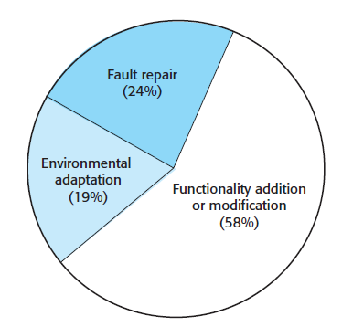


Slide 34
Maintenance Costs
It is usually more expensive to add new features to a system during maintenance than it is to add the same features during development
A new team has to understand the programs being maintained
Separating maintenance and development means there is no incentive for the development team to write maintainable software
Program maintenance work is unpopular
Maintenance staff are often inexperienced and have limited domain knowledge
As programs age, their structure degrades and they become harder to change

Slide 35
Maintenance Prediction
Maintenance prediction is concerned with assessing which parts of the system may cause problems and have high maintenance costs
Change acceptance depends on the maintainability of the components affected by the change
Implementing changes degrades the system and reduces its maintainability
Maintenance costs depend on the number of changes and costs of change depend on maintainability

Slide 36
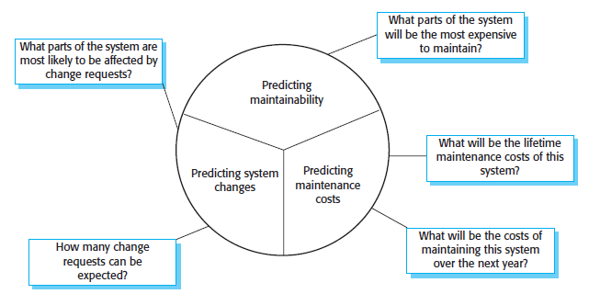
Maintenance Prediction

Slide 37
Software Reengineering
Restructuring or rewriting part or all of a legacy system without changing its functionality
Applicable where some but not all sub-systems of a larger system require frequent maintenance
Reengineering involves adding effort to make them easier to maintain
The system may be re- structured and re-documented

Slide 38
Advantages of Software Reengineering
Reduced Risk
There is a high risk in new software development
There may be development problems, staffing problems and specification problems
Reduced Cost
The cost of re-engineering is often significantly less than the costs of developing new software

Slide 39
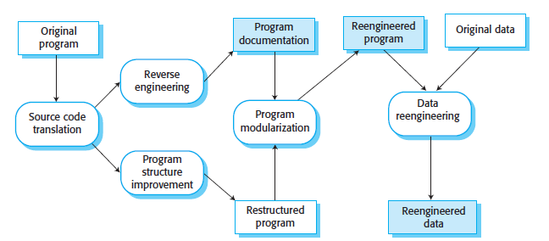
Software Reengineering Process

Slide 40
Reengineering Process Activities
Source Code Translation
Convert code to a new language
Reverse Engineering
Analyze the program to understand it
Program Structure Improvement
Restructure automatically for understandability
Program Modularization
Reorganize the program structure
Data Reengineering
Clean-up and restructure system data.

Slide 41
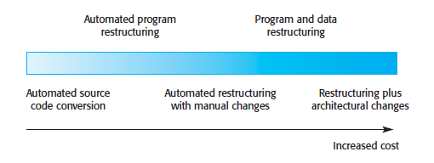
Reengineering Approaches

Slide 42
Refactoring
The process of making improvements to a program to slow down degradation through change
You can think of refactoring as ‘preventative maintenance’ that reduces the problems of future change
Refactoring involves modifying a program to improve its structure, reduce its complexity or make it easier to understand
When you refactor a program, you should not add functionality but rather concentrate on program improvement

Slide 43
Refactoring & Reengineering
Re-engineering takes place after a system has been maintained for some time and maintenance costs are increasing. You use automated tools to process and re- engineer a legacy system to create a new system that is more maintainable.
Refactoring is a continuous process of improvement throughout the development and evolution process. It is intended to avoid the structure and code degradation that increases the costs and difficulties of maintaining a system.

Slide 44
‘BAD SMELLS’ - Improved through Refactoring
Duplicate Code
The same or very similar code may be included at different places in a program
This can be removed and implemented as a single method or function that is called as required
Long Methods
If a method is too long, it should be redesigned as a number of shorter methods
Switch (Case) Statements
These often involve duplication, where the switch depends on the type of a value
The switch statements may be scattered around a program
In object-oriented languages, you can often use polymorphism to achieve the same thing

Slide 45
‘BAD SMELLS’ - Improved through Refactoring
Data Clumping
Data clumps occur when the same group of data items (fields in classes, parameters in methods) re-occur in several places in a program
These can often be replaced with an object that encapsulates all of the data
Speculative Generality
This occurs when developers include generality in a program in case it is required in the future
This can often simply be removed

