Slide 1
Revenue and profit analysis of a company
File created on: 10/23/2021 5:05:57 AM

Slide 2
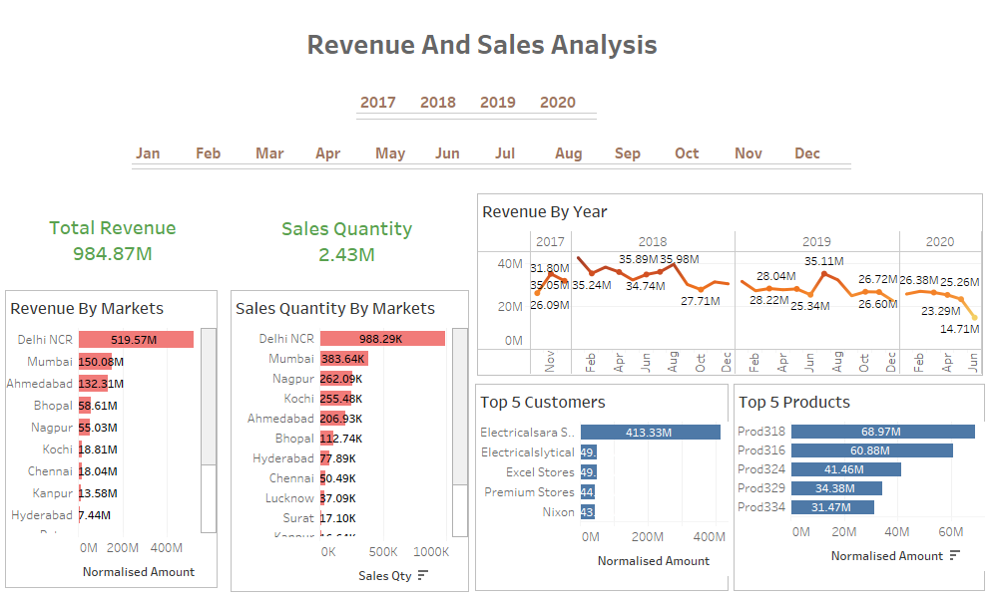

Slide 3
