Slide 1

High Level System Design Architecture

Slide 2
Problem Statement.
Propose an MVP Solution.
Perform ETL Operation on the Data through automation.
Work through Data inconsistency issues.
Prepare a high-level structure of the MVP.
Analyze inconsistencies and propose solutions / next steps for the same.
Bonus: Suggest improvement to the existing process.

Slide 3
Constraints
The Solution should use Open-Source tools.
Client's source system pushes data into SFTP server.
Business wants to have clean and high-quality data monthly.

Slide 4
Assumptions
Based on the given information, it is safe to assume that:
Connection to the SFTP server is established and working.
Data is uploaded daily.
Apart from data inconsistencies, the format of the data will remain the same.
The resultant data structures and format has already been agreed upon.

Slide 5
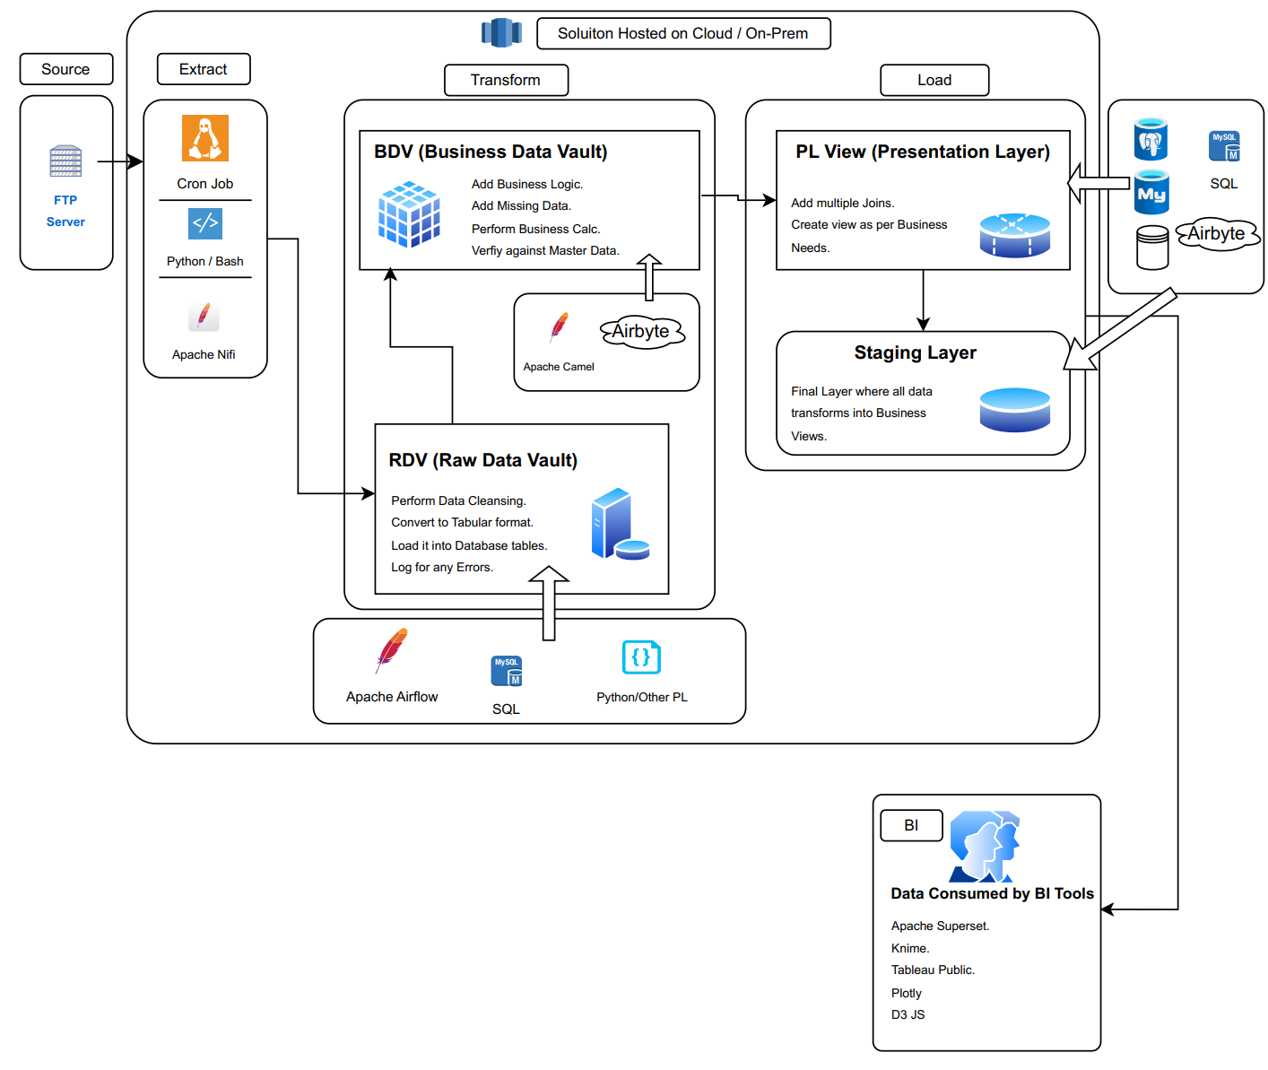
Technical Architecture

Slide 6
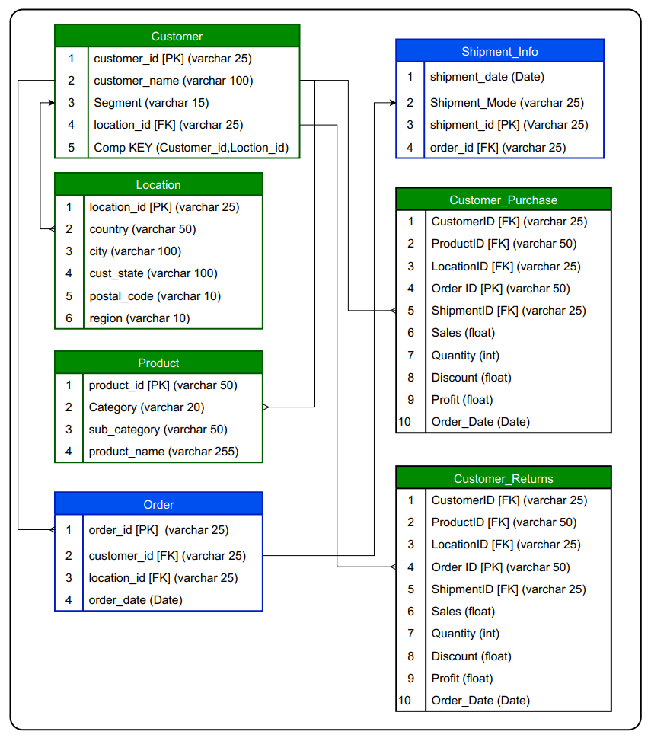
Structure of the Datawarehouse
Misc. Tables:
Logging table to keep track of the data sent by the client.
Errors table, to keep track of the errors encountered in the files.
Business Views, to get the different dataset which the client needs for reporting purposes.

Slide 7
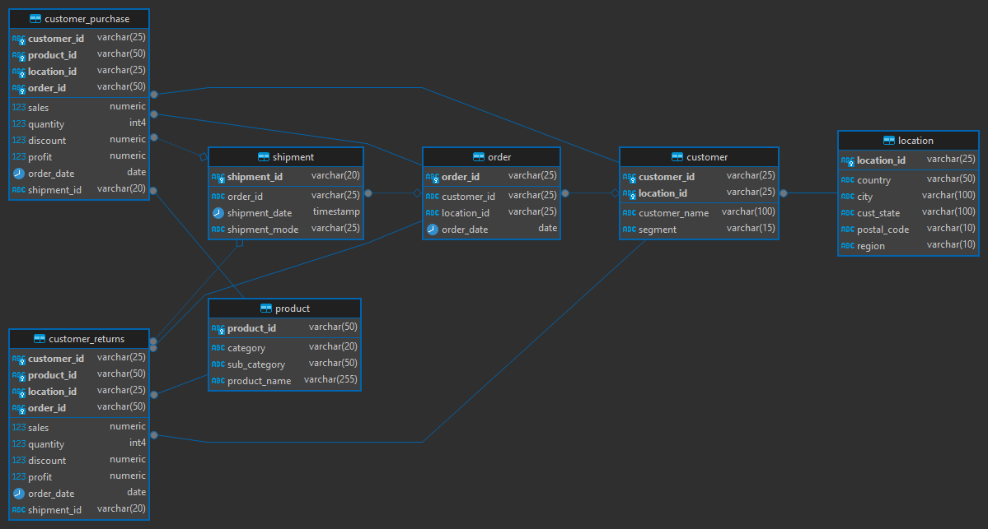
ER-Diagram of the Tables

Slide 8

Data Processing Flow
First, we identify where the ETL activity will take place and provision a server accordingly (Whether cloud or on-prem).
As per the problem statement, the data would be delivered via a SFTP server on a regular basis, so we can create a mount point from the client SFTP server to the ETL server.
Data can be ingested via various ways:
Running cron jobs to check the filename and date and verify if the file has already been processed. Based on the business needs, we can process the file once a day or the number of times it is uploaded.
Create a Python / any other PL script, which will verify the data in the RDV tables against the data that has been provisioned.
Use tools such as Apache Nifi / Apache Airflow / Airbyte any other open-source tool, which is specialized for this job.
Once the data has been brought over, we can save the data temporarily for processing. Here we may perform the following steps:
Analyse the date and time the data was delivered, based on the file names.
Fix issues with file encoding if any.
Fix issues with file formats.
Find out the missing columns and replace the same with null values.
Log all the above activities for a future reference.
The data pre-processing step can be done either via python or one of the tools mentioned above.
Once, the data has been cleansed, we can push the data into the RDV. This is done so that we have a record of what was the raw data that originated from the client, which may come in handy in case of any disputes in the future.
From here, the data is moved into the Data Warehouse layer, where the whole data turns into transactional records.
At this stage, the data is compared with the master data and relevant entries are made.
This is a good time to compare the Master data with the transactional data and check for any records that are invalid.
Such records, then, can be stored in a separate table, where the transaction exists for no master data records. This can be then referenced by the client for further actions.
Finally, views are created on top of the Master and transactional records, which in turn, is consumed by the Business to gain valuable insights.
Note: All these steps can be performed by either the tools mentioned in the System Design individually or in conjunction, based on the Business use case, the time and the complexity involved. Automation is inherently supported either within the tools mentioned or by using the coding workflows.

