Slide 1
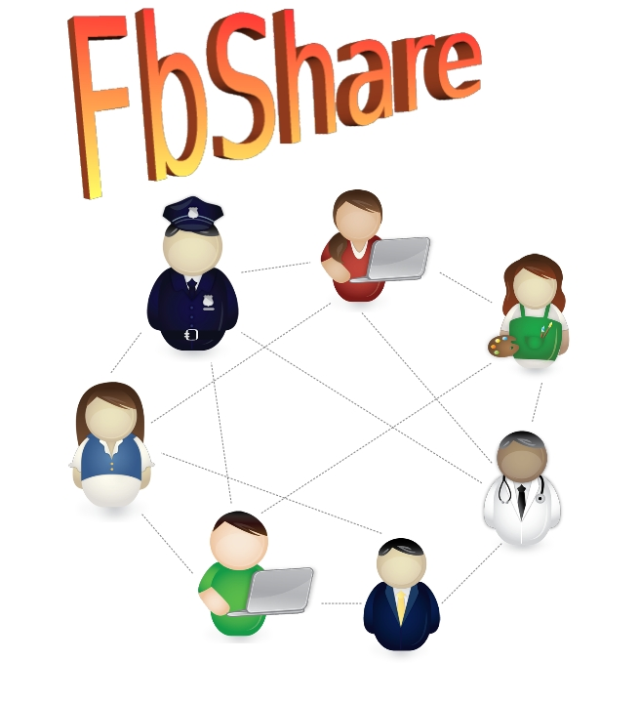
FbShare:
A DIFFERENT METHOD OF SHARING FILES
ESE 543: Mobile Cloud Computing Course Project Presentation
By: Shashank Gururaj Rao

Slide 2
What FbShare is all about
FbShare is a novel technique of sharing files between different users
Users upload file onto a cloud storage shared among the group and then notify the other group members through Facebook posts
FbShare is able to share files of different types – PDF, DOCX, Audio, Images and Videos
Customized notifications are posted onto Facebook for different file types; with all the group members already included in the shared post (as tagged friends)

Slide 3
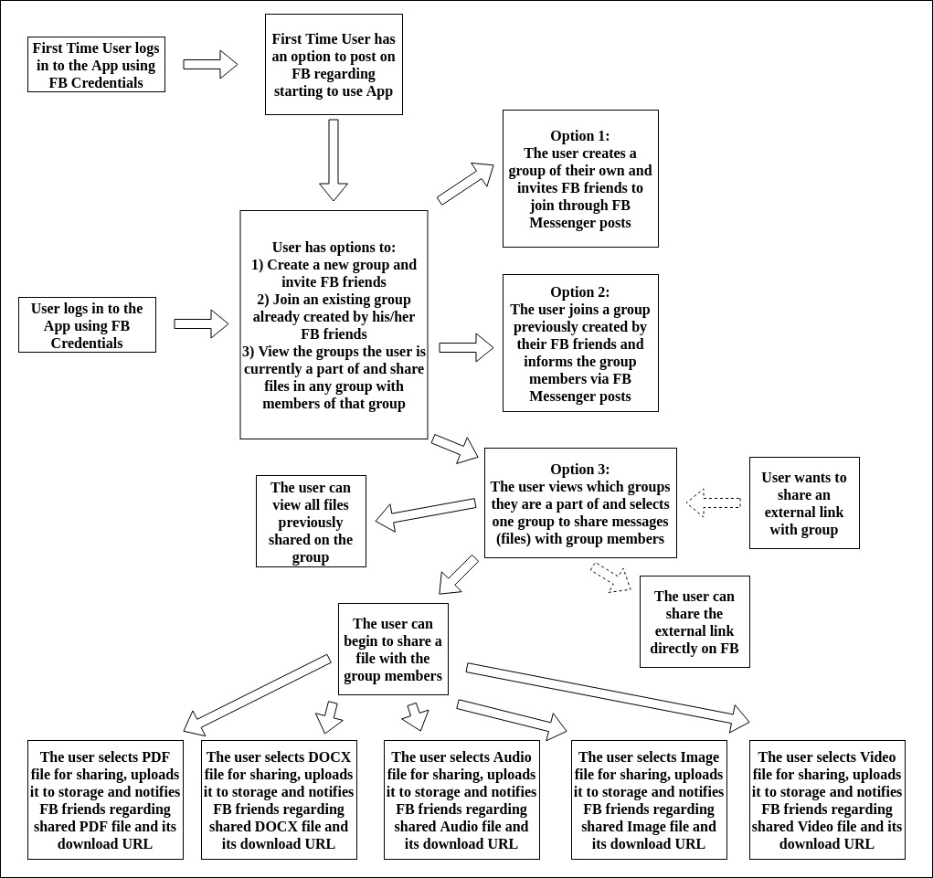
Functional flow of the App for the User

Slide 4
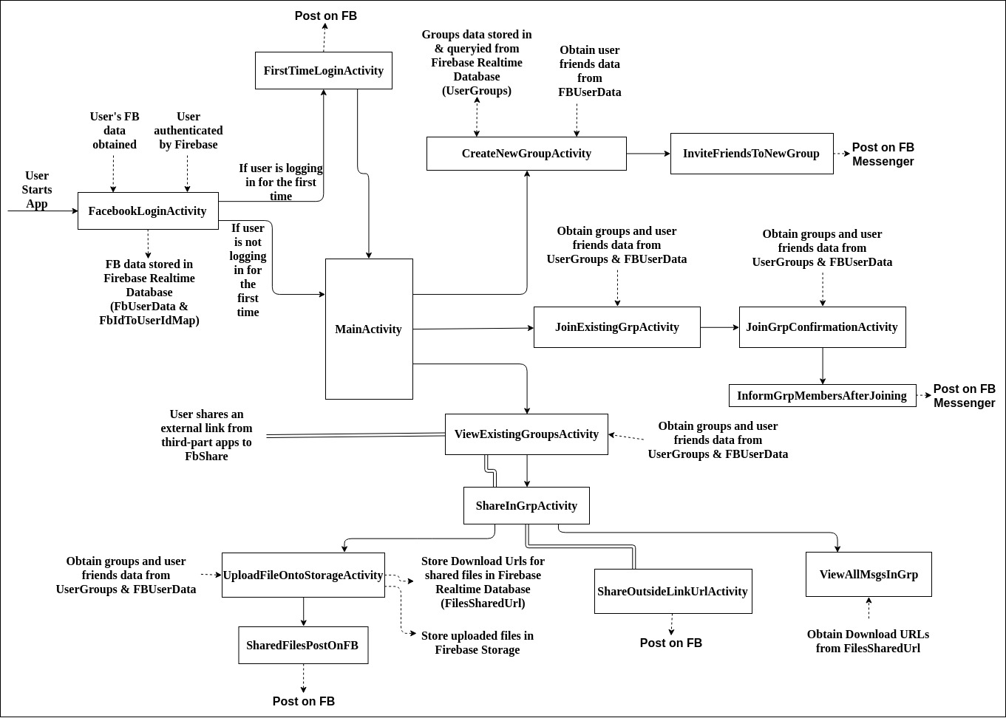
Activity Flow for the App

Slide 5
App Demo

Slide 6
Basic Evaluations Performed
Size of FbShare App on device: 6.02 MB
Maximum RAM usage of App recorded (during uploading an audio file of 142. MB and a video file of 582.92MB): 264 MB
Battery usage under high load (during uploading an audio file of 146.1 MB and a video file of 582.92MB): 3%

Slide 7
Timing tests:
Average time taken for First-time user to navigate from Login screen to First-time Facebook post Activity – 3s
Average time taken for user to navigate from Main screen to Create Group Facebook Messenger Post Activity – 4s
Average time taken for user to navigate from Main screen to Join Group Facebook Messenger Post Activity – 6s
Maximum time taken for user to navigate from Main screen to upload file(during upload of video file of 582.92 MB) - 3 minutes
Average time taken for user to share an external link Facebook post: 4s

Slide 8
Conclusions

