Slide 1
Shashank Updates

Slide 2
K Point and Kinetic energy cutoff – parameters used (unit cell)
Ibrav = 0, # atoms = 3
Grimme's DFT-D2 van der Waals correction used
Nbnd (# of valence bands) = 50
Max # of iterations in scf step = 300; For self consistency, Convergence threshold= 1.0D-8, Mixing factor = 0.7, under Davidson iterative diagonalization
BFGS quasi-newton algorithm used for cell dynamics, with only x and y components being allowed to change and cell factor = 2.5

Slide 3
Kinetic energy cutoff optimization

Slide 4
K Points optimization

Slide 5
Optimization results
K point used for Monkhorst-Pack grids = 10x10x1
Kinetic energy cutoff for wavefunctions used (ecutwfc) = 60
Kinetic energy cutoff for charge density used = 600 (since ultrasoft pseudopotential used)
Calculations performed for 1x1x1 unit cell

Slide 6
Pseudopotentials
GGA pseudopotential results in underestimation of results
LDA pseudopotential results in overestimation of results

Slide 7
LDA Pseudopotential

Slide 8
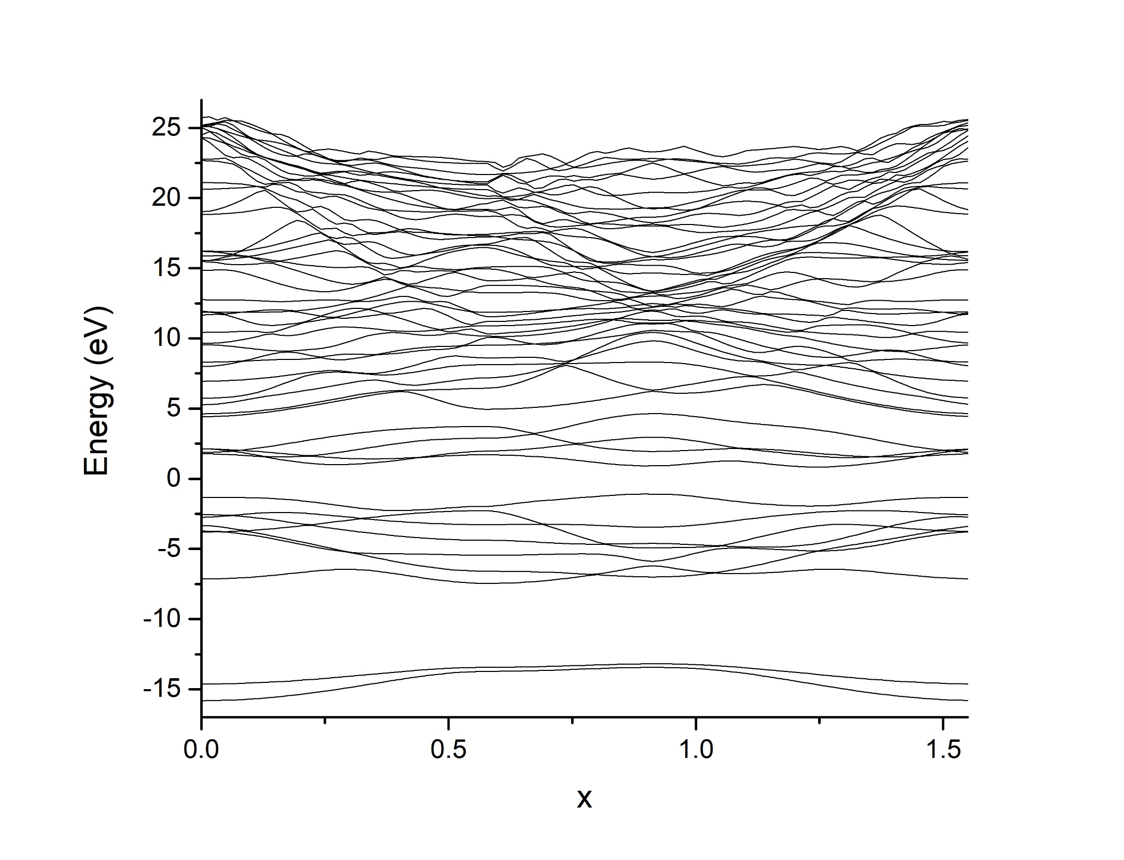
Band structure for unit cell

Slide 9
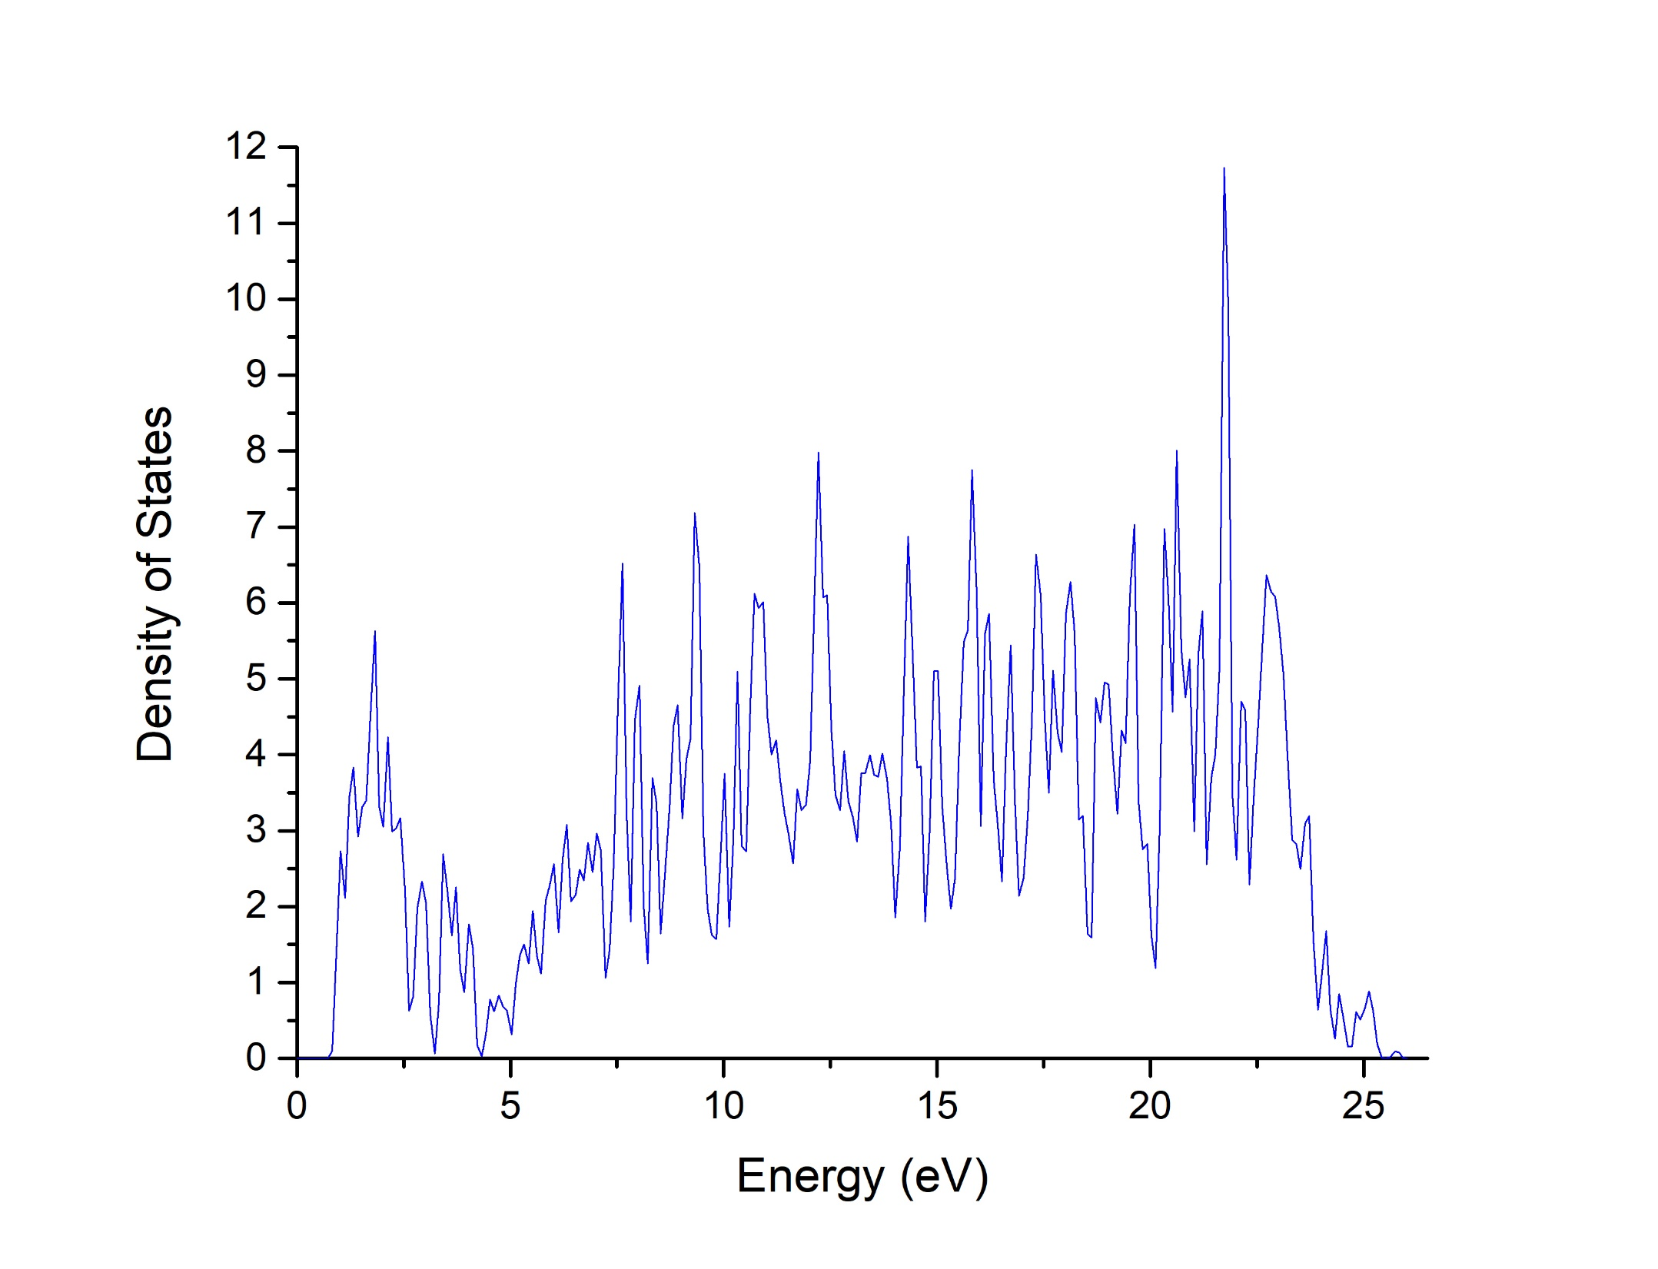
Density of States Plot

Slide 10
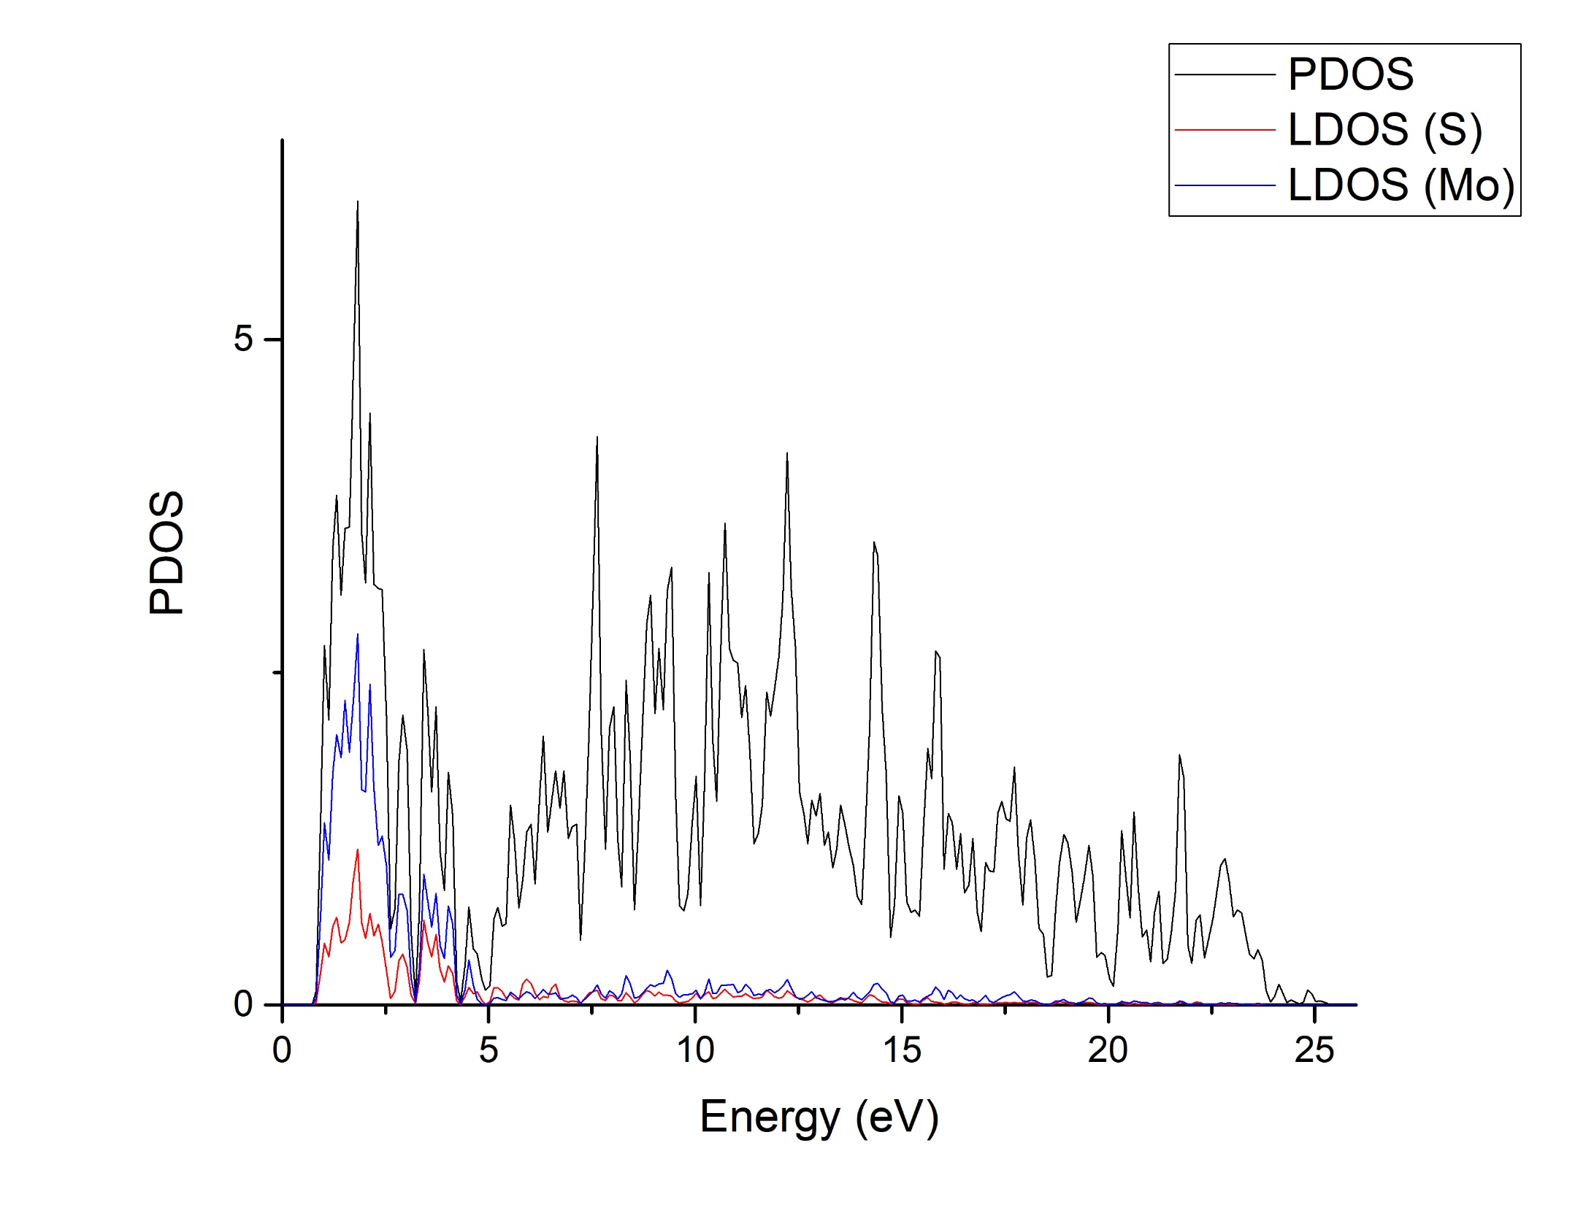
PDOS Plot

Slide 11
GGA Pseudopotential

Slide 12
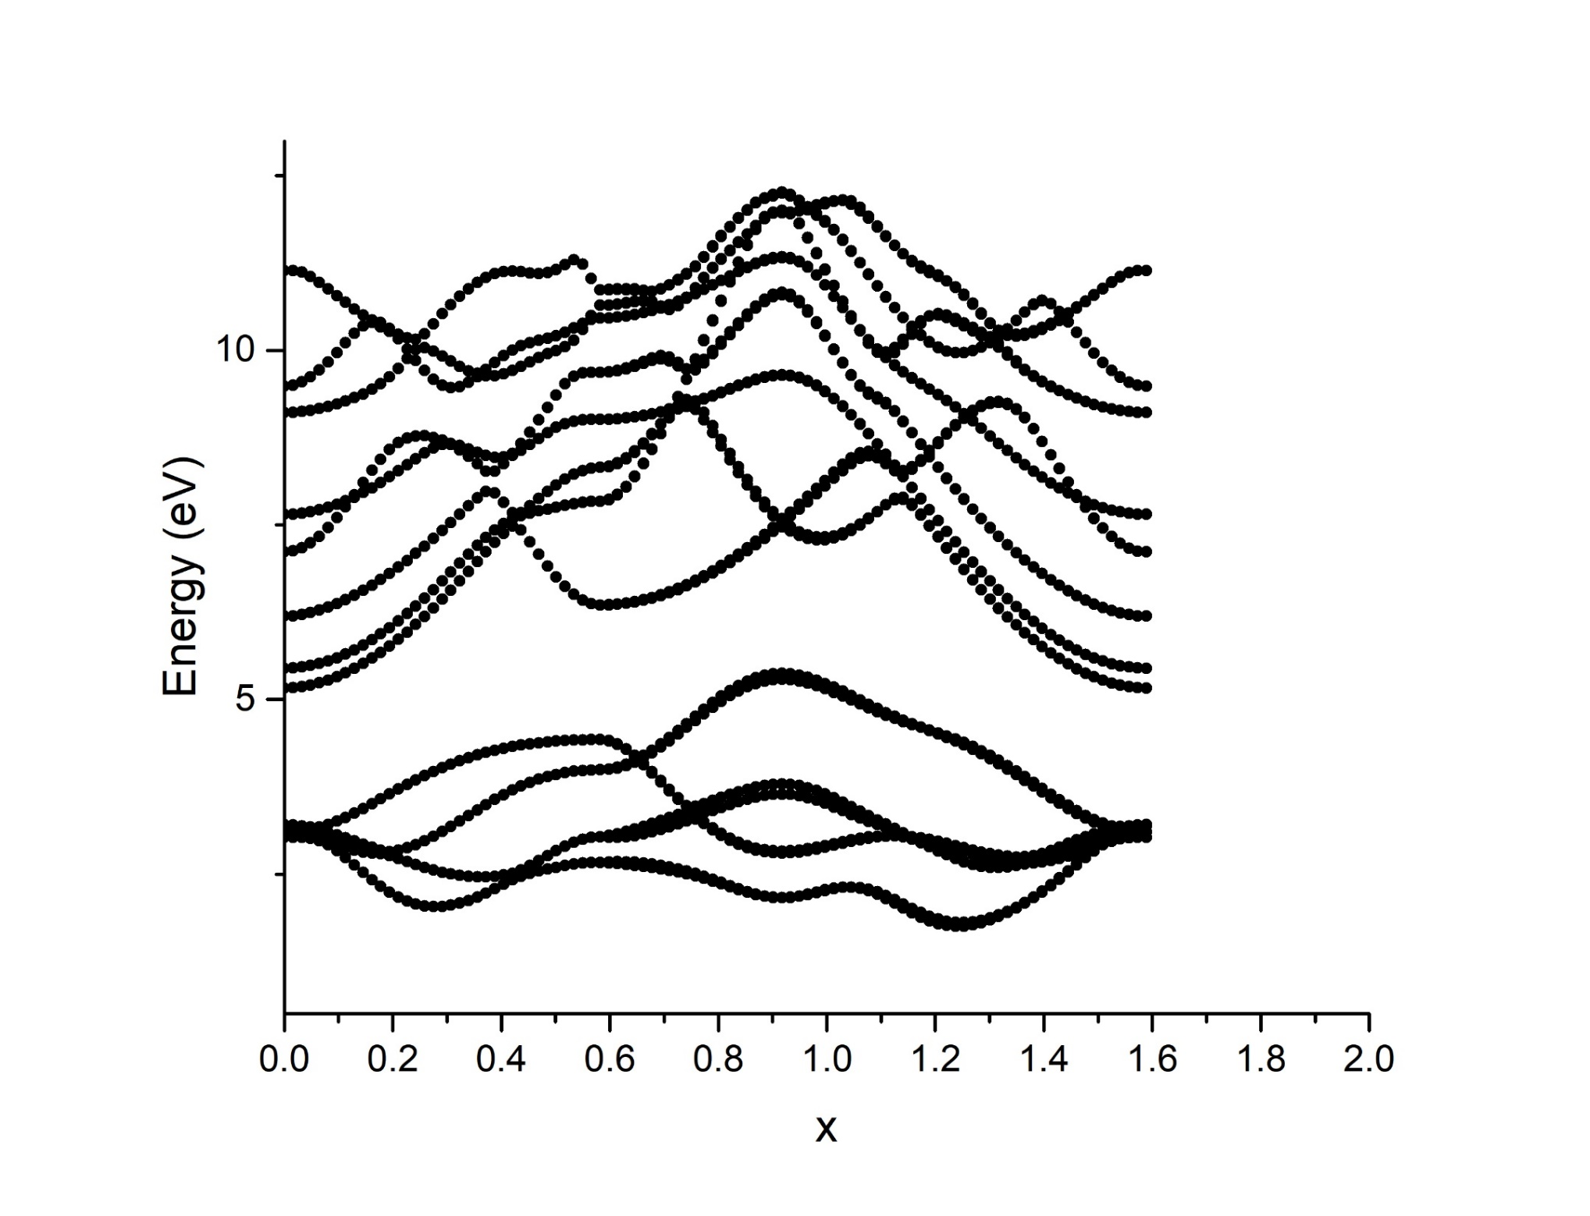
Band structure for unit cell

Slide 13
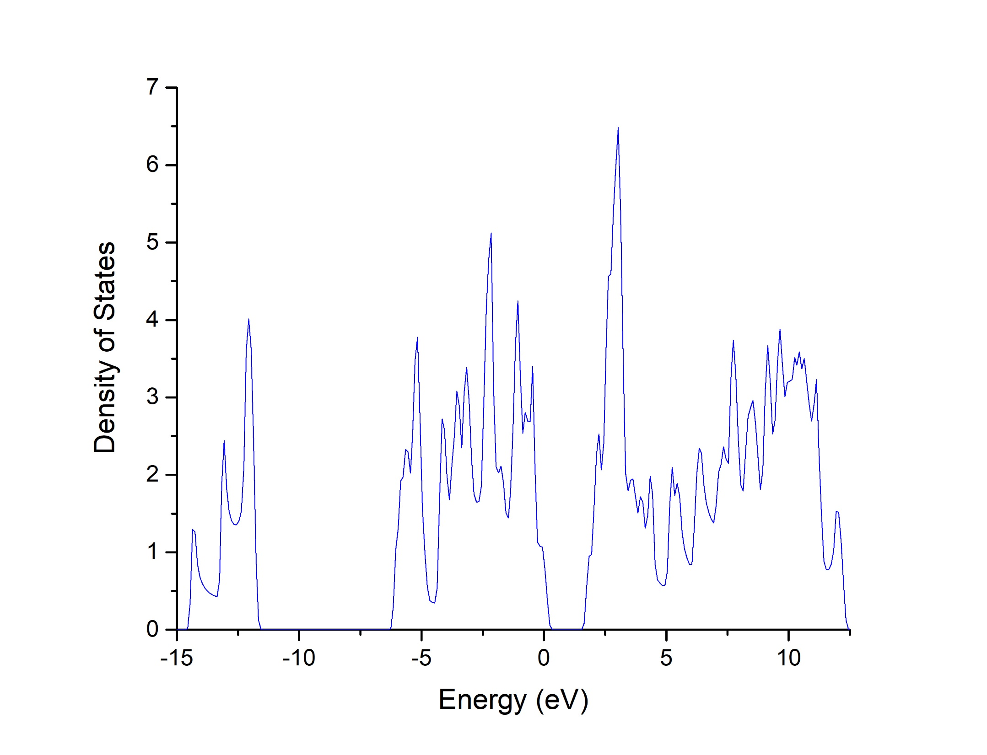
Density of States Plot

Slide 14
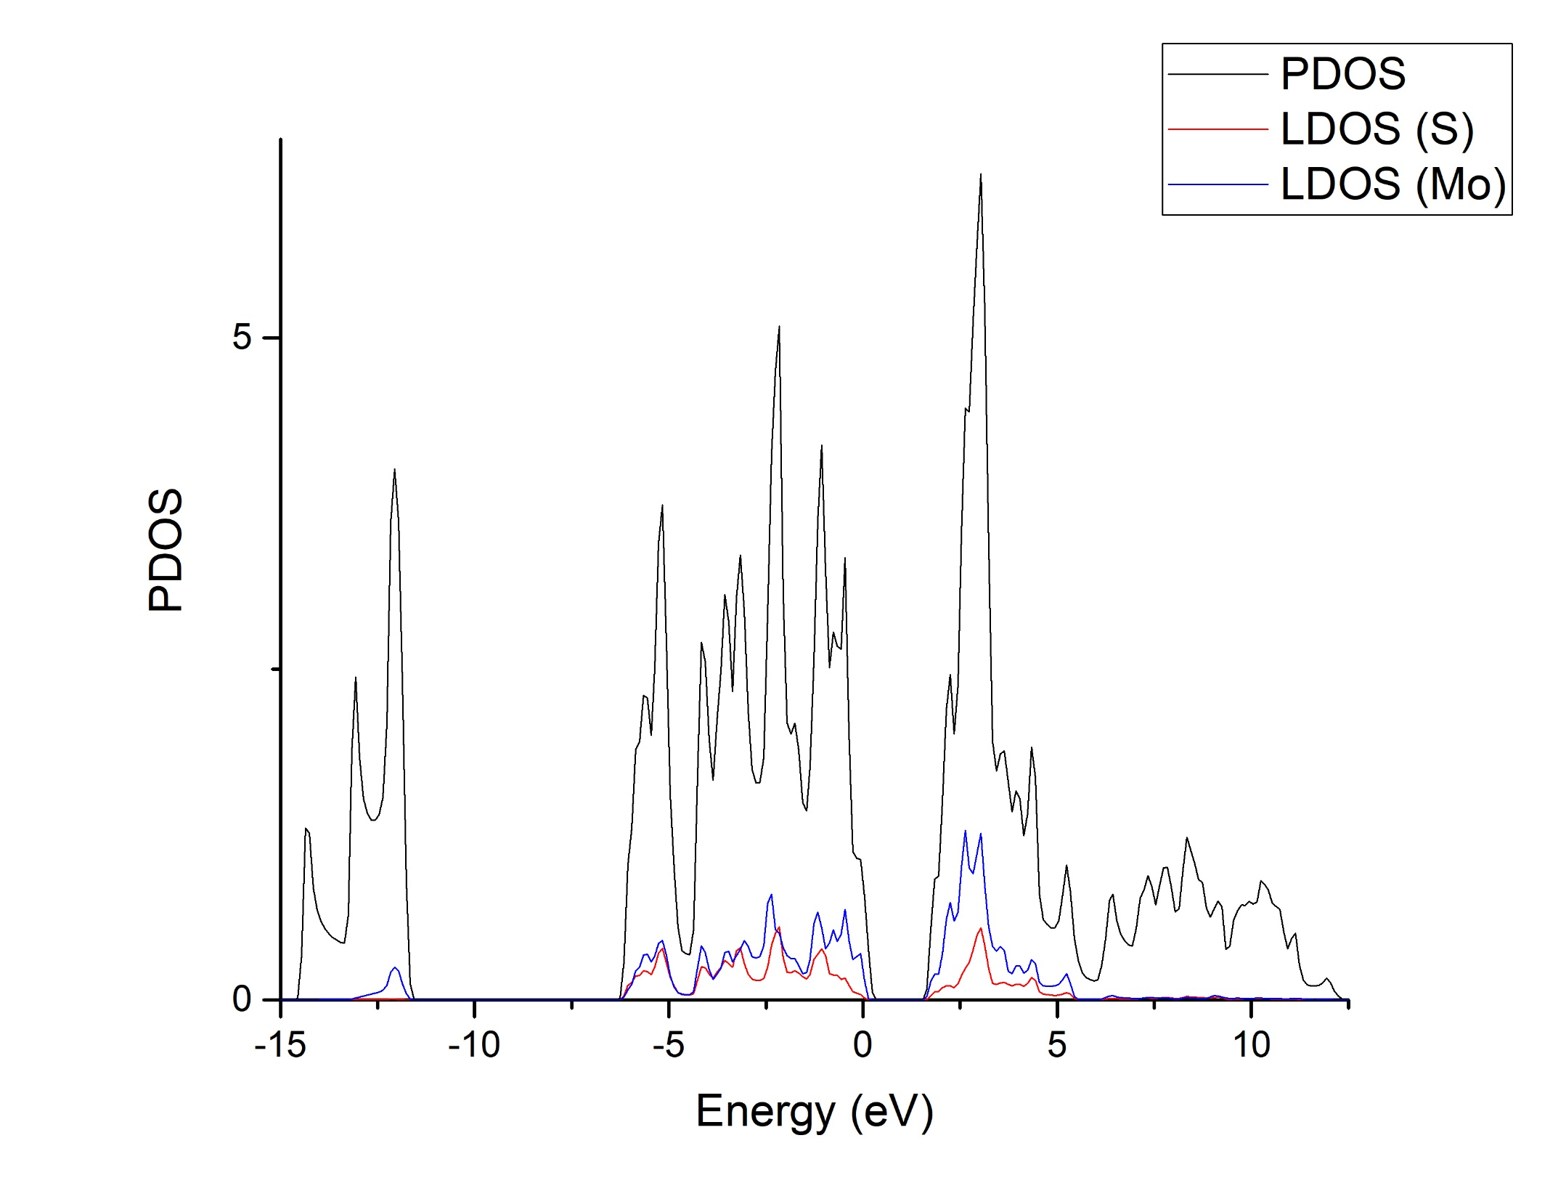
PDOS Plot

Slide 15
Next steps
Repeat for 3x3x1
Repeat for 3x3x1, top S defect

