Slide 1

Predicting: Covid-19 Cases
Shashank Raj
P192A074

Slide 2
Data Preparation
Media: Git Hub.
URL: https://github.com/datasets/covid-19/
Columns: Date, Country, Confirmed, Deaths
Framework: Facebook Prophet

Slide 3
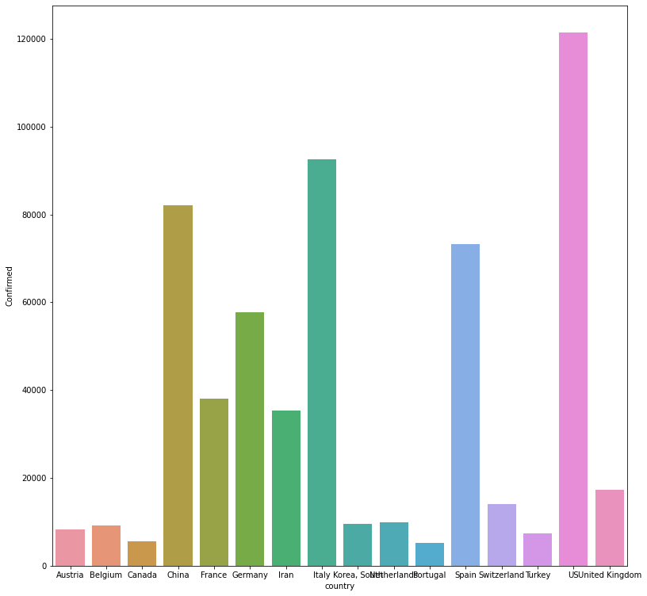
Top Effected Countries

Slide 4
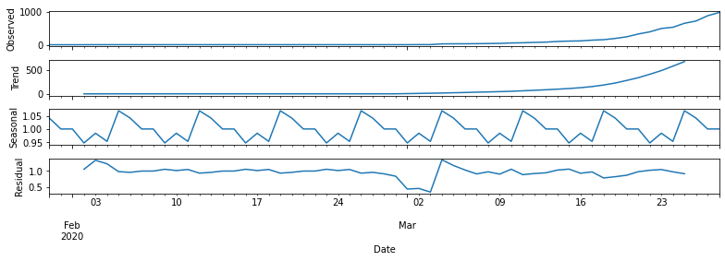
Seasonality and Trend

Slide 5
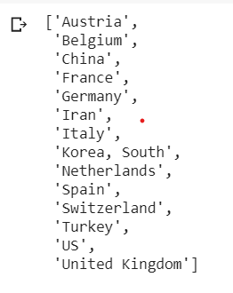
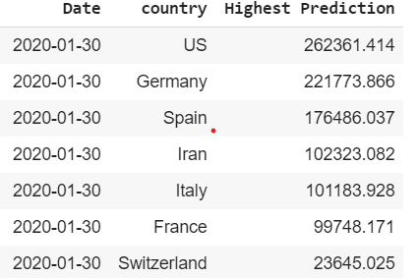
Part A: Top Country(% Change in cases)
Top Countries with Percentage change in number of conformed patients
Selected Countries
Hence, US, Germany and Spain are the top 3 countries to be effected for the given date.

Slide 6
Part B: Prediction for India
Variables in play:
Lockdown: Created a lockdown variable and added the date till 14th April so as to reduce weightage of such days.
Daily Seasonality = False, Weekly and Yearly Seasonality = True
Seasonality Mode = Multiplicative

Slide 7
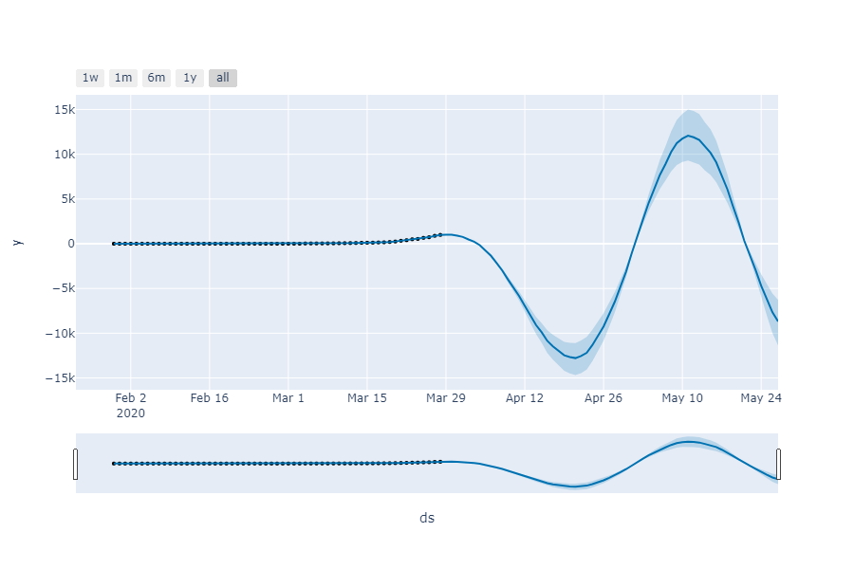
Part B: Visualisation
Interactive Image(on-hover) by: Prophet

Slide 8
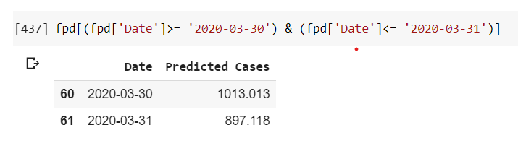
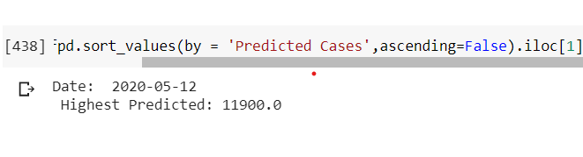
Part B: Insights
Number of Cases for date 30th and 31st March = 1013 and 897 respectively
Highest Number of Cases within a 2 month period = 11900 on 12th May

Slide 9
Thanks

