Slide 1
Insertion in red-black trees
a-b trees
  What are they?
  Insertion and deletion in a-b trees

Slide 2
Insertion in red-black trees
Let k be the key being inserted
As in the case of a BST we first search for k; this gives us the place where we have to insert k.
We create a new node with key k and insert it at this place.
The new node is colored red.

Slide 3
Insertion(2)
Since inserted node is colored red, the black height of the tree remains unchanged.
However, if the parent of inserted node is also red then we have a double red problem.
k
k
No problem
Double red problem

Slide 4
Insertion: case 1
Parent of inserted node (a) is red.
Parent of (a) must be black (b)
The other child of (b) is black (c).
a
b
c
a
b
k
k
c
The 2-4 tree node contains {b,a,k} and is malformed.
The rotation corrects the defect.

Slide 5
Insertion: Case 2
Parent of inserted node (a) is red.
Parent of (a) must be black (b)
The other child of (b) is also red (c).
b
b
a
c
a
c
k
k
b
c
b
a
k
c
a
k

Slide 6
Insertion: case 2 (contd)
The parent of b could also be red. In that case, the double red problem moves up a level.
We repeat this process at the next level.
Eventually, we might color the root red.
In this case we recolor the root black. This increases the black depth of every external node by 1.
In the 2-4 tree this corresponds to splitting the root.

Slide 7
Insertion and Deletion: Summary
In both insertion and deletion we need to make at most one rotation.
We might have to move up the tree but in doing so we only recolor nodes.
Time taken is O(log n)

Slide 8
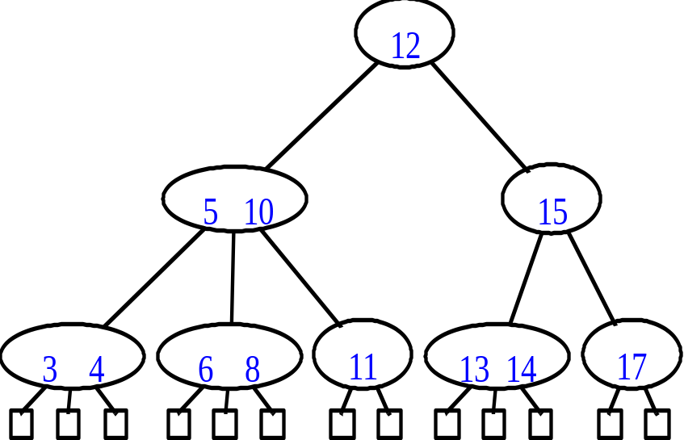
(a,b) Trees
A multiway search tree.
Each node has at least a and at most b children.
Root can have less than a children but it has at least 2 children.
All leaf nodes are at the same level.
Height h of (a,b) tree is at least log_{b} n and at most log_{a} n.

Slide 9
Insertion
No problem if the node has empty space
21
23
29
7
13
22
3
8
18
25
1
2
4
5
9
14
15
20
24
26
28

Slide 10
Insertion(2)
Nodes get split if there is insufficient space.
The median key is promoted to the parent node and inserted there
29
7
13
22
3
8
18
25
1
2
4
5
9
14
15
20
23
24
26
28

Slide 11
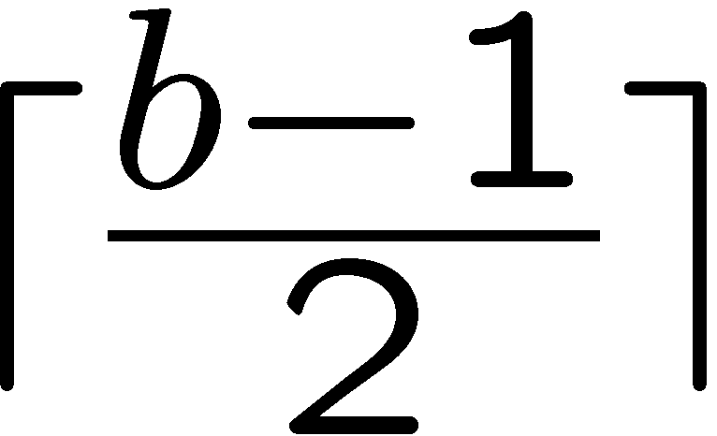
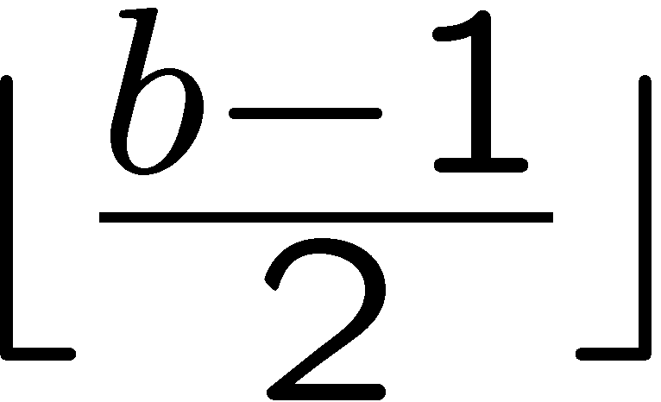
Insertion(3)
A node is split when it has exactly b keys.
One of these is promoted to the parent and the remaining are split between two nodes.
Thus one node gets and the other
keys.
This implies that a-1 >=

Slide 12
Deletion
If after deleting a key a node becomes empty then we borrow a key from its sibling.
Delete 20
13
5
22
3
8
10
18
24
28
1
2
4
6
7
9
11
12
14
15
20
23
26
29
30

Slide 13
Deletion(2)
If sibling has only one key then we merge with it.
The key in the parent node separating these two siblings moves down into the merged node.
Delete 23
13
5
22
3
8
10
18
24
28
1
2
4
6
7
9
11
12
14
15
20
23
26
29
30

Slide 14
Deletion(3)
In an (a,b) tree we will merge a node with its sibling if the node has a-2 keys and its sibling has a-1 keys.
Thus the merged node has 2(a-1) keys.
This implies that 2(a-1) <= b-1 which is equivalent to a-1 <= .
Earlier too we argued that a-1 <=
This implies b >= 2a-1
For a=2, b >= 3

Slide 15
Conclusion
The height of a (a,b) tree is O(log n).
b >= 2a-1.
For insertion and deletion we take time proportional to the height.

