Slide 1
Rank
Rank of an element is its position in ascending key order.
[2,6,7,8,10,15,18,20,25,30,35,40]
rank(2) = 0
rank(15) = 5
rank(20) = 7

Slide 2
Selection Problem
Given n unsorted elements, determine the k’th smallest element. That is, determine the element whose rank is k-1.
Applications
  Median score on a test.
    k = ceil(n/2).
  Median salary of Computer Scientists.
  Identify people whose salary is in the bottom 10%. First find salary at the 10% rank.

Slide 3
Selection By Sorting
Sort the n elements.
Pick up the element with desired rank.
O(n log n) time.

Slide 4
Divide-And-Conquer Selection
Small instance has n <= 1. Selection is easy.
When n > 1, select a pivot element from out of the n elements.
Partition the n elements into 3 groups left, middle and right as is done in quick sort.
The rank of the pivot is the location of the pivot following the partitioning.
If k-1 = rank(pivot), pivot is the desired element.
If k-1 < rank(pivot), determine the k’th smallest element in left.
If k-1 > rank(pivot), determine the (k-rank(pivot)-1)’th smallest element in right.

Slide 5
D&C Selection Example
Find kth element of:
a
3
2
8
0
11
10
1
2
9
7
1
Use 3 as the pivot and partition.
a
1
2
1
0
2
4
3
10
11
9
7
8
rank(pivot) = 5. So pivot is the 6’th smallest element.

Slide 6
D&C Selection Example
a
1
2
1
0
2
4
3
10
11
9
7
8
If k = 6 (k-1 = rank(pivot)), pivot is the element we seek.
If k < 6 (k-1 < rank(pivot)), find k’th smallest element in left partition.
If k > 6 (k-1 > rank(pivot)), find (k-rank(pivot)-1)’th smallest element in right partition.

Slide 7

Time Complexity
Worst case arises when the partition to be searched always has all but the pivot.
  O(n²)
Expected performance is O(n).
Worst case becomes O(n) when the pivot is chosen carefully.
  Partition into n/9 groups with 9 elements each (last group may have a few more)
  Find the median element in each group.
  pivot is the median of the group medians.
  This median is found using select recursively.

Slide 8
Closest Pair Of Points
Given n points in 2D, find the pair that are closest.

Slide 9
Applications
We plan to drill holes in a metal sheet.
If the holes are too close, the sheet will tear during drilling.
Verify that no two holes are closer than a threshold distance (e.g., holes are at least 1 inch apart).

Slide 10

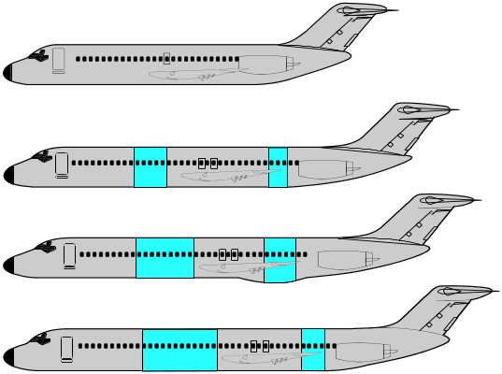


Air Traffic Control
3D -- Locations of airplanes flying in the neighborhood of a busy airport are known.
Want to be sure that no two planes get closer than a given threshold distance.

Slide 11
Simple Solution
For each of the n(n-1)/2 pairs of points, determine the distance between the points in the pair.
Determine the pair with the minimum distance.
O(n²) time.

Slide 12
Divide-And-Conquer Solution
When n is small, use simple solution.
When n is large
  Divide the point set into two roughly equal parts A and B.
  Determine the closest pair of points in A.
  Determine the closest pair of points in B.
  Determine the closest pair of points such that one point is in A and the other in B.
  From the three closest pairs computed, select the one with least distance.
Notes:
Algorithm doesn’t actually find closest pair with 1 point in A and other in B. Rather, it does this only if such a pair is the closest overall pair!

Slide 13
Example
A
B
Divide so that points in A have x-coordinate <= that of points in B.

Slide 14
Example
d₁
A
B
Find closest pair in A.
Let d₁ be the distance between the points in this pair.

Slide 15
Example
d₁
d₂
A
B
Find closest pair in B.
Let d₂ be the distance between the points in this pair.

Slide 16
Example
d₁
d₂
A
B
Let d = min{d₁, d₂}.
Is there a pair with one point in A, the other in B and distance < d?

Slide 17
Example
A
R_{A}
R_{B}
B
Candidates lie within d of the dividing line.
Call these regions R_{A} and R_{B}, respectively.

Slide 18
Example
q
A
R_{A}
R_{B}
B
Let q be a point in R_{A}.
q need be paired only with those points in R_{B} that are within d of q.y.

Slide 19
Example
2d
q
d
A
R_{A}
R_{B}
B
Points that are to be paired with q are in a d x 2d rectangle of R_{B} (comparing region of q).
Points in this rectangle are at least d apart.

Slide 20
Example
2d
q
d
A
R_{A}
R_{B}
B
So the comparing region of q has at most 6 points.
So number of pairs to check is <= 6| R_{A} | = O(n).

Slide 21
Time Complexity
Create a sorted by x-coordinate list of points.
  O(n log n) time.
Create a sorted by y-coordinate list of points.
  O(n log n) time.
Using these two lists, the required pairs of points from R_{A} and R_{B} can be constructed in O(n) time.
Let n < 4 define a small instance.

Slide 22
Time Complexity
Let t(n) be the time to find the closest pair (excluding the time to create the two sorted lists).
t(n) = c, n < 4, where c is a constant.
When n >= 4,
  t(n) = t(ceil(n/2)) + t(floor(n/2)) + an,
  where a is a constant.
To solve the recurrence, assume n is a power of 2 and use repeated substitution.
t(n) = O(n log n).
Notes:
When you add in the initial sort time for the sort by x and sort by y lists, the overall time remains O(n log n).

