Slide 1

EduFlare: A Comprehensive E-Learning Platform

Slide 2
Introduction
The dynamic e-learning platform EduFlare bridges the distance between instructors ready to offer their expertise and students eager to learn. It meets different preferences for learning by providing a large range of courses in fields by sorting them into different categories.
Notes:
Globally linking students and instructors, EduFlare is an e-learning platform It offers courses in business, arts, and technology among other disciplines. The platform seeks to provide interactive and flexible possibilities for learning, therefore improving information exchange and skill development.

Slide 3
Purpose and Target Audience
EduFlare's primary purpose is to provide an online environment platform that supports professional development, personal growth, and skill upgrading. Its adaptability lets students access materials whenever it would be most convenient and helps instructors impart their expert knowledge. The platform targets:
Students: Professionals, lifelong learners, college students seeking fresh skills or exploration of interests.
Instructors: Professionals from several fields want to sell their knowledge worldwide and profit from it.
Notes:
The platform seeks instructors ready to offer knowledge and students who want to pick up new skills or follow personal interests. EduFlare provides easily available education that fits students' schedules, therefore encouraging career development and lifetime learning.

Slide 4
Workflow of the Project
EduFlare's design is meant to guarantee a seamless interaction among its main users:
Admin: Platform operations—including user accounts, course reviews, and category development—are handled by the administrator.
Instructor: Instructors create and manage courses, properly classify them.
Student: Students start the course and goes through the course content and can rate the content and write their review for that.
Notes:
This slide lays out the system's flow. Platform administration is under supervision by administrators; course development is handled by instructors; and students engage with the content. The feedback loop guarantees ongoing enhancement of delivery and content.

Slide 5
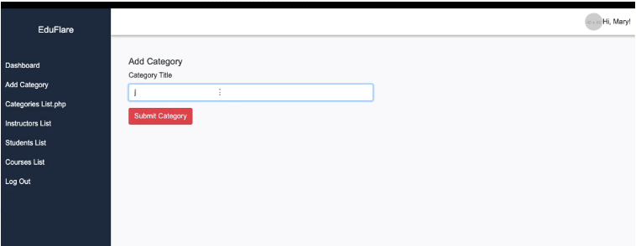
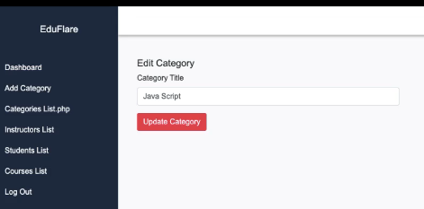
System Roles and Responsibilities
Admin:
Has access to look all the registered instructors and students
Can access the course feedback and avg rating for all the courses
Can add new categories and edit/ delete the existing ones
Notes:
Platform management depends critically on the administrative position, which also guarantees quality monitoring and user approval of courses. Administrators also maintain data integrity and check analytics to enhance platform performance.

Slide 6
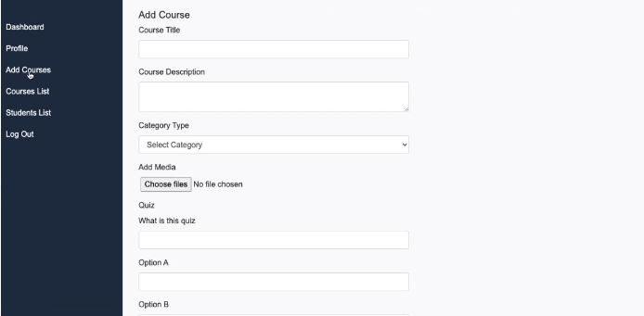
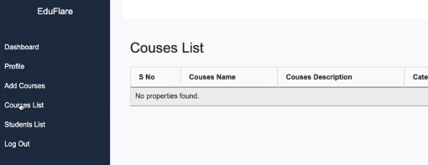
Continue..
Instructor:
Design, upload, and manage courses with multimedia assistance.
Sort items into categories for simple student access.
Can update the course material based on the feedback
Notes:
Instructors focus on developing, organizing, and classifying their materials. They also interact with feedback from students to raise the level of quality and applicability of their materials, thereby enhancing the learning environment.

Slide 7
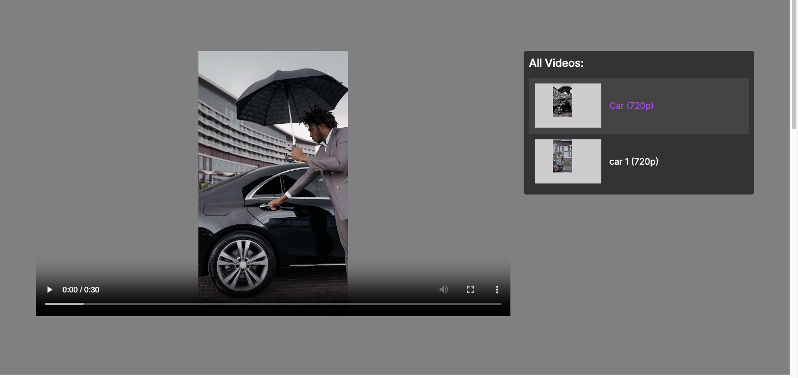
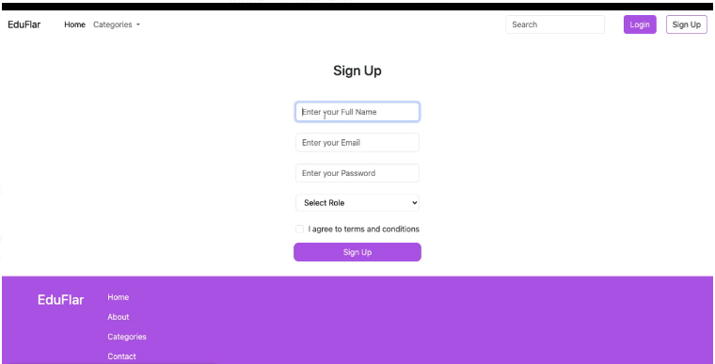
Continue..
Student:
Search a well-organized course catalog arranged for easy navigation.
Track progress, start courses.
Feedback and suggestions will help to enhance the course materials.
Notes:
Students browse the site and register for classes. Their learning path is both organized and fulfilling as they can monitor their development, provide evaluations, and get certificates.

Slide 8
Technologies Used
Modern and strong technology is the foundation of EduFlare to guarantee scalability, efficiency, and user satisfaction:
Frontend Technologies:
PHP: For server-side scripting and dynamic content rendering.
CSS: Provides a responsive and user-friendly interface.
Backend Technologies:
MySQL: A relational database for organized retrieval and storing of structured data.
Applies dynamic query optimization and safe user authentication.
Notes:
Modern web technologies allow EduFlare to guarantee scalability and speed. MySQL manages backend data; PHP and CSS drive the frontend. This strong stack promises a flawless user interface.

Slide 9
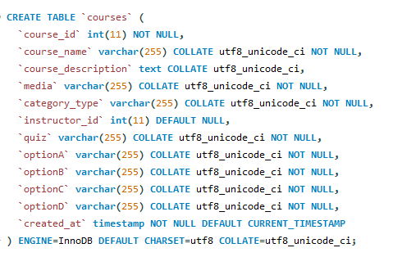
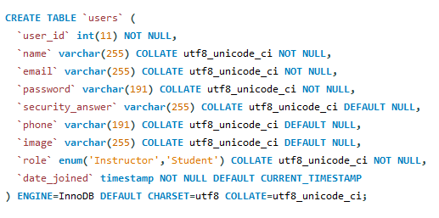
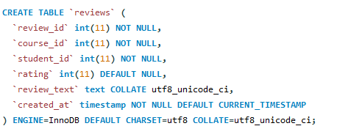
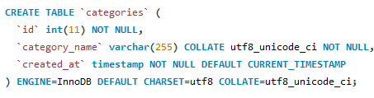
Database Structure
The way EduFlare's database is set ensures seamless interaction between courses, reviews, and users as well as data integrity. The following tables are included in the database:
Users Table: Organizes data about instructors, administrators, and students. Each has a different role assigned to them.
Courses Table: Manages course details in connection to instructors.
Reviews Table: Stores feedback from students on courses.
Categories Table: Maintaining course classification for simple browsing.
Notes:
The database is organized so that data integrity is maintained using standardized tables.

Slide 10
Foreign Key Relationships
Linking every course to its creator, the instructor_id in courses references user_id in users.
Review references match course_id in courses, therefore ensuring that reviews are related to existing courses.
The student_id in reviews references user_id in users, verifying valid student input.
Notes:
Significant relationships link courses, reviews, users, and categories. Good data storage and retrieval made possible by this approach guarantees scalability.

Slide 11
Future Improvements
Make student registration only possible if it gets the instructor approval
Make instructor to upload tests for the course and course certifications
Live class tutoring and assignments for the courses
Notes:
Advanced analytics, suggestions powered by artificial intelligence, and mobile app development are among future improvements. Including gamification and multimedia tools will improve user involvement, hence increasing the platform's attractiveness and interactability.

Slide 12
Thank you

