Slide 1
Case study
Data-Driven Marketing: Purchase Behavioral
Targeting in Travel Industry based on
Propensity Model
By : Shashank Shanu
19125760086

Slide 2
D – define the biz problem
Business language : To explore techniques of big data marketing and purchasing behavioral targeting, and to apply them in marketing for travel agents and tour operators. So that the overall Business can be can be improve.
Analytics language (Y) : To build tourist purchasing propensity models, and to evaluate propensity model accuracy with the test data set and to provide marketing recommendations based on the propensity models, that is, to discuss how to use the results of propensity models to propose marketing strategy guidance.

Slide 3
C – collect the data
Sources of data : As we discussing the research method, in this paper, data collection sources would focus on individual behavior and customer historical bookings, since this is a case study at an individual level . Thus, the data was collected from the organizational CRM database, archival records, and marketing activities at company A.
Sampling : The purpose is to withdraw 100,000 customer historical booking records in order to better explain the propensity models. Because we need to use 40% of the customer records to test and validate the accuracy of the propensity model, therefore, 60%, that is 60,000, of the customer booking records would be used to build the propensity model in terms of logistic regression.

Slide 4
O- organise the data
1. Missing values : Needs to be treated as per the requirement.
2. Outliers : Needs to be treated as per the requirement.
3. Dummy variables : Buy2MonthsAhead, Buy3to6MonthsAhead, Buy7to9MonthsAhead, BuyAgent
Buy10orMoreMonthsAhead, BuyDirect, BuyOnline
4. Derived variables: Dep1to2, Dep3to6, Dep7to9, Dep10to12, GenderF or GenderM
5. Combine data : HotelOther

Slide 5
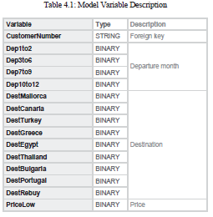
V – Visualise
1. Dependent variable (Y) : The travelers’ purchasing behavior
2. Independent variable’s(X) : In total, 64 independent variables are selected for propensity modeling. All of the variable’s are shown , see table 4.1 . CustomerNumber does not belong to independent variable it’s just a foreign key to identify each customer record.

Slide 6
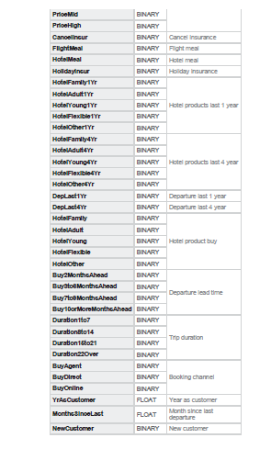
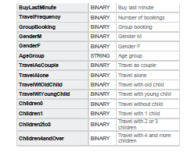
Independent variable’s(X)

Slide 7
Sample Dataset
Table 4.2: Sample Case Data

Slide 8
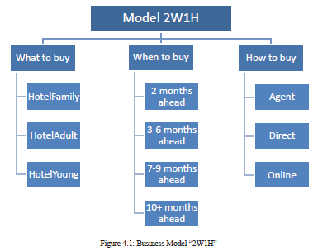
Business Case Analysis
Business Case Analysis is prepared to discuss and analyze the business case with the collected customer historical data from a tour operator company A. Propensity model and logistic regression techniques will be conducted to build predictive model for behavioral targeting.

Slide 9
Analysis of 2W1H model
The business model “2W1H”, it is shown that, there are three hotel products we can predict to see if a customer is going to buy one or not under the business model “What to buy”; there are four departure lead time periods we can forecast to check when the customer will make next booking under the business model “When to buy”; and under business model “How to buy”, there are also three channels we can predict which way a customer is going to purchase next trip.

Slide 10
1. Analysis of “What to buy”
As said, we take “HotelFamily” as dependent variable for business model “What to buy” to run propensity model to predict if a customer is going to buy family hotel product. Load the training data set into R and run logistic regression. At the first run, we might come across the situation where there would be some independent variables that is not significant for predicting the appointed event, then we need to take way the insignificant variables and rerun the propensity model again until we get rid of all the insignificant variables. Thereafter, we get a proper propensity model with a summary that includes only significant predictors in below table 5.1.

Slide 11
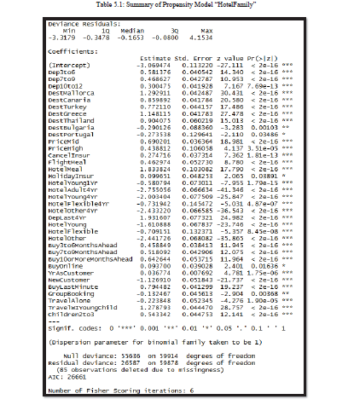

Accuracy of Propensity Model “HotelFamily”: 92.23 %

Slide 12
2. Analysis of “When to buy”
For business model “When to buy”, we take “Buy2MonthsAhead” as dependent valuable, which we want to predict if a customer is going to purchase next trip 2 months before departure. Load the data into RStudio, and apply logistic regression.
The summary of model_Buy2MonthsAhead at first run of glm() propensity model is shown in Table 5.2. From the summary, we can see that some of the independent variables are not significant to predict if a customer is going to purchase next trip 2 months before departure. So, we need to take those insignificant variables away and rerun the model again until all the predictors are significant, then we get the proper propensity model for “Buy2MonthAhead”.

Slide 13
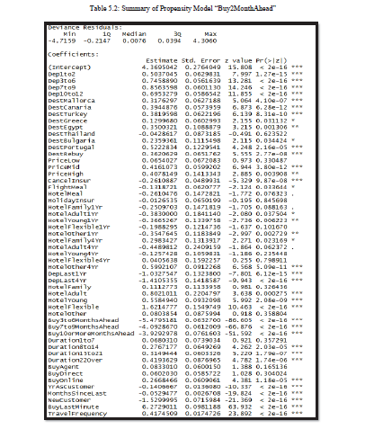
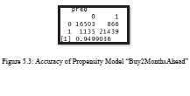
Accuracy of Propensity Model “Buy2MonthsAhead”:94.99%

Slide 14
3. Analysis of “How to buy”
For business model “How to buy”, we will take “BuyOnline” as an example to run propensity model to predict if a customer is going to purchase next trip online. And the forecast for other two channels “BuyDirect” and “BuyAgent” can follow the same steps afterwards. Load both the training data and test into RStudio, and run logistic regression.
At first,we need to take out around ten independent variables due to the insignificance to the propensity model. After second and third rerunning of the propensity model, in total there are 19 insignificant variables that have been taken out. Thereafter, we get a proper propensity model with a summary that includes 45 significant predictors in below table 5.3.

Slide 15
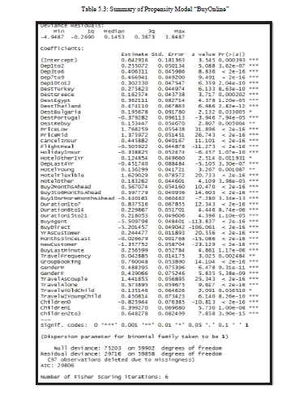
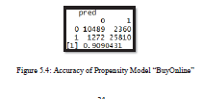
Accuracy of Propensity Model “BuyOnline” : 90.90%

Slide 16
I - Insights
By analyzing the business model “2W1H” and the propensity model on each business model, both the validation of the model based on training model and test data set, and the validation of actual marketing activities, it has been proven that predictive analytics plays a vital role in the implementation of travelers’ purchasing behavioral targeting in marketing.
Through investigating the procedures and implementation of big data and data-driven marketing by applying
propensity models to predict traveler’s purchasing behavior at Tour Operator Company A, a cost-effective and reliable targeting approach was demonstrated. The evidence suggests that implementing personalized targeting in marketing increases sales and conversion rate.
Options: This paper discusses two validation ways of the performance of propensity model, it would be valuable and recommended to also track and follow up on customer retention rate, repeater ratio, customer satisfaction scores, and NPS (Net Promoter Scores) and see what the effect will be when implementing purchasing behavioural targeting in tourism marketing.
2. The best way : To stand out in the competitive travel business, it’s important for the marketers to establish data- driven and big data marketing mindset.

Slide 17
Thank You

