Slide 1
Iplayer Music
By Shashank shrivastava

Slide 2
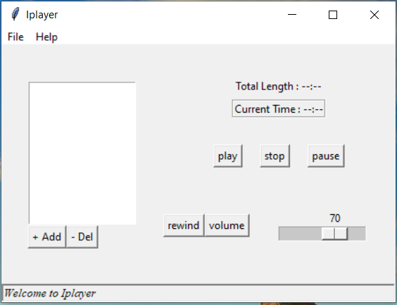
Iplayer-feel the music
welcome to iplayer.
IT is used for listening music.

Slide 3
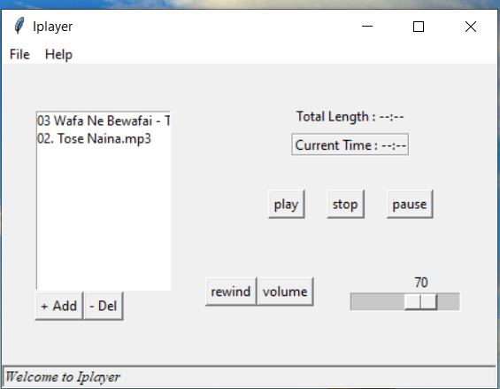
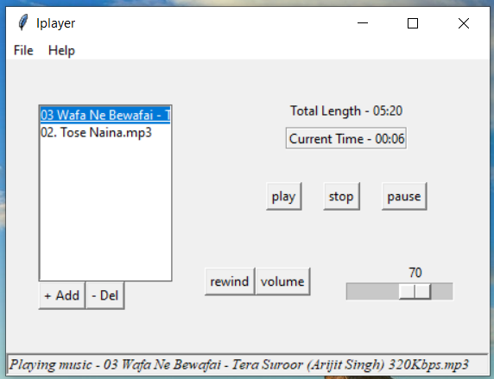
select the music and select and play the music by clicking on play button

Slide 4
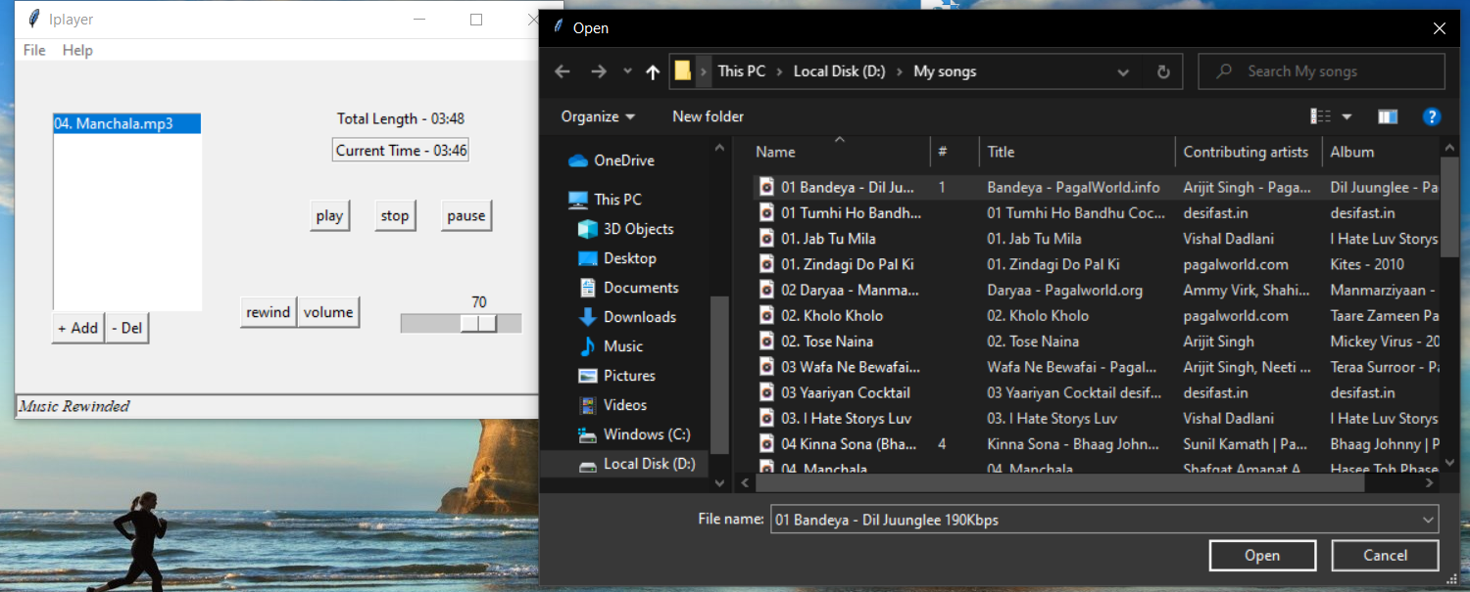
CREATING A PLAYLIST
click on file and open the file dialog
And choose the fav. Song and also add and delete the song by using add and del buttons.

Slide 5
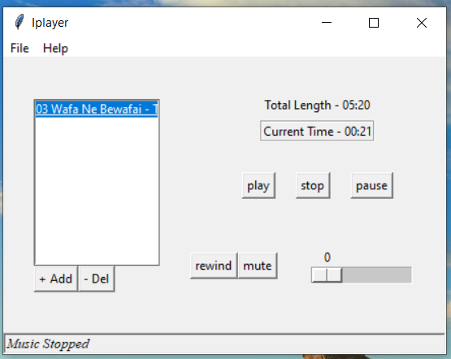
Playing and stop and mute the song
Click on a play button to play the song.
To mute and stop the song click on stop and mute button .By using volume button the seek bar goes to 0. and mute the song

Slide 6
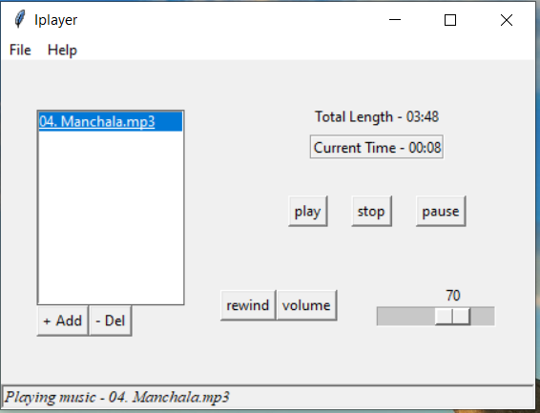
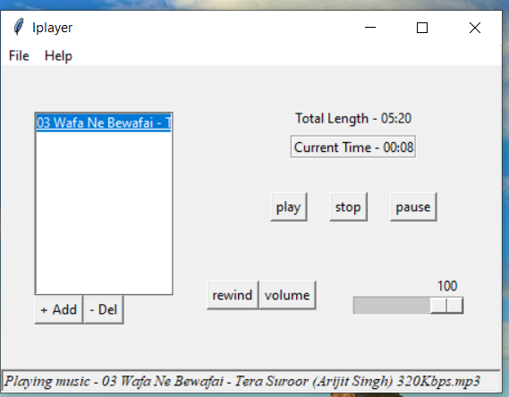
Max and default volume
The default value of volume is 70 and maximum value is 100.By seeking on seek bar we change the value of volume

Slide 7
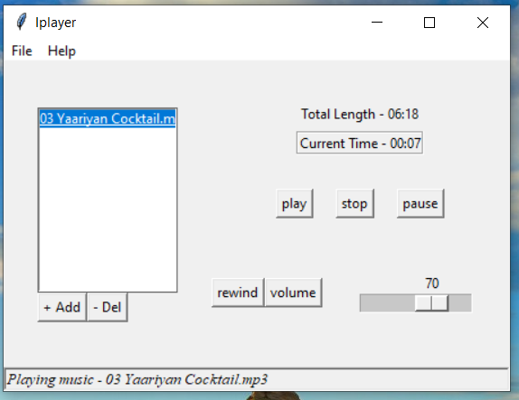
Length and song details
The total length define a total length of song and current time define the current time of song .and status bar show the details of songs which current is playing

Slide 8
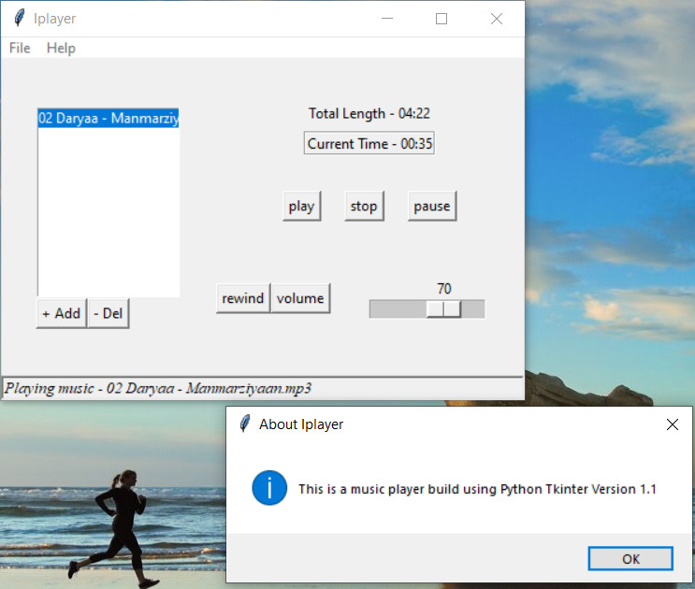
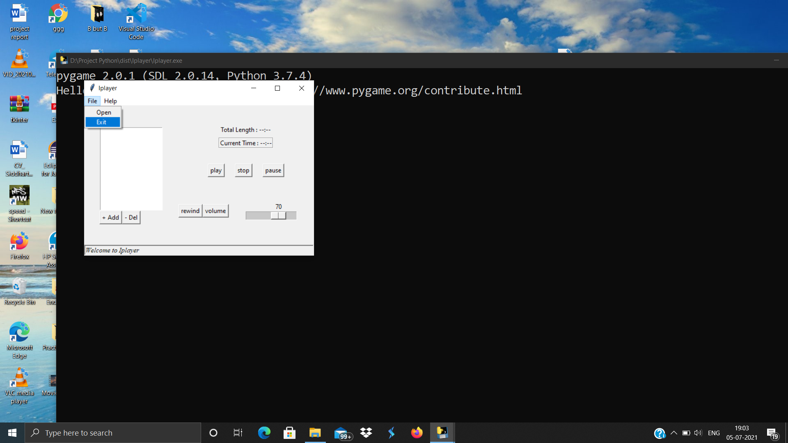
Help and Exit the Iplayer
To click on help section which give details on a about section of Iplayer and version of Iplayer.
To close the Iplayer click on exit which is in a on a file menu and click on exit
Thank You..

