Slide 1

AUTOMATIC ATTENDANCE SYSTEM
USING FACE RECOGNITION
Under guidance of :
Prof. Haranath Kar
Presented by:
Kavya Paliwal ( 20145041 )
Shashank Singh ( 20145061 )
Lanka Vamsi Krishna ( 20145024 )

Slide 2
Introduction
Authentication is one of the significant issues in the era of information system.
Among various biometric method, human face recognition (HFR) is one of known techniques which can be used for user authentication.
As an important branch of biometric verification, HFR has been widely used in many applications, such as video monitoring/surveillance system, human-computer interaction, door access control system and network security.
We are trying to implement it for student attendance system in classroom.

Slide 3
Present scenario
It takes manual effort and is time consuming.
It is tedious to keep records in bulk.
Chances of fake attendance is high
Using automated system, paperwork will be reduced and it will save time.

Slide 4







Required technologies

Slide 5
Flow chart and process overview
INPUT
Realtime : RGB Image
Pre -
Processing
Equalization and normalization using Histogram equalisation
Conversion to Greyscale
Face
Detection
Using Haar feature - based classifiers ?
Pre -
Processing
Crop face from equalized and normalized greyscale image
Resizing
Face
Recognition
Eigen?
Fisher?
LBPH?
Success
Face Recognised

Slide 6
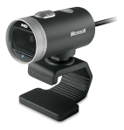



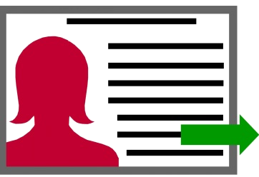

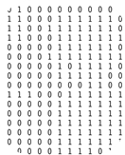

Working
20xxxxxx
Database
20xxxxxx
Prediction
Pre - processing
Training
data

Slide 7
References
Technologies Related :
Python ( As programming language ) : https://www.python.org/doc/
OpenCV ( For image processing ) : http://docs.opencv.org/3.0-beta/doc/py_tutorials/py_tutorials.html
SQLite ( DBMS ) : https://www.tutorialspoint.com/sqlite/
HTML5 ( For frontend design ) : https://www.w3schools.com/html/html5_intro.asp
CSS3 ( For frontend design ) : https://www.w3schools.com/css/default.asp
Bootstrap3 ( For frontend design ) : https://www.w3schools.com/bootstrap/default.asp
Flask ( A framework for backend management ) : http://flask.pocoo.org/docs/0.12/
Useful Image Processing Algorithms :
Histogram equalization ( For better image contrast ) : https://en.wikipedia.org/wiki/Histogram_equalization
Haar-cascade ( For face detection ) : http://ds.cs.ut.ee/Members/artjom85/2014dss-course-media/Object%20detection%20using%20Haar-final.pdf
Eigen ( For face recognition ) : https://en.wikipedia.org/wiki/Eigenface
Fisher ( For face recognition ) : https://en.wikipedia.org/wiki/Fisher_kernel
Local Binary Patterns Histograms ( For face recognition ) : https://en.wikipedia.org/wiki/Local_binary_patterns

Slide 8
Thank you

