Slide 1


BRINDAVAN COLLEGE OF ENGINEERING
Dwarakanagar, Bagalur Main Road, Yelahanka, Bengaluru – 560063
Affiliated to VTU Belagavi, Approved by AICTE, New Delhi, India .Accredited ‘B++’ level by NAAC
Department of Electronics and Communication Engineering
Major Project Work Presentation On
“RoboPet: AI-Based Smart Robotic Companion (Sentinel-X)”
Under the guidance of
Presented by
SHANKAR S
Prof. BOBAN MATHEW
[1BO23EC080] [1BO23EC083] [1BO23EC098] [1BO23EC112]
SHASHANK SP UDHAYAVANAN M YASHAS MR

Slide 2
INTRODUCTION
Sentinel-X is an advanced intelligent robotic system designed to function as both a companion and a smart monitoring device.
It integrates modern technologies such as artificial intelligence, sensors, and communication modules to perform multiple tasks efficiently.
One of its primary features is home surveillance, where it continuously monitors the surroundings using cameras and sensors to enhance security.
The system also includes user recognition, enabling it to identify authorized individuals through facial recognition techniques.
The robot understands voice commands, responds intelligently, and learns user behavior over time.

Slide 3
OBJECTIVE
Develop a multi-functional robotic companion
Design a robot that can act as both a personal assistant and a monitoring system.
Integrate advanced technologies Combine Artificial Intelligence (AI), Internet of Things (IoT), and sensors for efficient and intelligent operation.
Enhance smart living Ensure safety, efficiency, and user comfort while enabling complete smart home automation in a single system.

Slide 4
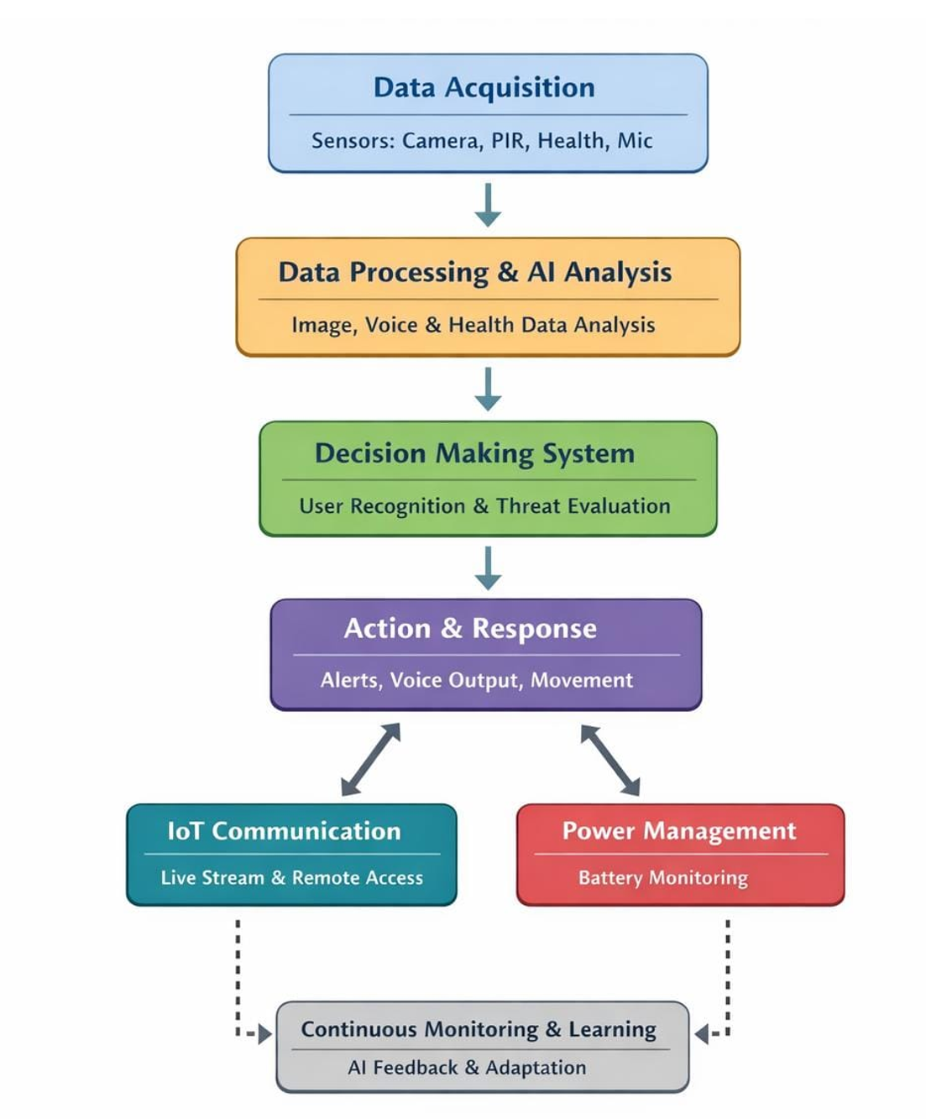
BLOCK DIAGRAM

Slide 5
Literature Review
Valls Mascaro E, Yan Y, Lee D (2024) Robot interaction behavior generation based on social motion forecasting for human-robot interaction. In 2024 IEEE International Conference on Robotics and Automation (ICRA)
AhmedA. A.AbualiT. M.BelkherA. A. A. (2025). The role of advanced robotics in enhancing human-machine collaboration. Open Eur. J. Eng. Sci. Res. (OEJESR), 32–43.
Bogdan Gabriel Draghici, Alexandra Elena Dobre, Marius Misaros, and Ovidiu Petru Stan. Development of a human service robot application using pepper robot as a museum guide. In 2022 IEEE International Conference on Automation, Quality and Testing, Robotics (AQTR), pages 1–5. IEEE, 2022.
Kumar, K., & Dhanalakshmi, K. (2020). A Smart Surveillance System for Real-Time Monitoring and Alerts. In 2020 11th International Conference on Computing, Communication and Networking Technologies (ICCCNT) (pp. 1-5). IEEE.
Nguyen PD, Bottarel F, Pattacini U, et al. Merging physical and social interaction for effective human-robot collaboration. 2018 IEEE-RAS 18th International Conference on Humanoid Robots (Humanoids); 2018 Nov 6-9; Beijing, China. IEEE; 2018. pp. 1–9.

Slide 6
CONCLUSION
Current systems are fragmented and inefficient Sentinel-X aims to solve this by providing a smart, integrated, and intelligent solution.
The system leverages real-time data from sensors and cameras to monitor the environment and user health, providing alerts in case of anomalies.
AI-driven interaction and predictive behavior enable the Sentinel-X to respond intelligently to user commands and social cues, enhancing usability and trust.

Slide 7
