Slide 1
Design Patterns
Shashank Srivastava
20-March-2019

Slide 2
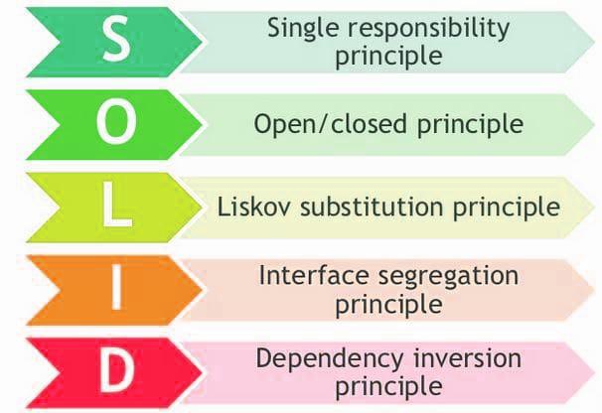
What is a Design Pattern?
In software engineering, a design pattern is a general repeatable solution to a commonly occurring problem in software design. A design pattern isn't a finished design that can be transformed directly into code. It is a description or template for how to solve a problem that can be used in many different situations. They represent the best practices used by experienced object-oriented software developers.
Design patterns help in designing software without flouting any of the SOLID design principles:

Slide 3
Advantages of Design Patterns
Time-tested solutions to recurring design problems
Represent relationships between classes and objects with defined responsibilities that act in concert to carry out the solution.
Once you understand or learn a pattern, debugging the issue becomes easier.
With use of design patterns development is fast and bug-free.
SOLID principles are honored
Less code smells

Slide 4
Disadvantages of Design Patterns:
Lot of code duplication is possible
Complex design patterns require a thorough understanding of OOPS concepts
Puts the burden on developers to learn the patterns
Chances of anti-patterns appearing is high if code review is not strict or if code passes on from one team to another

Slide 5
Different types of Design Patterns:
Design patterns are categorized into three types:
Creational Design Pattern
Structural Design Pattern
Behavioral Design Pattern

Slide 6
Creational Design Patterns
These design patterns are about class instantiation. They deal with object creation mechanisms, trying to create objects in a manner suitable to the situation. The basic form of object creation could result in design problems or added complexity to the design. Creational design patterns solve this problem by controlling object creation.
Types:
Singleton
AbstractFactory
Builder
Factory
Object pool
Prototype

Slide 7
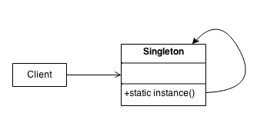
Singleton Design Pattern
Intent of a Singleton Design Pattern is to:
Ensure a class has only one instance, and provide a global point of access to it.
Encapsulated "just-in-time initialization" or "initialization on first use".
No matter what only one instance of Singleton will be created and available for use.

Slide 8
Steps to create a Singleton Design Pattern
Step1:
Mark class as final
Step 2:
Mark constructor as private
Step 3:
Provide a method to create Singleton object using private constructor and access the Singleton instance

Slide 9
Code Example
public final class Singleton {
private static Singleton instance;
private Singleton() {
}
public static synchronized Singleton getInstance(){
if (instance == null) {
instance = new Singleton();
}
return instance;
}
}
1. Mark class as final
2. Declare a private static class variable
3. Create a private Constructor
4. Create a public static method to access the Singleton object

Slide 10
Object Pool Design Pattern
Intent of Object pooling is to offer a significant performance boost.
It is most effective in situations where the cost of initializing a class instance is high.
Instantiation rate of a class is high and the number of instantiations in use at any one time is low.
It relies on object caching and avoids creation of new object by simply asking the pool for one that has already been instantiated instead of creating a new one.
Thread Object Pool
execute();
Client

Slide 11
Code Example
Simple Runnable Task
class Task implements Runnable
{
private String name;
public Task(String s)
{
name = s;
}
public void run()
{
try
{
System.out.println(“ Task “ + name);
for (int i = 0; i<=5; i++)
{
Thread.sleep(1000);
}
System.out.println(name+" complete");
}
catch(InterruptedException e)
{
e.printStackTrace();
}
}
}
Sample Task Class
Prints task name and sleeps for 1s
This Whole process is repeated 5 times

Slide 12
Code Example (Contd.)
Runner class
public class Test
{
static final int MAX_T = 3;
public static void main(String[] args)
{
Runnable r1 = new Task("task 1");
Runnable r2 = new Task("task 2");
Runnable r3 = new Task("task 3");
Runnable r4 = new Task("task 4");
Runnable r5 = new Task("task 5");
ExecutorService pool = Executors.newFixedThreadPool(MAX_T);
pool.execute(r1);
pool.execute(r2);
pool.execute(r3);
pool.execute(r4);
pool.execute(r5);
// pool shutdown ( Step 4)
pool.shutdown();
}
}
1. Declare maximum number of Objects that has to handled at a time
2. Create Tasks required to be run
3. Object creation is restricted to 3 here, we create max 3 thread objects in thread pool
4. Submit 5 tasks to be executed by Threadpool of 3 thread objects

Slide 13
Structural Design Pattern
Structural design patterns are Design Patterns that ease the design by identifying a simple way to realize or establish relationships between entities. They are the design patterns used to define structures of objects and classes that can work together and to define how the relations can be defined between entities.
Types:
Adapter
Bridge
Composite
Decorator
Facade
Flyweight
Private Class Data
Proxy.

Slide 14
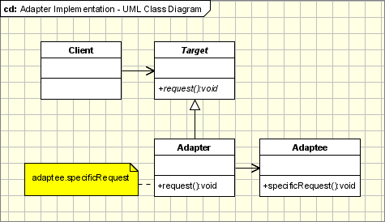
Adapter Design Pattern
Intent of this design pattern is to:
Convert the interface of a class into another interface that clients expect. Adapter lets classes work together that couldn't otherwise because of incompatible interfaces.
Wrap an existing class with a new interface.
Impedance match an old component to a new system

Slide 15
Code Example
Client Class
public class ClientSystem {
public static void main(String...strings) {
ZomatoOrderI order = getOrderObject();
if (order instanceof ZomatoOrderI) {
String orderDetails = order.getOrder();
System.out.println(orderDetails);
}
}
private static ZomatoOrderI getOrderObject() {
//Fetch order from network or a file
}
}
Client expecting only a certain type of order, it will not be able to process orders from other online merchants
Ideal class for the client
interface ZomatoOrderI{
String getOrder();
}
class ZomatoOrderImpl implements ZomatoOrderI {
@Override
public String getOrder() {
return "Order from Zomato";
}
}
Object of this class would easily fit into the existing system as it is designed with Zomato orders in mind.

Slide 16
Code Example (contd.)
Problem class for the Client
class SwiggyOrder {
public String getSwiggyOrder() {
return "Order from Swiggy";
}
}
This class doesn’t implement ZomatoOrderI interface and also doesn’t have compatible method that Client class is expecting

Slide 17
Code Example (contd.)
Solution
1. Create a Swiggy order adapter by implementing ZomatoOrderI
class SwiggyOrderAdapter implements ZomatoOrderI{
SwiggyOrder swiggyOrder;
public SwiggyOrderAdapter (SwiggyOrder order) {
this.swiggyOrder = order;
}
@Override
public String getOrder() {
return swiggyOrder.getSwiggyOrder();
}
}
2. Create a constructor and pass SwiggyOrder as argument to this constructor and assign it to class variable of order
3. Access method of SwiggyOrder in adapter through class variable.
4.The class is compatible with Client expectations and Swiggy orders will now be successfully processed.

Slide 18
Decorator Design Pattern
Intent of this design pattern is to:
Attach additional responsibilities to an object dynamically. Decorators provide a flexible alternative to subclassing for extending functionality at runtime.
One can start with a plain object and then keep on adding new functionality as and when required by the program.
Client-specified embellishment of a core object by recursively wrapping it.
Wrapping a gift, putting it in a box, and wrapping the box.

Slide 19
Code Example
Naïve design – this design openly flouts many of the SOLID Principles
class FarmHousePizza implements Pizza {
public CheesePizza (Capscicum caps, Jalapeno jal, Tomato tomato, Olives olives,.. //so on)
{
this.caps = caps;
this.jal = jal;
….
….
}
public String getDescription() {
return "Paneer" + caps.getDescription() + jal.getDescription() + //..so on;
}
public int getCost() {
int totalToppingsCost = 0;
if (hasJalapeno() )
totalToppingsCost += jalapenoCost;
if (hasCapsicum() )
totalToppingsCost += capsicumCost;
// similarly for other toppings
return totalToppingsCost;
}
}
1. Keep on adding new toppings in constructor or through setters – very bulky constructor
2. Get description info from each topping object – you have to keep touching this section whenever you add a new topping
3. Similarly calculate cost of each topping by getting cost of each topping object
Can you identify issues with this design approach?

Slide 20
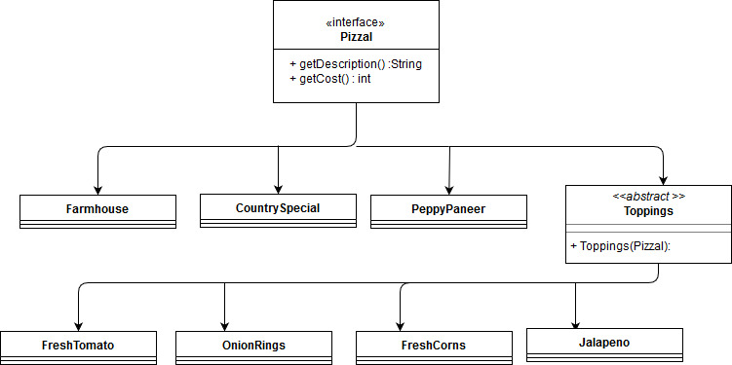
Code Example (contd.)
Improved design by using a decorator

Slide 21
Code example (contd.)
interface PizzaI {
String getDescription();
int getCost() ;
}
Pizza abstraction
class FarmHousePizza implements PizzaI {
@Override
public String getDescription() {
return "Farm house Pizza" + "(" + getCost() + ")";
}
@Override
public int getCost() {
return 300;
}
}
class CountrySpecial implements PizzaI{
@Override
public String getDescription() {
return "Country Special";
}
@Override
public int getCost() {
return 350;
}
}
Concrete implementations of PizzaI

Slide 22
Code Example (contd.)
interface PizzaI {
String getDescription();
int getCost() ;
}
abstract class Toppings implements PizzaI {
public Toppings(PizzaI pizza) {
}
}
class FreshTomato extends Toppings {
private PizzaI pizza;
public FreshTomato(PizzaI pizza) {
super(pizza);
this.pizza = pizza;
}
@Override
public String getDescription() {
return pizza.getDescription() + " + Tomato" + "(" + getCost() + ")";
}
@Override
public int getCost() {
return pizza.getCost() + 30;
}
}
class OnionRings extends Toppings {
private PizzaI pizza;
public OnionRings(PizzaI pizza) {
super(pizza);
this.pizza = pizza;
}
@Override
public String getDescription() {
return pizza.getDescription() + " + Onion Rings" + "(" + getCost() + ")";
}
public int getCost() {
return pizza.getCost() + 20;
}
}
class FreshCorns extends Toppings {
private PizzaI pizza;
public FreshCorns(PizzaI pizza) {
super(pizza);
this.pizza = pizza;
}
@Override
public String getDescription() {
return pizza.getDescription() + " + Fresh Corns" + "(" + getCost() + ")";
}
@Override
public int getCost() {
return pizza.getCost() + 40;
}
}

Slide 23
Code Example (contd.)
How everything fits together !!
public class PizzaOrderMachine {
public static void main(String...strings) {
PizzaI pizza = new FarmHousePizza();
pizza = new FreshTomato(pizza);
pizza = new FreshCorns(pizza);
pizza = new OnionRings(pizza);
pizza = new FreshTomato(pizza);
System.out.println(“--------- Order Summary --------------”);
System.out.println("Pizza info: " + pizza.getDescription());
System.out.println("Total Pizza cost: " + pizza.getCost());
}
}
1. You go to Pizza PoS terminal and start placing your order
2. Tell what Pizza you want
3. Keep on adding the toppings that you want on your pizza, all the logic is taken care of by decorator
4. You get your Order summary with all the details
--------- Order Summary --------------
Pizza info: Farm house Pizza(300) + Tomato(330) + Fresh Corns(370) + Onion Rings(390) + Tomato(420)
Total Pizza cost: 420

Slide 24
Behavioral design Pattern
In software engineering, behavioural design patterns are design patterns that identify common communication patterns among objects and realize these patterns. By doing so, these patterns increase flexibility in carrying out this communication.
Types:
Chain of Responsibility Pattern
Command Pattern
Interpreter Pattern
Iterator Pattern
Mediator Pattern
Memento Pattern
Observer Pattern
State Pattern
Strategy Pattern
Template Pattern
Visitor Pattern
Null Object

Slide 25
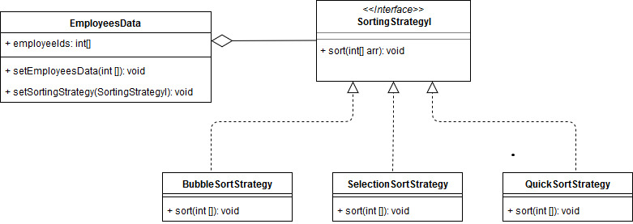
Strategy Design Pattern
Intent of this pattern is:
To define a family of algorithms, encapsulate each one,
Make them interchangeable.
Strategy lets the algorithm vary independently from clients that use it.

Slide 26
Code Example:
interface SortingStrategyI {
void sort(int[] empIds);
}
class QuickSort implements SortingStrategyI {
@Override
public void sort(int[] empIds) {
System.out.println("Sorting using Quick Sort ...");
quickSort(empIds, 0, empIds.length);
}
private void quickSort(int[] arr, int start, int end){
int partition = partition(arr, start, end);
if(partition-1>start) {
quickSort(arr, start, partition - 1);
}
if(partition+1<end) {
quickSort(arr, partition + 1, end);
}
}
public static int partition(int[] arr, int start, int end){
int pivot = arr[end];
for(int i=start; i<end; i++){
if(arr[i]<pivot){
int temp= arr[start];
arr[start]=arr[i];
arr[i]=temp;
start++;
}
}
int temp = arr[start];
arr[start] = pivot;
arr[end] = temp;
return start;
}
}
class BubbleSort implements SortingStrategyI {
@Override
public void sort (int[] empIds) {
System.out.println("Sorting using Bubble Sort ...");
int n = empIds.length;
for (int i = 0; i < n-1; i++)
for (int j = 0; j < n-i-1; j++)
if (empIds[j] > empIds[j+1])
{
int temp = empIds[j];
empIds[j] = empIds[j+1];
empIds[j+1] = temp;
}
}
}
class SelectionSort implements SortingStrategyI {
@Override
public void sort(int[] empIds) {
System.out.println("Sorting using Selection Sort ...");
for (int i = 0; i < empIds.length - 1; i++)
{
int index = i;
for (int j = i + 1; j < empIds.length; j++)
if (empIds[j] < empIds[index])
index = j;
int smallerNumber = empIds[index];
empIds[index] = empIds[i];
empIds[i] = smallerNumber;
}
}
}

Slide 27
Code Example:
class EmployeesData {
private int [] employeeIds = new int[10];
public EmployeesData() {
// TODO Auto-generated constructor stub
}
public EmployeesData(int [] empIds) {
this.employeeIds = empIds;
}
public void setEmployeesData(int[] empIds) {
this.employeeIds = empIds;
}
public void setSortingStrategy(SortingStrategyI strategy) {
strategy.sort(employeeIds);
System.out.print("[ ");
for (int i : employeeIds) {
System.out.print(i + " ");
}
System.out.print("] ");
}
}
public class StrategyTest {
public static void main(String...strings) {
EmployeesData empData = new EmployeesData();
empData.setEmployeesData(new int[]{12, 4 ,5 ,10, 3, 5});
empData.setSortingStrategy(new SelectionSort());
}
}
interface SortingStrategyI {
void sort(int[] empIds);
}

Slide 28
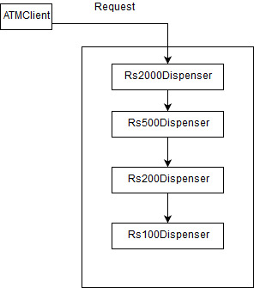
Chain of Responsibility
Intent of this design pattern is to:
Avoid coupling the sender of a request to its receiver by giving more than one object a chance to handle the request.
Chain the receiving objects and pass the request along the chain until an object handles it.
Launch-and-leave requests with a single processing pipeline that contains as many possible handlers.

Slide 29
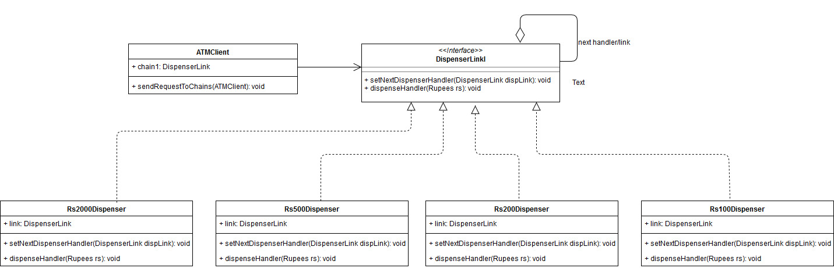
UML interpretation of Chain Of Responsibility

Slide 30
Code Example:
interface DispenserLinkI {
void setNextDispenserHandler(DispenserLinkI dispLink);
void dispenseHandler(Rupees rs);
}
class Rs2000Dispenser implements DispenserLinkI {
private DispenserLinkI link;
private final int denomination = 2000;
@Override
public void setNextDispenserHandler(DispenserLinkI dispLink) {
this.link = dispLink;
}
@Override
public void dispenseHandler(Rupees rs) {
if(rs.getAmount() >= denomination){
int num = rs.getAmount()/denomination;
int remainder = rs.getAmount() % denomination;
System.out.println("Dispensing "+num+ " " + denomination + "note");
if(remainder !=0) this.link.dispenseHandler(new Rupees(remainder));
}else{
this.link.dispenseHandler(rs);
}
}
}
class Rs500Dispenser implements DispenserLinkI {
private DispenserLinkI link;
private final int denomination = 500;
@Override
public void setNextDispenserHandler(DispenserLinkI dispLink) {
this.link = dispLink;
}
@Override
public void dispenseHandler(Rupees rs) {
if(rs.getAmount() >= denomination){
int num = rs.getAmount()/denomination;
int remainder = rs.getAmount() % denomination;
System.out.println("Dispensing "+num+ " " + denomination + "note");
if(remainder !=0) this.link.dispenseHandler(new Rupees(remainder));
}else{
this.link.dispenseHandler(rs);
}
}
}
class Rs200Dispenser implements DispenserLinkI {
private DispenserLinkI link;
private final int denomination = 200;
@Override
public void setNextDispenserHandler(DispenserLinkI dispLink) {
this.link = dispLink;
}
@Override
public void dispenseHandler(Rupees rs) {
if(rs.getAmount() >= denomination){
int num = rs.getAmount()/denomination;
int remainder = rs.getAmount() % denomination;
System.out.println("Dispensing "+num+ " " + denomination + "note");
if(remainder !=0) this.link.dispenseHandler(new Rupees(remainder));
}else{
this.link.dispenseHandler(rs);
}
}
}

Slide 31
Code Example (contd.)
public class ATMClient {
private DispenserLinkI chain1;
public ATMClient() {
// Initialise the chain
chain1 = new Rs2000Dispenser();
DispenserLinkI chain2 = new Rs500Dispenser();
DispenserLinkI chain3 = new Rs200Dispenser();
DispenserLinkI chain4 = new Rs100Dispenser();
// Set links for Chain of Responsibilitys
chain1.setNextDispenserHandler(chain2);
chain2.setNextDispenserHandler(chain3);
chain3.setNextDispenserHandler(chain4);
}
public static void main(String[] args) throws Exception{
ATMClient atmDispenserClient = new ATMClient();
sendRequestToChains(atmDispenserClient);
}
private static void sendRequestToChains(ATMClient atmDispenser) {
System.out.println("Enter amount to dispense");
Scanner input = new Scanner(System.in);
Rupees amount = new Rupees(input.nextInt());
if (amount.getAmount() % 100 != 0) {
System.out.println("Amount should be in multiple of 100s.");
}
input.close();
atmDispenser.chain1.dispenseHandler(amount);
}
final class Rupees {
private int amount;
public Rupees(int amount) {
this.amount = amount;
}
public int getAmount() {
return amount;
}
}
Create links of the responsibility chain
Create chains with links in order the request will be processed
interface DispenserLinkI {
void setNextDispenserHandler(DispenserLinkI dispLink);
void dispenseHandler(Rupees rs);
}
Start request processing by sending the request to first chain

Slide 32
Source and inspirations:
Source code for all the examples here can be found at:
https://github.com/shashanksriva/javapractice/tree/master/src/com/shashank/designpatterns
Inspirations:
www.oodesign.com
sourcemaking.com/design_patterns
www.journaldev.com
www.geeksforgeeks.org
Tool used for UML diagrams:
www.draw.io

