Slide 1
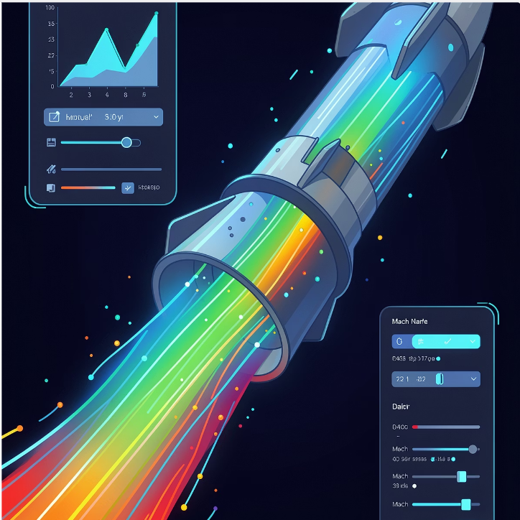

Interactive Nozzle Flow Visualization Platform
Real-Time Scientific Visualization using Unity
DE & DKE
Hemanth Nagaraj
Rakshan Sujan Shetty
Mantasha Khanam
CEE
Shashank Suresh Srinivasan
Theresa Kasthuri Dinah Samuel
Jaideep Paramashivaiah Buksagarmath

Slide 2
Solver development
Wall profile development
Quasi 1D system definition & solver development
2D system definition
Investigation & selection of numerical & computational methods
Solver development
Testing & Optimization
Packaging the solver for the app
Notes:
Sss

Slide 3
Wall Profile Development
Governing conditions
Profile considerations
Continuous & smooth profile
Area-Mach consistency (according to required outlet conditions)
Prandtl-Meyer expansion compatibility (for shockfree outlet condition)
Method of Characteristics contour
Common mathematical functions
Rao’s bell contour
Notes:
Sss

Slide 4





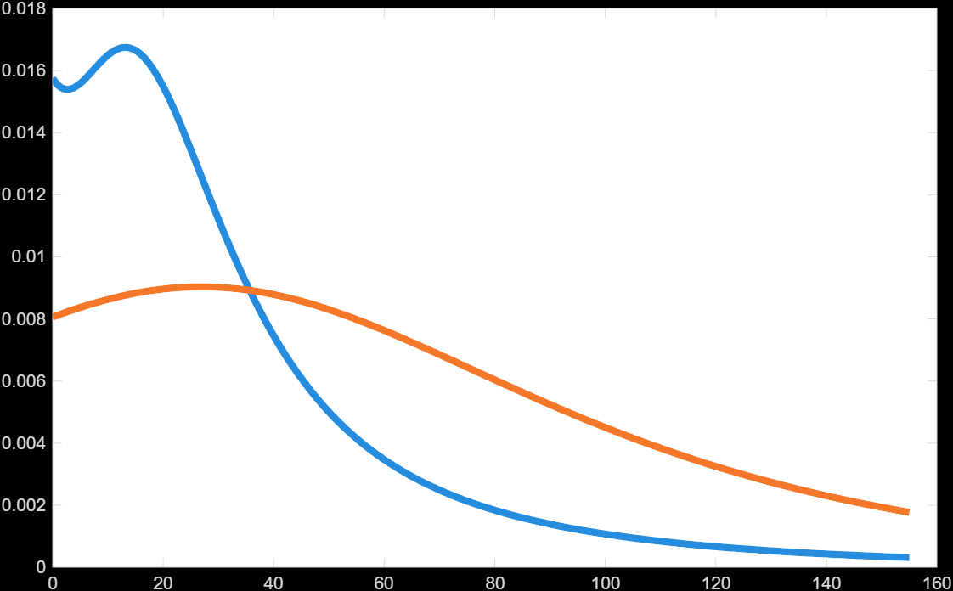
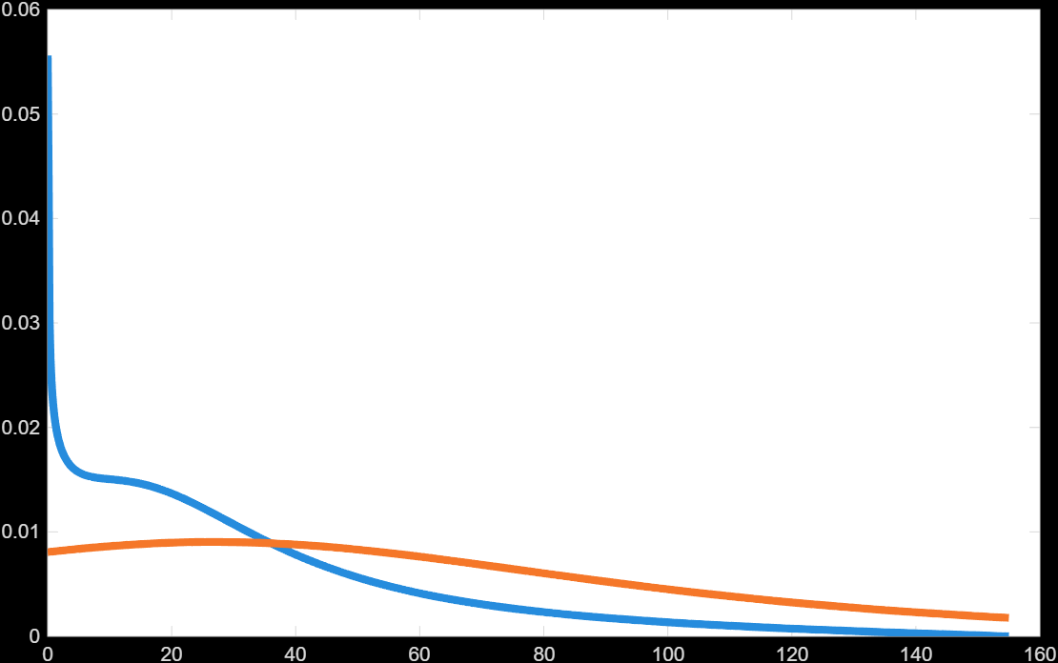
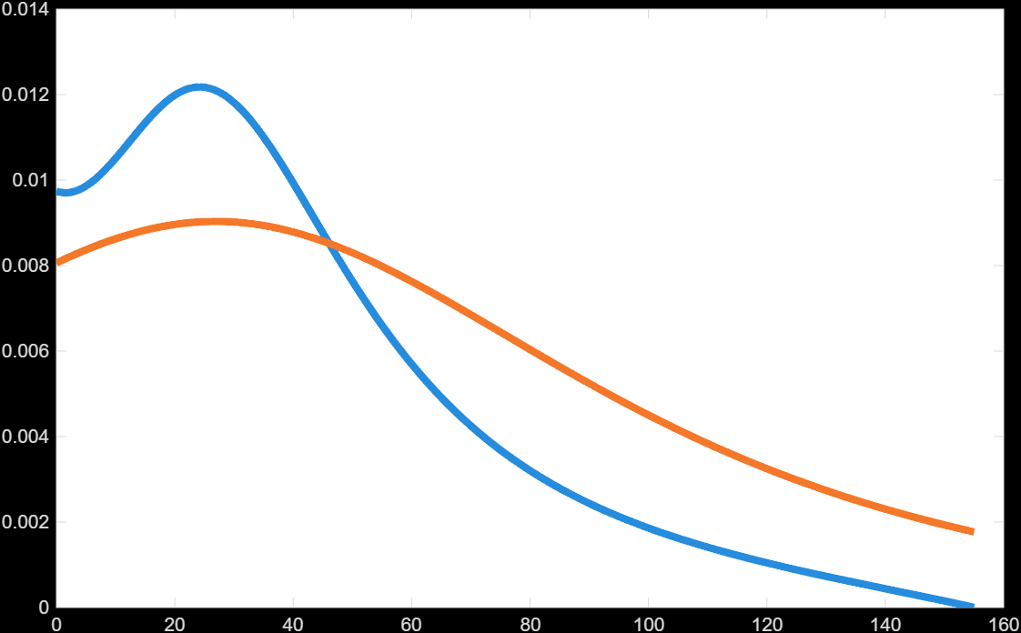
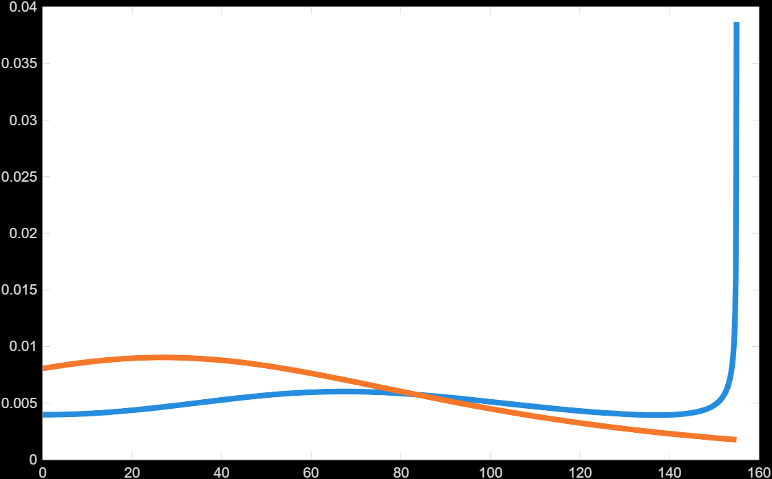
Wall Profile Development
Common mathematical functions
Exponential
Sinusoidal
Algebraic
Elliptical
PM theoretical limit
Wall profile contour
Exponential
Sinusoidal
Prandtl-Meyer expansion equation
Algebraic
Elliptical
Notes:
Sss

Slide 5


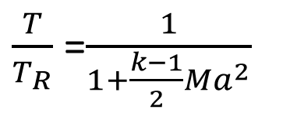
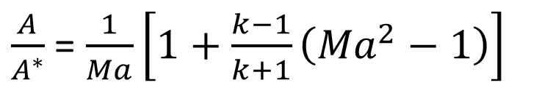

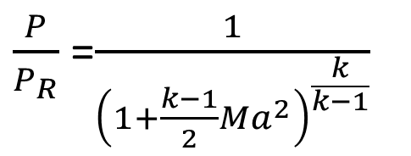
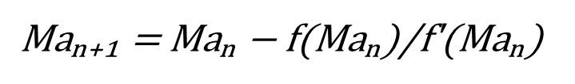



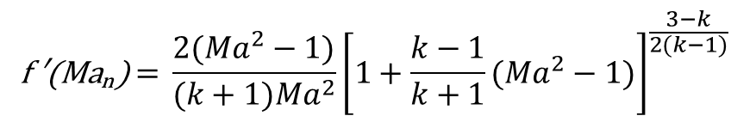
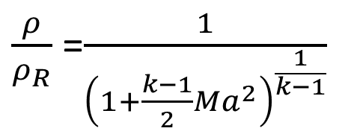
Quasi 1D system definition & solver development
Governing conditions & equations
Prof. D. Thevenin, Advanced Fluid Dynamics Script, Lab of Fluid Mechanics & Technical Flows, OVGU
Area-Mach Number Relation
Newton-Raphson Solution
Notes:
Sss

Slide 6
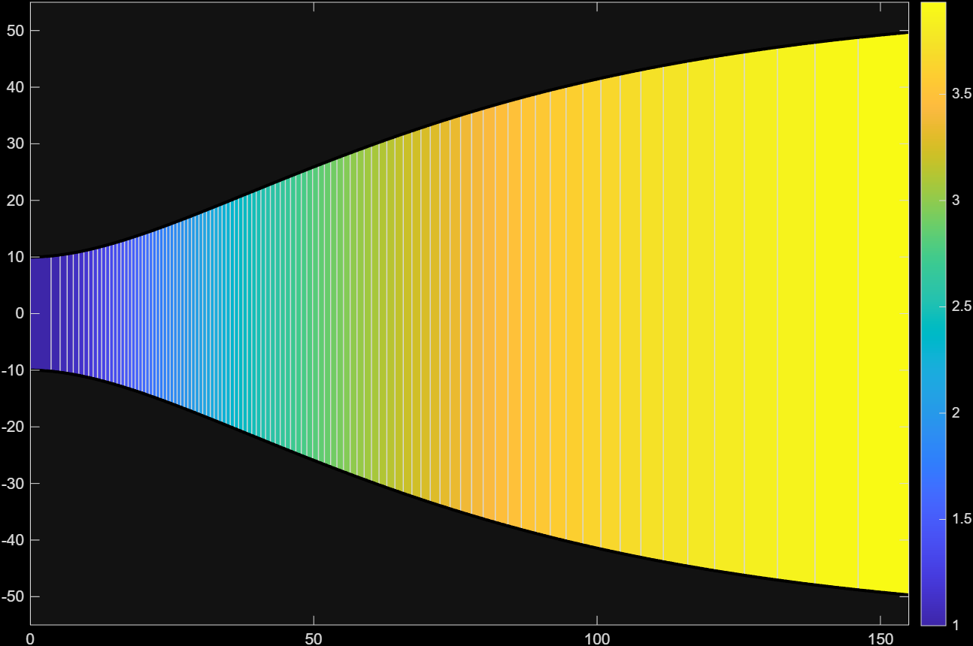
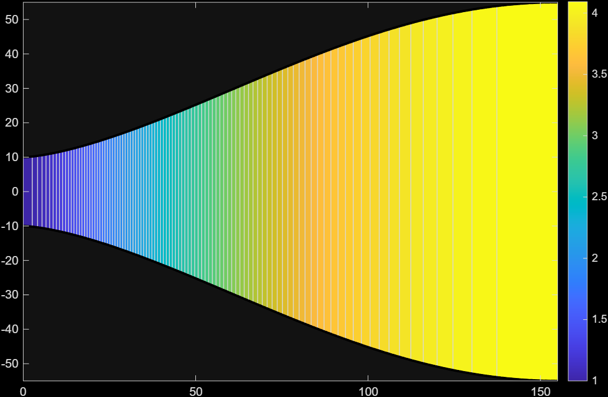
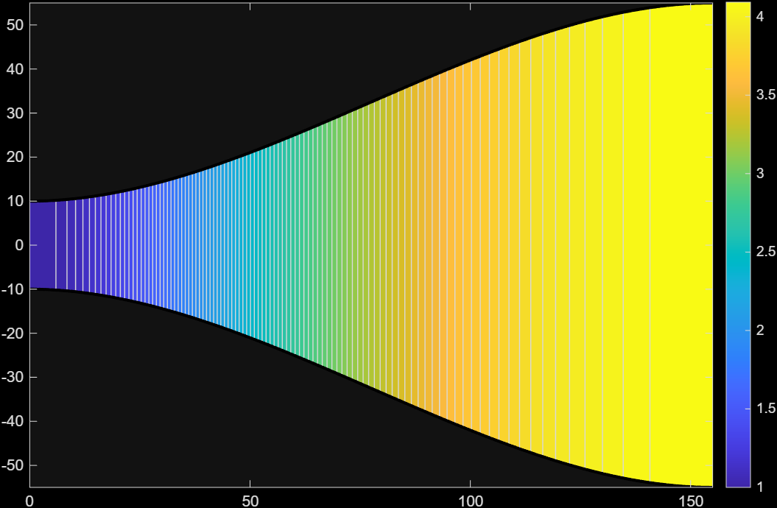
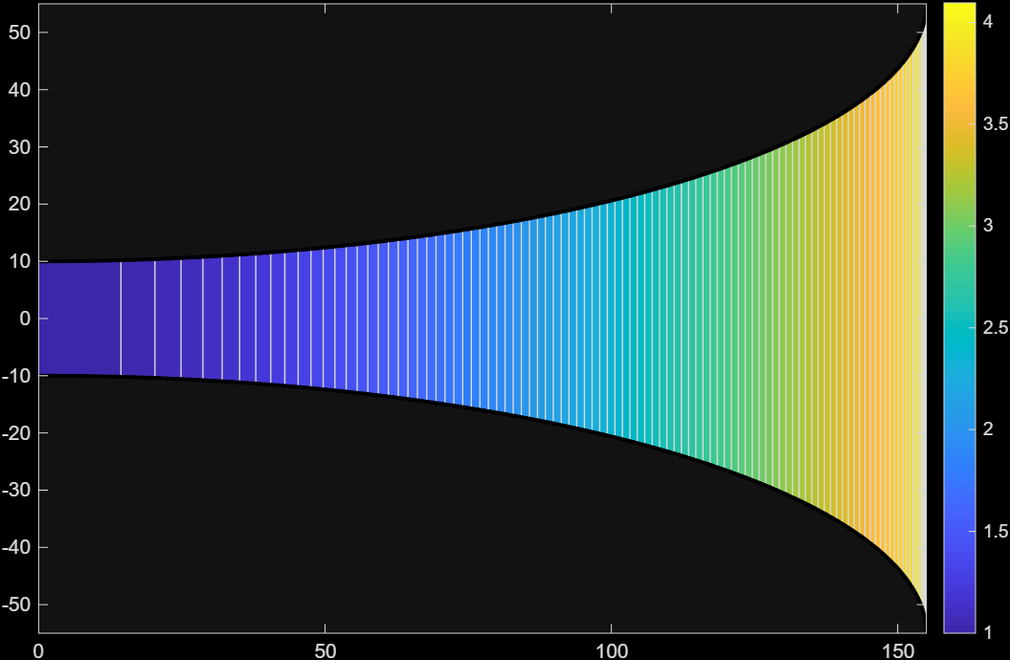
Quasi 1D system definition & solver development
Diffuser solver - Mach number plot (supersonic exit)
Exponential
Sinusoidal
Algebraic
Elliptical
Notes:
Sss

Slide 7
Target for next sprint
Complete solver for quasi 1D system using MoC
Hand over complete placeholder data set to the development team
Detailed problem definition for 2D system
Investigate and choose numerical & computational approaches
Notes:
Sss

Slide 8
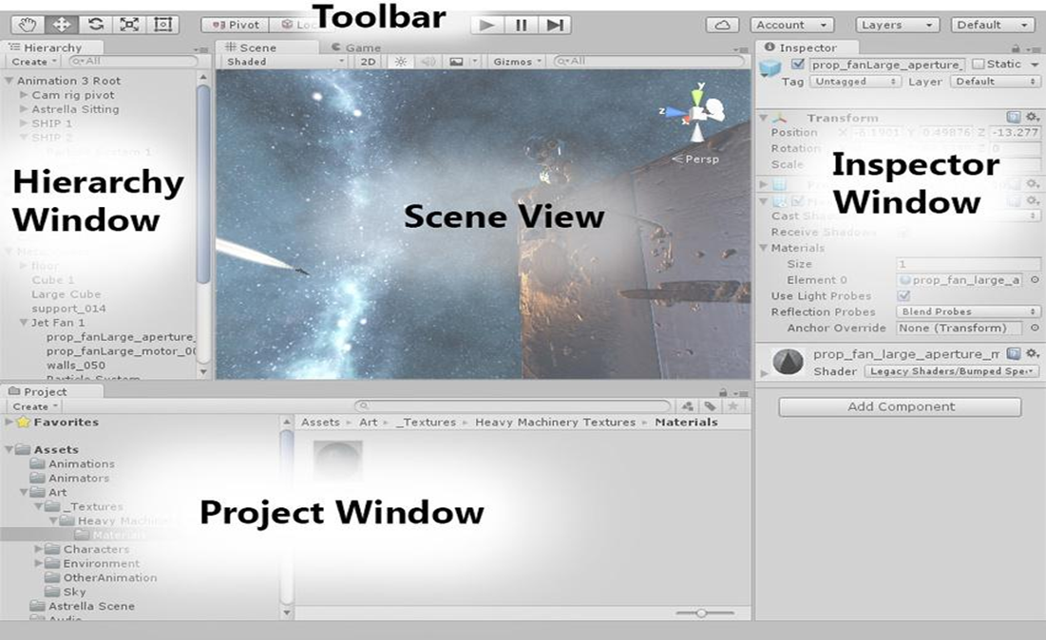
Interactive Nozzle Flow Visualization Platform
• Unity scientific visualization platform for compressible nozzle flow
• Integrates engineering datasets from the CEE team
• Interactive exploration of:
- Mach number
- Pressure
- Temperature
- Density
• Real-time parameter mapping and runtime visualization
• Designed for interactive engineering analysis and scientific exploration
Notes:
Sss

Slide 9
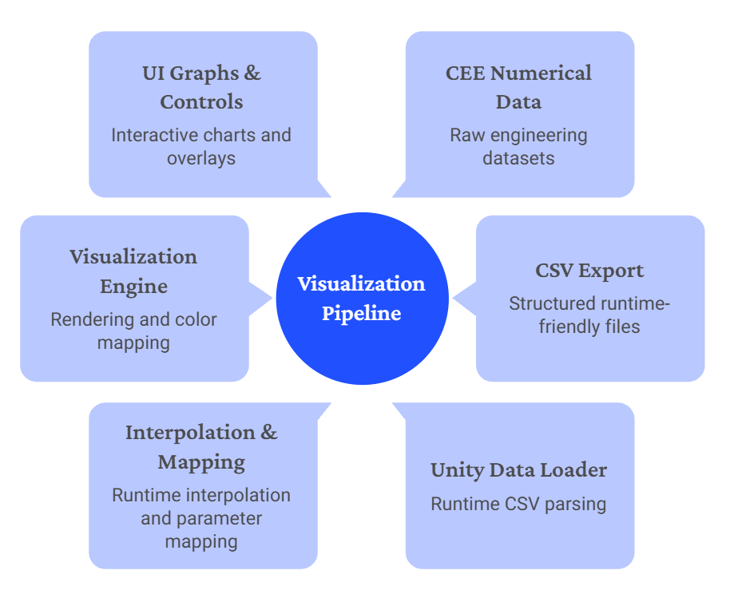
Visualization Architecture

Slide 10
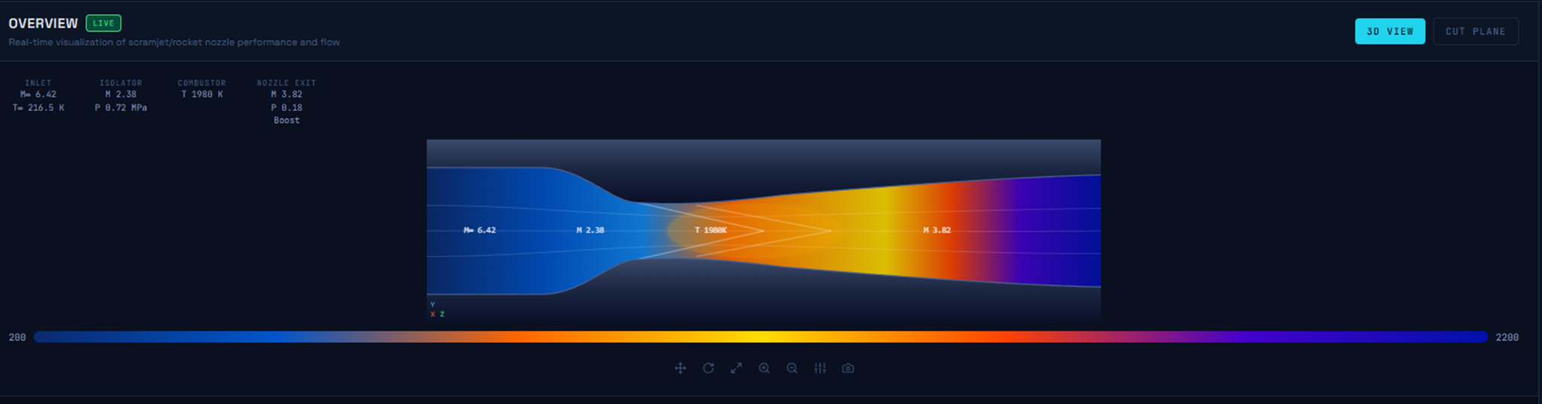
Current Unity Prototype
Implementation Progress
CSV datasets successfully integrated
Runtime parameter mapping implemented
Modular nozzle segmentation system created
Interactive visualization pipeline established
Foundation for dynamic rendering completed

Slide 11
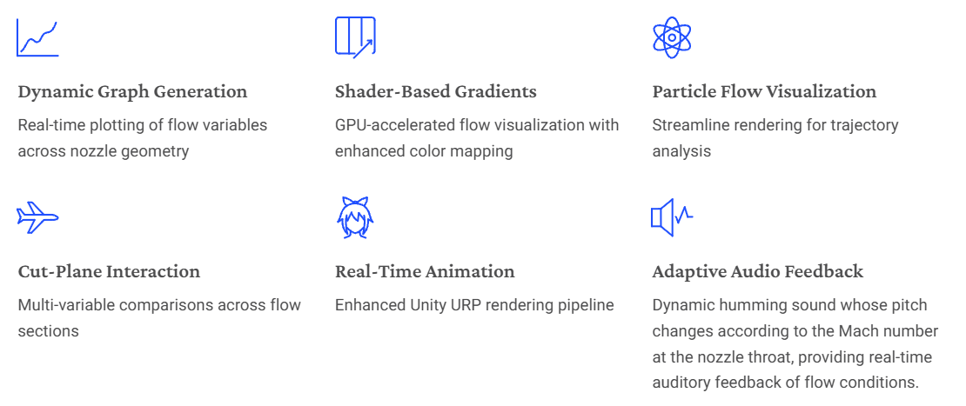
Planned Visualization Features

Slide 12
Thank You

