Slide 1
Support Vector Machines
Kernel Machines

Slide 2
DONE
DONE
Radial basis function networks
Feed-forward networks
Non-linear classifiers
Supervised learning
Support vector machines
DONE
Linear classifiers
DONE
Perceptron
Adaline
We are here!!
Self-organizing maps
K-means
DONE
Clustering
DONE
Unsupervised learning
DONE
Content addressable memories
Optimization
Hopfield networks

Slide 3
History of SVM
SVM is inspired from statistical learning theory [3]
SVM was first introduced in 1992 [1]
SVM becomes popular because of its success in handwritten digit recognition
  1.1% test error rate for SVM. This is the same as the error rates of a carefully constructed neural network, LeNet 4.
    See Section 5.11 in [2] or the discussion in [3] for details
SVM is now regarded as an important example of “kernel methods”, arguably the hottest area in neural networks/machine learning
[1] B.E. Boser et al. A Training Algorithm for Optimal Margin Classifiers. Proceedings of the Fifth Annual Workshop on Computational Learning Theory 5 144-152, Pittsburgh, 1992.
[2] L. Bottou et al. Comparison of classifier methods: a case study in handwritten digit recognition. Proceedings of the 12th IAPR International Conference on Pattern Recognition, vol. 2, pp. 77-82, 1994.
[3] V. Vapnik. The Nature of Statistical Learning Theory. 2nd edition, Springer, 1999.
Notes:
First introduced in COLT-92 by Boser, Guyon and Vapnik
COLT = computational learning theory
B. Scholkopf et al. ICANN 96. 47-52.

Slide 4
What is a Good Decision Boundary?
Consider a two-class, linearly separable classification problem
Many decision boundaries!
  The Perceptron algorithm can be used to find such a boundary
Are all decision boundaries equally good?
Class 2
Class 1

Slide 5
Examples of Bad Decision Boundaries
Class 2
Class 2
Class 1
Class 1

Slide 6

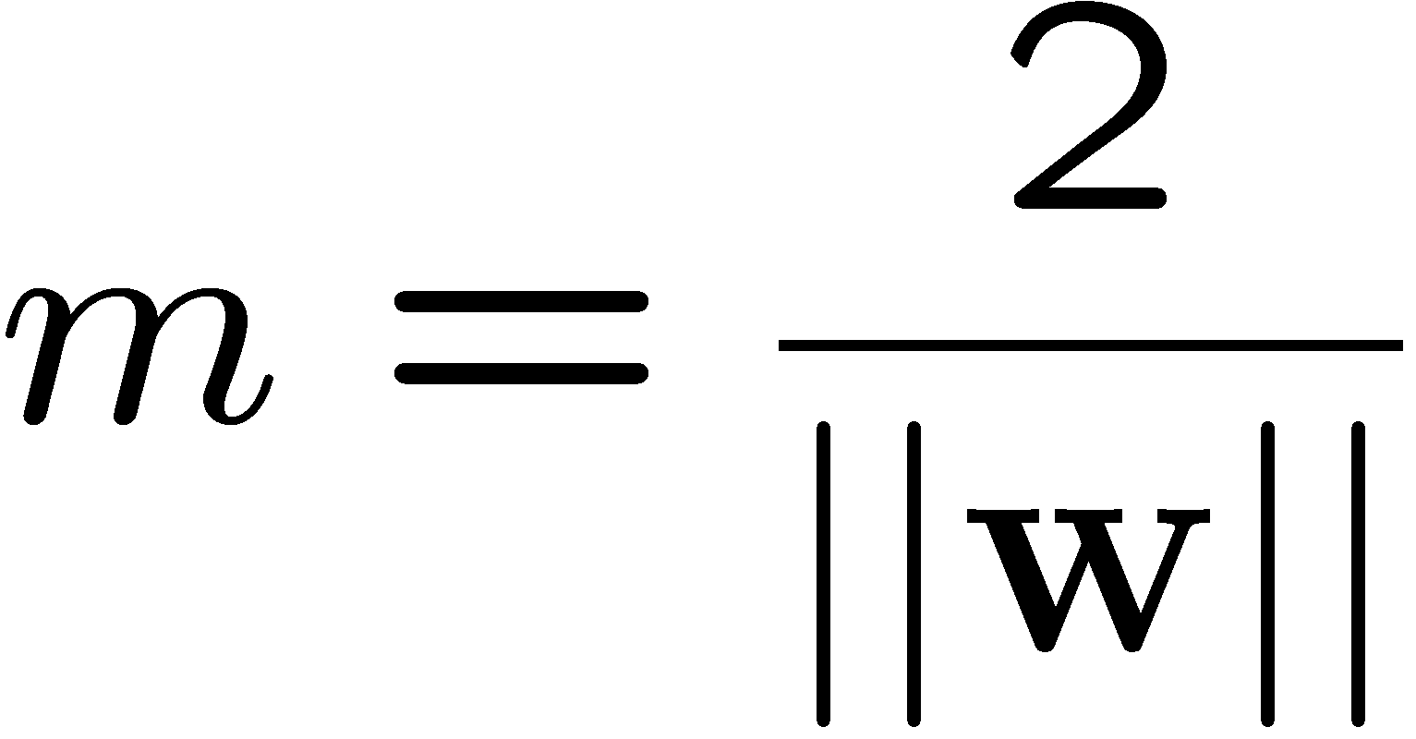
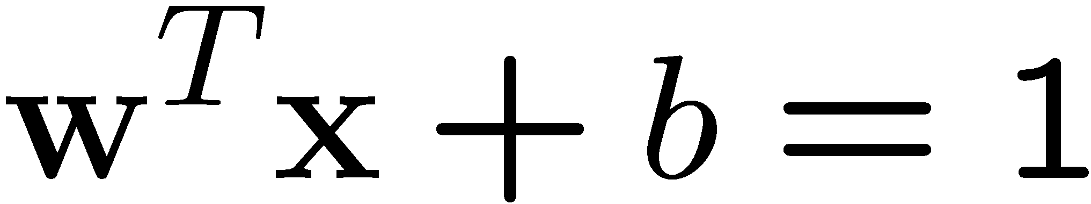
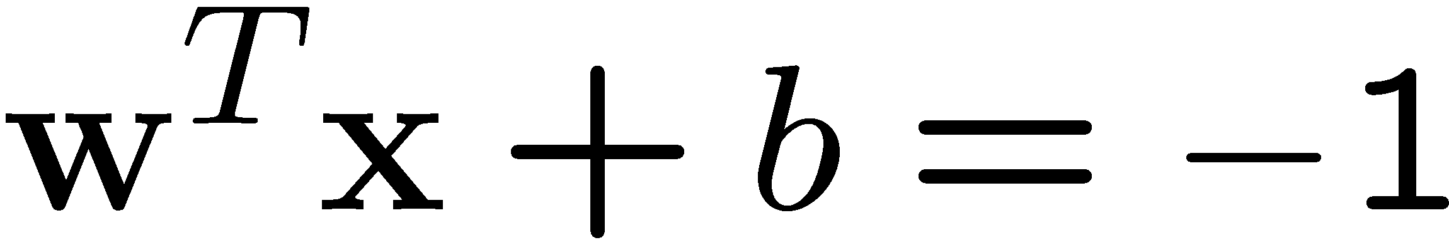
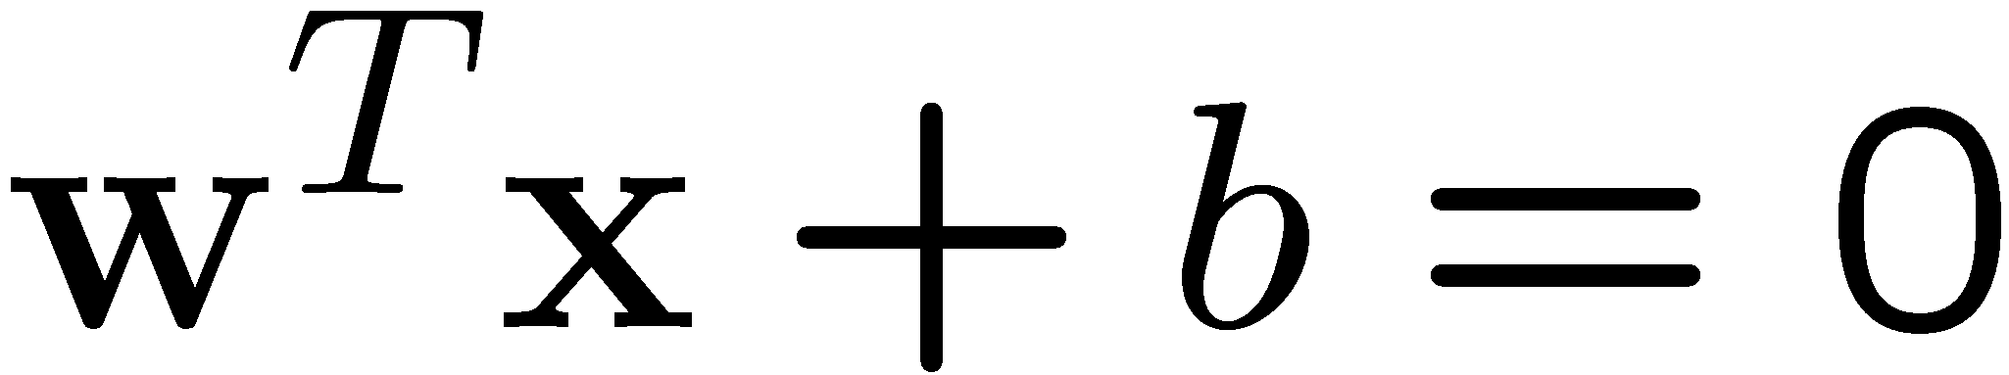
Large-margin Decision Boundary
The decision boundary should be as far away from the data of both classes as possible
  We should maximize the margin, m
Class 2
m
Class 1

Slide 7
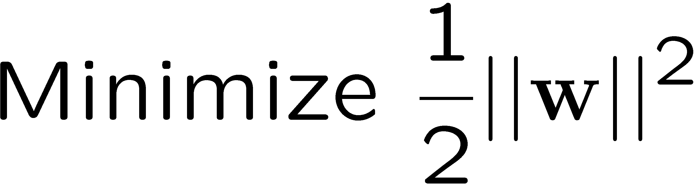
Finding the Decision Boundary
Let {x₁, ..., x_{n}} be our data set and let y_{i} ∈ {1,-1} be the class label of x_{i}
The decision boundary should classify all points correctly ⇒
The decision boundary can be found by solving the following constrained optimization problem
The Lagrangian of this optimization problem is

Slide 8
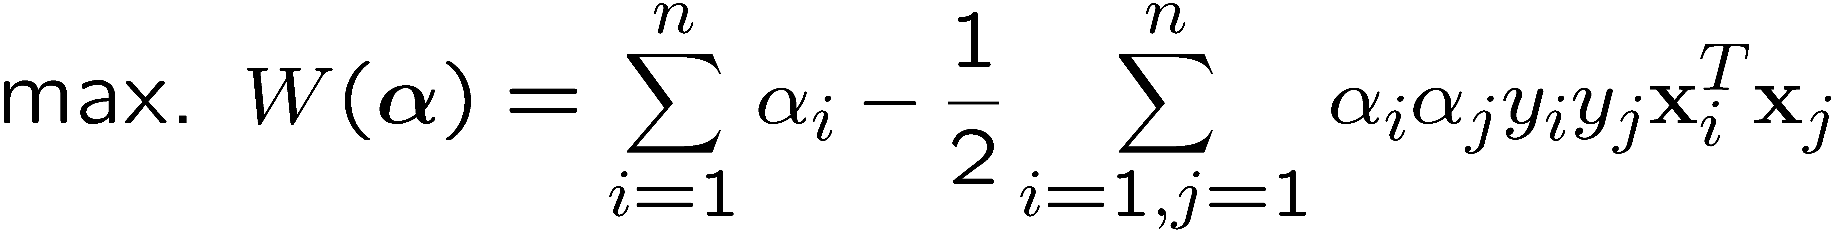
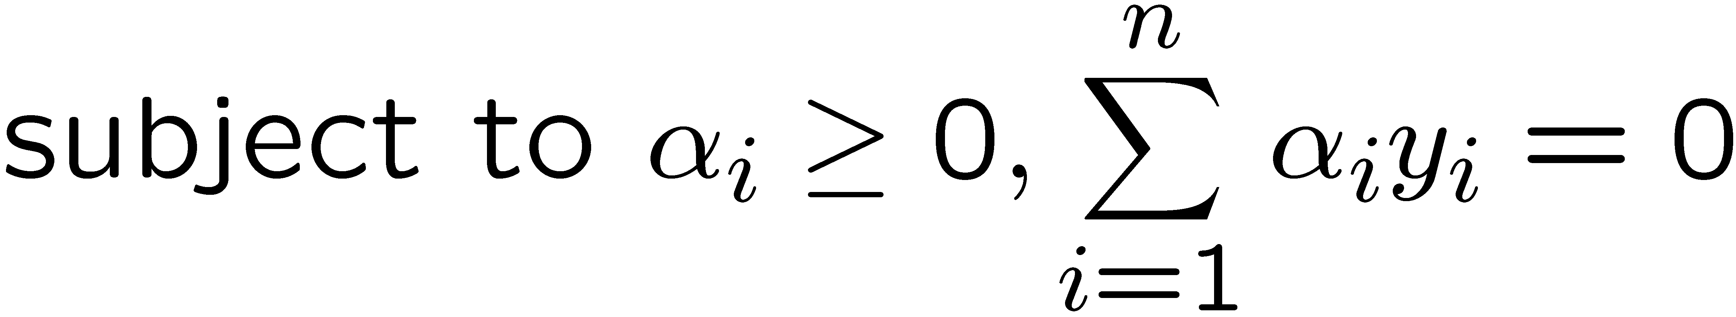
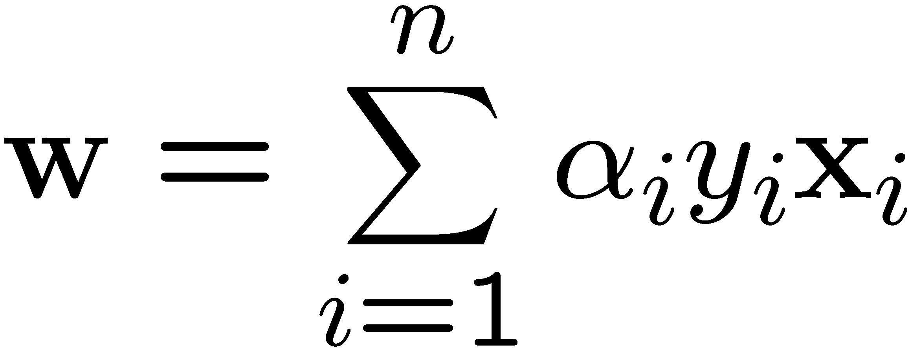
The Dual Problem
By setting the derivative of the Lagrangian to be zero, the optimization problem can be written in terms of α_{i} (the dual problem)
This is a quadratic programming (QP) problem
  A global maximum of α_{i} can always be found
w can be recovered by
If the number of training examples is large, SVM training will be very slow because the number of parameters Alpha is very large in the dual problem.
Notes:
Let x(1) and x(-1) be two S.V.
Then b = -1/2( w^T x(1) + w^T x(-1) )
From here we can see if training example is large, SVM will be very slow because the number of parameters Alpha is very large in the dual problem.

Slide 9
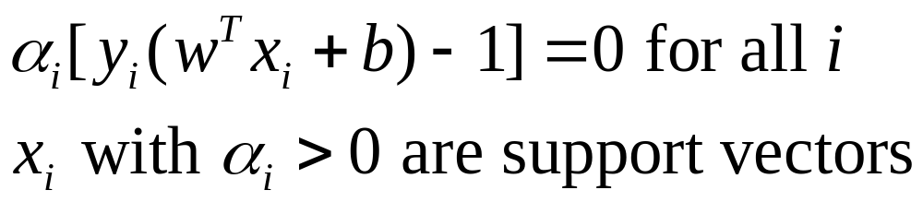
KTT Condition
The QP problem is solved when

Slide 10
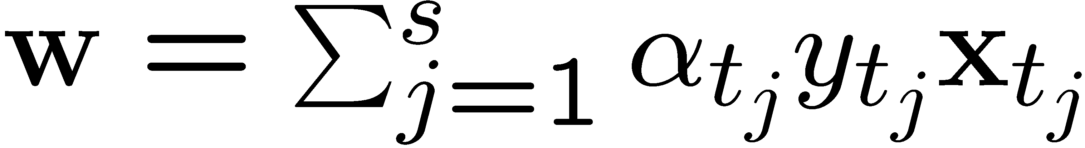
Characteristics of the Solution
KTT condition indicates many of the α_{i} are zero
  w is a linear combination of a small number of data points
x_{i} with non-zero α_{i} are called support vectors (SV)
  The decision boundary is determined only by the SV
  Let t_{j} (j=1, ..., s) be the indices of the s support vectors. We can write
For testing with a new data z
  Compute
  and classify z as class 1 if the sum is positive, and class 2 otherwise.

Slide 11
A Geometrical Interpretation
Class 2
α₁₀=0
α₈=0.6
α₇=0
α₂=0
α₅=0
α₁=0.8
α₄=0
α₆=1.4
α₉=0
α₃=0
Class 1
Notes:
So, if change internal points, no effect on the decision boundary

Slide 12
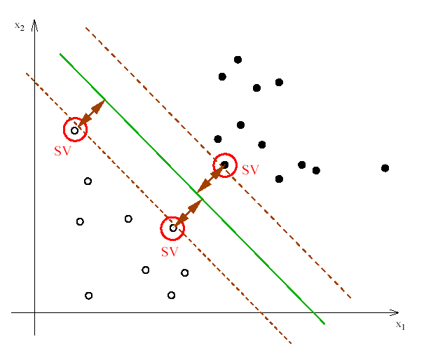
Support vectors
The training points that are nearest to the separating function are called support vectors.
What is the output of our decision function for these points?

Slide 13

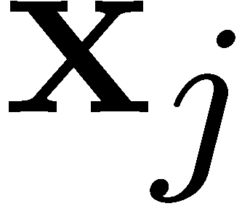
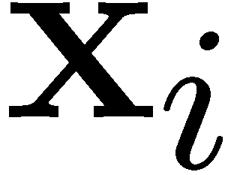

Non-linearly Separable Problems
We allow “error” ξ_{i} in classification
Class 2
Class 1

Slide 14
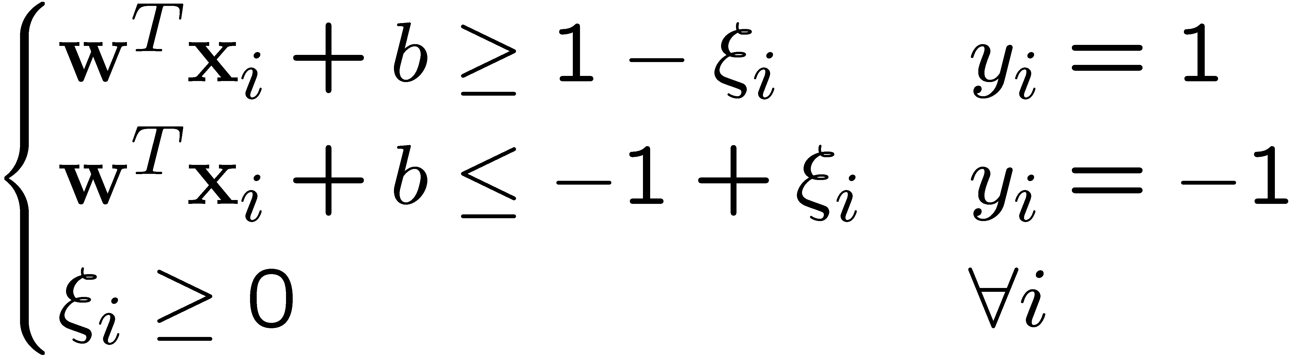
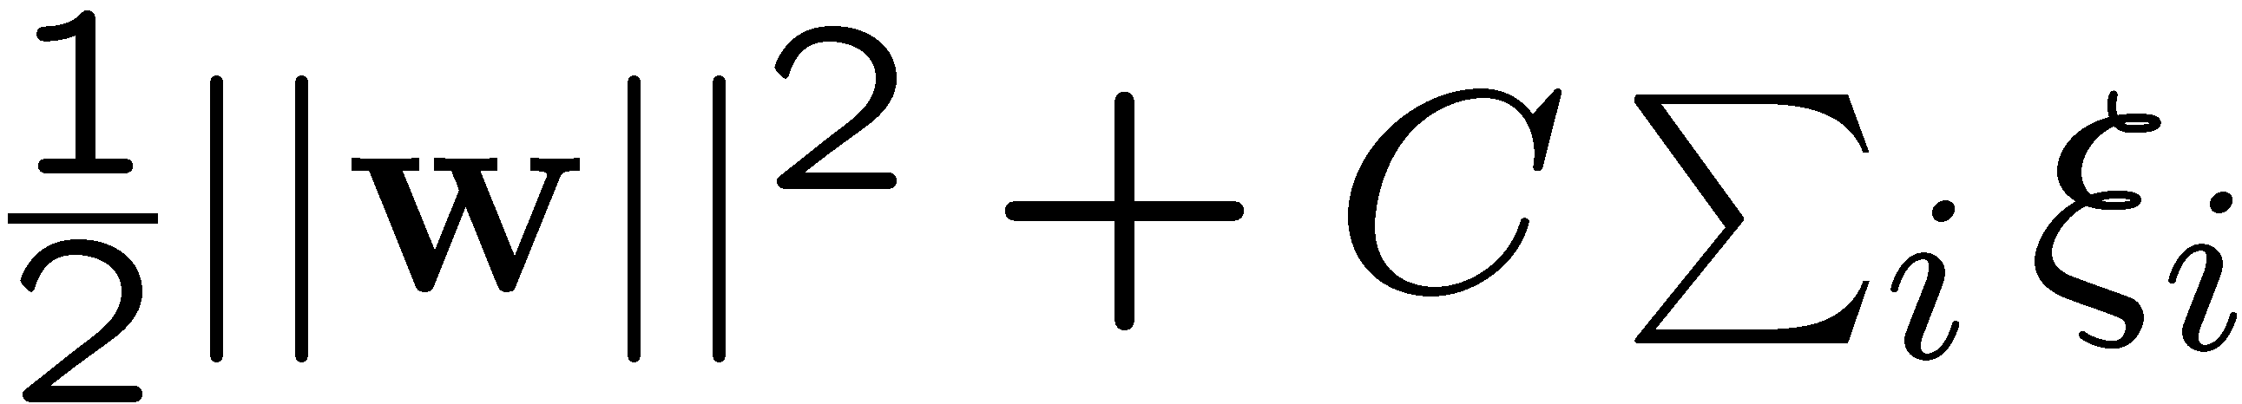
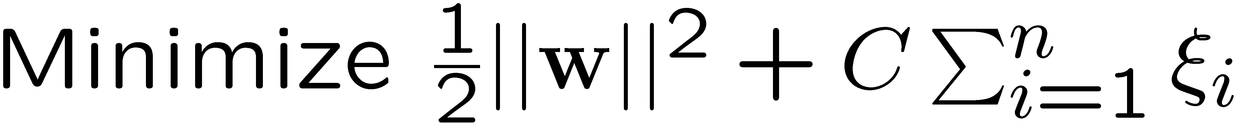
Soft Margin Hyperplane
By minimizing ∑_{i}ξ_{i}, ξ_{i} can be obtained by
  ξ_{i} are “slack variables” in optimization; ξ_{i}=0 if there is no error for x_{i}, and ξ_{i} is an upper bound of the number of errors
We want to minimize
  C : tradeoff parameter between error and margin
The optimization problem becomes

Slide 15
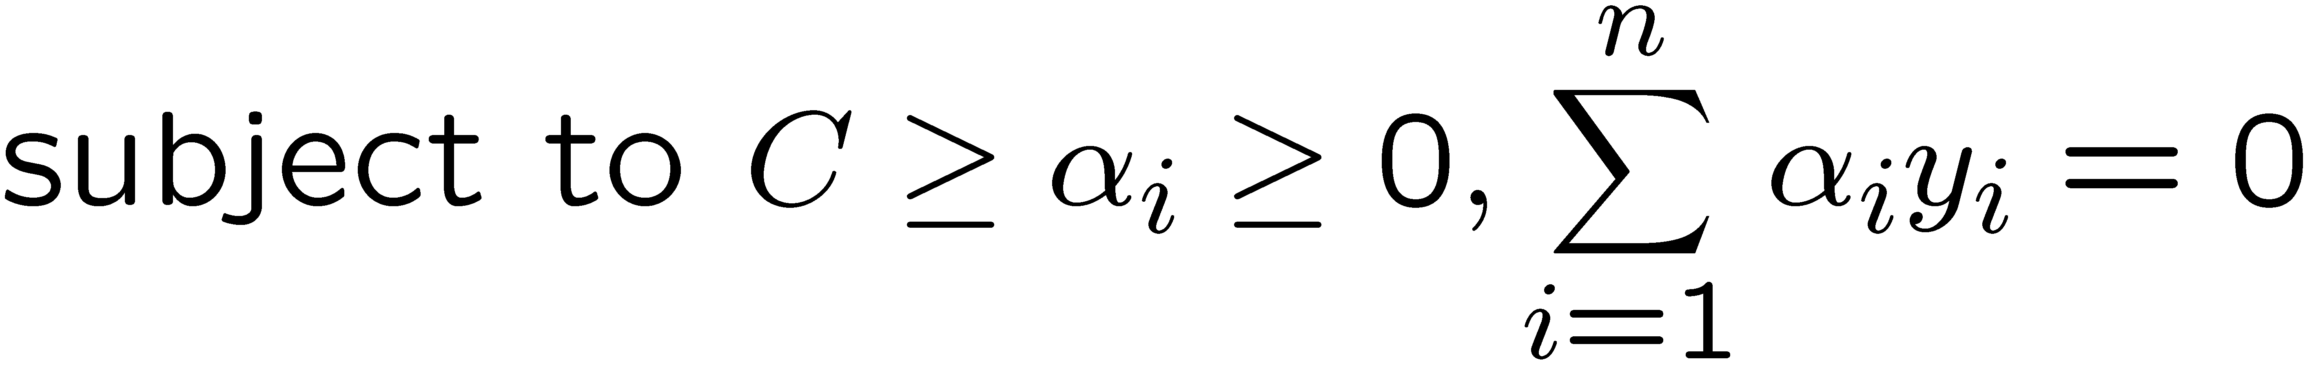
The Optimization Problem
The dual of the problem is
w is recovered as
This is very similar to the optimization problem in the linear separable case, except that there is an upper bound C on α_{i} now
Once again, a QP solver can be used to find α_{i}
Notes:
Note also, everything is done by inner-products
The soft margin only introduces an additional C in the formulation of dual problem, which is the upper bound of the multipliers.

Slide 16
Extension to Non-linear Decision Boundary
So far, we only consider large-margin classifier with a linear decision boundary, how to generalize it to become nonlinear?
Key idea: transform x_{i} to a higher dimensional space to “make life easier”
  Input space: the space the point x_{i} are located
  Feature space: the space of φ(x_{i}) after transformation
Why transform?
  Linear operation in the feature space is equivalent to non-linear operation in input space
  Classification can become easier with a proper transformation. In the XOR problem, for example, adding a new feature of x₁x₂ make the problem linearly separable
Notes:
XOR: x_1, x_2, and we want to transform to x_1^2, x_2^2, x_1 x_2
It can also be viewed as feature extraction from the feature vector x, but now we extract more feature than the number of features in x.

Slide 17
Transforming the Data
φ( )
φ( )
φ( )
φ( )
φ( )
φ(.)
φ( )
φ( )
φ( )
φ( )
φ( )
φ( )
φ( )
φ( )
φ( )
φ( )
φ( )
φ( )
φ( )
Input space
Feature space
Computation in the feature space can be costly because it is high dimensional
  The feature space is typically infinite-dimensional!
The kernel trick comes to rescue

Slide 18
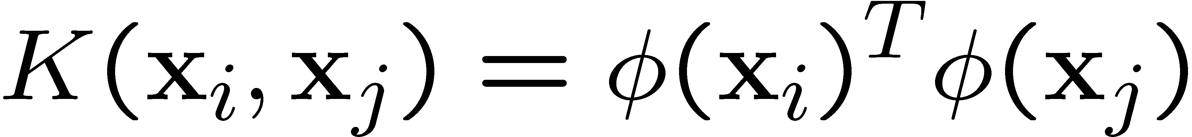
The Kernel Trick
Recall the SVM optimization problem
The data points only appear as inner product
As long as we can calculate the inner product in the feature space, we do not need the mapping explicitly
Many common geometric operations (angles, distances) can be expressed by inner products
Define the kernel function K by

Slide 19
An Example for φ(.) and K(.,.)
Suppose φ(.) is given as follows
An inner product in the feature space is
So, if we define the kernel function as follows, there is no need to carry out φ(.) explicitly
This use of kernel function to avoid carrying out φ(.) explicitly is known as the kernel trick

Slide 20

Kernel Functions
In practical use of SVM, only the kernel function (and not φ(.)) is specified
Kernel function can be thought of as a similarity measure between the input objects
Not all similarity measure can be used as kernel function, however Mercer's condition states that any positive semi-definite kernel K(x, y), i.e.
  can be expressed as a dot product in a high dimensional space.

Slide 21
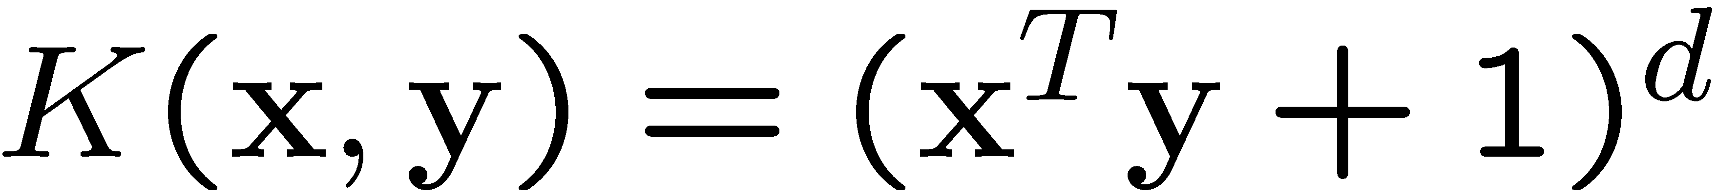
Examples of Kernel Functions
Polynomial kernel with degree d
Radial basis function kernel with width σ
  Closely related to radial basis function neural networks
Sigmoid with parameter κ and θ
  It does not satisfy the Mercer condition on all κ and θ
Notes:
Despite violating Mercer condition, the sigmoid kernel function can still work

Slide 22
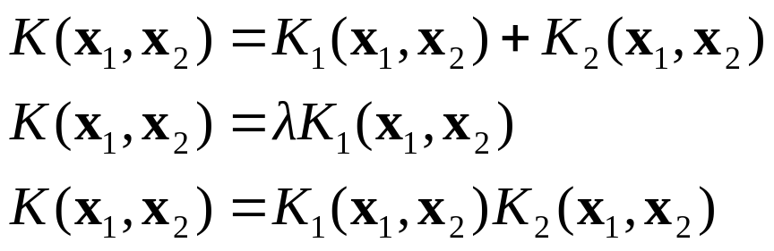

Making kernels
New kernels can be made from valid kernels by allowed operations e.g. addition, multiplication and rescaling of kernels gives a proper kernel
Also, given a real-valued function f(x) over inputs x, then the following is a valid kernel

Slide 23
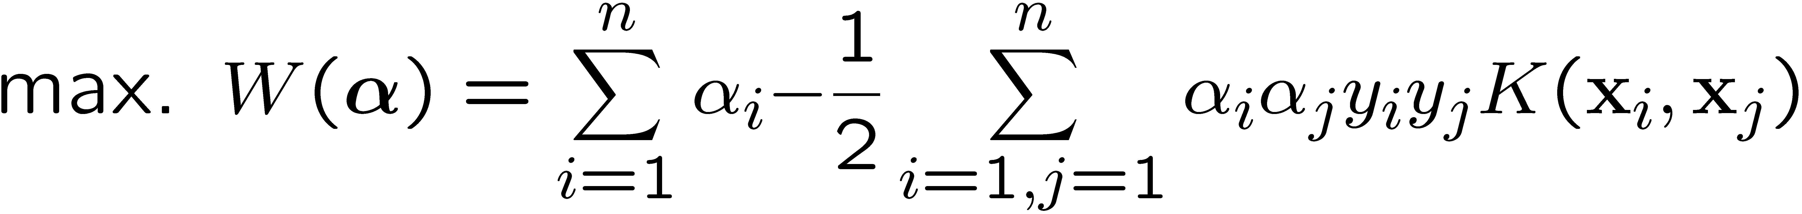
Modification Due to Kernel Function
Change all inner products to kernel functions
For training,
Original
With kernel function

Slide 24
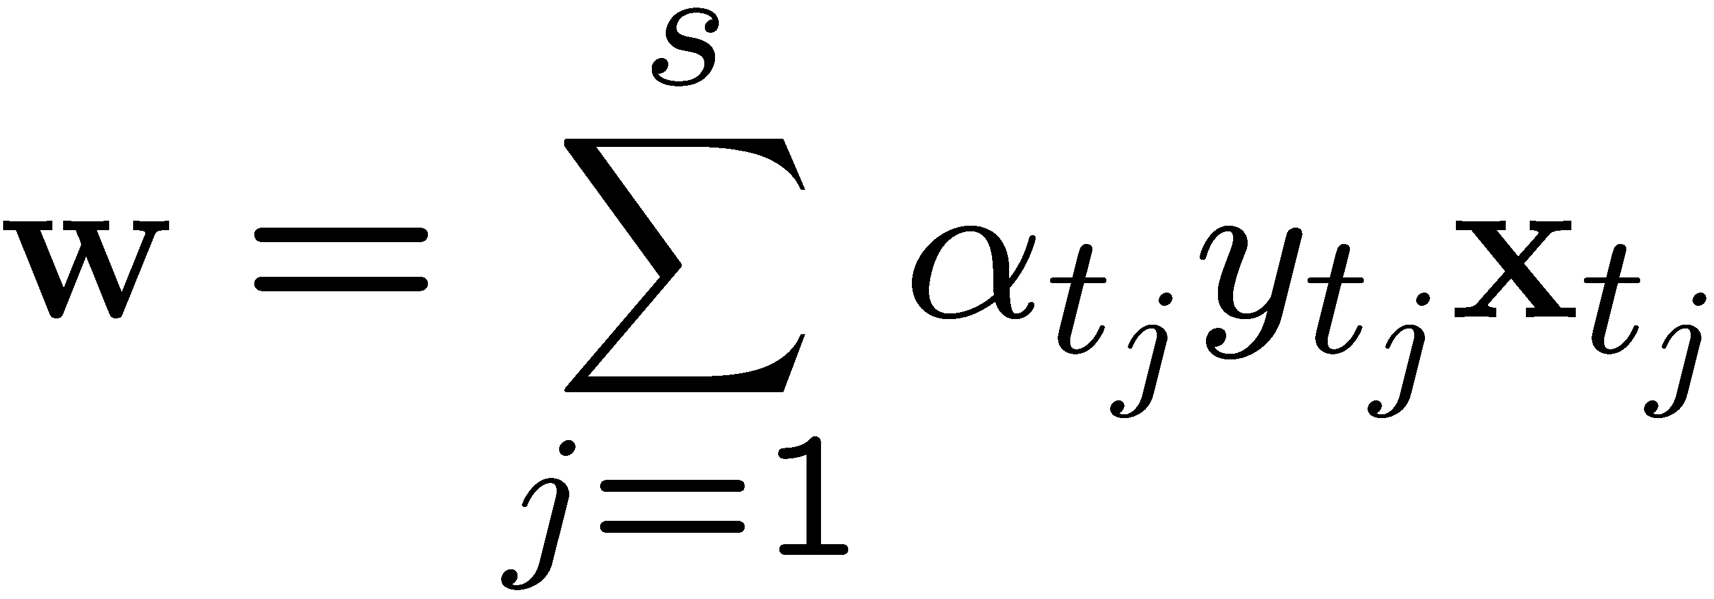
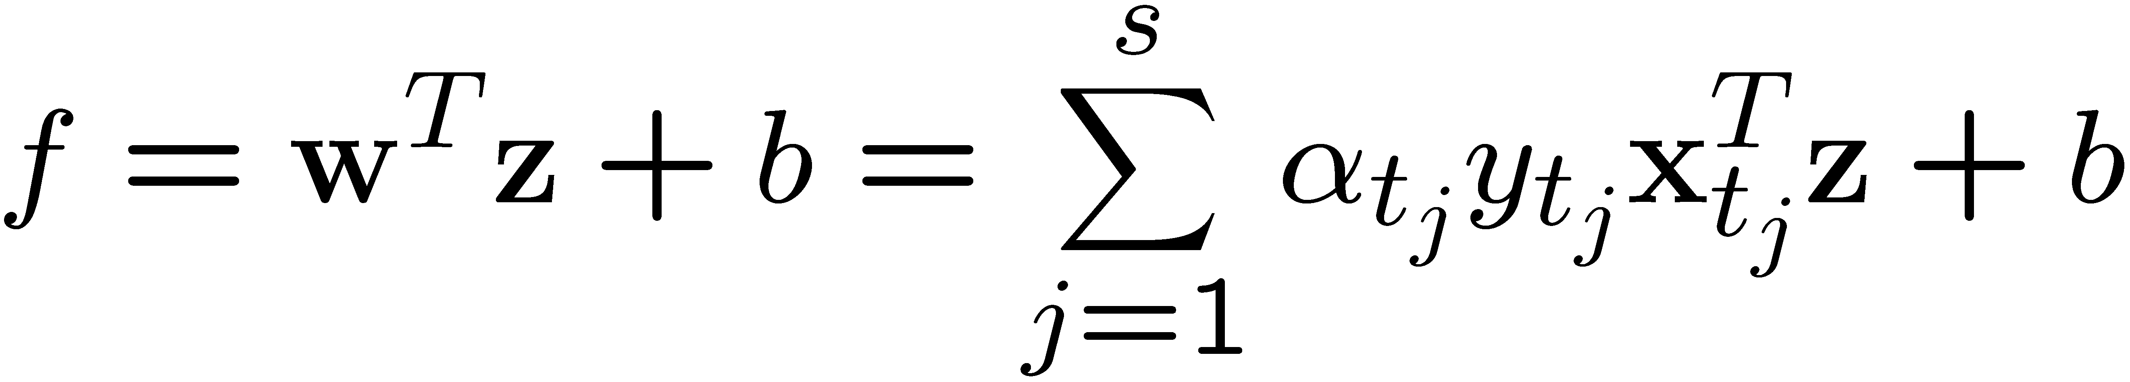
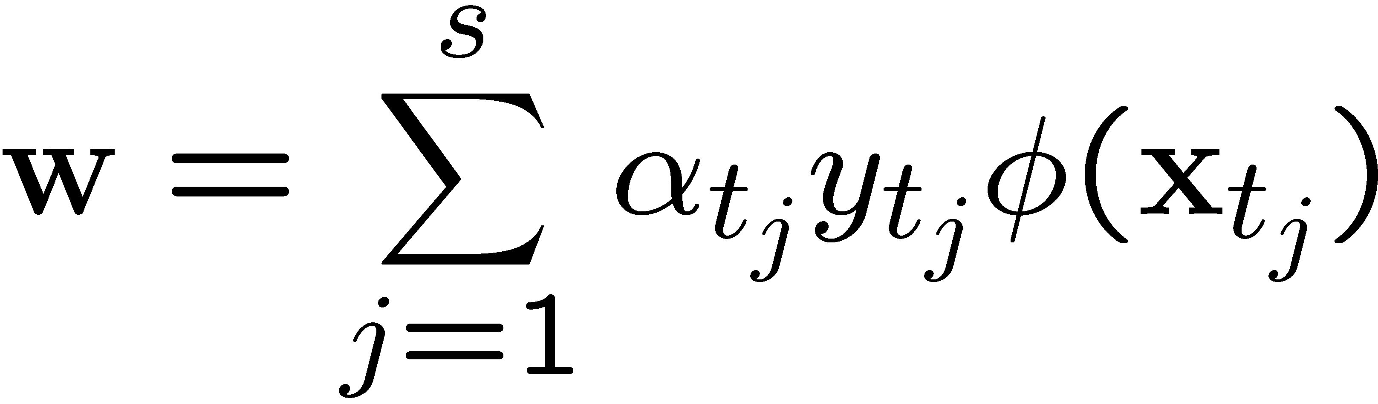
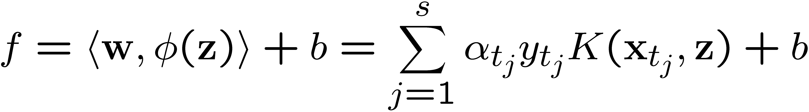
Modification Due to Kernel Function
For testing, the new data z is classified as class 1 if f ≥0, and as class 2 if f <0
Original
With kernel function
Notes:
This tells us why we can not simply store the weighting vector in the model file, because it is not enough for kernel-based SVM.

Slide 25
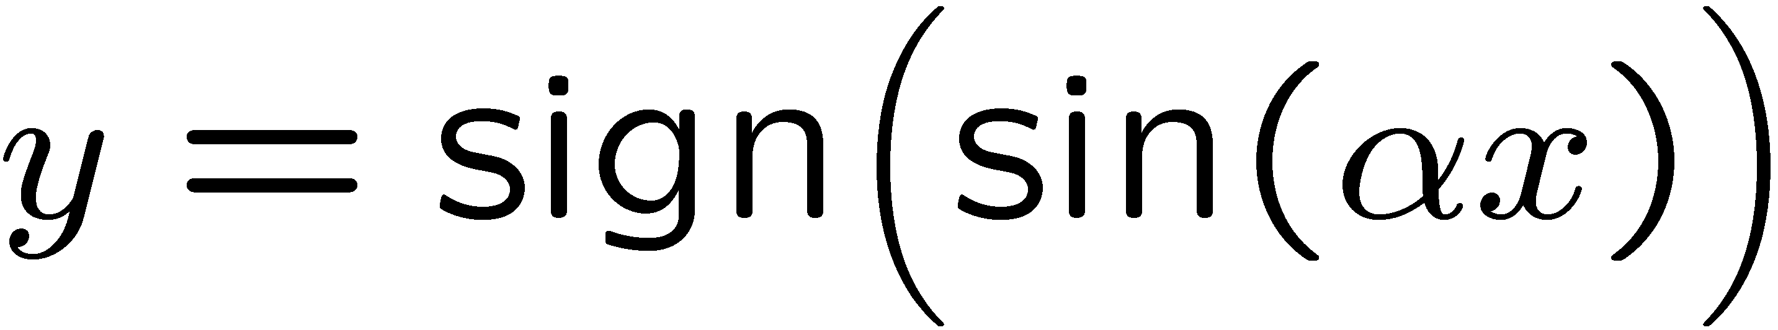
Why SVM Works?
The feature space is often very high dimensional. Why don’t we have the curse of dimensionality?
  A classifier in a high-dimensional space has many parameters and is hard to estimate
Vapnik argues that the fundamental problem is not the number of parameters to be estimated. Rather, the problem is about the flexibility of a classifier
Typically, a classifier with many parameters is very flexible, but there are also exceptions
  Let x_{i}=10^{i} where i ranges from 1 to n. The classifier
  can classify all x_{i} correctly for all possible combination of class labels on x_{i}
  This 1-parameter classifier is very flexible

Slide 26
Why SVM Works?
Vapnik argues that the flexibility of a classifier should not be characterized by the number of parameters, but by the capacity of a classifier
  This is formalized by the “VC-dimension” of a classifier
The addition of ½||w||² has the effect of restricting the VC-dimension of the classifier in the feature space
The SVM objective can also be justified by structural risk minimization: the empirical risk (training error), plus a term related to the generalization ability of the classifier, is minimized
Notes:
Another view. When you fit splines (for example), a large ||w|| corresponds to a “rough” decision boundaries.
Here we should discuss what is VS dimension

Slide 27
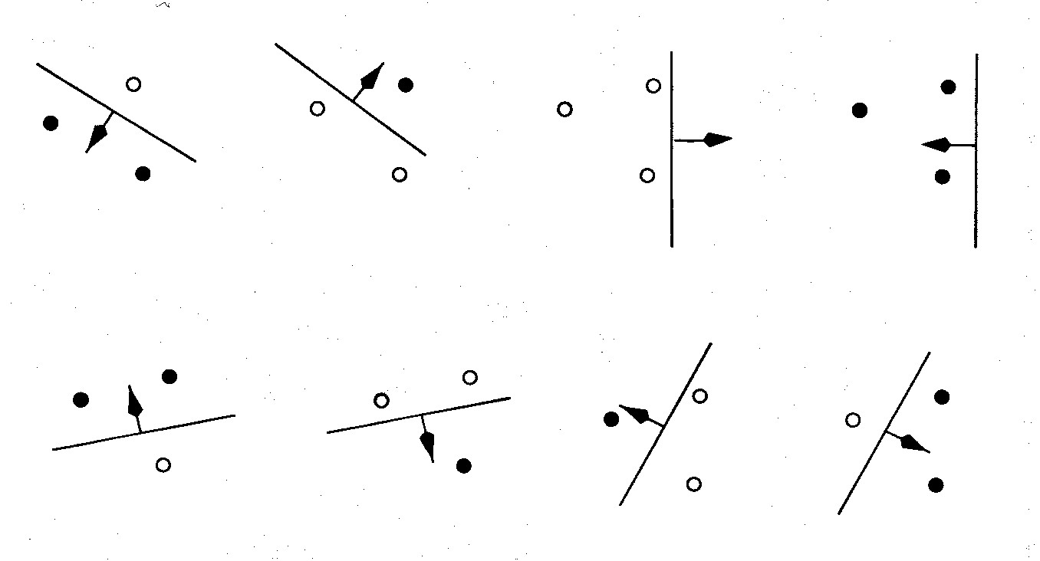
An example of VC dimension
Suppose our model class is a hyperplane.
In 2-D, we can find a plane (i.e. a line) to deal with any labeling of three points. A 2-D hyperplane shatters 3 points
But we cannot deal with some of the possible labelings of four points. A 2-D hyperplane line does not shatter 4 points.

Slide 28
Choosing the Kernel Function
Probably the most tricky part of using SVM.
The kernel function is important because it creates the kernel matrix, which summarize all the data
Many principles have been proposed (diffusion kernel, Fisher kernel, string kernel, …)
There are even research to estimate the kernel matrix from available information
In practice, a low degree polynomial kernel or RBF kernel with a reasonable width is a good initial try for most applications.
It was said that for text classification, linear kernel is the best choice, because of the already-high-enough feature dimension

Slide 29
Strengths and Weaknesses of SVM
Strengths
  Training is relatively easy
    No local optimal, unlike in neural networks
  It scales relatively well to high dimensional data
  Tradeoff between classifier complexity and error can be controlled explicitly
  Non-traditional data like strings and trees can be used as input to SVM, instead of feature vectors
  By performing logistic regression (Sigmoid) on the SVM output of a set of data can map SVM output to probabilities.
Weaknesses
  Need to choose a “good” kernel function.

Slide 30
Summary: Steps for Classification
Prepare the pattern matrix
Select the kernel function to use
Select the parameter of the kernel function and the value of C
  You can use the values suggested by the SVM software, or you can set apart a validation set to determine the values of the parameter
Execute the training algorithm and obtain the α_{i}
Unseen data can be classified using the α_{i} and the support vectors

Slide 31
Fast SVM Implementations
SMO: Sequential Minimal Optimization
SVM-Light
LibSVM
BSVM
……

Slide 32
SMO: Sequential Minimal Optimization
Key idea
  Divide the large QP problem of SVM into a series of smallest possible QP problems, which can be solved analytically and thus avoids using a time-consuming numerical QP in the loop (a kind of SQP method).
  Space complexity: O(n).
  Since QP is greatly simplified, most time-consuming part of SMO is the evaluation of decision function, therefore it is very fast for linear SVM and sparse data.

Slide 33
SMO
At each step, SMO chooses 2 Lagrange multipliers to jointly optimize, find the optimal values for these multipliers and updates the SVM to reflect the new optimal values.
Three components
  An analytic method to solve for the two Lagrange multipliers
  A heuristic for choosing which multipliers to optimize
  A method for computing b at each step, so that the KTT conditions are fulfilled for both the two examples

Slide 34
Using SVM for classification
Prepare the data matrix
Select the kernel function to use
Execute the training algorithm using a QP solver to obtain the α_{i} values
Unseen data can be classified using the α_{i} values and the support vectors

Slide 35
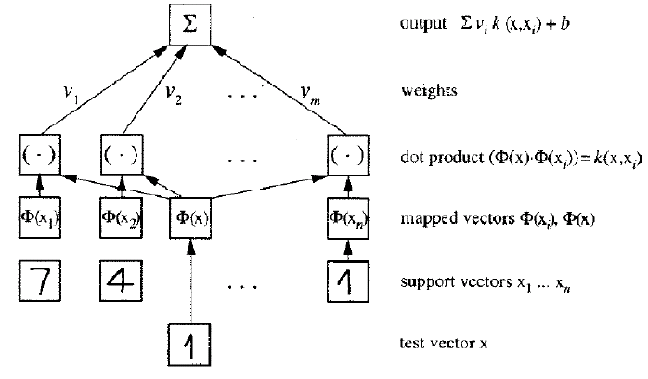
Applications
Handwritten digits recognition
  Of interest to the US Postal services
  4% error was obtained
  about 4% of the training data were SVs only
Text categorisation
Face detection
DNA analysis
…

Slide 36
Conclusions
SVMs learn linear decision boundaries (cf perceptrons)
  They pick the hyperplane that maximises the margin
  The optimal hyperplane turns out to be a linear combination of support vectors
Transform nonlinear problems to higher dimensional space using kernel functions; then there is more chance that in the transformed space the classes will be linearly separable.

Slide 37
Resources
SW & practical guide to SVM for beginners http://www.csie.ntu.edu.tw/~cjlin/libsvm/
Kernel machines website:
http://www.kernel-machines.org/
Burges, C.J. C: A tutorial on Support Vector Machines for Pattern Recognition. Data Mining and Knowledge Discovery, Vol.2, nr.2, pp.121—167, 1998. Available from http://svm.research.bell-labs.com/SVMdoc.html
Cristianini & Shawe-Taylor: SVM book (in the School library)
Slides adapted from Ata Kaban (UK), Tie-Yan Liu (Microsoft)

Slide 38
Conclusion of NN course
Neural networks provide a powerful approach for supervised and unsupervised learning.
In this course we have seen a number of popular NN models and learning algorithms, as well as advanced topics (support vector machines).
There is a lot more about neural networks we have not seen here.
Look at http://ieee-nns.org/research/ if you are interested in NN research topics.

Slide 39
Course Theory Exam
The theory exam will consist of six questions, one for each (theory) topics of the course. Answers to these questions can be obtained by studying the material of the slides.
Questions have (possibly different) weights, depending on their difficulty.
You will not use any material (slides, books, notes, etc) during the exam.
Two examples of a possible exam are given in the next slide.
STORM has copies of past exams
I will make an example of good exam with top score available to be used as guideline on how to answer questions)

Slide 40
Exam (example 1)
Perceptron/Adaline.
  (15 points) Describe the architecture, neuron model and learning algorithm of the perceptron.
  (15 points) State and prove the convergence theorem.
FFNN.
  (10 points) Describe the types of decision regions that can be specified using the following NN architectures:
    single layer NN
    FFNN with one hidden node
    FFNN with two hidden nodes
RBF. (15 points)
  What are the parameters of a RBF network that have to be learnt?
  Describe a learning algorithm for learning the parameters of an RBF network.

Slide 41
Exam (example 1)
SOM, competitive learning.
  (15 points) Describe the SOM architecture and learning algorithm.
Hopfield NN.
  (5 points) What is the network state of an Hopfield network?
  (5 points) When a network state of an Hopfield network is called stable/fixed point?
Support Vector Machines.
  (10 points) What is a support vector classifier with linear kernel?
  (5 points) What are the support vectors?
  (5 points) What is the kernel trick?

Slide 42
Exam (example 2)
Perceptron/Adaline.
  (10 points) Compare Adaline and Perceptron.
  (10 points) What are the limitations of single-layer neural networks?
FFNN.
  (20 points) Describe the back-propagation learning algorithm.
RBF.
  (10 points) Compare FFNN and RBF networks.
SOM , competitive learning.
  (10 points) Describe the Gaussian neighborhood function.
  (10 points) Describe the K-means clustering algorithm.
Hopfield NN.
  (5 points) What is the energy of an Hopfield network ?
  (15 points) Prove that firing a neuron of an Hopfield network decreases the energy of the network.
Support Vector Machines.
  (10 points) Describe the differences between linear SVM and perceptron.

