Slide 1
Formatting Scripts
JavaScript scripts are set apart from the rest of the html in a web page by using the <script> tag.
<script>
Here is some JavaScript
</script>
The script accepts a parameter called Language, which is used to specify the type of scripting language that is being used.
<script Language=“JavaScript”> … </script>

Slide 2
Introducing JavaScript Syntax
Prg1.html
<html>
<head>
<Title> Hello World </Title>
</head>
<body>
<script language=“JavaScript”>
document.write(“Hello,World wide web”);
</script>
</body>
</html>

Slide 3
Comments
A single line comment is denoted with two slashes ( // )
// this is comment, it will be ignored by the browser.
Multi line comments
/*
some text
*/

Slide 4
DATA TYPES
There are 5 basic data types in JavaScript: string, number, Boolean, object and function.

Slide 5
Variables
Variables are "containers" for storing information.
Rules for JavaScript variable names:
Variable names are case sensitive (y and Y are two different variables)
Variable names must begin with a letter or the underscore character
Declaring (Creating) JavaScript Variables
Creating variables in JavaScript is most often referred to as "declaring" variables.
You can declare JavaScript variables with the var statement:
var x; var carname;
After the declaration shown above, the variables are empty (they have no values yet).
However, you can also assign values to the variables when you declare them:
var x=5; var carname="Volvo";

Slide 6
Expressions
The methods that can be employed to manipulate the data are called expressions.
There are 2 types of expressions: numerical and logical
Numerical expressions deal with the number data type.
Logical expression might compare two data values, including strings, to see if they match.
Numerical expressions
Addition, subtraction, multiplication and division are all types of numeric expressions.
Numeric operators are: +, -, *, /, %

Slide 7
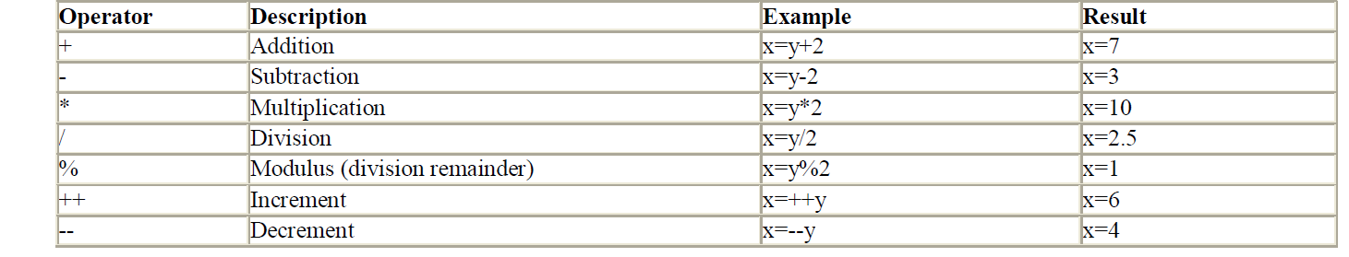
Numerical Expressions

Slide 8
Logical Expressions
These are expressions that, when evaluated, can return either a true or a false.
Logical Operators
&& - And
|| - Or
! - Not
== - Equal
!= - Not Equal
> - Greater than
>=
<
<=

Slide 9
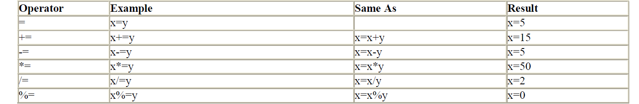
Assignment Operator

Slide 10
+ operator used on strings
To add two or more string variables together, use the + operator.
txt1="What a very";
txt2="nice day"; txt3=txt1+txt2;
After the execution of the statements above, the variable txt3 contains "What a verynice day".
To add a space between the two strings, insert a space into one of the strings:
txt1="What a very ";
txt2="nice day";
txt3=txt1+txt2;
or insert a space into the expression:
txt1="What a very";
txt2="nice day";
txt3=txt1+" "+txt2;
After the execution of the statements above, the variable txt3 contains:
"What a very nice day"
The rule is: If you add a number and a string, the result will be a string!

Slide 11
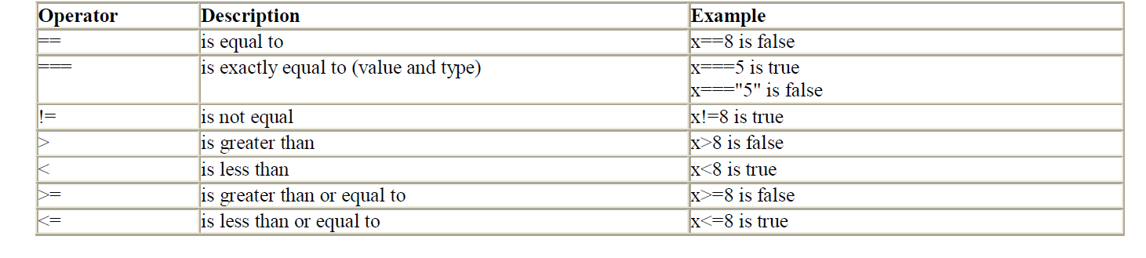
Comparison Operator

Slide 12
Logical Operator

Slide 13
Conditional Operator
JavaScript also contains a conditional operator that assigns a value to a variable based on some condition.
Syntax
variablename=(condition)?value1:value2
Example
greeting=(visitor=="PRES")?"Dear President ":"Dear ";
If the variable visitor has the value of "PRES", then the variable greeting will be assigned the value "Dear President " else it will be assigned "Dear

Slide 14
Flow Control
Conditional statements are used to perform different actions based on different conditions.
In JavaScript we have the following conditional statements:
if statement - use this statement to execute some code only if a specified condition is true
if...else statement - use this statement to execute some code if the condition is true and another code if the condition is false
if...else if....else statement - use this statement to select one of many blocks of code to be executed
switch statement - use this statement to select one of many blocks of code to be executed

Slide 15
If Statement
Use the if statement to execute some code only if a specified condition is true.
Syntax
if (condition) { code to be executed if condition is true }
Example
<script type="text/javascript"> //Write a "Good morning" greeting if //the time is less than 10 var d=new Date(); var time=d.getHours(); if (time<10) { document.write("<b>Good morning</b>"); } </script>

Slide 16
If … Else Statement
Use the if....else statement to execute some code if a condition is true and another code if the condition is not true.
Syntax
if (condition) { code to be executed if condition is true } else { code to be executed if condition is not true }

Slide 17
If...else Statement
Example
<script type="text/javascript"> //If the time is less than 10, you will get a "Good morning" greeting. //Otherwise you will get a "Good day" greeting. var d = new Date(); var time = d.getHours(); if (time < 10) { document.write("Good morning!"); } else { document.write("Good day!"); } </script>

Slide 18
If...else if...else Statement
Use the if....else if...else statement to select one of several blocks of code to be executed.
Syntax
if (condition1) { code to be executed if condition1 is true } else if (condition2) { code to be executed if condition2 is true } else { code to be executed if condition1 and condition2 are not true }

Slide 19
Example
<script type="text/javascript">
var d = new Date()
var time = d.getHours()
if (time<10)
{
document.write("<b>Good morning</b>");
}
else if (time>10 && time<16)
{
document.write("<b>Good day</b>");
}
else
{
document.write("<b>Hello World!</b>");
}
</script>

Slide 20
JavaScript Switch Statement
Conditional statements are used to perform different actions based on different conditions.
The JavaScript Switch Statement
Use the switch statement to select one of many blocks of code to be executed.
Syntax
switch(n) { case 1: execute code block 1 break; case 2: execute code block 2 break; default: code to be executed if n is different from case 1 and 2 }

Slide 21
JavaScript Switch Statement
<script type="text/javascript"> //You will receive a different greeting based //on what day it is. Note that Sunday=0, //Monday=1, Tuesday=2, etc. var d=new Date(); theDay=d.getDay(); switch (theDay) { case 5: document.write("Finally Friday"); break; case 6: document.write("Super Saturday"); break; case 0: document.write("Sleepy Sunday"); break; default: document.write("I'm looking forward to this weekend!"); } </script>

Slide 22
JavaScript For Loop
Loops execute a block of code a specified number of times, or while a specified condition is true.
JavaScript Loops
Often when you write code, you want the same block of code to run over and over again in a row. Instead of adding several almost equal lines in a script we can use loops to perform a task like this.
In JavaScript, there are two different kind of loops:
for - loops through a block of code a specified number of times
while - loops through a block of code while a specified condition is true
The for Loop
The for loop is used when you know in advance how many times the script should run.
Syntax
for (var=startvalue;var<=endvalue;var=var+increment) { code to be executed }

Slide 23
JavaScript For Loop
Example
<html> <body> <script type="text/javascript"> var i=0; for (i=0;i<=5;i++) { document.write("The number is " + i); document.write("<br />"); } </script> </body> </html>

Slide 24
JavaScript While Loop
The while loop loops through a block of code while a specified condition is true.
Syntax
while (var<=endvalue) { code to be executed }

Slide 25
JavaScript While Loop
Example
<html> <body> <script type="text/javascript"> var i=0; while (i<=5) { document.write("The number is " + i); document.write("<br />"); i++; } </script> </body> </html>

Slide 26
do...while
This loop will execute the block of code ONCE, and then it will repeat the loop as long as the specified condition is true.
Syntax
do
{
code to be executed
} while (var<=endvalue);

Slide 27
Example
<html>
<body>
<script type="text/javascript">
var i=0;
do
{
document.write("The number is " + i);
document.write("<br />");
i++;
}
while (i<=5);
</script>
</body> </html>

Slide 28
break
will break the loop and continue executing the code that follows after the loop (if any).
Example
<html>
<body>
<script type="text/javascript">
var i=0;
for (i=0;i<=10;i++)
{
if (i==3)
{
break;
}
document.write("The number is " + i);
document.write("<br />");
}
</script>
</body> </html>

Slide 29
continue
will break the current loop and continue with the next value.
Example
<html>
<body>
<script type="text/javascript">
var i=0
for (i=0;i<=10;i++)
{
if (i==3)
{
continue;
}
document.write("The number is " + i);
document.write("<br />");
} </script>
</body>
</html>

Slide 30
For in
The for...in statement loops through the elements of an array or through the properties of an object.
Syntax
for (variable in object)
{
code to be executed
}
Note: The code in the body of the for...in loop is executed once for each element/property.
Note: The variable argument can be a named variable, an array element, or a property of an object.

Slide 31
Example
<html>
<body>
<script type="text/javascript">
var x;
var mycars = new Array();
mycars[0] = "Saab";
mycars[1] = "Volvo";
mycars[2] = "BMW";
for (x in mycars)
{
document.write(mycars[x] + "<br />");
}
</script> </body> </html>

Slide 32
Functions
A function is simply a block of code with a name, which allows the block of code to be called by other components in the scripts to perform certain tasks.
Functions can also accept parameters that they use complete their task.
JavaScript actually comes with a number of built-in functions to accomplish a variety of tasks.

Slide 33
Creating Custom Functions
In addition to using the functions provided by javaScript, you can also create and use your own functions.
General syntax for creating a function in JavaScript is as follows:
function name_of_function(argument1,argument2,…arguments) {
………………………………………… //Block of Code …………………………………………
}

Slide 34
Creating Custom Functions
Calling functions
There are two common ways to call a function: From an event handler and from another function.
Calling a function is simple. You have to specify its name followed by the pair of parenthesis.
<SCRIPT TYPE="TEXT/JAVASCRIPT">
name_of_function(argument1,argument2,…arguments)
</SCRIPT>

Slide 35
Creating Custom Functions
<html> <head> <title>Henley's Department Store</title>
<Script Language="JavaScript">
function welcomeMessage()
{
document.write("Welcome to Web Technologies!");
}
</Script>
</head>
<body>
<h1>ACE ENGINEERING COLLEGE</h1>
<h3>DEPARTMENT OF CSE</h3>
<Script Language="JavaScript">
welcomeMessage();
</Script>
</body>
</html>

Slide 36
Objects
JavaScript is an object oriented programming language
That means that elements within the language are treated as objects that can be used in different scripts.
Another advantage of objects is that they have methods and properties associated with them.
In javascript, the syntax for using objects is:
Object.Method.Property

Slide 37
Strings
used to manipulate a stored piece of text.
Methods of String
Example
var txt=“Hello world!”
Method | Description | Syntax | Output
length | Returns the length of the string | txt.length | 12
toUpperCase() | to convert a string to uppercase letters | txt. toUpperCase() | HELLO WORLD!

Slide 38
Methods
Method | Description | Syntax | Output
indexOf() | Return the position of the first occurrence of a text in a string | txt.indexOf("WORLD") | -1
match() | Search for a text in a string and return the text if found | txt.match("World") | null
replace() | Replace characters in a string | txt.replace(“world!",“students") | Hello students

Slide 39
Example
<html>
<body>
<script type="text/javascript">
var str="Hello world!";
document.write(str.length);
document.write(str.indexOf("d") + "<br />");
document.write(str.indexOf("WORLD") + "<br />");
document.write(str.indexOf("world"));
</script>
</body>
</html>

Slide 40
Arrays
The array concept is used to store a set of values in a single variable name. This is a very important concept in any programming language
Array Definition:
The array must first be defined before it is accessed or used. There are a variety of ways this can be accomplished in JavaScript. Below are some of the ways of defining arrays in JavaScript.
Defining an Array in JavaScript:
Array is defined in JavaScript by making use of the keyword new.
General format of defining array in JavaScript is as follows:
var varaiblename = new Array( )
For example, if a programmer wants to define an array exforsys, it is written as follows:
var exforsys = new Array( )

Slide 41
Arrays
The format for adding elements in this structure is as follows:
var varaiblename = new Array( ) variablename[0]=”element1” variablename[1]=”element2” variablename[2]=”element3” variablename[3]=”element4” ………………………
var Exforsys = new Array( ) Exforsys[0]=”Training” Exforsys[1]=”Division” Exforsys[2]=”Institute” Exforsys[3]=”Company”

Slide 42
Arrays
It is also possible that if the programmer is certain of the array length, it can be defined while defining the array itself as:
var Exforsys = new Array(4)
Shorter form:
The elements can also be defined in a shorter form as:
var variablename=new Array(“element1”,”element2”,”elements3”,….)
Accessing Arrays in JavaScript
You can access an array element by referring to the name of the array and the element's index number.
Displaying Array Elements
document.write(Exforsys[1])

Slide 43
Methods in Array
METHOD | DESCRIPTION
toString() | converts an array to a string of (comma separated) array values.
join() | joins all array elements into a string
pop() | removes the last element from an array
push() | adds a new element to an array (at the end)
shift() | removes the first array element and "shifts" all other elements to a lower index.
splice() | used to add new items to an array:

Slide 44
Methods in Array
METHOD | DESCRIPTION
slice() | slices out a piece of an array into a new array
reverse() | Reverses an array
sort() | Sorts an array in ascending order
concat() | Concates one array with another array

Slide 45
Date and Time
The Date object is used to work with dates and times.
Date objects are created with new Date().
<script Language=“JavaScript”>
rightNow = new Date()
</script>
Methods of Date() object
getDate() - Returns the day of the month (from 1-31)
getDay() Returns the day of the week (from 0-6)
getFullYear() Returns the year (four digits)
getHours() Returns the hour (from 0-23)
getMilliseconds() Returns the milliseconds (from 0-999)

Slide 46
Date and Time
getMinutes() Returns the minutes (from 0-59)
getMonth() Returns the month (from 0-11)
getSeconds() Returns the seconds (from 0-59)
setDate() Sets the day of the month (from 1-31)
setFullYear() Sets the year (four digits)
setHours() Sets the hour (from 0-23)
setMilliseconds() Sets the milliseconds (from 0-999)
setMinutes() Set the minutes (from 0-59)
setMonth() Sets the month (from 0-11)
setSeconds() Sets the seconds (from 0-59)

Slide 47
Date and Time
Example
<Html>
<head> <Title> Date and Time Example </Title> </head>
<body>
<script language=“JavaScript”>
rightNow = new Date();
var status;
hour = rightNow.getHours()
minute = rightNow.gteMinutes()
if (hour > = 13 )
status = “PM”;
else
status = “AM”;
if (hour>12) hour = hour – 12;

Slide 48
Date and Time
document.write (hour, “:”, minute,status);
Month = rightNow.getMonth();
Month = month + 1;
Day = rightNow.getDate();
Year = rightNow.getYear();
document.write(“ “, month, “/”, day, “/”, year, “ “);
</script>
</body>
</html>

Slide 49
Math
allows to perform mathematical tasks

Slide 50
Methods
Methods | Description
round() | to round a number to the nearest integer
random() | return a random number between 0 and 1
max() | return the number with the highest value of two specified numbers
min() | return the number with the lowest value of two specified numbers

Slide 51
Example
<html> <body>
<script type="text/javascript">
//return a random number between 0 and 1
document.write(Math.random() + "<br />");
//return a random integer between 0 and 10
document.write(Math.floor(Math.random()*11));
</script> </body> </html>

Slide 52
Alert Boxes and Confirmations
Alert Box
An alert box is often used if you want to make sure information comes through to the user.
Example
<html> <head> <script type="text/javascript"> function show_alert() { alert("I am an alert box!"); } </script> </head> <body> <input type="button" onclick="show_alert()" value="Show alert box" /> </body> </html>

Slide 53
Alert Boxes and Confirmations
A confirm box is often used if you want the user to verify or accept something.
Example
<html> <head> <script type="text/javascript"> function show_confirm() { var r=confirm("Press a button"); if (r==true) { document.write("You pressed OK!"); } else { document.write("You pressed Cancel!"); } } </script> </head>
<body> <input type="button" onclick="show_confirm()" value="Show confirm box" /> </body> </html>

Slide 54
Prompt Box
used if you want the user to input a value before entering a page.
When a prompt box pops up, the user will have to click either "OK" or "Cancel" to proceed after entering an input value. If the user clicks "OK" the box returns the input
value. If the user clicks "Cancel" the box returns null.
Syntax
prompt("sometext","defaultvalue");

Slide 55
Example
<html> <head>
<script type="text/javascript">
function show_prompt()
{
var name=prompt("Please enter your name","Harry Potter");
if (name!=null && name!="")
{
document.write("Hello " + name + "! How are you today?");
}
} </script> </head> <body>
<input type="button" onclick="show_prompt()" value="Show prompt box" />
</body> </html>

Slide 56
Event Handlers
Events are actions that can be detected by JavaScript.
Every element on a web page has certain events which can trigger a JavaScript.
For example, we can use the onClick event of a button element to indicate that a function will run when a user clicks on the button. We define the events in the HTML tags.
Examples of events:
• A mouse click
• A web page or an image loading
• Mousing over a hot spot on the web page
• Selecting an input field in an HTML form
• Submitting an HTML form
• A keystroke
Note: Events are normally used in combination with functions, and the function will not be executed before the event occurs!

Slide 57
Events
EVENTS | DESCRIPTION
onblur | Triggers when the window loses focus
onchange | Triggers when an element changes
onclick | Triggers on a mouse click
onfocus | Triggers when the window gets focus
onkeydown | Triggers when a key is pressed
onkeypress | Triggers when a key is pressed and released
onkeyup | Triggers when a key is released

Slide 58
Events
EVENTS | DESCRIPTION
onload | Triggers when the document loads
onmousedown | Triggers when a mouse button is pressed
onmousemove | Triggers when the mouse pointer moves
onmouseover | Triggers when the mouse pointer moves over an element
onunload | Triggers when the user leaves the document
onsubmit | Triggers when a form is submitted

Slide 59
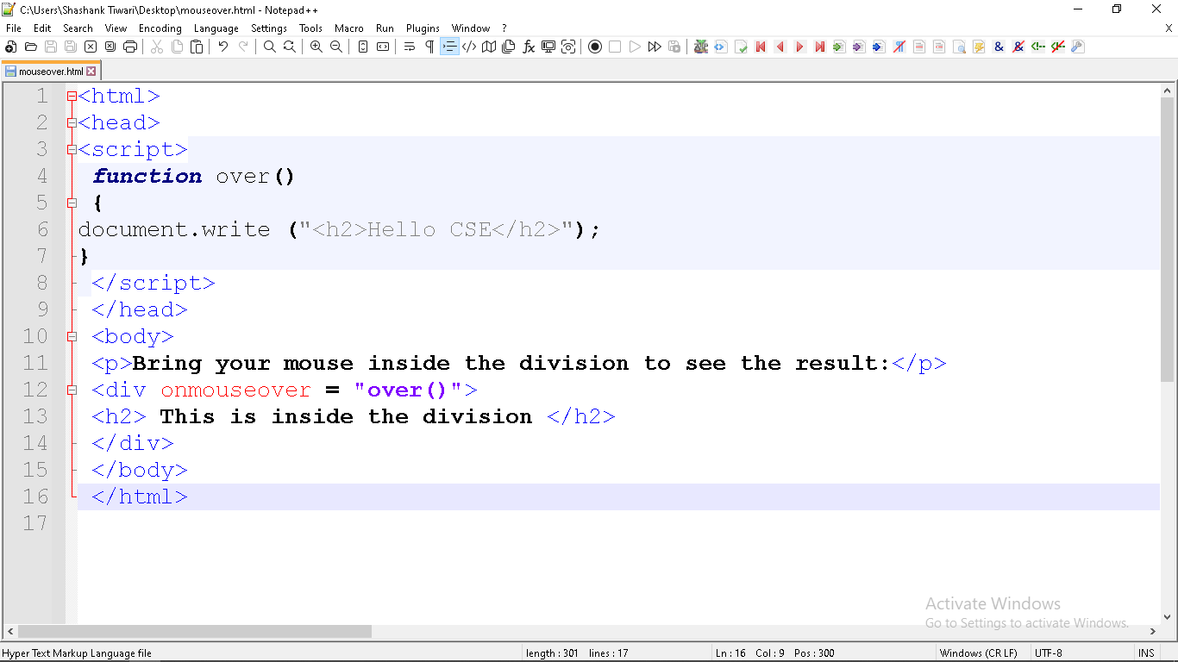
Example

Slide 60
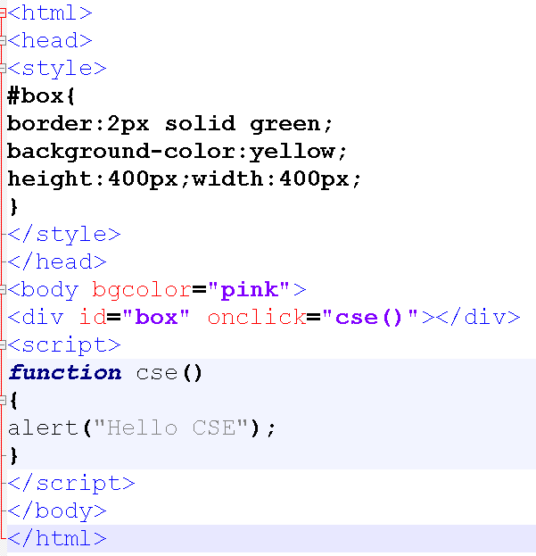
Example

Slide 61
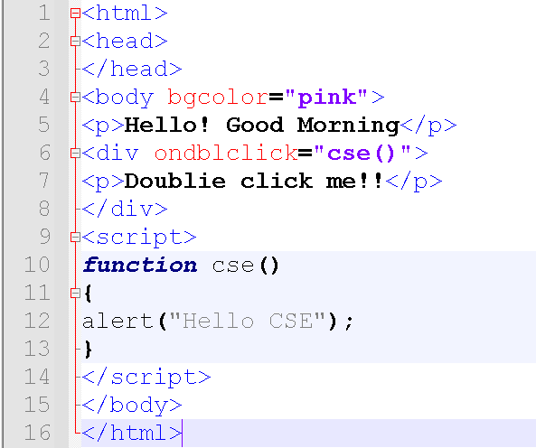
Example

Slide 62
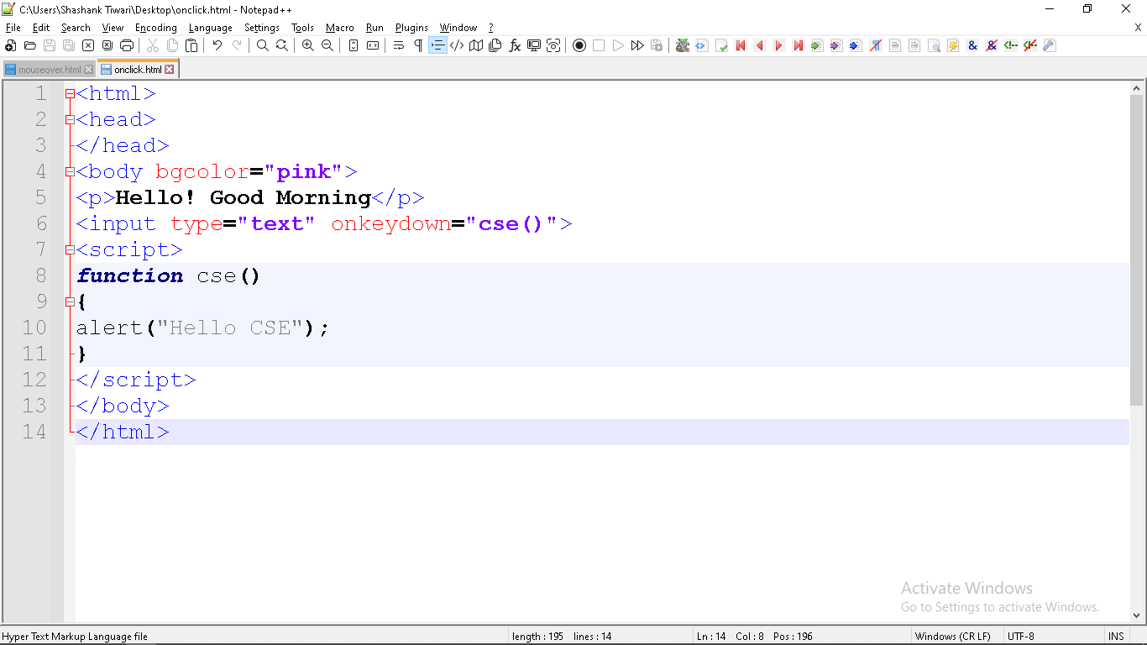
Example
onkeydown event occurs when the user is pressing a key (on the keyboard).

Slide 63
Example
onkeyup event occurs when the user releases a key (on the keyboard).

