Slide 1
Airport Flight Board & Scheduler
Dheeraj Jasti
2620030644
Shashank Varma
2620030229

Slide 2
Abstract
A centralized system that automates flight records, gate assignments and scheduling at an airport
Admins can add, update, search and remove flights (number, airline, source, destination, time, gate, status)
Automatic gate-conflict detection when two flights get overlapping gate times
Passengers can search a flight or view a self-updating board of arrivals, departures and delays

Slide 3
Understanding Problem Statement
Airports still track flights and gates manually on fixed displays
Manual updates are slow and cannot keep up with delays or gate swaps
No automatic check for overlapping gate slots
Searching flights or building reports means digging through paperwork
Goal: one centralized system with conflict detection and a live flight board

Slide 4
CO 1 Topics
Variables
Data Types
Constants
Literals
Operators
Typecasting

Slide 5
CO 2 Topics
Conditional Statements
Loops
if / else-if ladder
switch-case-default-break
Nested loops
Compound statements

Slide 6
CO 3 Topics
Methods
Arrays
Parameter passing
Return values
Method overloading
1D array
2D array
Searching
Summation, average, counting

Slide 7
CO 4 Topics
Inheritance
Polymorphism
(runtime binding)
Abstract Classes
Interfaces
Packages

Slide 8
CO 5 Topics
Exception Handling
(exception hierarchy)
File I/O Streams
Collections Framework
Generics
Lambda Expressions
Stream API & Optional

Slide 9
CO 6 Topics
UniFlow System
Integration
Testing & Persistence
Architecture and workflow
OOP, file handling, collections, functional programming
File-backed persistence
Performance, modularity, maintainability

Slide 10
Conclusion
Replaces manual flight tracking with one centralized, automated system
Gate-conflict detection prevents overlapping gate assignments
Live flight board keeps arrivals, departures and delays accurate for passengers and staff
Less manual error, saved time and easy schedule reports
Future scope: delay notifications, real-time refresh and role-based access

Slide 11
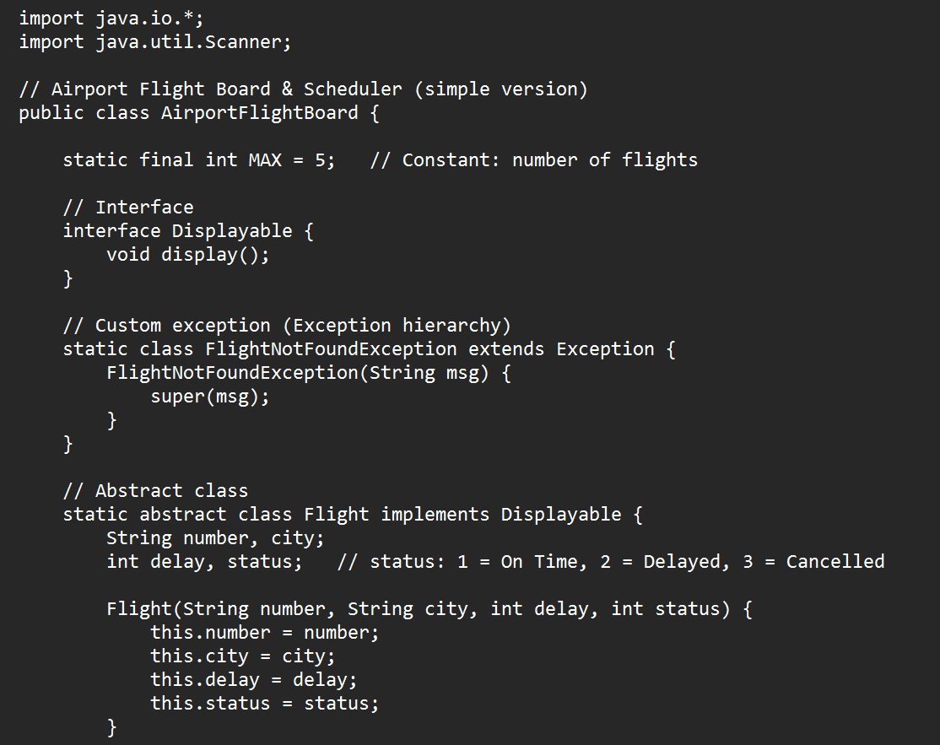
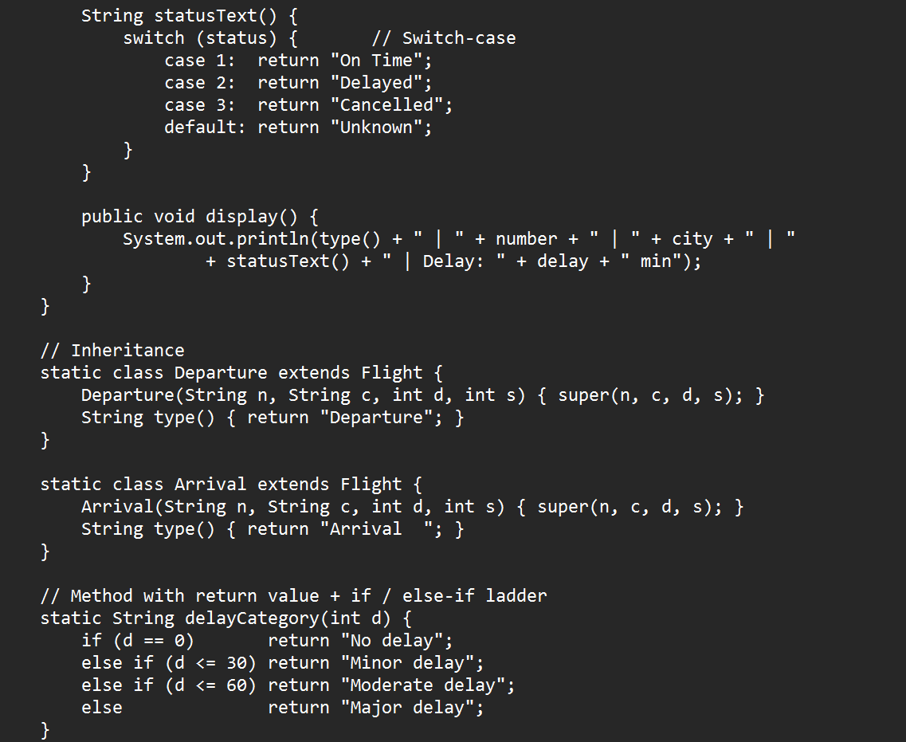
Screen Shots – Code (1 of 3)

Slide 12
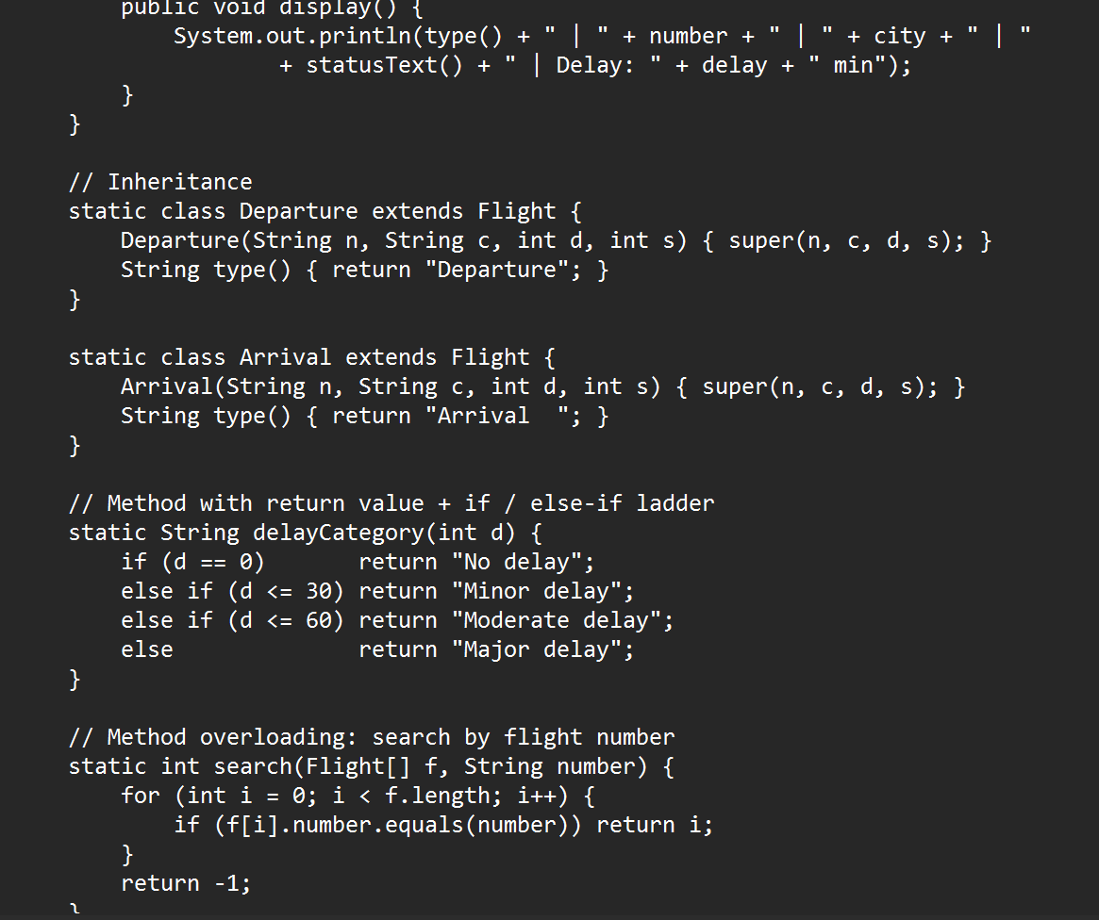
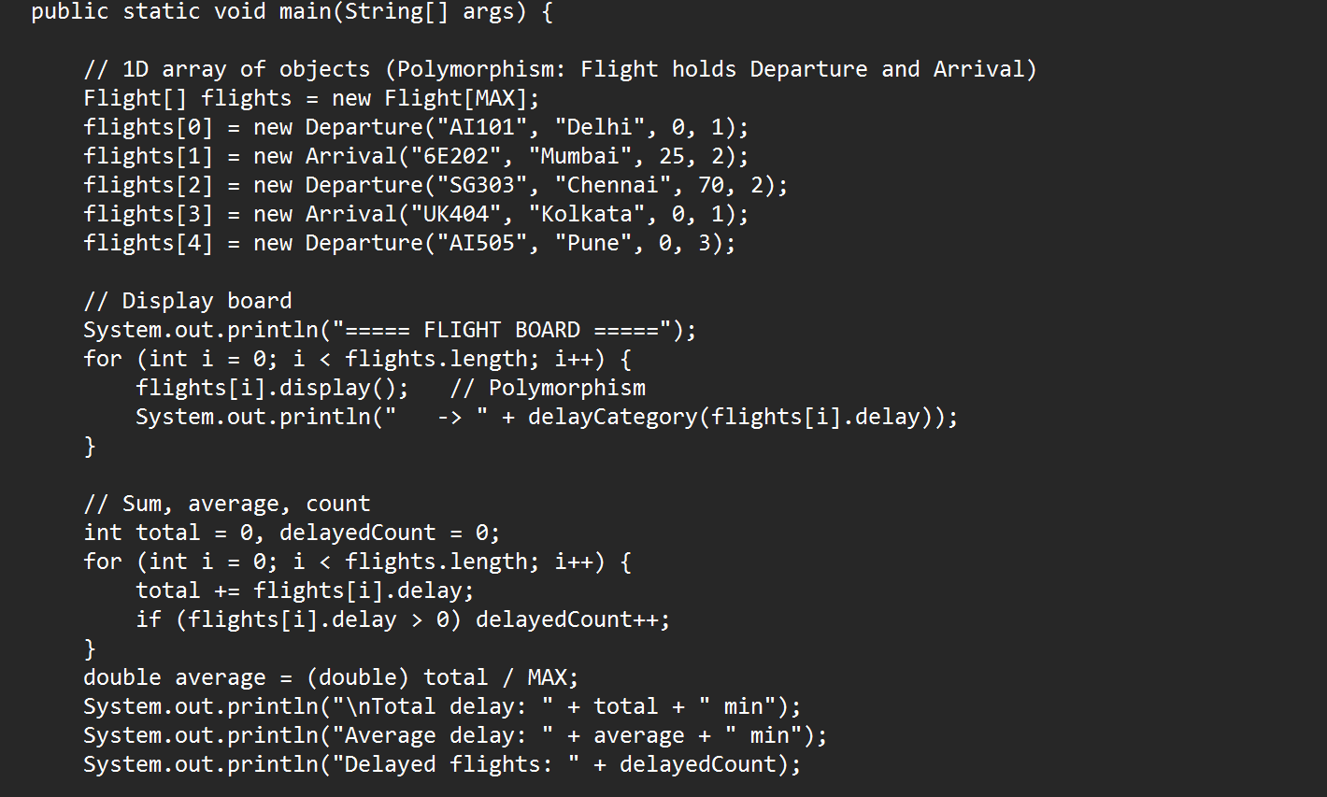
Screen Shots – Code (2 of 3)

Slide 13
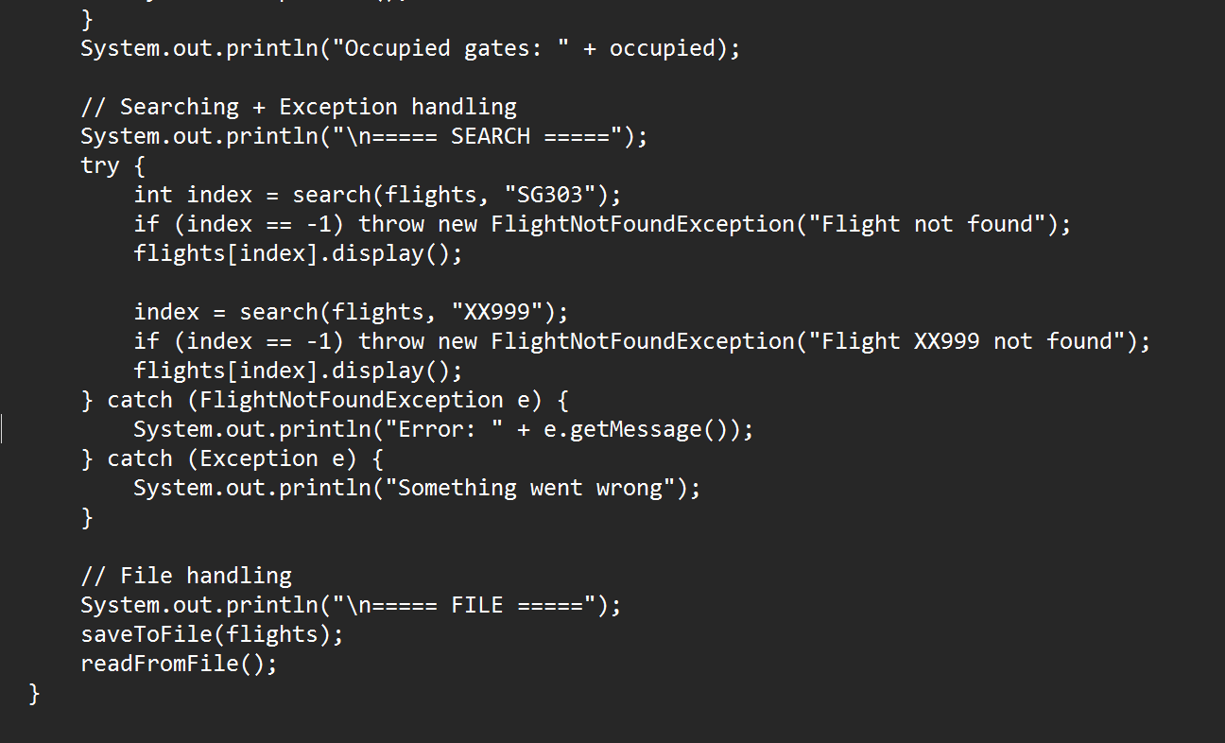
Screen Shots – Code (3 of 3)

Slide 14
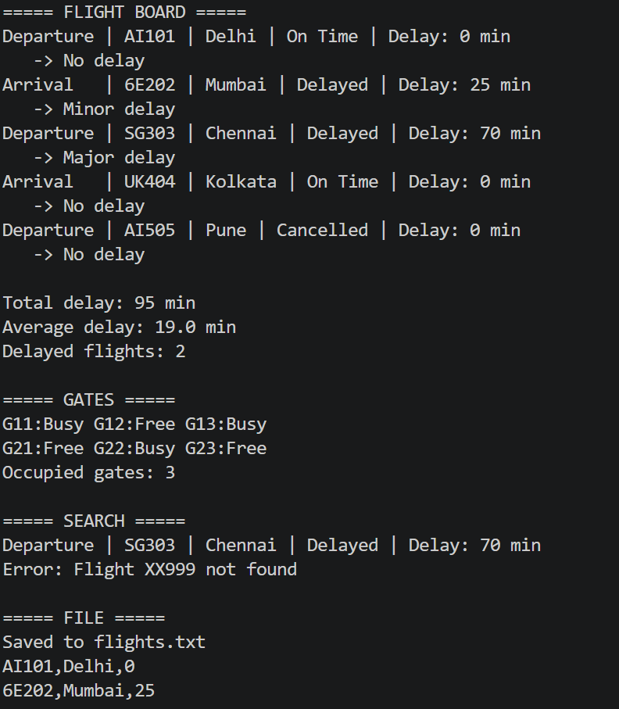
Screen Shots – Expected Output

Slide 15
Geo Tag Photo and git hub link

