Slide 1
ZS YOUNG DATA SCIENCE CHALLENGE
Shashank Vasisht

Slide 2
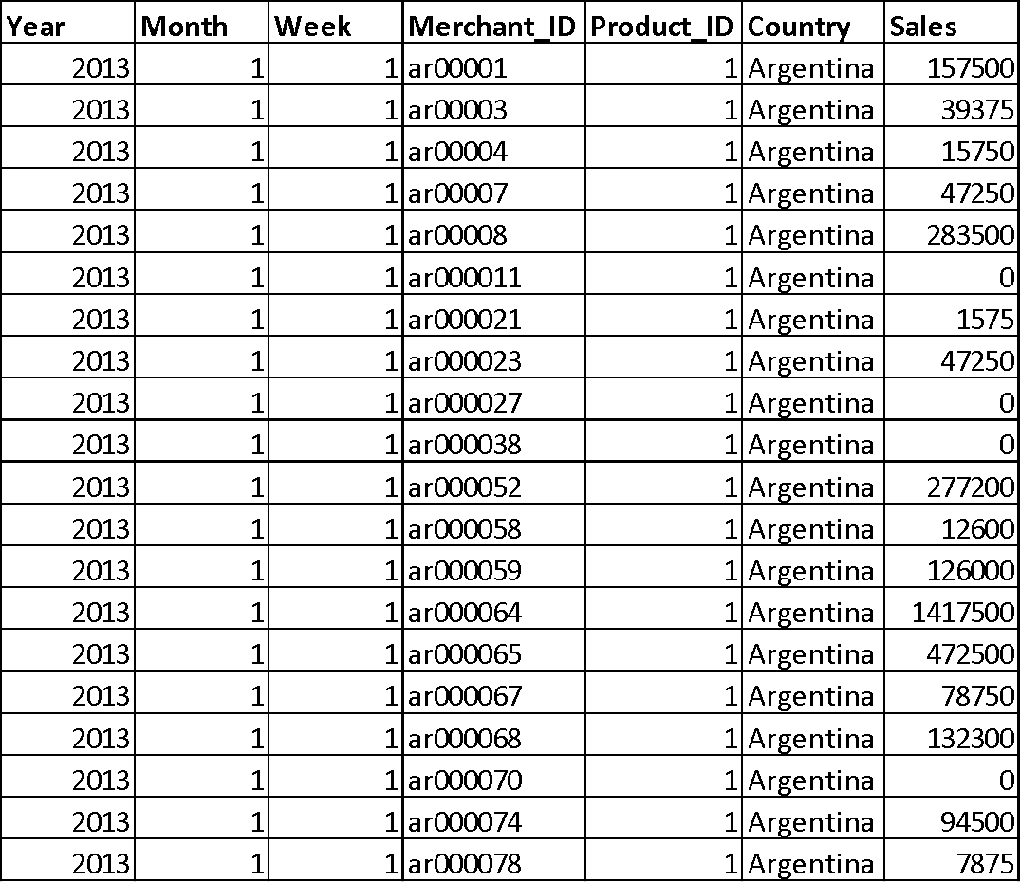
Approach
The data provided had the features as Year, Month, Week, Merchant_ID , Product_ID and Country.
The Target Variable here is the Sales Column.
Since the Target Variable is a real valued output, i.e. the output is continuous and there are no finite classes, this problem was thought of as a Regression Problem.
The data was cleaned in the desired format in which the data had to be submitted and a Linear Regression Model was trained to give predictions.

Slide 3
Error Checking
The data provided was checked for any value to be not readable like ‘NaN’ values so as to drop those rows, however no such rows were found.
Some Sales values were ‘0’ which was perfectly acceptable since there can be times when the sales is 0, hence no error was found in data

Slide 4
Data Preprocessing
The first step in cleaning the data was to analyze how the output was to be computed.
The problem stated that the output should be provided in the resolution of Country X Product X Month.
Hence the training data was cleaned to get monthly output corresponding to this resolution.
The total sales produced by all the unique merchants every week of the month was summed up
This provided us with total sales in a month irrespective of the week and the merchant, thereby making the two columns needless.

Slide 5
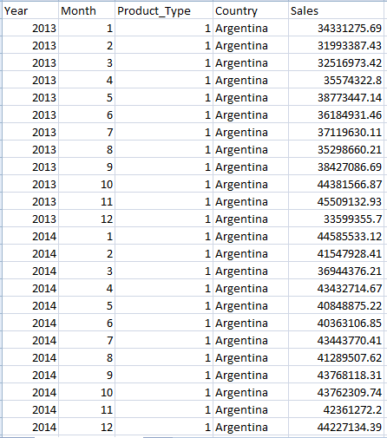
Data Preprocessing
Thus after computing monthly sales of each product type by each country, the columns like S_No , Week , Merchant_ID were dropped.
The new dataset looked like :

Slide 6
Adjusting the Promotional Expenses
We were also provided with a promtional_expenses.csv file which gave the information about how much money was spent on promotions.
The resolution was again in the form of Country X Month X Product.
Thus according to each combination of year, month, product_id and country, the expenses from the promotional_expenses.csv file was subtracted to the corresponding Sales value from the newly made Sales dataset in Country X Product X Month resolution, to adjust for money spent on promotions.

Slide 7
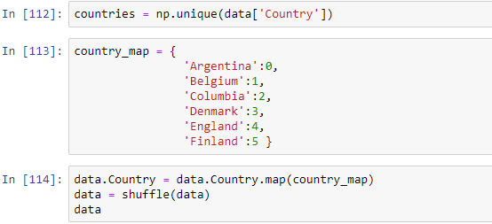
Mapping the Country Column
The Country Column had names of countries stored in the string format which was not suitable for training of the data.
Thus the unique country names were mapped with an equivalent integer value.

Slide 8
Model Choice and Features
Thus the final features chosen were Year, Month, Product_ID and Country.
The model of choice was Scikit-Learn’s Linear Regression model.
The four features mentioned above were considered as Input Features or ‘X’ and
the ‘Sales’ column was considered as the target variable or ‘Y’.
The model was trained and the predictions were made on the yds_test2018.csv file.
These predictions were stored as a list and were used to fill in the ‘Sales’ column
in the yds_test.csv file .

