Slide 1
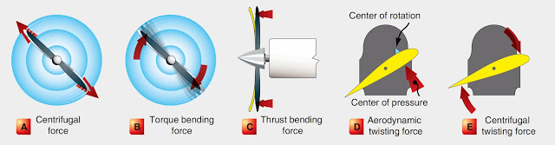
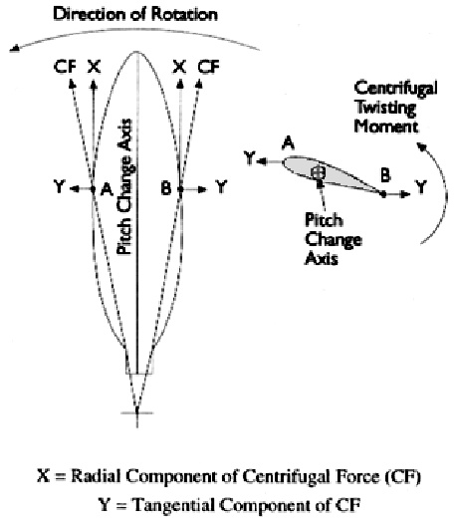

Slide 2
Why propellers fail
Forces on a propeller
High performance engines have caused propeller tips to break, presumably due to fatigue failure from vibration. Propeller blades are especially susceptible to destructive vibration if they are excited near its resonant frequency.
Sometimes they may get damage due to some airborne obstacles like birds and branches.

Slide 3
EKF Failsafe
The EKF failsafe monitors the health of EKF (the position and attitude estimation system) to catch problems with the vehicle’s position estimate (often caused by GPS glitches or compass errors) and prevent “flyaways”.
The EKF failsafe will trigger when any two of the EKF “variances” for compass, position or velocity are higher than the FS_EKF_THRESH parameter value for 1 second.
These “variances” come from the EKF itself and are numbers indicating the EKF’s confidence in its estimates. The values are between 0 and 1 with 0 meaning the estimate is very trustwrothy and 1.0 is very untrustworthy.

Slide 4
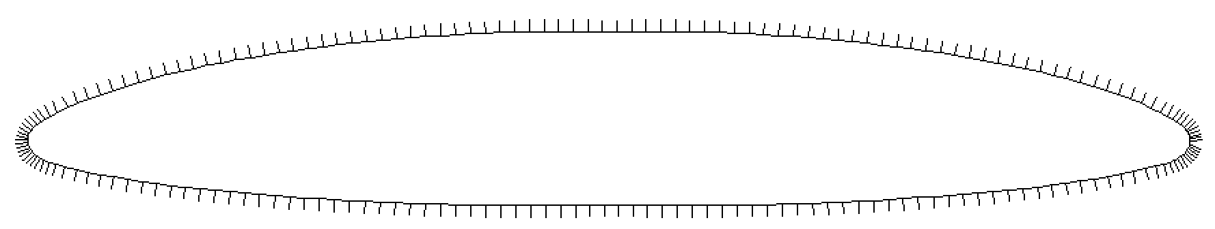
Gives same lift in both cases
In case of airflow flowing in opposite direction, the Airflow around the airfoil wont be same as in case of correct direction and it will be less.

Slide 5
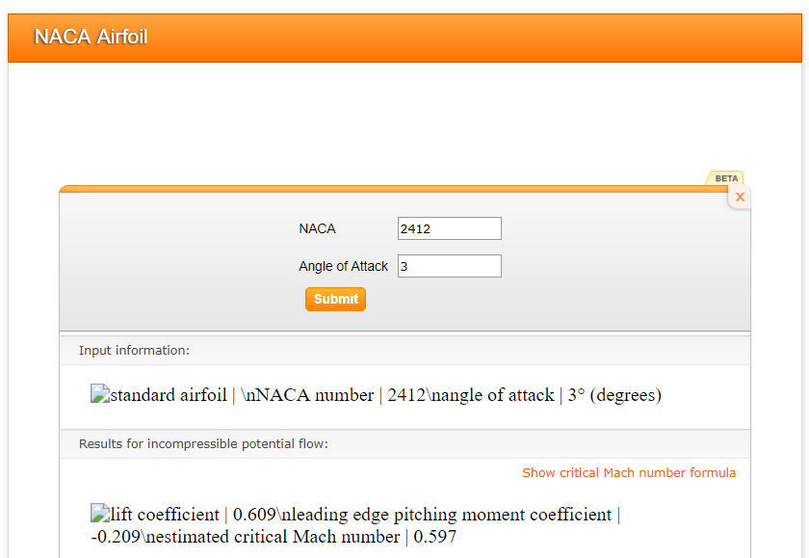
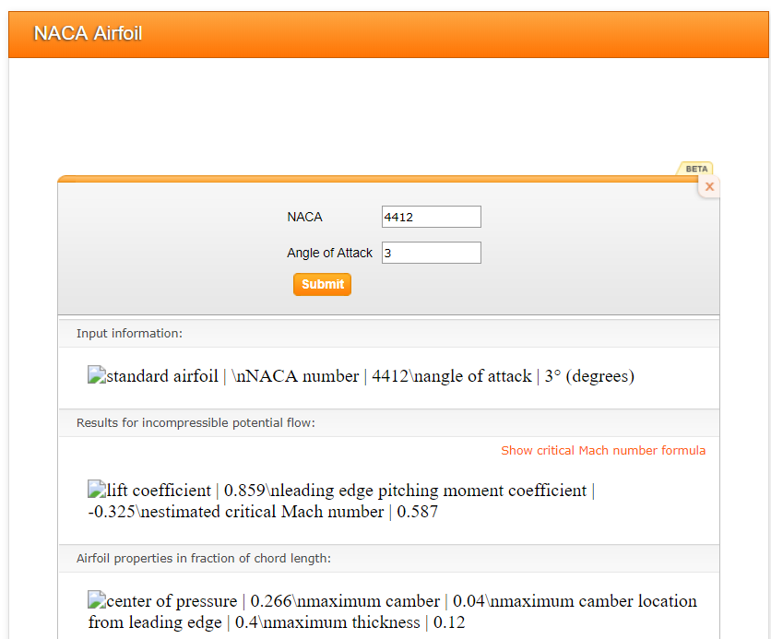
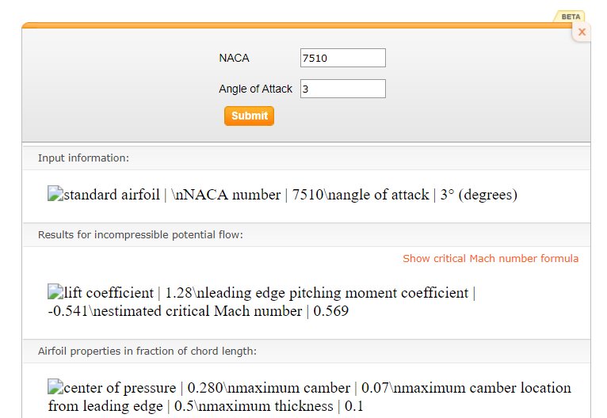

Slide 6
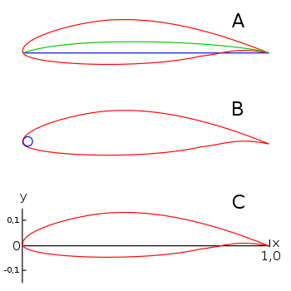
National Advisory Committee for Aeronautics (NACA) Airfoils.
A: blue line = chord, green line = camber mean-line, B: leading edge radius, C: x-y-coordinates for the profile geometry (Chord = x-Axis; y-Axis line on that leading edge)
The NACA four-digit wing sections define the profile by:
First digit describing maximum camber as percentage of the chord.
Second digit describing the distance of maximum camber from the airfoil leading edge in tens of percents of the chord.
Last two digits describing maximum thickness of the airfoil as percent of the chord.

