Slide 1
HEALTHCARE APPOINTMENT
No-Show Prediction
Data Analytics, Power BI Dashboards & Machine Learning Project
June 2026

Slide 2
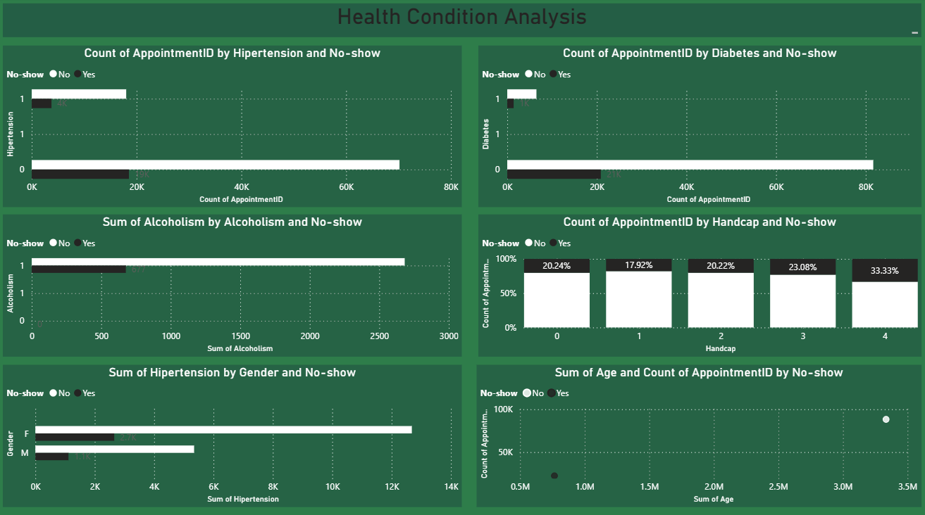
Project Overview
Missed medical appointments cost healthcare systems time, money, and clinical capacity. This project analyzes 110,527 real-world appointment records to understand why patients miss appointments, and builds tools to predict and prevent it.
1
Explore
Analyze demographics, behavior & scheduling patterns driving no-shows
2
Visualize
Build interactive Power BI dashboards for ops & executive teams
3
Predict
Train a Decision Tree classifier to flag at-risk appointments
4
Recommend
Translate insights into actionable retention strategies
Healthcare No-Show Prediction | 2

Slide 3
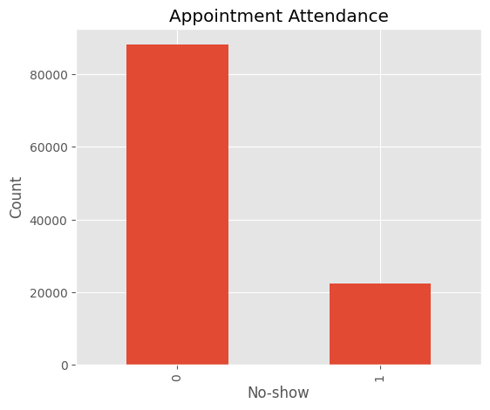
Dataset Overview
110,527
88,208
22,319
20.19%
Total Appointments
Patients Attended
No-Show Patients
No-Show Rate
Field | Description
Gender / Age | Patient demographics
Neighbourhood | Location of facility
Scholarship | Welfare program enrollment
Hipertension / Diabetes / Alcoholism / Handcap | Chronic health condition flags
SMS_received | Whether reminder SMS was sent
WaitingDays (engineered) | Days between booking and appointment
No-show | Target: 0 = Attended, 1 = Missed
Field | Description
Healthcare No-Show Prediction | 3

Slide 4
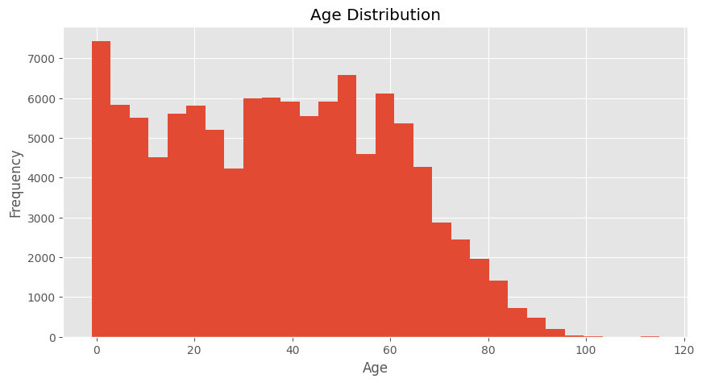
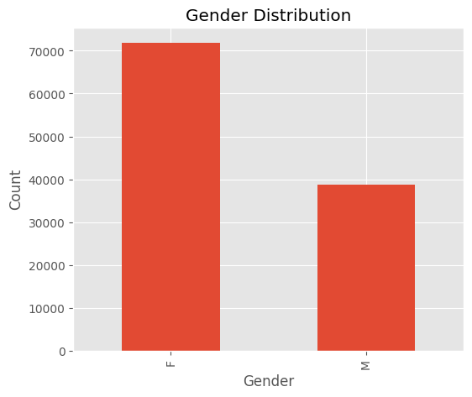
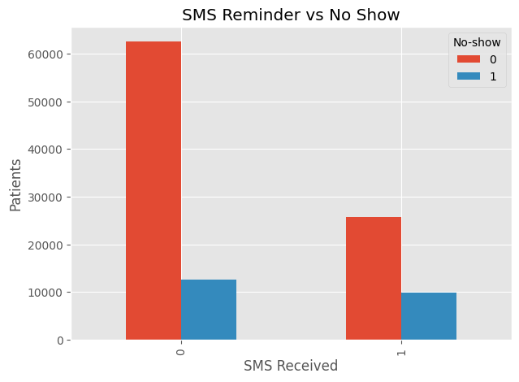
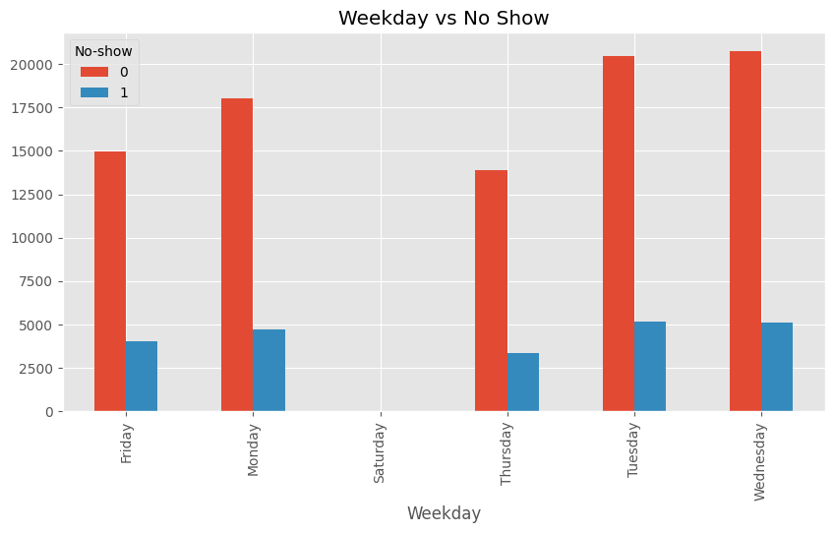
EDA Highlights
Age Distribution
Gender Split
SMS vs No-Show
Weekday vs No-Show
Healthcare No-Show Prediction | 4

Slide 5
Power BI: Executive Dashboard
Total appointments, attendance rate, and breakdowns by gender & scholarship at a glance.
Healthcare No-Show Prediction | 5

Slide 6
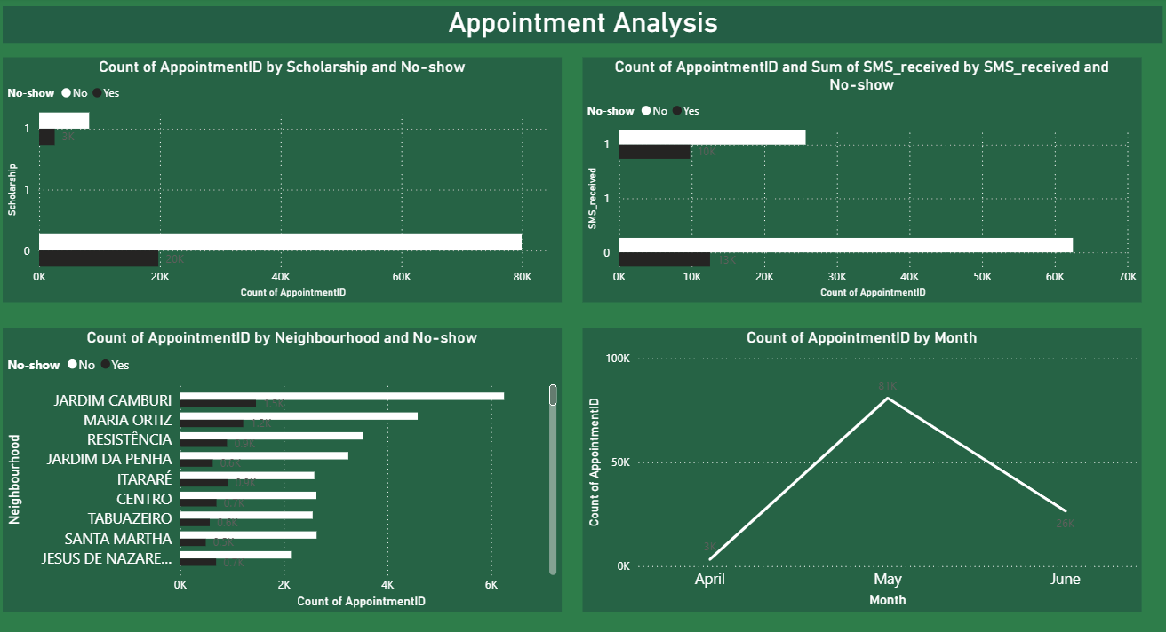
Power BI: Appointment Analysis Dashboard
Scholarship, SMS reminders, top neighbourhoods, and monthly appointment volume trends.
Healthcare No-Show Prediction | 6

Slide 7
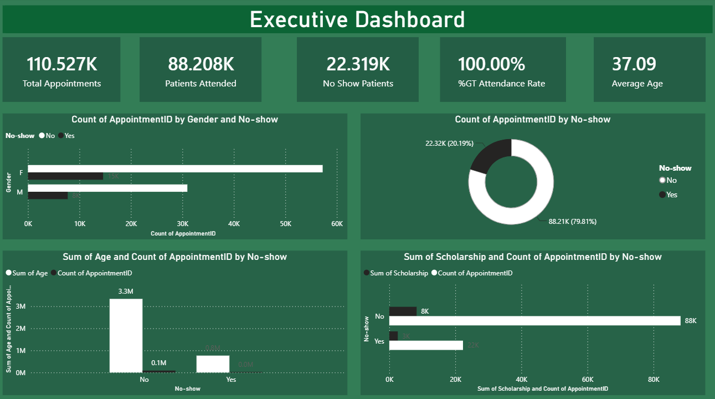
Power BI: Health Condition Analysis Dashboard
No-show behavior segmented by hypertension, diabetes, alcoholism, handicap level & gender.
Healthcare No-Show Prediction | 7

Slide 8
Dashboard Insights
Executive
Appointment Analysis
Health Condition
~20% of all appointments are no-shows — a real capacity gap
Female patients drive ~2x the appointment volume of male patients
Average patient age 37 — working-age-dominant base
Volume peaks in May (~81K) vs April (~3K) — seasonal staffing signal
Jardim Camburi alone drives 7K+ appointments — top target neighbourhood
SMS reminders sent broadly, but no-shows persist — timing matters more than presence
Handicap level 4 patients show the highest no-show rate (33.3%)
No-show rate rises steadily with handicap severity (20% → 33%)
Chronic conditions show only modest influence vs scheduling factors
Scheduling & operational factors (waiting time, neighbourhood, month) outweigh demographic and clinical factors — pointing to long-wait bookings, high handicap-severity patients, and top-volume neighbourhoods as the highest-impact intervention targets.
Healthcare No-Show Prediction | 8

Slide 9
Machine Learning Methodology
Data
Cleaning
Feature
Engineering
Train/Test
Split
Decision Tree
Training
Evaluation &
Cross-Validation
Engineered Features Used
Model: Decision Tree Classifier
WaitingDays — days between booking and appointment (dominant predictor)
Age, Gender, Neighbourhood
Weekday and Month of appointment
SMS_received, Scholarship
Hipertension, Diabetes, Alcoholism, Handcap
A Decision Tree was chosen for its interpretability, allowing clear identification of the rules driving no-show predictions. The model was evaluated using accuracy, precision, recall, F1-score, AUC, and 5-fold cross-validation to ensure robustness.
Healthcare No-Show Prediction | 9

Slide 10
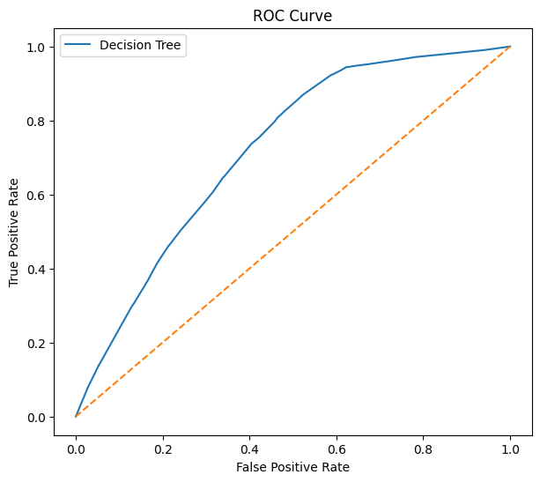
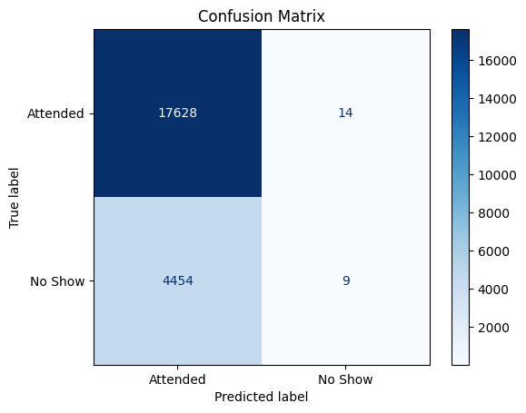
Model Results
79.79%
0.72
Accuracy
AUC Score
79.60%
35.29%
Cross-Val Accuracy
Precision (No-show)
0.13%
0.27%
Recall (No-show)
F1 Score (No-show)
High overall accuracy is driven by class imbalance (~80% attended). The model rarely flags true no-shows (recall 0.13%), despite moderate AUC of 0.72 — indicating room for improvement via class-balancing techniques.
Healthcare No-Show Prediction | 10

Slide 11
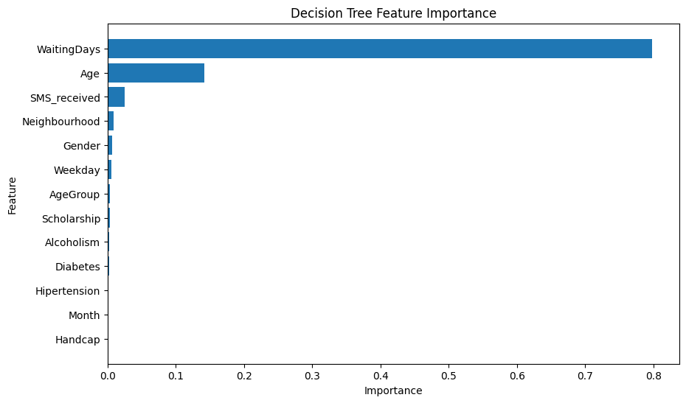
Feature Importance
Top Predictors
WaitingDays — importance ≈ 0.80, by far the dominant factor
Age — importance ≈ 0.14
SMS_received — importance ≈ 0.03
Neighbourhood, Gender, Weekday — minor contributors
Health conditions (Hypertension, Diabetes, Handcap) contribute negligibly
Healthcare No-Show Prediction | 11

Slide 12
Recommendations
1
2
3
Balance the Model
Target Long Waits
Smarter Reminders
Apply SMOTE, class-weighting, or ensemble methods (Random Forest, XGBoost) to improve no-show recall.
Introduce overbooking or stand-by lists for appointments with high WaitingDays.
Send multi-stage reminders (48h + 2h) rather than a single SMS, especially for advance bookings.
4
5
6
Engage Younger Adults
Real-Time Risk Scoring
Monitor Continuously
Use confirmation calls or incentives for age groups showing elevated no-show rates.
Surface WaitingDays-based risk scores to staff at the point of booking.
Track no-show trends monthly via the Power BI dashboards to measure intervention impact.
Healthcare No-Show Prediction | 12

Slide 13
Conclusion
This project delivers an end-to-end healthcare analytics workflow — from data cleaning and EDA, through interactive Power BI dashboards, to a predictive Decision Tree model. WaitingDays emerged as the single strongest driver of no-shows, far outweighing demographic or health factors. While overall model accuracy is strong (79.8%), low recall on the no-show class highlights a clear next step: addressing class imbalance to build models that proactively flag at-risk appointments and help providers use clinical capacity more efficiently.
79.8%
0.72
20.2%
Model Accuracy
AUC Score
No-Show Rate
Thank You

