Slide 1

DATABASE SYSTEMS ENGINEERING AND DISTRIBUTED BACKEND DEVELOPMENT
(25CS1302E)
Vehicle Service Booking and Tracking System
TEAM MEMBERS
M SHASHANTH 2520090129
M AKSHAY 2520090065
G NANDHA KISHORE 2520080050
Under the Esteemed Guidance of
Dr. M Gayatri
Associate Professor

Slide 2
Abstract
The Vehicle Service Booking and Tracking System is a web-based platform that digitises the complete vehicle servicing process of a service center. Customers register vehicles, book services and track progress online, while service centers manage bookings, job cards, technician allocation and spare parts.
The system generates digital invoices, maintains complete service history, and supports notifications and online payments. It is built with React.js, Node.js, Express.js and MySQL, with Razorpay and Firebase Cloud Messaging as integrations. The goal is to reduce manual work and improve service visibility and efficiency.

Slide 3
Problem Statement
PROBLEM STATEMENT:
Vehicle service centers still depend on phone calls, walk-ins, paper job cards and manual billing. Customers cannot see the status of their vehicle, service history is hard to retrieve, and centers struggle to allocate technicians and track spare parts.
The proposed system provides one centralized platform where customers book and track services, and service centers manage job cards, technicians, parts, invoices and payments, all backed by a normalized relational database.

Slide 4
Motivation
Manual booking and paper records are slow, error-prone and hard to maintain.
Customers get little or delayed information about their vehicle status.
Technician workload and spare-part stock are difficult to manage manually.
Paper-based billing causes delays and disputes.
A database-driven design gives consistent, secure and queryable service records.
The project applies relational design, SQL, REST APIs and secure backend engineering from the course to a real-world problem.

Slide 5
Objectives
To develop a web application for vehicle service booking and tracking.
To let customers register vehicles, book services and view service history.
To manage job cards, technician allocation and service status updates.
To design a normalized MySQL schema (ER model, 3NF) with constraints and indexes.
To build a secure REST backend with JWT, role-based access control and validation.
To generate digital invoices and support online payments and notifications.
To reduce manual work and improve service visibility for all users.

Slide 6
Literature Survey
Existing garage and workshop management tools mostly offer appointment forms and basic billing. Many are desktop-based or paper-assisted and give customers limited visibility into progress.
Commercial automobile-service platforms provide online booking and reminders, but are often closed, costly or not customised to small service centers. Academic work on service management systems highlights the value of centralized databases, job-card digitisation and status tracking.
Modern web stacks (React.js, Node.js/Express, MySQL) with payment gateways (Razorpay) and push notifications (FCM) make it practical to combine booking, tracking, parts, invoicing and payment in one system.

Slide 7
Research Gap
Existing systems often handle only one part of the workflow, such as booking or billing. Many lack integrated job-card management, technician allocation, spare-part tracking, live service status, digital invoicing and online payment in a single platform.
Few solutions are built on a properly normalized relational schema with secure role-based APIs that can later grow into microservices.
Therefore, the proposed system provides an end-to-end, database-driven workflow from booking to payment, making vehicle servicing faster, more transparent and easier to manage.

Slide 8
Proposed Methodology
Customer
→
Vehicle
→
Booking
→
Job Card
Technician
→
Service
→
Invoice
→
Payment
Users register and log in; the backend verifies credentials and issues a JWT.
Customers add vehicles and book a service; the center creates a job card and assigns a technician.
Status updates, spare parts used and the final invoice are stored in MySQL; payment is done via Razorpay and notifications are sent via FCM.

Slide 9
System Architecture
React.js Frontend (Customer / Service Center UI)
↓
Node.js + Express.js (Router → Middleware → Controller → Service Layer)
External Services
Razorpay (payments)
Firebase Cloud Messaging (notifications)
←
↓
REST APIs (Auth, Vehicles, Bookings, Invoices, Payments)
↓
MySQL Database

Slide 10
Technologies Used
React.js - Frontend user interface
Node.js + Express.js - Backend and REST APIs
MySQL - Relational database (DDL, constraints, indexes)
JWT, bcrypt, RBAC - Authentication and security
Razorpay - Online payment gateway
Firebase Cloud Messaging (FCM) - Notifications
Postman - API testing
VS Code, MySQL Workbench - Development and DB design
Git & GitHub - Version control

Slide 11
Dataset / Input Details
The system uses application-generated service data stored in MySQL. Main entities and inputs:
Customer
Vehicle
Service
customer_id, name
email, phone
vehicle_id, customer_id (FK)
registration_no, model
service_id, service_name
base_price
Booking
Other inputs
booking_id, vehicle_id (FK), service_id (FK)
booking_date, status
Job cards, technicians, spare parts
Invoices and payment records

Slide 12
Implementation – Module 1
Module 1: Database Design (ER Model, Schema & SQL)
ER model with entities Customer, Vehicle, Service and Booking, and their cardinalities (one customer has many vehicles; one vehicle has many bookings).
Relational schema with primary keys, foreign keys, UNIQUE and NOT NULL constraints.
Normalized through 1NF → 2NF → 3NF to remove redundancy and improve consistency.
DDL scripts (e.g. CREATE TABLE Vehicle) and indexes on booking_date and booking_status for faster queries.
Advanced SQL: joins for service history, aggregates for reports, transactions for booking and billing.

Slide 13
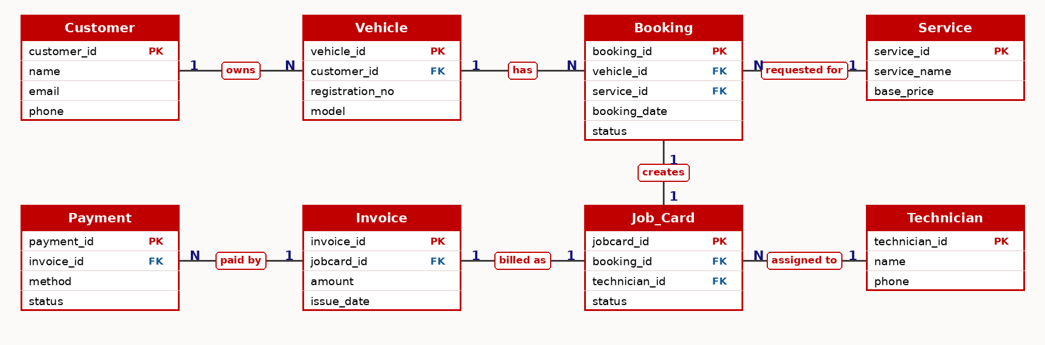
ER Diagram (CO1)
1 = one, N = many. PK = primary key, FK = foreign key. Customer 1:N Vehicle, Vehicle 1:N Booking, Service 1:N Booking, Booking 1:1 Job_Card, Technician 1:N Job_Card, Job_Card 1:1 Invoice, Invoice 1:N Payment.

Slide 14
Implementation – Module 2
Module 2: Backend REST API & Security (Node.js + Express)
Layered architecture: Router → Middleware → Controller → Service Layer → MySQL.
Endpoints: POST /api/auth/register, /api/auth/login, GET/POST /api/vehicles, POST /api/bookings, PUT /api/bookings/:id/status.
JWT authentication, role-based access control (customer / service center), password hashing, input validation, rate limiting and HTTPS.
Async/await with non-blocking I/O and centralised error handling.
APIs tested with Postman for authentication, validation and status codes.

Slide 15
Implementation – Module 3
Module 3: Service Workflow, Invoicing & Payments
Job-card creation and technician allocation for each confirmed booking.
Service-status tracking (booked, in progress, completed) visible to the customer.
Spare-part management linked to job cards.
Digital invoice generation (POST /api/invoices) and online payment via Razorpay (POST /api/payments).
Notifications through Firebase Cloud Messaging and a complete service-history view.

Slide 16
Experimental Setup
Software
Hardware
Windows 10/11, VS Code
Node.js, Express.js, React.js
MySQL Server & Workbench
Postman, Git & GitHub
Intel Core i3 or above
Minimum 8 GB RAM
20 GB free storage
Internet connection (payments, FCM)
Testing Approach
Database tested with sample customers, vehicles, services and bookings
REST APIs tested with Postman (auth, validation, status codes)
End-to-end flow tested: register → book → job card → invoice → payment

Slide 17
Results
Customers can register, log in and add vehicles.
Service bookings are created and stored with their status.
Job cards and technician allocation are managed by the service center.
Service status can be updated and tracked by the customer.
Invoices are generated and payments are recorded.
Service history is available for every vehicle.
Update this list to match the features completed in your build.

Slide 18
Performance Evaluation
Parameter | Approach | Observed Result
API response time | Postman timing on key endpoints | ___ ms (fill in)
Query performance | Indexes on booking_date, status | ___ ms before / ___ ms after
Security | JWT, RBAC, hashing, rate limiting | Unauthorised requests rejected
Data integrity | PK/FK constraints, transactions | No orphan or duplicate records
Load test | Concurrent booking requests | ___ requests/sec (fill in)
Replace the blanks with your measured values.

Slide 19
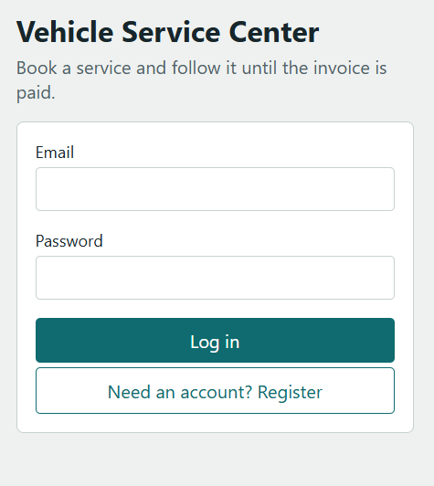
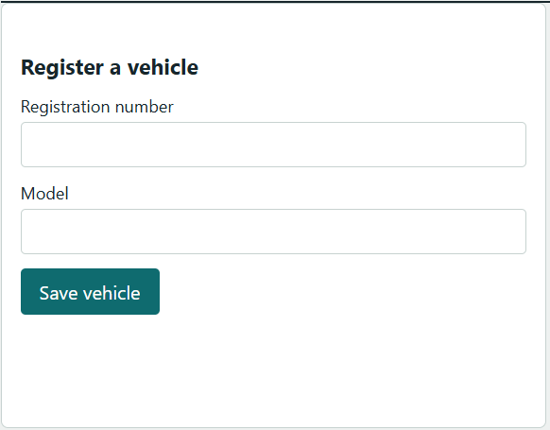
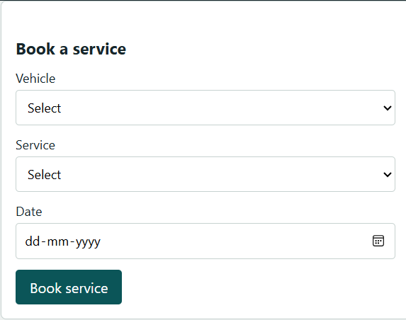
Screenshots / Working Demo

Slide 20
Comparison with Existing System
Feature | Existing (Manual) System | Proposed System
Booking | Phone call / visit | Online service booking
Job card | Paper job card | Digital job card
Status visibility | Limited | Real-time status tracking
Records | Paper, hard to maintain | Centralized MySQL database
Billing | Manual billing | Digital invoice & online payment
Communication | Delayed | Notifications (FCM)

Slide 21
Challenges & Solutions
Designing a consistent schema
→
Normalized to 3NF with PK/FK constraints
Slow queries on bookings
→
Added indexes on date and status
Securing user access
→
JWT, RBAC, password hashing, validation
Handling payments and notifications
→
Integrated Razorpay and FCM with error handling
Keeping backend maintainable
→
Layered router–controller–service structure

Slide 22
Current Progress
Completed
In Progress
Pending
Requirement analysis
ER model and schema
Normalization (3NF)
DDL and indexes
Core REST APIs
Job-card and technician modules
Invoice generation
Payment integration
Notifications
Frontend integration
Testing and load testing
Docker deployment
Documentation and demo
Final presentation
Adjust these columns to your actual status.

Slide 23
Future Work
Microservices with API gateway and database-per-service
Redis caching for faster responses
MongoDB for logs and activity data (polyglot persistence)
Real-time vehicle service tracking
Vector search for smart service recommendations
Docker, Kubernetes, CI/CD and monitoring (Prometheus, Grafana)

Slide 24
Conclusion
The Vehicle Service Booking and Tracking System provides a centralized, database-driven platform for managing the complete vehicle servicing process.
It offers faster and easier service booking, better service-status visibility, digital job cards and invoices, organized customer and vehicle records, improved service history management and a secure REST-based backend.
"A database-driven platform for efficient and scalable vehicle service management."

Slide 25
References
MySQL Reference Manual - https://dev.mysql.com/doc/
Node.js Documentation - https://nodejs.org/docs/
Express.js Documentation - https://expressjs.com/
React Documentation - https://react.dev/
Razorpay API Documentation - https://razorpay.com/docs/
Firebase Cloud Messaging - https://firebase.google.com/docs/cloud-messaging
JWT Introduction - https://jwt.io/introduction
Elmasri & Navathe, Fundamentals of Database Systems
Research papers / articles on vehicle service management systems

Slide 26
Thank you

