Slide 1
Customer, Risk and Growth Analysis
eSewa Data Analyst Assessment · Round 2
Presented by Shailesh Sharma
1M
25.3M
24
users analysed
transactions
months of history
Notes:
Introduce yourself. One sentence on the assignment: leadership raised six concerns; this deck covers the five biggest findings, the customer segments, the outlook, and the dashboard where it all lives.

Slide 2




How I approached it
Built the dataset
No data was provided, so I generated a realistic one: 1M users, 25.3M transactions, with real-world patterns and real-world dirt.
1,000,000
25.3M
users
transactions
Audited and cleaned
Every integrity check run; 25,274 duplicate records (0.1%) found and removed so volumes are not overstated.
0.1%
24 mo
Explored and tested
Distributions, funnels, anomalies; the headline finding is backed by a formal hypothesis test.
duplicates removed
of history
Segmented and shipped
Six customer groups with distinct behaviour, exported into an interactive Power BI dashboard.
Notes:
Key point to land: I kept the analysis honest despite building the data myself. Ground truth was held out of the pipeline. The code would run unchanged on real eSewa data.

Slide 3
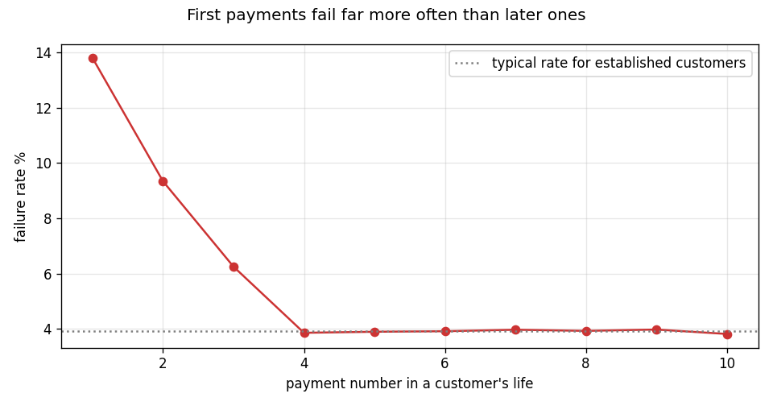
First payments fail 3.5x more than later ones
1 in 7
first payments fails (13.8%)
By a customer's fourth payment, failures settle near 1 in 25. The risk is concentrated exactly where the customer is least committed.
Action to take: Make the first payment the most reliable moment in the product. Fix the technical causes; add instant retry with a small apology credit.
Notes:
This is the headline chart. If failures were random across a lifetime the line would be flat. It is not: 13.8% on the first payment, 3.9% baseline after the fourth.

Slide 4
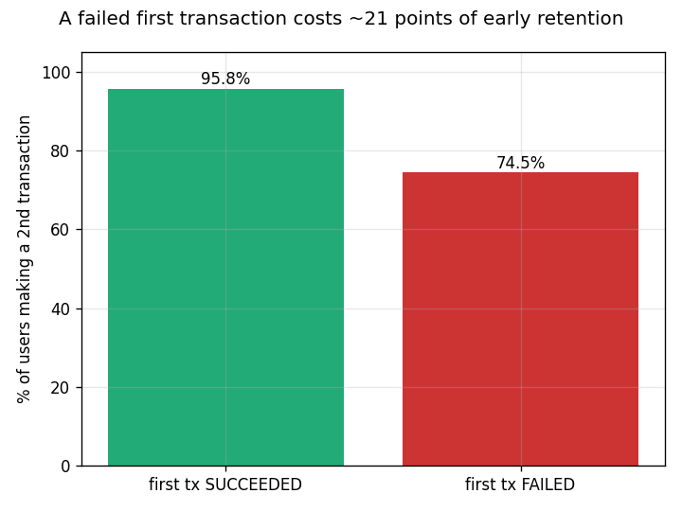
A failed first payment costs 21 points of retention
96% vs 74%
come back for a second payment
One bad first experience loses roughly one in five new customers, after acquisition has already been paid for. Confirmed by a two-proportion test: the gap is real, not noise (z = 279).
Action to take: Treat first-payment reliability as a retention investment, not a support ticket.
Notes:
This connects three leadership concerns into one problem: failed transactions, weak new-user retention, and rising acquisition cost. Fixing the first fixes all three.

Slide 5
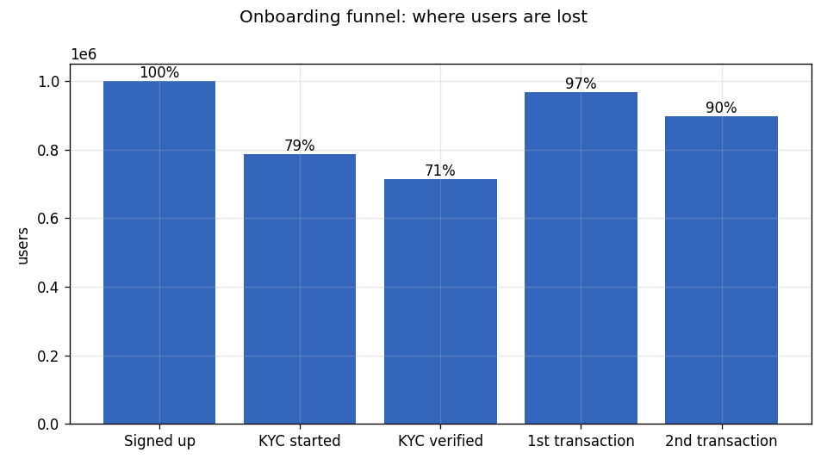
Onboarding leaks before customers ever start
29%
of signups never complete KYC
21 out of every 100 people who sign up never even start verification, and another 3 never make a payment. This means we're losing customers during onboarding, not because of a lack of advertising.
Action to take: Simplify the verification steps and track time-to-verify as a standard KPI.
Notes:
Note the funnel is deliberately non-monotonic: customers can transact before verifying, under limits. That is itself a compliance observation.

Slide 6
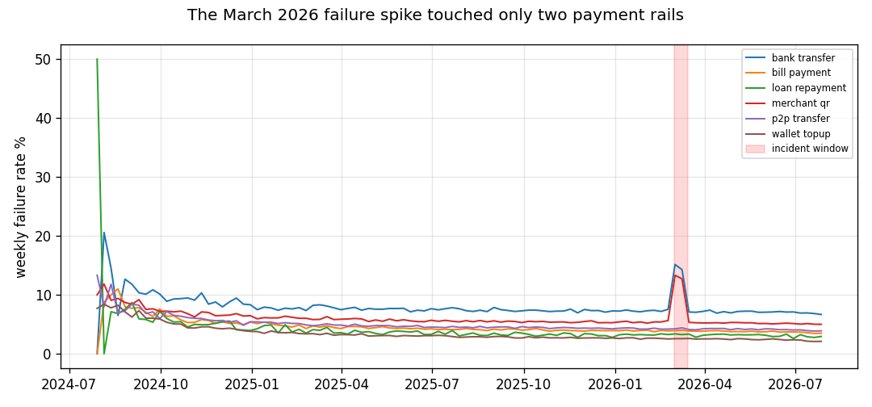
The March spike was infrastructure, not fraud
2 rails
affected for 2 weeks, all else normal
Failures increased only for Merchant QR and Bank Transfers. Transaction amounts and volumes stayed normal, so this does not look like a fraud problem or a data outage.
Action to take: Review the issue with the payment gateway provider and agree on clear service standards before transaction volume increases further.
Notes:
Show the diagnostic reasoning: a fraud wave would not respect rail boundaries this cleanly, and a logging outage would distort volumes too. Both were considered and ruled out.

Slide 7
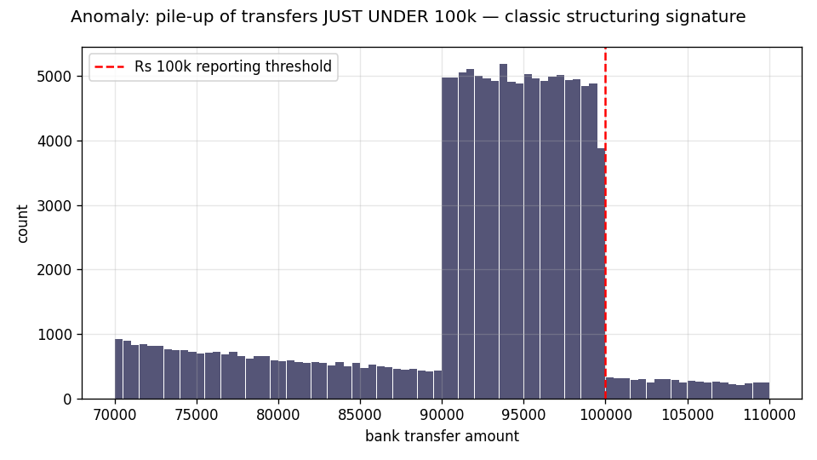
Transfers cluster just under the reporting threshold
Rs 100k
the line transfers stay just below
Splitting payments to stay below a limit can be a sign of money laundering. A small high-risk group (5% of users) is responsible for almost half of the failed payments, and very few of them complete verification.
Action to take: Send these accounts for compliance review and limit what unverified users can do until they complete verification.
Notes:
Vocabulary: this pattern is called structuring. The Risky segment on the next slides overlaps heavily with these accounts.

Slide 8
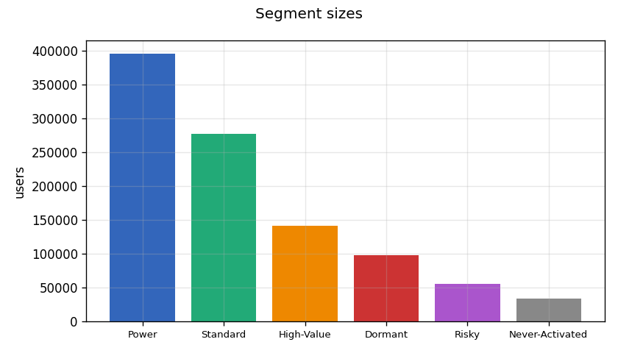
Six customer groups, not one customer base
Group | Share | Notes
High-Value | 14% | Top spend, near-daily use
Power | 40% | Constant use, moderate spend
Standard | 28% | Occasional use
Dormant | 10% | Were active, gone quiet
Risky | 5% | 48% failures, 7% verified
Never started | 3% | Signed up, never paid
Groups found by clustering behaviour (recency, frequency, spend); the Risky group by explicit rule, since risk proved independent of engagement.
Notes:
If asked how: k-means on RFM features, log-transformed, validated against held-out labels. Risk is rule-based because failure rate is uncorrelated with engagement. Mention the first model failed and was fixed; that story is in the notebook.

Slide 9
Each group needs a different play
High-Value
Power
Standard
Protect them: priority support, perks, bundles. Keeping them is cheaper than replacing them.
Turn them into advocates: referral rewards aimed at the 40% who use us constantly.
Encourage a second service; service diversity is the clearest upgrade path.
Dormant
Risky
Never started
Win-back offers, tested first: many came only for cashback promotions.
Compliance review and limits on unverified accounts.
Nudge within days of signup, and make sure the first payment succeeds.
Notes:
The one number to repeat: the most valuable 14% carry most of the money. Retention for them outperforms broad acquisition spend.

Slide 10
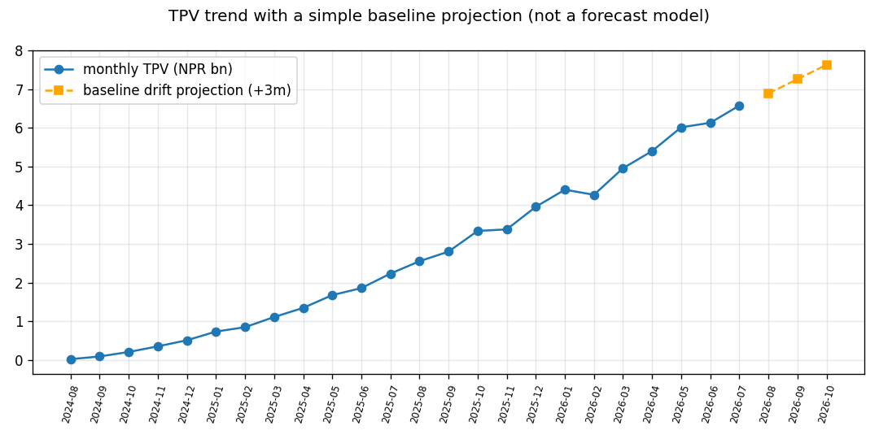
Volume keeps growing: plan for it
Rs 6bn
monthly payment volume, and rising
The orange dashed line shows the recent trend, not an exact forecast. Use it as a planning guide: prepare capacity and cashback budgets for continued growth. March showed the risk when service reliability could not keep up.
Notes:
Be upfront: I deliberately did a lightweight baseline instead of a full forecasting model, and traded that time for depth on diagnostics. A tested SARIMA or Prophet model is the natural next iteration.

Slide 11
Five actions, ranked
1
Fix first-payment reliability and add an instant retry flow
protects new-customer retention and the acquisition budget
2
Simplify KYC and track time-to-verify as a KPI
plugs the biggest leak in the onboarding funnel
3
Run the gateway incident review and set service levels
prevents a repeat of March as volume grows
4
Send structuring accounts and the Risky group to compliance
closes the clearest suspicious-activity exposure
5
Launch a High-Value retention programme
defends the 14% of customers who carry most of the money
Notes:
Ranked by impact per effort. Each action traces back to a specific finding and a specific leadership concern; be ready to make that link out loud.

Slide 12
Thank you
Every number in this deck is reproducible from code. Happy to go deeper on any part: the data build, the statistics, the segmentation, or the dashboard.
[Shailesh Sharma] · [ssharma.balkhu@gmail.com]
Notes:
Close with the reproducibility line; it is the strongest trust signal in the whole submission.

