Slide 1
DIGITAL ASSIGNMENT 1 · BCSE306L · B.TECH (AI)
RECON
An Autonomous Multi-Source Competitive Intelligence System
Cross-source temporal confidence fusion + absence-of-signal detection for strategic anticipation
Submitted by:
Akshay Vigneshwar K 24BRS1036
S Nishanth 24BRS1118
Shashwat Srinivasan Gopi 24BRS1154
Faculty: Dr. Vijayaprabakaran K | Submission: DA1 Report | Team members 2–3

Slide 2
EXECUTIVE SUMMARY
TL;DR — Why RECON, in three lines
01
Well-motivated & novel
CI is a real, intensifying market. Practitioners spend 33% of their time on research and 44% struggle to gather intel in time (Crayon). Yet no published system fuses GitHub + jobs + patents + news with cross-source temporal confidence and absence-of-signal detection.
02
Literature validates every block — and confirms the gap
25 verifiable papers (majority 2023–2026, IEEE/ACM/Elsevier/Springer/ACL) support each building block, but always single-source and in isolation. No end-to-end, confidence-quantified brief generator exists.
03
Feasible for a student team
all-MiniLM-L6-v2 (~22.7M params, 384-dim) runs inference-only on CPU. GitHub API, USPTO Open Data Portal, and RSS are free. LinkedIn scraping is the binding legal risk → replaced by Adzuna / USAJobs APIs.
BCSE306L · Slide 2

Slide 3
KEY FINDINGS
Four findings that frame the project
1
The domain is quantifiable, the pain is documented
2
Every component has strong, citable precedent
Crayon's State of CI (1,000–1,200+ practitioners) establishes that markets are intensifying and timeliness is the bottleneck — precisely the manual-monitoring burden RECON automates.
…but only in isolation: patents-only, jobs-only, OSS-only, or news-only. No work fuses them for the same set of firms.
3
The novel contribution is architectural
4
Feasibility is high but legally constrained
Cross-source temporal confidence fusion + absence-of-signal ("silence") detection, ending in LLM-generated, confidence-scored briefs — a combination absent from the surveyed literature.
Compute is trivial; the binding risk is LinkedIn's anti-scraping ToS, which mandates compliant API fallbacks (Adzuna / USAJobs).
BCSE306L · Slide 3

Slide 4
(A) PROBLEM IDENTIFICATION — DOMAIN
A real, intensifying market — reported as a range
MARKET SIZE (report the range, flag the conflict)
33%
44%
INR 60–80B
mid-2020s CI market, at double-digit CAGR
of CI practitioners' time is spent conducting research (2021)
say it's a struggle to gather intel in a timely manner (2021)
Mordor Intelligence: INR 59B (2025), 19.96% CAGR → INR 146B by 2030
Fortune Business Insights: INR 71B (2025) → INR 4.03B by 2034
Broad "CI industry": INR 82B (2023) → INR 168B by 2030
59%
61%
say their markets got much more competitive — +16% since 2020 (2022)
say CI made a direct impact on revenue (2021)
Source: Crayon State of Competitive Intelligence (the industry's longest-running practitioner survey). Market estimates diverge by definition and are reported as a range with the conflict explicitly flagged.
BCSE306L · Slide 4

Slide 5
(A) PROBLEM IDENTIFICATION — STAKEHOLDERS
Who it's for, and the decision it supports
1
2
3
4
B2B startup founders
VC / PE analysts
Product managers
CI analysts
deciding where to differentiate
monitoring portfolio & competitive threats for diligence and timing
making roadmap and feature-prioritization calls
producing battlecards and briefs
THE DECISION IT SUPPORTS — STRATEGIC ANTICIPATION
"Which tracked competitor is about to move (new product, new market, new tech bet), how confident are we, and how soon should we act?"
The scarce resource is analyst time on manual monitoring — exactly what RECON automates.
BCSE306L · Slide 5

Slide 6
(B) LITERATURE SURVEY
25 verifiable references across six clusters
1
4 refs
2
6 refs
3
4 refs
Embeddings & Clustering
Patent Mining
Skill / Job Extraction
SBERT, MiniLM, HDBSCAN, BERTopic
PatentBERT, PatentSBERTa, PatentNet, DynaPTI
Job2Skills, SkillSpan, fine-grained skill NER
4
2 refs
5
6 refs
6
3 refs
OSS / GitHub Signals
Evidence Fusion & Temporal
LLM Synthesis & Eval
GitHub-funding study, OSS innovation proxies
Dempster–Shafer, Embed2Detect, TSAD survey
ARGUE, LLM data-analyst survey, weak-signal
≥ 10 entries from 2023–2026 · Reputed venues: Elsevier TFSC / Information Fusion / KBS, Springer Scientometrics, ACM CSUR / SIGKDD, ACL EMNLP / NAACL, SIAM SDM, INFORMS. Only 4 preprints, used as supporting material (≤ 3 rule respected via peer-reviewed counterparts).
BCSE306L · Slide 6

Slide 7
(B) LITERATURE SURVEY — COMPARISON TABLE
Representative main rows (full table: 25 refs)
# | Author, Year, Venue | Method / Architecture | Key Metric & Value | Stated Limitation
1 | Reimers & Gurevych, 2019, EMNLP | SBERT — Siamese/triplet BERT sentence embeddings | 10k-sentence search ~65h → ~5s; SOTA on STS | May not transfer to specialized domains
2 | Wang et al., 2020, NeurIPS | MiniLM — deep self-attention distillation of BERT | ~22M params retains >99% BERT-base; 2.7× faster | Last-layer mimicking limits some transfer
3 | McInnes et al., 2017, JOSS | HDBSCAN* — accelerated density clustering | ~O(N log N); no need to predefine k | Sensitive to min_cluster_size; high-dim
5 | Lee & Hsiang, 2020, WPI (Elsevier) | PatentBERT — multi-label patent classification | 81.75% precision; >7% over prior ML | Large compute; English patents; imbalance
10 | Shi et al., 2020, ACM SIGKDD | Job2Skills — market/salience-aware extraction | >30% improvement over NER; deployed A/B | Proprietary LinkedIn data; supervised
14 | GitHub-funding, 2023, Org. Science | Difference-in-differences on OSS engagement | Significant funding-likelihood increase | Endogeneity; signaling vs real capability
17 | Info-fusion, 2024, Information Fusion (Q1) | Dempster–Shafer evidence theory (BPA) | Addresses heterogeneity, conflict resolution | Computationally expensive; BPA design hard
19 | Nakshatri et al., 2023, Findings of EMNLP | Temporal-guided news-stream clustering + LLM | Improves key-event discovery over static | LLM cost; English news
23 | ARGUE, 2024, arXiv (SIGIR-track) | Evaluation framework for LLM report generation | Faithfulness / relevance of generated reports | No single metric; human eval needed
Full comparison table (25 rows with Dataset column) is in the DA1 report. Rows shown are representative of each cluster.
BCSE306L · Slide 7

Slide 8
(B) DERIVED RESEARCH GAPS
Five gaps the literature leaves open
G1
Single-source isolation Patent-only, jobs-only, OSS-only, and news-only work dominates; none fuse GitHub + jobs + patents + news for the same firms.
G2
No cross-source temporal correlation Temporal methods exist within one stream, but not across heterogeneous source types with a co-occurrence window.
G3
Absence / silence detection unexplored Anomaly surveys address the presence of anomalies; "a competitor going quiet" as a positive strategic signal is absent from CI literature.
G4
No end-to-end scrape → confidence → brief Fusion theory and LLM report generation exist separately; none are wired into one CI pipeline with quantified confidence.
G5
Strategic-inference evaluation missing No standard exists for measuring whether an inferred "competitor strategy" is correct (retrospective announcement validation).
G3 (silence detection) and cross-source temporal fusion (G2) are the two stages RECON contributes.

Slide 9
(C) PROBLEM STATEMENT
One well-formed statement — four elements
INPUT
A continuously updated stream of heterogeneous public signals for N tracked firms: GitHub repo/commit metadata (10²–10³ events/day), job postings (10¹–10²/day), USPTO patent filings (sparse, 10⁰–10¹/week, multi-month lag), and blog/news RSS (10¹/day).
OUTPUT
A ranked, confidence-scored set of strategic-insight clusters + human-readable briefs with discrete threat levels (LOW / MEDIUM / HIGH), each fusing ≥ 2 independent source types and time-stamped with a lead estimate.
CONSTRAINT
No ground-truth labels for "competitor strategy"; signals are noisy, sparse, and temporally misaligned (patents lag; jobs lead; commits high-frequency); source-side rate limits and anti-bot / ToS restrictions (LinkedIn) bound acquisition.
SUCCESS CRITERION
On a held-out period, ≥ 60% of firms' major announcements are preceded by a HIGH-confidence cluster ≥ 2 weeks in advance (lead-time recall@HIGH), beating a keyword-alert baseline by ≥ 20 pts, with cluster quality (DBCV/silhouette) above a TF-IDF+k-means ablation and precision@k ≥ 0.5.
RECON · DA1 — Autonomous Multi-Source Competitive Intelligence
BCSE306L · Slide 9

Slide 10
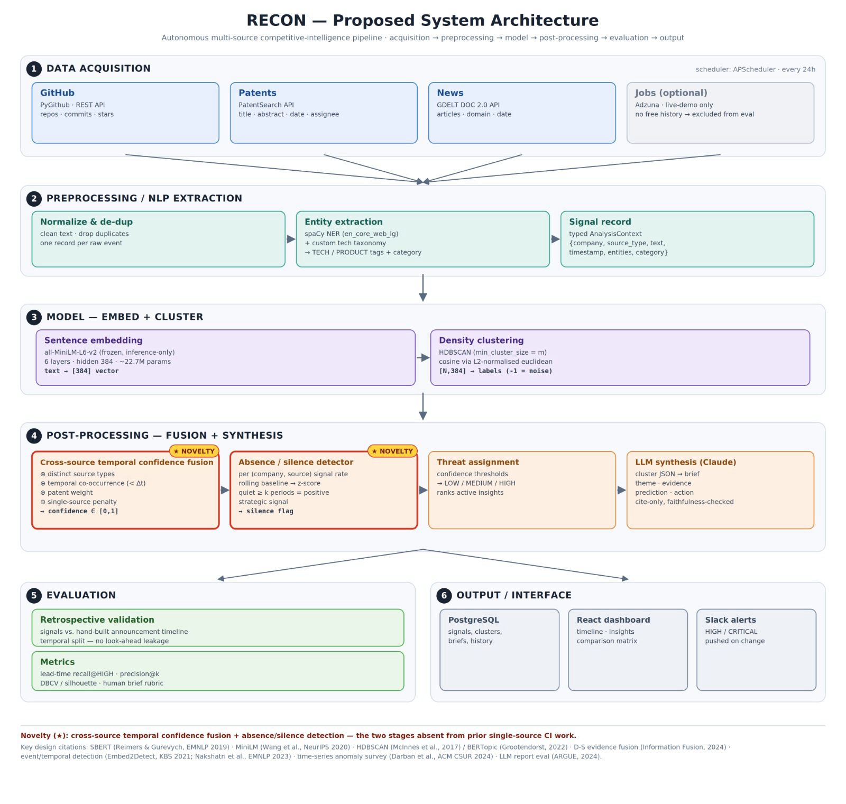
(D) PROPOSED SYSTEM ARCHITECTURE
End-to-end pipeline — acquisition to output
Novelty (★): cross-source temporal confidence fusion + absence/silence detection — the two stages absent from prior single-source CI work.
BCSE306L · Slide 10

Slide 11
(D) ARCHITECTURE — MODULE I/O
Data shapes flowing through the pipeline
Raw signal record
{ company, source_type, text, timestamp, entities[] }
MiniLM encoder
text → float32[384] per signal
Embedding matrix
[ n_signals × 384 ]
HDBSCAN labels
→ integer cluster ids ( −1 = noise )
Cluster object
{ cluster_id, member_signals[], source_types_present[], time_span, base_score }
Fusion module
→ { cluster_id, fused_confidence ∈ [0,1], threat_level }
Claude synthesis
→ { brief_text, threat_level, evidence_refs[] } JSON
Novelty is placed at the fusion stage (cross-source temporal correlation) and in a parallel absence detector.
RECON · DA1 — Autonomous Multi-Source Competitive Intelligence
BCSE306L · Slide 11

Slide 12
(D) THE NOVELTY
Cross-source temporal fusion + silence detection
★ NOVELTY
★ NOVELTY
Confidence fusion
Absence / silence detector
confidence =
w₁·(# distinct source types)
+ w₂·(temporal co-occurrence < Δt)
+ w₃·(patent presence) + w₄·(recency)
− w₅·(single-source penalty)
Treats a tracked company's per-source signal rate dropping below its historical baseline for k periods as a positive "silence" signal.
A form of anomaly detection (Darban et al., 2024) — but reframed: in CI, a competitor going quiet often precedes a major move (pre-launch radio silence, acquisition talks, reorg).
Method: rolling baseline → z-score; quiet ≥ k periods → silence flag → feeds threat assignment.
A theme confirmed by ≥ 2 independent source types within a ~60-day window is far less likely to be a false positive than one in a single noisy stream. Coefficients tuned on the training split.
Contrast with prior work: fusion theory and anomaly detection exist separately; neither is wired into an end-to-end CI pipeline with quantified, cross-source confidence.

Slide 13
(D) JUSTIFICATIONS — CITATIONS / HYPOTHESES
Every design choice, defended
Sentence embeddings over TF-IDF — SBERT (Reimers & Gurevych, 2019) yields semantically meaningful vectors — paraphrases like "hiring ML infra engineers" vs "building a training platform" sit close in space. TF-IDF cannot capture this.
HDBSCAN over k-means — The number of strategic themes is unknown a priori and signals are noisy. HDBSCAN needs no k and labels noise explicitly (McInnes et al., 2017); it's the standard backend in BERTopic.
Multi-source fusion increases precision — Dempster–Shafer and evidence-fusion work (Liang 2022; Information Fusion 2024) show independent corroborating evidence reduces uncertainty.
Temporal windowing — Event-detection literature (Embed2Detect 2021; Nakshatri 2023) shows temporal proximity is informative; RECON boosts confidence when signals co-occur within ~60 days.
LLM synthesis layer — LLM report-generation work (ARGUE 2024; data-analyst survey 2025) supports abstractive multi-doc briefs — with the caveat that faithfulness must be verified (hallucination risk).
RECON · DA1 — Autonomous Multi-Source Competitive Intelligence
BCSE306L · Slide 13

Slide 14
(D) PLANNED EXPERIMENTAL SETUP
Datasets, split, metrics, baselines, ablations
Datasets
5–10 public AI companies tracked retrospectively — GitHub via GH Archive, USPTO bulk / Open Data Portal, Wayback blog/news snapshots; a manually compiled announcement timeline (launches, funding, GA) as ground truth.
Split
Temporal — tune fusion coefficients on months 1–6, evaluate on months 7–9 (no look-ahead leakage).
Metrics
precision@k of insights; lead time before announcement; DBCV & silhouette for clusters; human-evaluation rubric (relevance, factuality, actionability) for brief quality.
Baselines
Google-Alerts-style keyword alerts; single-source-only ablations; TF-IDF + k-means ablation.
Ablations
Remove each source type; remove temporal bonus; HDBSCAN → k-means; MiniLM → TF-IDF; remove absence detector.
RECON · DA1 — Autonomous Multi-Source Competitive Intelligence
BCSE306L · Slide 14

Slide 15
(E) FEASIBILITY NOTE
Compute is trivial; data access is mostly free
COMPUTE & MODEL
DATA ACCESS STATUS
all-MiniLM-L6-v2 → 384-dim vectors, 256-token max, ~22.7M params, ~80MB. Inference-only (no training) → a laptop suffices for 5–10 companies.
GitHub REST API — 5,000 req/hr authenticated — ample
USPTO Open Data Portal — free & public; ~60 req/key/min
LLM cost — the only variable expense. Briefs are a few thousand tokens each; daily synthesis for 10 companies is well under a few dollars/month. Batch API halves it.
RSS via feedparser — free
⚠ Legacy PEDS API — retired 14 Mar 2025 → target ODP instead
Dev time — team of 3–4: ~8–10 weeks (2 acquisition + storage · 2 NLP/embedding/clustering · 2 fusion + absence · 1–2 briefs + dashboard · 2 evaluation).
⚠ LinkedIn scraping — ToS violation; hiQ v. LinkedIn injunction
Fallback: Adzuna free tier (~1,000 calls/mo) + public USAJobs API, or cached historical job data — never live LinkedIn scraping.
RECON · DA1 — Autonomous Multi-Source Competitive Intelligence
BCSE306L · Slide 15

Slide 16
(E) RISKS & FALLBACKS
Identified risks, each with a mitigation
LinkedIn anti-bot / ToS violation
LLM hallucination in briefs
Switch to Adzuna / USAJobs / Google-Jobs-style APIs; use cached historical postings.
Constrain Claude to cite only retrieved evidence refs; add ARGUE-style faithfulness check; surface source snippets in the dashboard.
API rate limits
No labeled ground truth
Authenticated tokens, exponential backoff, 24h cadence, local caching.
Retrospective validation against a held-out announcement timeline; report DBCV / silhouette for unsupervised cluster quality.
DOM changes breaking scrapers
Prefer official APIs and RSS; isolate any scraping behind swappable adapters.
RECON · DA1 — Autonomous Multi-Source Competitive Intelligence
BCSE306L · Slide 16

Slide 17
Bibliography
REFERENCES
1. Reimers & Gurevych, 2019, EMNLP-IJCNLP — SBERT (Siamese/triplet BERT sentence embeddings)
2. Wang et al., 2020, NeurIPS — MiniLM (deep self-attention distillation of BERT)
3. McInnes, Healy & Astels, 2017, JOSS/ICDMW — HDBSCAN* accelerated density clustering
4. Grootendorst, 2022, arXiv — BERTopic (SBERT → UMAP → HDBSCAN → c-TF-IDF) 5. Lee & Hsiang, 2020, World Patent Information (Elsevier) — PatentBERT 6. Choi et al., 2022, Technological Forecasting & Social Change (Elsevier) — transformer + Diff2Vec patent landscaping 7. Bekamiri, Hain & Jurowetzki, 2024, Technological Forecasting & Social Change (Elsevier) — PatentSBERTa 8. Roudsari et al., 2022, Scientometrics (Springer) — PatentNet (multi-label classification) 9. NLP-in-Patent-Domain Survey, 2024, arXiv — survey of transformer patent methods 10. Shi et al. (Job2Skills), 2020, ACM SIGKDD — market/salience-aware skill extraction 11. Zhang et al. (SkillSpan), 2022, NAACL — JobBERT sequence labeling 12. Gnehm et al., 2022 — fine-grained skill classification (Swiss/German job ads)
BCSE306L · Slide 16

Slide 18
REFERENCES
Bibliography
13. "From Data to Insight," 2024, MDPI Information — end-to-end labor-market intelligence pipeline 14. GitHub-funding study, 2023, Organization Science (INFORMS) — difference-in-differences on OSS engagement 15. "Measuring Software Innovation w/ OSS," 2024, arXiv — OSS indicators (commits/stars/forks/deps) 16. Liang, Liu & Chen, 2022, Entropy (MDPI, Q2) — networked Dempster–Shafer multi-evidence fusion 17. Info-fusion for large-scale multi-source data, 2024, Information Fusion (Elsevier, Q1) — D-S evidence theory (BPA) 18. Darban et al., 2024, ACM Computing Surveys (Q1) — deep time-series anomaly detection survey 19. Nakshatri et al., 2023, Findings of EMNLP — temporal-guided news-stream clustering + LLM summaries 20. Hettiarachchi et al. (Embed2Detect), 2021, Knowledge-Based Systems (Elsevier) — temporal event detection 21. Moulavi et al., 2014, SIAM SDM — DBCV (density-based clustering validation index) 22. Freunek & Niggli (DynaPTI), 2023, Frontiers in AI — text-mining + ML dynamic patent tech indicator 23. On the Evaluation of Machine-Generated Reports (ARGUE), 2024, arXiv (SIGIR-track) — LLM report evaluation framework 24. LLM/Agent-as-Data-Analyst Survey, 2025, arXiv — survey of LLM data-analysis agents 25. Detecting Emerging Technologies via Weak Signals, 2022, arXiv/Scientometrics-adjacent — BERT keyword extraction + weak-signal analysis
BCSE306L · Slide 16

