Slide 1
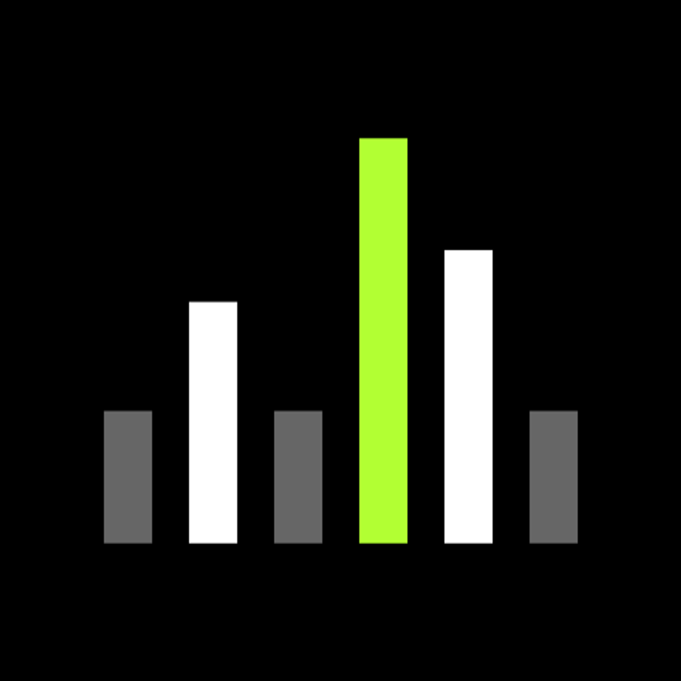
SHURE
Kotlin Multiplatform
for Shure
Shared device logic.
Native flexibility.
Wireless Channels initiative
Leadership proposal and PoC demonstration
01
Notes:
Opening: propose a bounded KMP pilot. The core argument is continuity with Shure’s existing native apps and Kotlin expertise. This deck recommends shared logic first. Shared Compose UI remains a separate decision.
Internal proposal, 5 October 2026.

Slide 2
SHURE
The proposal
A shared Kotlin core inside
our existing native applications
Preserve the investment
Validate the value
Retain native screens and platform capabilities.
Extract one device workflow at a time.
Use the PoC to test real device behavior.
Measure delivery effort before scaling.
02
Notes:
Ask for a six-week pilot as a planning assumption, not a committed estimate. Keep the existing native screens for the pilot and integrate a shared core into Android and iOS. The existing PoC uses a shared Compose console, which is useful for testing but does not prove integration into the current native screens.

Slide 3
SHURE
What KMP shares
Android native UI
iOS native UI
Shared Kotlin logic
Device models Use cases Requests Streams Persistence
KMP shares the core. Compose Multiplatform is a separate UI choice.
03
Notes:
Kotlin Multiplatform shares Kotlin code across targets. The Android target runs on the JVM/ART and iOS uses Kotlin/Native, including its own runtime and memory management. KMP does not automatically convert Android SDK code or Swift into common Kotlin. Native UI can remain. Compose Multiplatform is an optional UI strategy.
Sources: https://developer.android.com/kotlin/multiplatform
https://kotlinlang.org/docs/multiplatform/multiplatform-share-on-platforms.html

Slide 4
SHURE
Why Shure, why now
The device exposes an API
We already know Kotlin
A local server provides requests and live messages through a protocol contract.
Existing Android expertise supports migration of compatible logic into shared code.
Native flexibility still matters
The foundation already exists
Future discovery, Bluetooth and OS integration can use platform implementations.
The PoC has modules for networking, use cases, logging and local persistence.
04
Notes:
The device-server architecture and team Kotlin expertise come from the user’s supplied context, not an independent audit of the legacy app. Validate the exact legacy JNI/Apollo scope with the native team. Google support is externally documented.
Source: https://developer.android.com/kotlin/multiplatform

Slide 5
SHURE
A simpler device communication boundary
Existing integration
Proposed API boundary
Native app
KMP client core
JNI / Apollo integration path
REST / GraphQL / event stream
Device capabilities
Local server on device
The server simplifies either client stack. KMP adds continuity with our native investment.
05
Notes:
User-provided direction: the new device-hosted local server replaces the prior JNI/Apollo integration path for the target workflows. Apollo is optional in either architecture and GraphQL does not require it. The server change benefits both KMP and React Native. KMP’s separate advantage is reuse of Kotlin logic and continuity with the existing apps. Validate API coverage, versioning, server availability and streaming protocol before claiming full legacy parity.

Slide 6
SHURE
KMP adoption is growing
7%
18%
Share among surveyed
cross-platform developers
2024
2025
Google Docs
McDonald’s
Forbes
Shared business logic
on Android, iOS and web
Expanded KMP after an
initial payments feature
Reports sharing over
80% of Android / iOS logic
JetBrains surveys, 2024–2025. Company examples describe different adoption scopes.
06
Notes:
JetBrains State of Kotlin 2026 reports KMP use among surveyed cross-platform developers at 7% in 2024 and 18% in 2025. This is a survey measure, not a share of all apps or companies. Google officially supports sharing business logic between Android and iOS. Company examples are publisher-reported deployments with different scopes, not proof of Shure ROI.
Sources: https://kotlinlang.org/state-of-kotlin-2026/
https://android-developers.googleblog.com/2024/05/android-support-for-kotlin-multiplatform-to-share-business-logic-across-mobile-web-server-desktop.html
https://kotlinlang.org/docs/multiplatform/use-cases-examples.html

Slide 7
SHURE
Existing code reuse
Move into shared Kotlin | Adapt at the boundary | Retain on the platform
Models and validation | Android-specific dependencies | SwiftUI / UIKit screens
Business rules and use cases | Network and storage adapters | Android native screens
Compatible mapping and tests | Lifecycle and async APIs | Bluetooth / OS integrations
Reuse is selective, not automatic
07
Notes:
Compatible Kotlin logic can move to commonMain. Android-specific code remains in androidMain or changes to multiplatform dependencies and interfaces. Swift and Objective-C functionality remains in the iOS application or platform adapters, rather than automatically becoming shared Kotlin. Platform-specific APIs can be exposed through interfaces or expect/actual.
Sources: https://kotlinlang.org/docs/multiplatform/multiplatform-integrate-in-existing-app.html
https://kotlinlang.org/docs/multiplatform/multiplatform-share-on-platforms.html

Slide 8
SHURE
Kotlin expertise accelerates adoption
The team learns new platform boundaries
while keeping a familiar language
Existing strengths
Focused learning
Kotlin models, coroutines, use cases and repository patterns carry into the shared core.
iOS framework integration, Swift async boundaries and multiplatform dependency selection.
Pilot evidence will establish the timeline. Kotlin familiarity alone is not an estimate.
08
Notes:
The faster-adoption argument is a hypothesis based on the team’s reported Kotlin expertise. No Shure delivery metric or migration estimate has been measured. The proposed six-week pilot depends on available API contracts, devices and staffing. Sources for incremental reuse: https://kotlinlang.org/docs/multiplatform/multiplatform-integrate-in-existing-app.html
https://developer.android.com/kotlin/multiplatform

Slide 9
SHURE
KMP and React Native for this initiative
Decision factor | KMP | React Native
Existing Kotlin logic | Move compatible logic to shared core | Expose native logic or port it to JS / TS
Existing native UI | Keep screens and share logic first | Add React Native screens incrementally
Native functionality | Platform code and Kotlin / Swift interop | Native modules and components through JSI
Team adoption | Build on reported Kotlin expertise | Requires React / JS / TS expertise
Device API and streams | Supported through client libraries | Supported through client libraries
KMP fits our proposed shared-core migration. React Native remains credible for a React-led UI strategy.
09
Notes:
This comparison is a project-specific assessment, not a benchmark. React Native supports incremental adoption and native modules. Its New Architecture uses JSI and removes the old asynchronous bridge, so do not frame the comparison using obsolete bridge claims. Both can consume the local API and implement streaming. KMP also has runtime and interoperability considerations.
Sources: https://reactnative.dev/docs/integration-with-existing-apps
https://reactnative.dev/blog/2024/10/23/the-new-architecture-is-here
https://kotlinlang.org/docs/multiplatform/multiplatform-integrate-in-existing-app.html
https://developer.android.com/kotlin/multiplatform

Slide 10
SHURE
Shared architecture and foundation
UI / presentation
Core modules
common
network
database
datastore
Use cases
Repository interfaces
Ktor API / streams
Room / DataStore
Koin dependency injection
Proposed native screens consume the same shared core that powers the Compose demo console.
10
Notes:
Source inspection, 5 October 2026. Existing modules include core/common, core/network, core/database and core/datastore. Device flow uses DeviceViewModel, use cases and repository interfaces. Koin binds the dependencies. Native UI integration is a proposed next step. The current demo has shared Compose UI. The web device store is in memory, rather than Room.
Repository evidence: shared/src/commonMain/kotlin/com/shure/wireless/channels/devices/di/StoredDevicesModule.kt; core/network/src/commonMain; core/database/src/commonMain; core/datastore/src/commonMain.

Slide 11
SHURE
What the PoC contains today
Capability | Current source evidence | Demo readiness
GraphQL discovery | API, repository and use-case path | Verify against the live server
REST reads / writes | Generic GET / PUT clients | Add channel-specific operations
Streaming | WebSocket client and callback wrapper | Device events use a demo source
Persistence and logs | Room / DataStore and console logging | Verify mobile save / read behavior
Foundation exists in source. Complete real writes and streams before claiming device parity.
11
Notes:
Source inspection only. No Gradle tasks or live device validation were run for this presentation. Discovery operationName currently differs from the named query, and lastSeenAtEpochMillis is a placeholder. Resolve these before live demo. Device events currently delegate to DemoDeviceOperationsRepository. Generic PUT support exists in NetworkApiClient, but there is no demonstrated real channel-write use case in the inspected device path. WebSocket infrastructure exists, but GraphQL subscriptions require protocol-specific integration.
Evidence: GraphQlDeviceOperationsRepository.kt; DiscoverDevicesGraphQlModels.kt; NetworkApiClient.kt; WebSocketClient.kt; StoredDevicesModule.kt.

Slide 12
SHURE
The live demonstration
One device workflow on Android and iOS
01
Discover
Query the local server and select a device
02
Read
Display current channel state
03
Write
Change a supported property and read it back
04
Stream
Observe an external change arriving live
05
Recover
Reconnect and confirm saved state
12
Notes:
This is the target demonstration sequence, not a statement that every step works today. Use a real test device and server. Capture a short backup recording. Confirm the discovery query/operationName, endpoint, channel write contract and stream protocol. For Android emulator host testing, 10.0.2.2 addresses the host loopback. For a physical device, use the reachable device-server address. Do not expose secrets in leadership logs.

Slide 13
SHURE
Expected impact and how we measure it
Expected benefit | Pilot measurement
Less duplicated device logic | Shared vs platform-specific logic in the selected workflow
More consistent behavior | Same acceptance scenarios pass on Android and iOS
Faster feature changes | Engineering effort for one comparable change
Reliable live updates | Event latency, reconnect behavior and missed updates
Preserved native flexibility | One native capability works through a platform adapter
These are expected benefits to validate, not measured savings or performance claims.
13
Notes:
Expected benefits are hypotheses for the Shure pilot. No cost savings, defect reductions or delivery gains have been measured. Compare a bounded workflow against an agreed native baseline using engineering hours and the same acceptance tests. Avoid comparing different feature complexity. Include platform integration and testing effort.

Slide 14
SHURE
Risks and controls
Evaluation area | Pilot control
Server and API compatibility | Version contracts and verify supported device workflows
Stream interruptions | Test reconnect, resubscribe and state reconciliation
iOS integration | Review Swift API ergonomics and lifecycle ownership
Shared dependencies | Confirm target support and upgrade strategy
Cross-platform ownership | Pair native engineers and agree module ownership
The server boundary reduces client coupling. Availability and protocol handling still need engineering.
14
Notes:
These are known evaluation areas, not observed production incidents. Device-server changes reduce app dependency coupling but shift responsibilities to the server contract and connectivity. Assign shared-core ownership with Android and iOS engineers. Measure behavior before extending the architecture to additional workflows.

Slide 15
SHURE
A bounded pilot
Approve one device workflow
on Android and iOS
6 weeks proposed
Decision gate
Expand, adjust or stop
based on evidence
API parity and live streams
Native app integration
Measured delivery and reliability
15
Notes:
Proposed planning assumption: six weeks, subject to staffing and API availability. Week 1 establishes contracts and baseline. Weeks 2–3 implement real discovery/read/write/stream behavior. Weeks 4–5 integrate Android and iOS native screens and test recovery. Week 6 compares results against the baseline. Suggested owners: one Kotlin/shared-core engineer, one iOS engineer, QA support and a device/server contact. Leadership should approve scope and staffing, with a review gate rather than a full migration commitment.

Slide 16
SHURE
Evidence and references
External evidence
Shure evidence
JetBrains State of Kotlin 2026
Kotlin production case studies
Google Android KMP support
Kotlin code-sharing documentation
React Native integration and JSI docs
Existing PoC source
Device-server direction supplied by team
Reported Kotlin expertise
Live demo validation still required
Full source links and presentation guidance appear in speaker notes. Research checked 5 Oct 2026.
16
Notes:
Sources checked 5 October 2026. Adoption figures are JetBrains survey results and company case studies, not independent Shure measurements. PoC statements reflect source inspection rather than execution. User supplied the local server direction, native integration context and team expertise. Full citations are included in the relevant slide notes.
https://kotlinlang.org/state-of-kotlin-2026/
https://kotlinlang.org/docs/multiplatform/use-cases-examples.html
https://android-developers.googleblog.com/2024/05/android-support-for-kotlin-multiplatform-to-share-business-logic-across-mobile-web-server-desktop.html
https://developer.android.com/kotlin/multiplatform
https://kotlinlang.org/docs/multiplatform/multiplatform-integrate-in-existing-app.html
https://kotlinlang.org/docs/multiplatform/multiplatform-share-on-platforms.html
https://reactnative.dev/docs/integration-with-existing-apps
https://reactnative.dev/blog/2024/10/23/the-new-architecture-is-here

