Slide 1
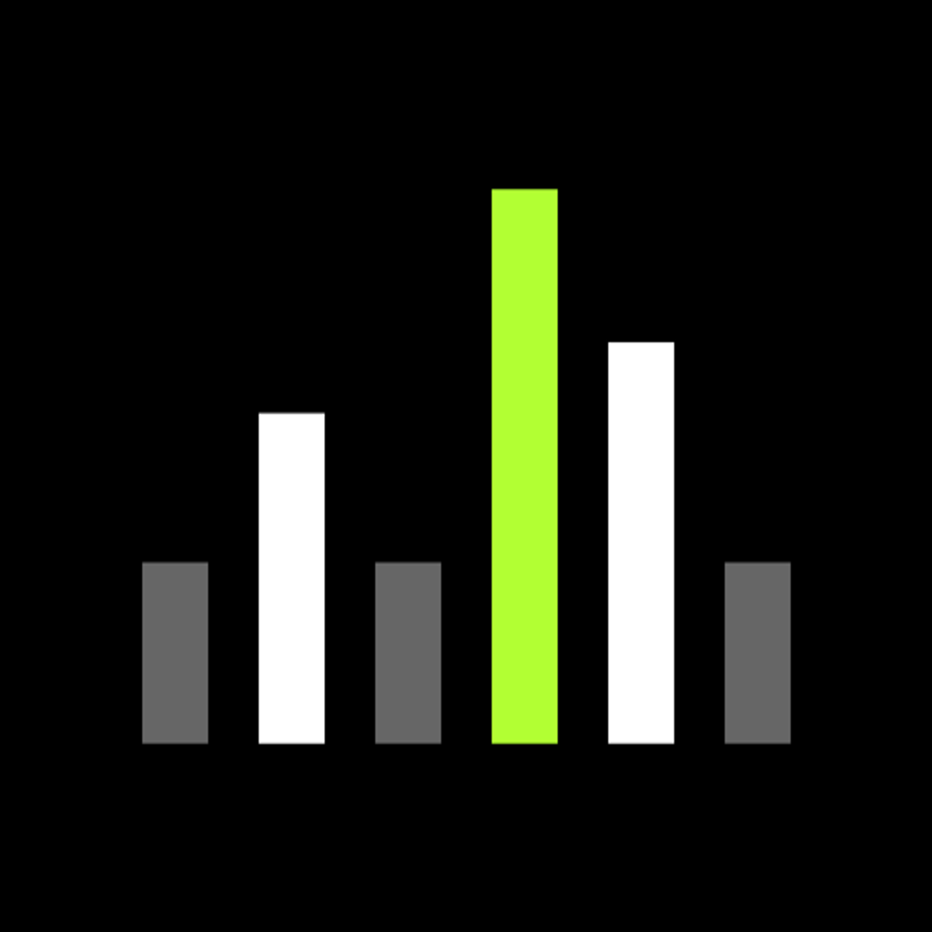
SHURE
One shared core.
Native flexibility.
Kotlin Multiplatform initiative
01
Notes:
Opening: propose a bounded KMP pilot. The core argument is continuity with Shure’s existing native apps and Kotlin expertise. This deck recommends shared logic first. Shared Compose UI remains a separate decision.
Internal proposal, 5 October 2026.

Slide 2
Why now
Device API
Kotlin expertise
Working PoC
Simpler integration
Familiar language
A foundation to test
A practical moment to share device logic
02
Notes:
The device-server architecture and team Kotlin expertise come from the user’s supplied context, not an independent audit of the legacy app. Validate the exact legacy JNI/Apollo scope with the native team. Google support is externally documented.
Source: https://developer.android.com/kotlin/multiplatform

Slide 3
What KMP means for Shure
Android native app
iOS native app
Shared Kotlin core
Device logic
API + streams
Local state
03
Notes:
Kotlin Multiplatform shares Kotlin code across targets. The Android target runs on the JVM/ART and iOS uses Kotlin/Native, including its own runtime and memory management. KMP does not automatically convert Android SDK code or Swift into common Kotlin. Native UI can remain. Compose Multiplatform is an optional UI strategy.
Sources: https://developer.android.com/kotlin/multiplatform
https://kotlinlang.org/docs/multiplatform/multiplatform-share-on-platforms.html

Slide 4
Device communication: existing and target
Existing path
Target path
Native app
Shared KMP client
JNI / Apollo
REST / GraphQL / streams
Device capabilities
Local server on device
The server change benefits either framework
04
Notes:
User-provided direction: the new device-hosted local server replaces the prior JNI/Apollo integration path for the target workflows. Apollo is optional in either architecture and GraphQL does not require it. The server change benefits both KMP and React Native. KMP’s separate advantage is reuse of Kotlin logic and continuity with the existing apps. Validate API coverage, versioning, server availability and streaming protocol before claiming full legacy parity.

Slide 5
Sony: a closer audio-device example
Auto Play
Sony Sound
Connect
KMP feature
Integrated in 2024
An audio companion app. Incremental adoption.
05
Notes:
Sony engineer Sergio Carrilho describes the Auto Play feature built with Kotlin Multiplatform, later integrated into Sony | Sound Connect in 2024. This supports an incremental feature-level story, not a claim that the complete Sound Connect app was rewritten. The case includes Compose Multiplatform as well as KMP, so it does not establish shared-core-only architecture. Sony consumer headphones differ from Shure professional device control and local server protocols. Use the analogy for audio companion software and adoption, not protocol parity or measured Shure ROI.
Primary practitioner source: https://sergiocarrilho.medium.com/six-years-zero-regrets-sonys-kotlin-multiplatform-success-story-1528087514d2
Sony engineering deck: https://speakerdeck.com/sony/sony-kmp-journey-kotlinconf2026
Philips distinction: https://kotlinlang.org/ describes HealthSuite mobile SDK in healthcare, not a verified Philips audio-app migration.

Slide 6
Adoption evidence
7%
18%
2024
2025
KMP usage among surveyed
cross-platform developers
JetBrains Developer Ecosystem surveys
06
Notes:
JetBrains State of Kotlin 2026 reports KMP use among surveyed cross-platform developers at 7% in 2024 and 18% in 2025. This is a survey measure, not a share of all apps or companies. Google officially supports sharing business logic between Android and iOS. Company examples are publisher-reported deployments with different scopes, not proof of Shure ROI.
Sources: https://kotlinlang.org/state-of-kotlin-2026/
https://android-developers.googleblog.com/2024/05/android-support-for-kotlin-multiplatform-to-share-business-logic-across-mobile-web-server-desktop.html
https://kotlinlang.org/docs/multiplatform/use-cases-examples.html
Survey denominator: surveyed cross-platform developers. Company-specific outcomes are not promises for Shure.

Slide 7
Companies using KMP
Sony
Google Docs
Philips
Audio companion feature
Shared app logic
HealthSuite mobile SDK
Forbes
McDonald’s
Cash App
Android / iOS logic
Mobile app logic
Fintech application
Different products. Different sharing scopes.
07
Notes:
Production examples, not claims that every company converted every app. Sony: Auto Play in Sound Connect, https://sergiocarrilho.medium.com/six-years-zero-regrets-sonys-kotlin-multiplatform-success-story-1528087514d2. Google Docs: shared business logic, https://android-developers.googleblog.com/2024/05/android-support-for-kotlin-multiplatform-to-share-business-logic-across-mobile-web-server-desktop.html. Philips: HealthSuite mobile SDK, https://kotlinlang.org/. Forbes and McDonald’s: mobile app logic. Cash App: documented fintech adoption. Source index: https://kotlinlang.org/docs/multiplatform/use-cases-examples.html. Verified 5 October 2026. Adoption scopes differ, and these examples do not establish Shure ROI.

Slide 8
Reuse follows the platform boundary
SHARE
KEEP NATIVE
Kotlin models
Business rules
Use cases
Screens
OS integrations
Android-specific dependencies need adaptation
08
Notes:
Compatible Kotlin logic can move to commonMain. Android-specific code remains in androidMain or changes to multiplatform dependencies and interfaces. Swift and Objective-C functionality remains in the iOS application or platform adapters, rather than automatically becoming shared Kotlin. Platform-specific APIs can be exposed through interfaces or expect/actual.
Sources: https://kotlinlang.org/docs/multiplatform/multiplatform-integrate-in-existing-app.html
https://kotlinlang.org/docs/multiplatform/multiplatform-share-on-platforms.html

Slide 9
The choice depends on our starting point
KMP | React Native
Kotlin shared core | React / TypeScript stack
Native screens can stay | Shared React Native screens
Builds on our Kotlin skills | Fits a React-led UI strategy
Both support device APIs and native integrations
09
Notes:
This comparison is a project-specific assessment, not a benchmark. React Native supports incremental adoption and native modules. Its New Architecture uses JSI and removes the old asynchronous bridge, so do not frame the comparison using obsolete bridge claims. Both can consume the local API and implement streaming. KMP also has runtime and interoperability considerations.
Sources: https://reactnative.dev/docs/integration-with-existing-apps
https://reactnative.dev/blog/2024/10/23/the-new-architecture-is-here
https://kotlinlang.org/docs/multiplatform/multiplatform-integrate-in-existing-app.html
https://developer.android.com/kotlin/multiplatform

Slide 10
The PoC foundation
ViewModel / presentation
Use cases
Repository interfaces
Ktor API / streams
Room / DataStore
Koin dependency injection
10
Notes:
Source inspection, 5 October 2026. Existing modules include core/common, core/network, core/database and core/datastore. Device flow uses DeviceViewModel, use cases and repository interfaces. Koin binds the dependencies. Native UI integration is a proposed next step. The current demo has shared Compose UI. The web device store is in memory, rather than Room.
Repository evidence: shared/src/commonMain/kotlin/com/shure/wireless/channels/devices/di/StoredDevicesModule.kt; core/network/src/commonMain; core/database/src/commonMain; core/datastore/src/commonMain.

Slide 11
Migration one workflow at a time
Existing
Kotlin logic
Shared
KMP module
Android + iOS
integration
Native screens
Native OS adapters
Native app investment stays in the architecture
11
Notes:
Compatible Kotlin logic can move to commonMain. Android-specific code remains in androidMain or changes to multiplatform dependencies and interfaces. Swift and Objective-C functionality remains in the iOS application or platform adapters, rather than automatically becoming shared Kotlin. Platform-specific APIs can be exposed through interfaces or expect/actual.
Sources: https://kotlinlang.org/docs/multiplatform/multiplatform-integrate-in-existing-app.html
https://kotlinlang.org/docs/multiplatform/multiplatform-share-on-platforms.html
Proposed migration sequence. Keep current app screens, extract compatible Kotlin use cases and repository contracts, then consume the shared core from both applications. Native OS implementations remain at platform boundaries. No migration duration follows from this diagram.

Slide 12
Live device demo
01
02
03
04
Discover
Read
Write
Stream
One device. Android and iOS.
Target demo: real writes and streams still need integration
12
Notes:
This is the target demonstration sequence, not a statement that every step works today. Use a real test device and server. Capture a short backup recording. Confirm the discovery query/operationName, endpoint, channel write contract and stream protocol. For Android emulator host testing, 10.0.2.2 addresses the host loopback. For a physical device, use the reachable device-server address. Do not expose secrets in leadership logs.
Target demo, subject to completion of real writes and device streams.

Slide 13
What success looks like
Less duplicated logic
Consistent device behavior
Native capability preserved
Pilot measures effort, parity and stream reliability
13
Notes:
Expected benefits are hypotheses for the Shure pilot. No cost savings, defect reductions or delivery gains have been measured. Compare a bounded workflow against an agreed native baseline using engineering hours and the same acceptance tests. Avoid comparing different feature complexity. Include platform integration and testing effort.

Slide 14
The proposal
One workflow.
Two platforms.
6-week pilot proposed
Review the evidence before expanding
14
Notes:
Proposed planning assumption: six weeks, subject to staffing and API availability. Week 1 establishes contracts and baseline. Weeks 2–3 implement real discovery/read/write/stream behavior. Weeks 4–5 integrate Android and iOS native screens and test recovery. Week 6 compares results against the baseline. Suggested owners: one Kotlin/shared-core engineer, one iOS engineer, QA support and a device/server contact. Leadership should approve scope and staffing, with a review gate rather than a full migration commitment.
Six weeks is a discussion assumption, not a commitment.

Slide 15
Appendix: PoC readiness
In source | Before the live demo
GraphQL discovery path | Validate query and operation name
GET / PUT client foundation | Implement real channel operations
WebSocket foundation | Wire the real device event source
Persistence and logs | Verify Android / iOS behavior
Current device events use a demo source
15
Notes:
Source inspection only. No Gradle tasks or live device validation were run for this presentation. Discovery operationName currently differs from the named query, and lastSeenAtEpochMillis is a placeholder. Resolve these before live demo. Device events currently delegate to DemoDeviceOperationsRepository. Generic PUT support exists in NetworkApiClient, but there is no demonstrated real channel-write use case in the inspected device path. WebSocket infrastructure exists, but GraphQL subscriptions require protocol-specific integration.
Evidence: GraphQlDeviceOperationsRepository.kt; DiscoverDevicesGraphQlModels.kt; NetworkApiClient.kt; WebSocketClient.kt; StoredDevicesModule.kt.

Slide 16
Appendix: evidence and boundaries
Sony
Auto Play feature in Sound Connect
Philips
HealthSuite SDK, healthcare
JetBrains
Survey evidence, not Shure ROI
Sources and technical detail are in speaker notes
16
Notes:
Sources checked 5 October 2026. Adoption figures are JetBrains survey results and company case studies, not independent Shure measurements. PoC statements reflect source inspection rather than execution. User supplied the local server direction, native integration context and team expertise. Full citations are included in the relevant slide notes.
https://kotlinlang.org/state-of-kotlin-2026/
https://kotlinlang.org/docs/multiplatform/use-cases-examples.html
https://android-developers.googleblog.com/2024/05/android-support-for-kotlin-multiplatform-to-share-business-logic-across-mobile-web-server-desktop.html
https://developer.android.com/kotlin/multiplatform
https://kotlinlang.org/docs/multiplatform/multiplatform-integrate-in-existing-app.html
https://kotlinlang.org/docs/multiplatform/multiplatform-share-on-platforms.html
https://reactnative.dev/docs/integration-with-existing-apps
https://reactnative.dev/blog/2024/10/23/the-new-architecture-is-here
Sony: https://sergiocarrilho.medium.com/six-years-zero-regrets-sonys-kotlin-multiplatform-success-story-1528087514d2
https://speakerdeck.com/sony/sony-kmp-journey-kotlinconf2026
Philips HealthSuite SDK: https://kotlinlang.org/
Verified 5 October 2026.

