Slide 1
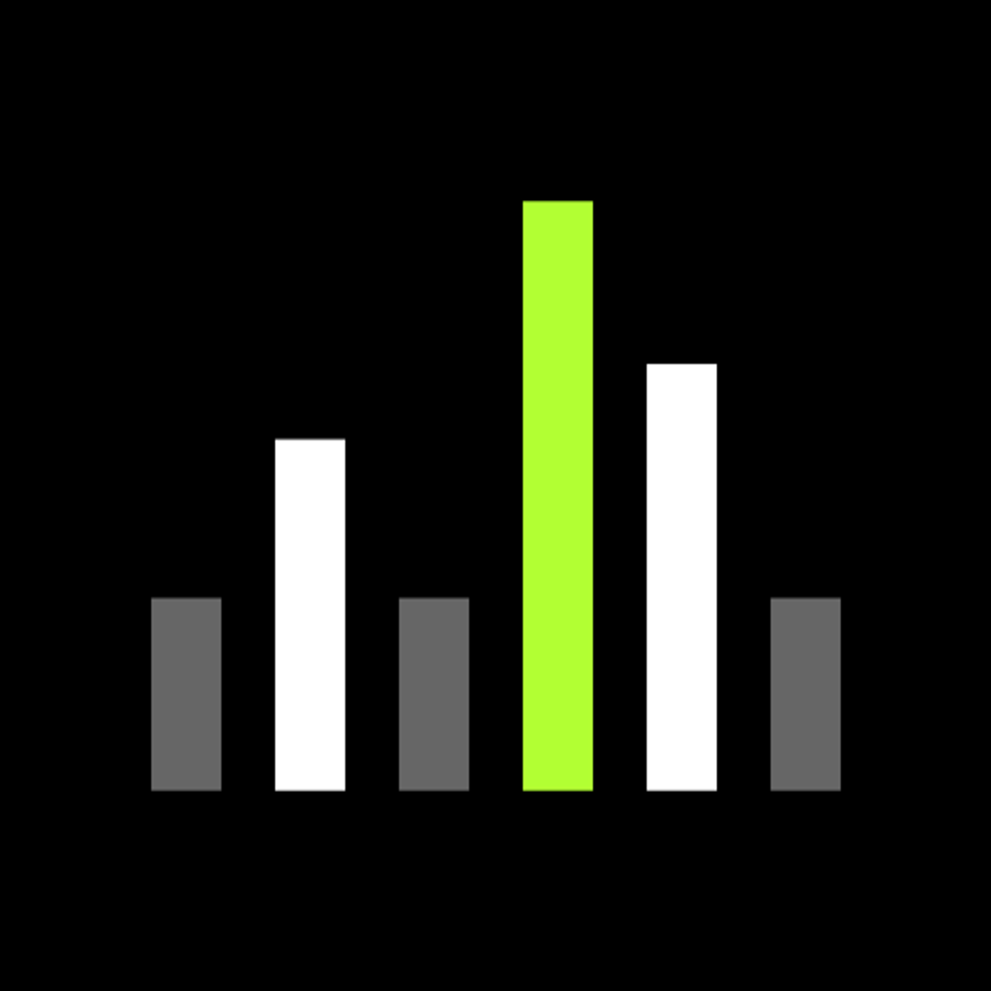
SHURE
One shared core.
Native flexibility.
Kotlin Multiplatform initiative
01
Notes:
[object Object]

Slide 2
Why now
Device API
Kotlin expertise
Working PoC
Simpler integration
Familiar language
A foundation to test
A practical moment to share device logic
02
Notes:
[object Object]

Slide 3
What KMP means for Shure
Android
iOS
Shared Kotlin core
Device logic
API + streams
Local state
Native UI remains an option
03
Notes:
[object Object]

Slide 4
The device API reduces client coupling
Existing path
Target path
JNI / Apollo
Local device server
REST
GraphQL
Live events
The server change benefits either framework
04
Notes:
[object Object]

Slide 5
Sony: a closer audio-device example
Auto Play
Sony Sound
Connect
KMP feature
Integrated in 2024
An audio companion app. Incremental adoption.
05
Notes:
Sony engineer Sergio Carrilho describes the Auto Play feature built with Kotlin Multiplatform, later integrated into Sony | Sound Connect in 2024. This supports an incremental feature-level story, not a claim that the complete Sound Connect app was rewritten. The case includes Compose Multiplatform as well as KMP, so it does not establish shared-core-only architecture. Sony consumer headphones differ from Shure professional device control and local server protocols. Use the analogy for audio companion software and adoption, not protocol parity or measured Shure ROI.
Primary practitioner source: https://sergiocarrilho.medium.com/six-years-zero-regrets-sonys-kotlin-multiplatform-success-story-1528087514d2
Sony engineering deck: https://speakerdeck.com/sony/sony-kmp-journey-kotlinconf2026
Philips distinction: https://kotlinlang.org/ describes HealthSuite mobile SDK in healthcare, not a verified Philips audio-app migration.

Slide 6
Adoption evidence
7%
18%
2024
2025
KMP usage among surveyed
cross-platform developers
JetBrains Developer Ecosystem surveys
06
Notes:
[object Object]
Survey denominator: surveyed cross-platform developers. Company-specific outcomes are not promises for Shure.

Slide 7
Reuse follows the platform boundary
SHARE
KEEP NATIVE
Kotlin models
Business rules
Use cases
Screens
OS integrations
Android-specific dependencies need adaptation
07
Notes:
[object Object]

Slide 8
The choice depends on our starting point
KMP | React Native
Kotlin shared core | React / TypeScript stack
Native screens can stay | Shared React Native screens
Builds on our Kotlin skills | Fits a React-led UI strategy
Both support device APIs and native integrations
08
Notes:
[object Object]

Slide 9
The PoC foundation
Presentation
Use cases
Repositories
Ktor APIs / streams
Room / DataStore
Koin wires the shared core
09
Notes:
[object Object]

Slide 10
The demonstration
01
02
03
04
Discover
Read
Write
Stream
One device. Android and iOS.
Target demo: real writes and streams still need integration
10
Notes:
[object Object]
Target demo, subject to completion of real writes and device streams.

Slide 11
What success looks like
Less duplicated logic
Consistent device behavior
Native capability preserved
Pilot measures effort, parity and stream reliability
11
Notes:
[object Object]

Slide 12
The proposal
One workflow.
Two platforms.
6-week pilot proposed
Review the evidence before expanding
12
Notes:
[object Object]
Six weeks is a discussion assumption, not a commitment.

Slide 13
Appendix: PoC readiness
In source | Before the live demo
GraphQL discovery path | Validate query and operation name
GET / PUT client foundation | Implement real channel operations
WebSocket foundation | Wire the real device event source
Persistence and logs | Verify Android / iOS behavior
Current device events use a demo source
13
Notes:
[object Object]

Slide 14
Appendix: evidence and boundaries
Sony
Auto Play feature in Sound Connect
Philips
HealthSuite SDK, healthcare
JetBrains
Survey evidence, not Shure ROI
Sources and technical detail are in speaker notes
14
Notes:
[object Object]
Sony: https://sergiocarrilho.medium.com/six-years-zero-regrets-sonys-kotlin-multiplatform-success-story-1528087514d2
https://speakerdeck.com/sony/sony-kmp-journey-kotlinconf2026
Philips HealthSuite SDK: https://kotlinlang.org/
Verified 5 October 2026.

