Slide 1

SAMSUNG PRISM
Generative AI
Hackathon
3rd Edition 2026 – 27
Theme ID - Theme 2: Troubleshooting [TO FILL: Theme ID]
Team Name - [TO FILL]
College Name - [TO FILL]
Member Name & Email 1- [TO FILL]
Member Name & Email 2- [TO FILL]
Member Name & Email 3- [TO FILL]
Member Name & Email 4- [TO FILL]
Submission Github link - https://github.com/shashi-bhushan-27/samsungPrism (tag PRISM_GENAI_HACKATHON_Y2026)

Slide 2
Theme
Theme 2: Smart Guided Troubleshooting Engine. Turn a vague device complaint into a short, safe, one-tap fix plan.
Input: the customer's complaint and the SIIS knowledge-base answer retrieved for it.
Output (schema.py contract): a goal, a sentence-case title and ordered actions. Each action has imperative steps, a category (auto / manual / critical) and, for Settings changes, the exact catalog deeplink.
Hard rules:
  Use only steps found in the SIIS text. Use only deeplinks found in the catalog. No URLs.
  One action per screen or feature. Critical actions such as restart or reset come last.
  8–10 query variations. Fast on repeated or paraphrased complaints: P95 ≤ 300 ms on a cache hit, ≤ 8 s cold.
Official data: 20 customer complaints (screen and display issues), 1 reference sample, a 577-entry masked deeplink catalog (voiceassist://).

Slide 3
Existing Solutions & Gaps
Approach | What it does well | Gap for this theme
FAQ / knowledge-base search | Finds the right article | Leaves the customer to read it; no one-tap action, no ordering
LLM chatbot (free text) | Understands messy language | Invents steps and links, varies run to run, slow and costly per query
Rule-based decision trees | Predictable, cheap | Breaks on new phrasing; every new issue needs manual authoring
Retrieval + LLM (plain RAG) | Grounded answer text | No structure: screens, categories and deeplinks are not guaranteed
Our gap to close: keep the language understanding of an LLM, but let code decide everything that must be exact: the grounding, the deeplink, the order, the schema and the cache.

Slide 4
Our Solutions & Architecture Diagram
POST /v1/troubleshoot {query, siis_response?}
Query enrichment
typo fix, intent,
canonical query
Cache lookup
exact key → semantic
(bge-small, gated)
SIIS source
request text, else
BM25+dense KB
Grounded extraction
LLM (JSON schema)
+ grounding check
Deeplink mapping
BM25+dense hybrid
+ exact-screen resolver
Sequencing + gates
critical last; schema,
rules, URL scan
HIT → validated plan returned
no model call
Validated JSON
(schema.py) → cache
The model is an assistant, not the controller:
• it only reads language and extracts structure from the SIIS text;
• the URI is always copied from the catalog object, never from model output;
• every response passes schema.py, the business rules and a URL scan before it is returned or cached.
Catalog registry
577 masked URIs

Slide 5
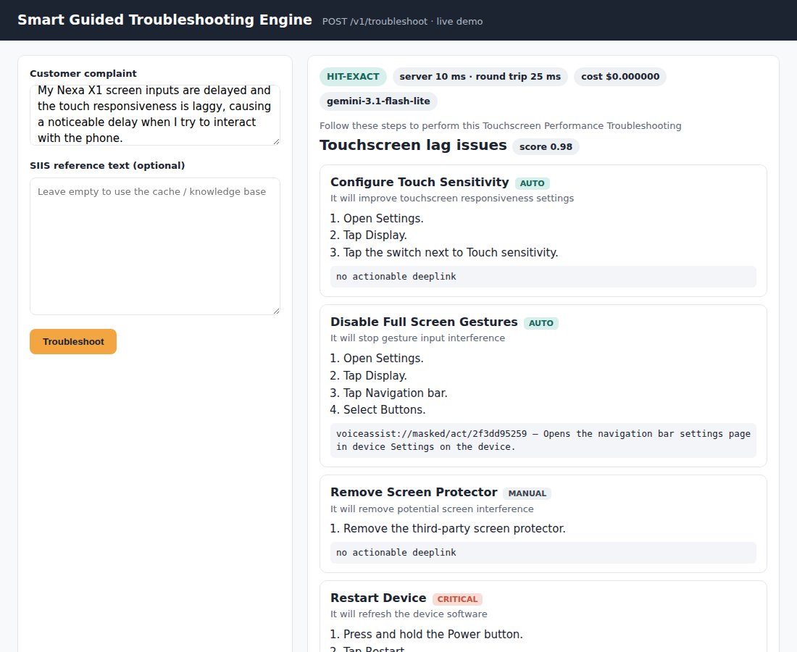
Demo & Product Walkthrough
Demo video: docs/demo.webm in the repository [TO FILL: YouTube / Drive link]
Live walkthrough (http://localhost:8000/demo):
  1. Paste an official complaint → plan in about 2–3 s on the first request (model call).
  2. Same or paraphrased complaint → served from the semantic cache in milliseconds, no model call.
  3. A SIIS text carrying a URL or a prompt injection → the link and the injected instruction are removed.
  4. An out-of-scope complaint → empty contexts with fallback no_siis_context (no invented plan).
Example (official row): "My Nexa X1 screen inputs are delayed and the touch responsiveness is laggy, causing a noticeable delay when I…"
  [auto] Configure Touch Sensitivity
  [auto] Disable Full Screen Gestures → View Navigation bar
  [manual] Remove Screen Protector
  [critical] Restart Device

Slide 6
Tools and tech stack used
Layer | Choice | Why
API | Python 3.11, FastAPI, Pydantic v2, uvicorn | Typed contract (schema.py) end to end
Model (run time) | Google Gemini gemini-3.1-flash-lite (extraction and variations; fail-over gemini-3.5-flash-lite → gemini-3.6-flash); Groq gpt-oss also supported | Strict JSON-schema output, fail-over chain, hedging
Embeddings | BAAI/bge-small-en-v1.5 via fastembed (ONNX, local) | No network at request time; ~384-d vectors
Retrieval | BM25 + dense hybrid, exact-screen resolver | Deterministic deeplink choice
Cache | SQLite (WAL): exact + semantic, versioned | Hits skip the model; invalidated on catalog change
Quality | pytest (390 offline tests), live benchmarks | Unit, integration, regression, adversarial
Delivery | Docker (non-root, HEALTHCHECK), Makefile | One-command setup
Dev tooling | Claude Code (AI-assisted development) | See AI disclosure form

Slide 7
Impact & Use case
Customer: one-tap fixes instead of reading an article. Each Settings action opens the exact screen, and a validation deeplink can confirm the toggle took effect.
Support centre: repeated and paraphrased complaints are answered from the cache, with no model call and no per-query model cost.
Cost: cold path ≈ $0.00118 per query (1.46 model calls, 1607 input / 516 output tokens); cache hits cost $0.
Safety: no invented steps, links or URLs reach the customer. Disruptive actions (restart, safe mode, reset) are always last.
Use cases: in-device help (assistant or Settings search), customer-care chat and agent-assist, self-service web support.
Extensible: a new product area needs only its SIIS articles and catalog entries; nothing is hard-coded per issue.

Slide 8
Innovation highlights, results and limitations
Check (official data, live model, real HTTP) | Target | Measured
Schema-valid responses | ≥ 99% | 100% (262/262)
Goal / title / description rules | ≥ 95% | 100%
URL leaks | 0 | 0
Deeplinks found verbatim in the catalog | 100% | 100% (85/85)
Auto actions with a valid deeplink | ≥ 90% | 31.5%
P95 latency: exact cache hit | ≤ 300 ms | 10 ms
P95 latency: unseen paraphrase hit | ≤ 300 ms | 38 ms
P95 latency: cold full pipeline | ≤ 8 s | 2.58 s
Unseen paraphrases served the correct plan | ≥ 80% | 81.2% (65/80)
Wrong-plan cache hits (unseen paraphrases) | 0 | 1/80
Official queries with a grounded plan | — | 18/20 (others: no_match)
Innovation
• Model assists, code decides: catalog-only URIs, grounding filter, deterministic order.
• Gated semantic cache (concept + qualifier checks) to avoid serving the wrong plan.
Limitations (honest)
• Only 1 official reference sample: step accuracy vs. gold is not measurable at scale.
• Some SIIS answers do not address the complaint; the system returns no_match rather than inventing steps.
• One multi-intent edge case (E04) returned no_match instead of a plan.
• Most official auto steps are outside Settings (panels, other apps): no catalog link exists for them.

Slide 9
What’s next
More gold data: label the official queries (expected actions and deeplinks) to measure step accuracy and deeplink relevance, not only rule compliance.
On-device or edge model for extraction, so cold requests need no network and no third-party API.
Validation loop: after a one-tap action, read the validation deeplink and adapt the next step (e.g. skip a toggle already on).
Multilingual complaints: the embedding cache and the lexicon are English-only today.
Catalog coverage report: list SIIS screens with no catalog entry (served with the placeholder deeplink today) so they can be added.
Feedback signal: use 'did this fix it?' answers to rank actions and to retire stale cache entries.

Slide 10
Brownie points slide( differentiation)
Zero invented deeplinks or URLs across every measured response: the URI is copied from the catalog, never generated.
Hostile review: prompt and URL injection, fake URIs, parent-menu traps and cache poisoning were probed live (synthetic fixture) and offline; every issue found was fixed with a regression test (HARDENING_REPORT.md, H1–H19).
Measured, not claimed: metrics.md is rendered from JSON reports produced against a real server and a real model; no number is typed by hand.
Ablation (synthetic fixture): full-LLM vs. hybrid vs. rules deeplink mapping on the same extracted actions; on 13 gold actions the full-LLM mapper scored 1.77/2 deeplink relevance vs 2.00 for hybrid retrieval, at about 7× the cost per query.
Requirements traceability: each rule maps to its code, its test and its evidence; targets not met are marked as such.
Format-tolerant: adapted from the synthetic fixture to the official voiceassist:// catalog and SIIS objects without changing the contract.

Slide 11
Checklist- Updated on Public GitHub
Working prototype code — public or shared GitHub repo: Y (https://github.com/shashi-bhushan-27/samsungPrism)
README with reproducible setup instructions: Y (make install / indexes / test / serve; Docker)
Demo video, max 5 minutes: Y (docs/demo.webm) [TO FILL: YouTube or Drive link]
Presentation file (PPT or PDF): Y (this deck, docs/ folder)
AI disclosure form: Y (docs/LangAI3.0_AI_Disclosure.docx, AI_DISCLOSURE.md)
GitHub tag: PRISM_GENAI_HACKATHON_Y2026

Slide 12
Thank you
Organised by the Language AI Team and the PRISM Team, Samsung R&D Institute India
Notes:
Closing slide. Add the Google Form URL and a contact email before sharing. Edition 2 organising team for reference: Language AI - Sourabh Tiwari, Gaurav, Sanjeeth Pothireddy, Gorang Maniar; PRISM - Binny Lakra, Prakhar Chandrakar, Vishu Kumar; Kick-off and mentors - Giridhar Jakki, Deepraj Prabhakar Patkar (Language AI), Srimanu Prasad Nagaraju, Ashish Kumar (Tech Strategy).

